Slide 1
Online Presence – Comp 1205
Kate Dickens, Hugh Davis, Su White

Slide 2
Objectives of this session
Understanding the process of auditing personal attributes, evidencing skills and building up your CV in a LinkedIn world
Issues of safety and the problems of persistence of information on the Web
Understanding the contribution of social networks and social networking software to your online presence

Slide 3
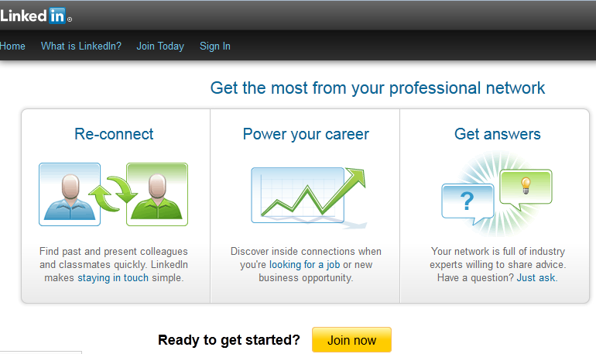
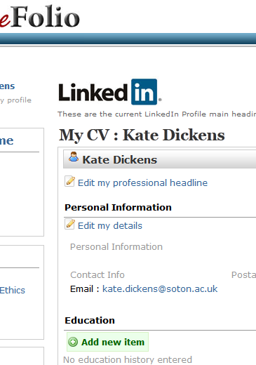
Evidencing your skills in a LinkedIn world …
Skills audit of personal attributes
Evidencing personal attribures
What are employers looking for?
Focusing on improving specific skills
Creating a CV suitable for LinkedIn
  Use CV function in eFolio or similar - easier to edit
  Employers may use your profile to support your application
Don’t forget to customise CV or letter for each application!

Slide 4
Managing your online presence – projecting yourself – to who?
Prospective employers?
Colleagues at work?
Collaborators?
Potential customers?
People to whom some knowledge you have might be useful?
Your friends?
Your family?
People like you?

Slide 5
Projecting what?
Professional?
Your contact details
Information about you (informal and formal)
Blogs that aim to inform
Your schedule
What I have / what I can give
Personal?
Details about your taste and interests
Diary as a blog
Your social networks
Your photos
Your music
Links to other people / sites sharing your interests

Slide 6
Watch what info you are inadvertently giving away
People will scrape the web for info on you (so make sure it’s good!)
  Or not scrapable
You need to be careful about giving away some info (eg your home address, anything that might allow someone to steal your identity, anything that might trouble your family)
You need to think carefully about whether you would be happy with what you put there some time ago being available to an employer or the general public later in your life …
  Dare you Google yourself … ??
  192.com
  Social mention
  Wayback machine

Slide 7
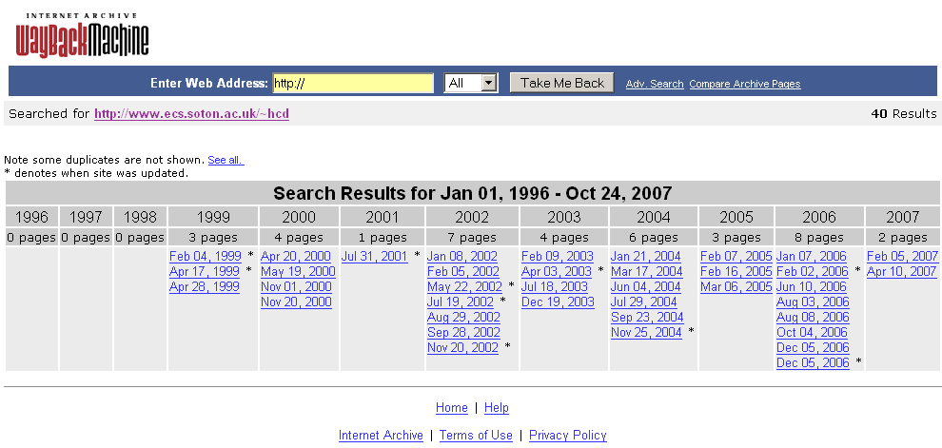
The internet archive keeps it all …

Slide 8
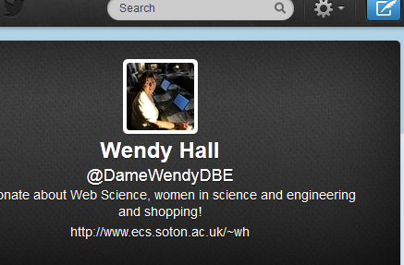
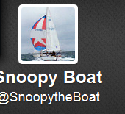
Managing professional v personal
Making sure that you positively manage your online presence so that you know what people can see about you …
Did you know that there is no such thing as a private Tweet – not even a Direct Message?!?
Making sure that people can find you – moving up the Google rankings – one of the best ways that you can do this is to blog regularly
Have you thought about having more than one Twitter account?

Slide 9
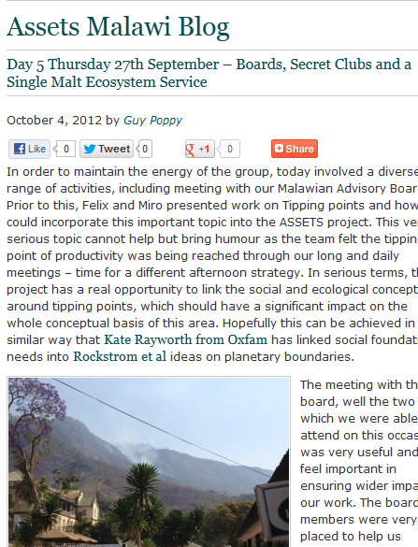
Rationale for blogging
The more you blog – the more your visibility will improve (the higher you will move up Google rankings)
Use your blog as a ‘one’ stop shop for people to get to know more about you - include links to Twitter / LinkedIn / about.me / Youtube / Pinterest / Flickr
Engage with others in your community - link to and comment on other people’s blogs
Provide social media links

Slide 10
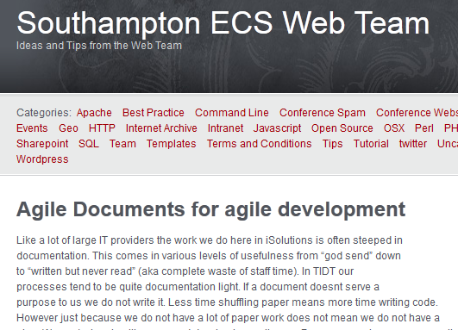
Types of blog
Personal brand building
  Create blog through eFolio (advantage of Southampton blog address) or directly in Wordpress
Problem solver in your community
  Post about short-cuts solutions that you have come across eg Southampton ECS web team blog http://blog.soton.ac.uk/webteam/
A reflective diary relating to your course

