Slide 1
CINAHL
(Cumulative Index of Nursing and Allied Health Literature)
Subject Heading Searching

Slide 2
Why use Subject Headings rather than Keyword searching? - 1
CINAHL Subject Headings are assigned to each record to describe the subject content of the record. They are applied consistently which means that once you have identified the correct CINAHL Heading(s) you do not need to think about synonyms, different word endings or alternative spellings.
For example, an article on stroke will have the subject heading stroke assigned to it even if the author of the article uses a synonym such as cva, cvas, cerebrovascular accident or cerebral vascular accident .
And…….

Slide 3
Why use Subject Heading rather than Keyword searching? - 2
The indexers also assign the subject terms according to the level of importance of the term within the article; the most important points are called Major Subjects and those of lesser importance are called Minor Subjects
For instance…..

Slide 4
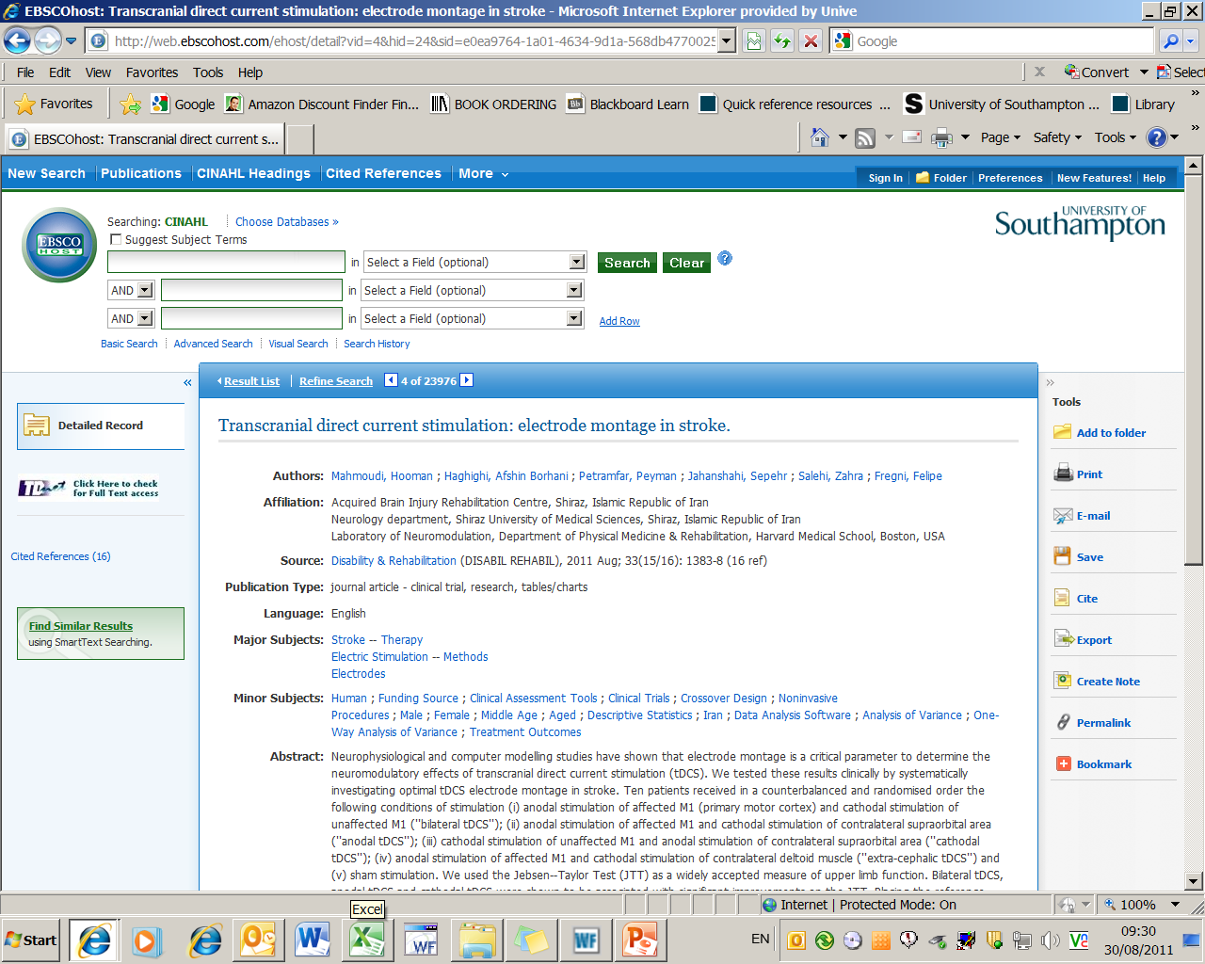
We can see this when we look at a reference in CINAHL

Slide 5
Why use Subject Heading rather than Keyword searching? - 3
You tend to retrieve articles that are more relevant:
  Searching using the subject heading stroke will retrieve articles that are about the medical condition stroke whereas free text searching will retrieve any article which has the word in the title or abstract, whether that is relevant to the subject of the article or not. They could also include references to articles about pet therapy (people who stroke animals are more relaxed) and references about swimming or heat stroke.

Slide 6
But….
…..subject headings are not infallible so to make sure you retrieve all relevant articles a combination of subject headings and free text is sometimes required.

Slide 7
CINAHL (Cumulative Index to Nursing
and Allied Health Literature)
Comprehensive database covering Nursing, Midwifery and Allied Health subjects
Lists articles in over 900 English language journals
Over 3 million records
Data since 1982
Available via the Library Web pages using your iSolutions username and password

Slide 8
Bibliographic databases -
what do they do?
List the “bibliographic” details of journal articles – author and title of the article; journal title, volume, issue and pages.
Mostly refer to journal articles, but some refer to newspapers, conference papers, book chapters or videos.
They can be searched – much like WebCat.
But they are nationally or internationally produced so…..

Slide 9
…we do not have access to the full-text of all of the journal references on CINAHL

Slide 10
Section 1
Putting together your search strategy

Slide 11
Search example:
“What research evidence is there to support the theory that exercise or exercise programmes help in the prevention of falls in the elderly?”
Notes:
.

Slide 12
But before you start searching you need to spend some time thinking about your search…..

Slide 13
You need to:
Identify the concepts of your query
List alternative phrases and keywords
Include both narrow and broad terms
Identify any key periods of research
Identify any key authors in the field

Slide 14
Identify your search terms
  “What research evidence is there to support the theory that exercise or exercise programmes help in the prevention of falls in the elderly?”
Notes:
.

Slide 15
The key topics are obvious
“What research evidence is there to support the theory that exercise or exercise programmes help to prevent falls in the elderly?”
falls
elderly
exercise
prevention
But how else can these topics be described and do we need to include them all?

Slide 16
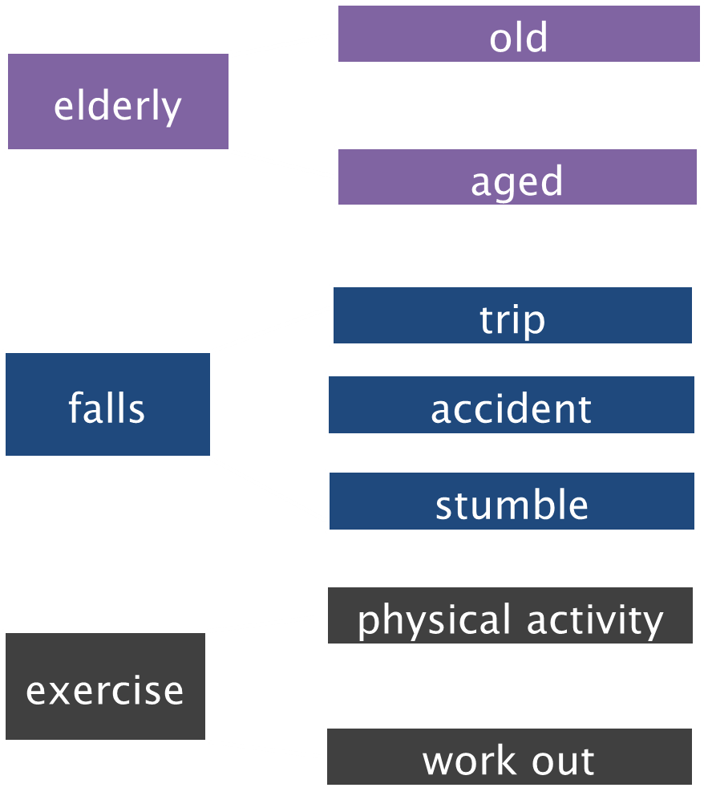

Slide 17
Join these terms together using:
Boolean logic
and
Truncation

Slide 18
Boolean Logic….
Allows you to search for multiple keywords
  or combines different expressions for the same concept
    teenagers or adolescents
  and links two different concepts together
    children and communication

Slide 19
Truncation
Finds any keyword with a common stem
Truncation symbol is commonly *
Physiotherap* will find:
  physiotherapist
  physiotherapists
  physiotherapy

Slide 20
Section 2
Starting your search

Slide 21
Library home page
www.soton.ac.uk/library

Slide 22
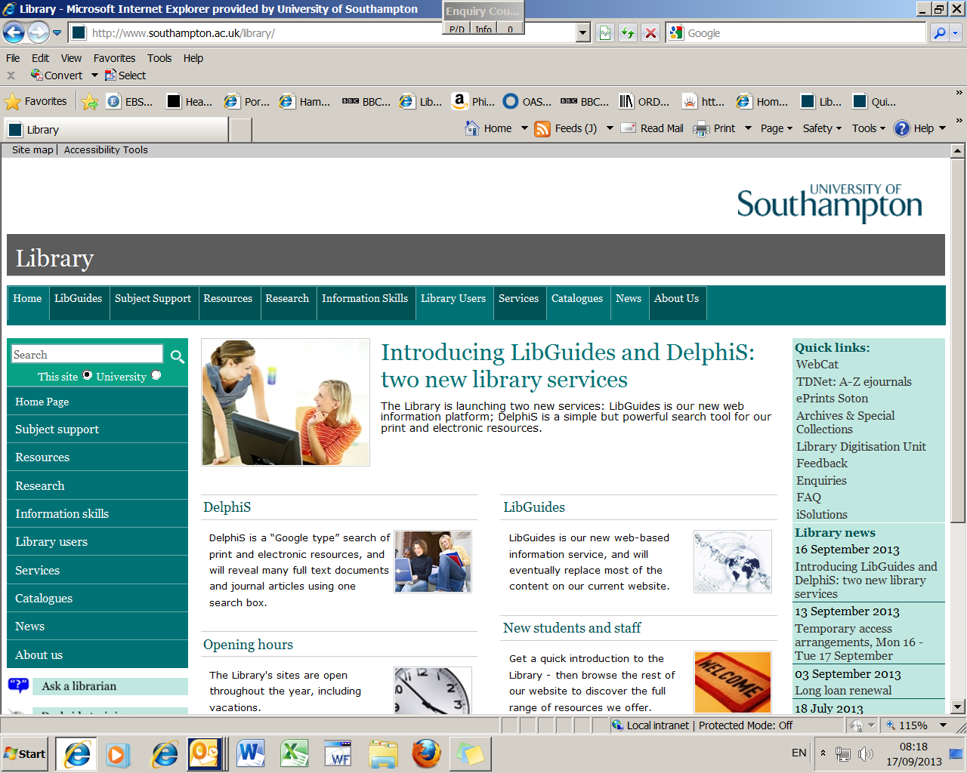

Slide 23
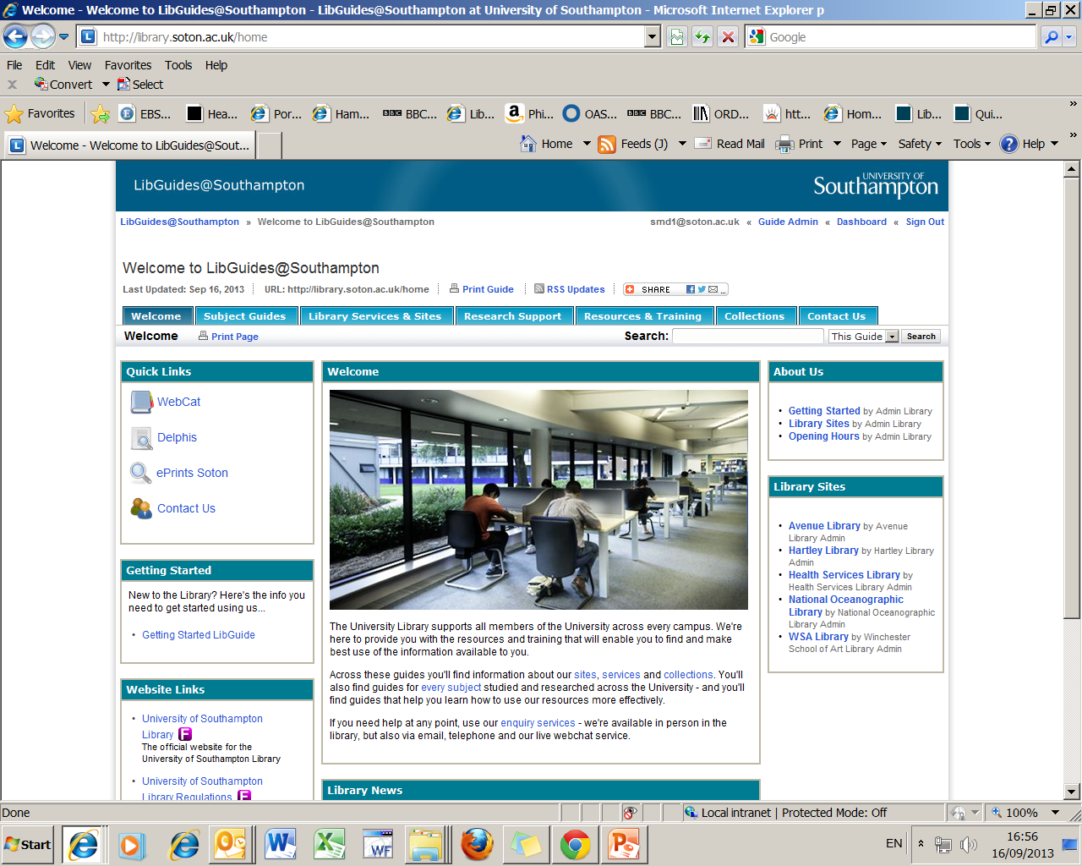

Slide 24
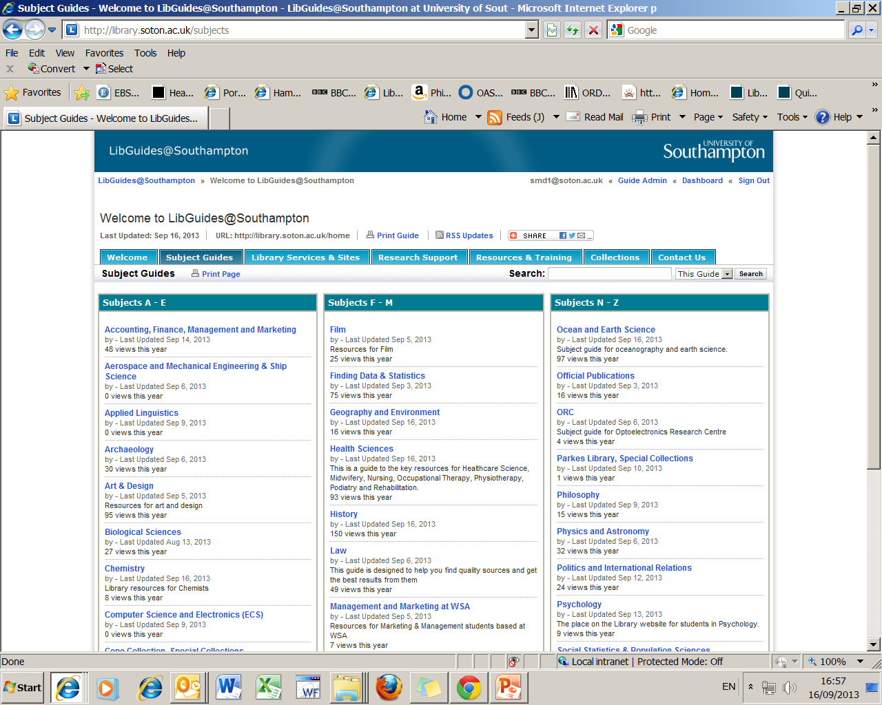

Select the relevant subject link

Slide 25
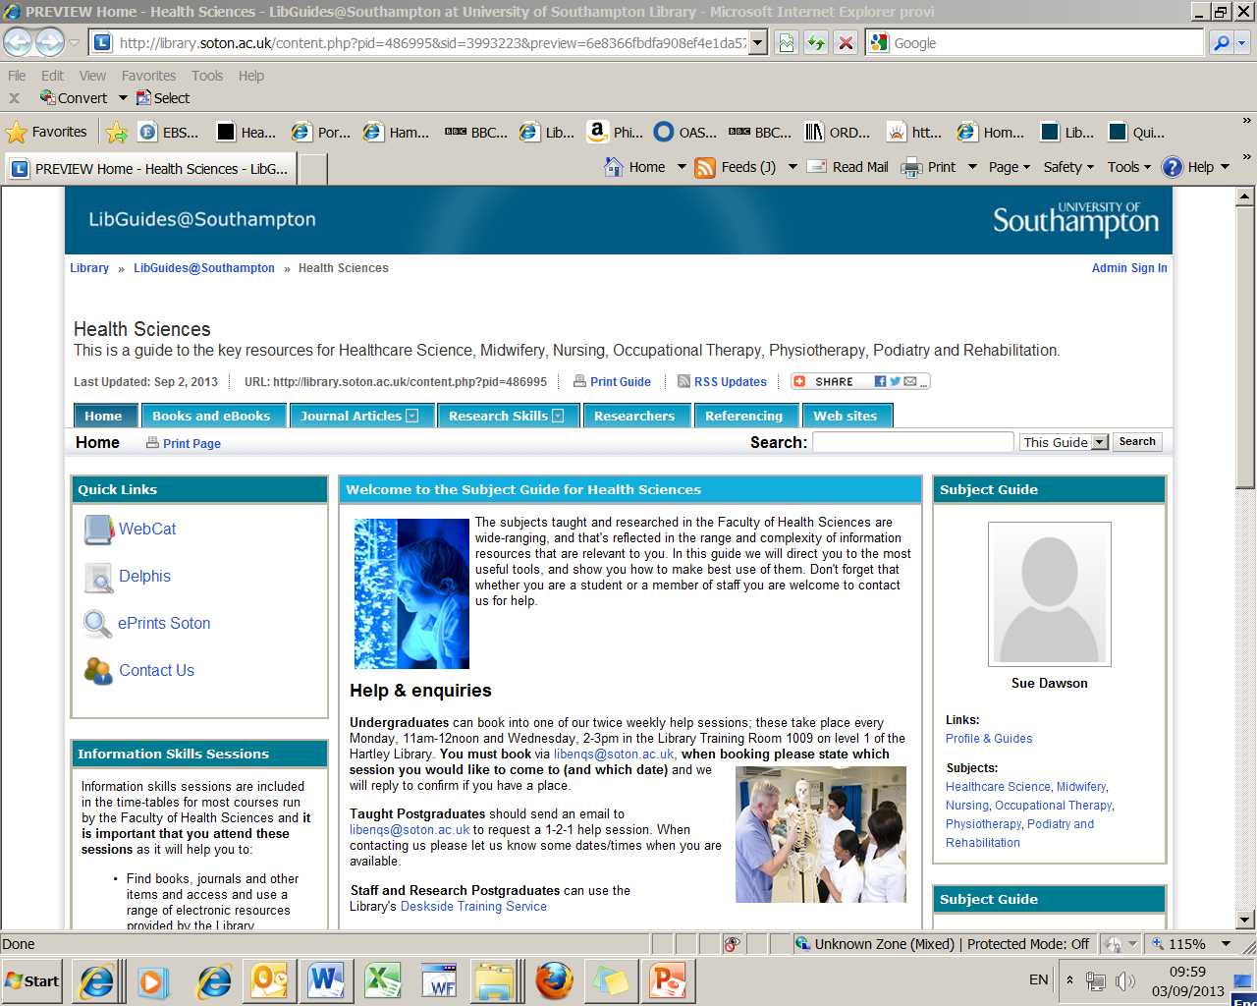
Scroll down to the Key Databases section

Slide 26
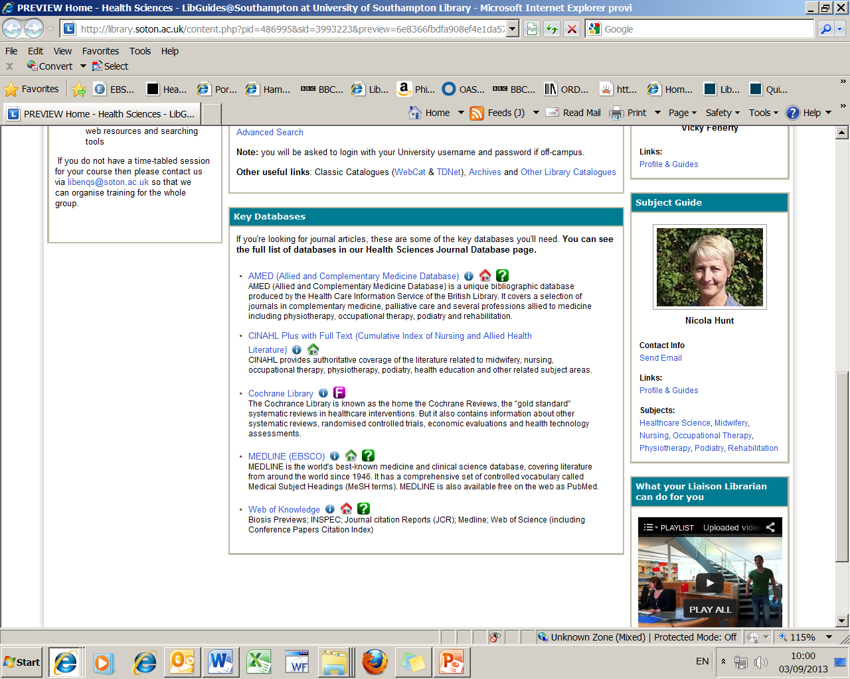
Don’t forget that there are other databases available
on our Journal Database tab at the top of this page
Link to CINAHL

Slide 27
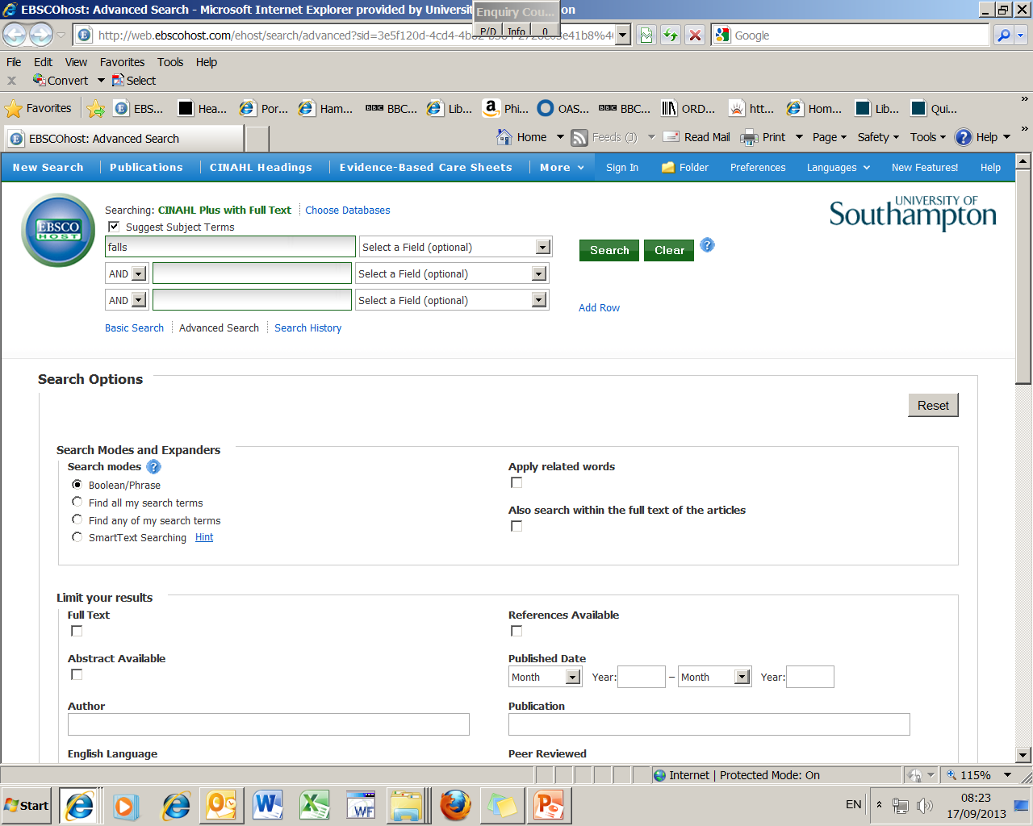
1. Place tick here
2. Enter term and then search

Slide 28
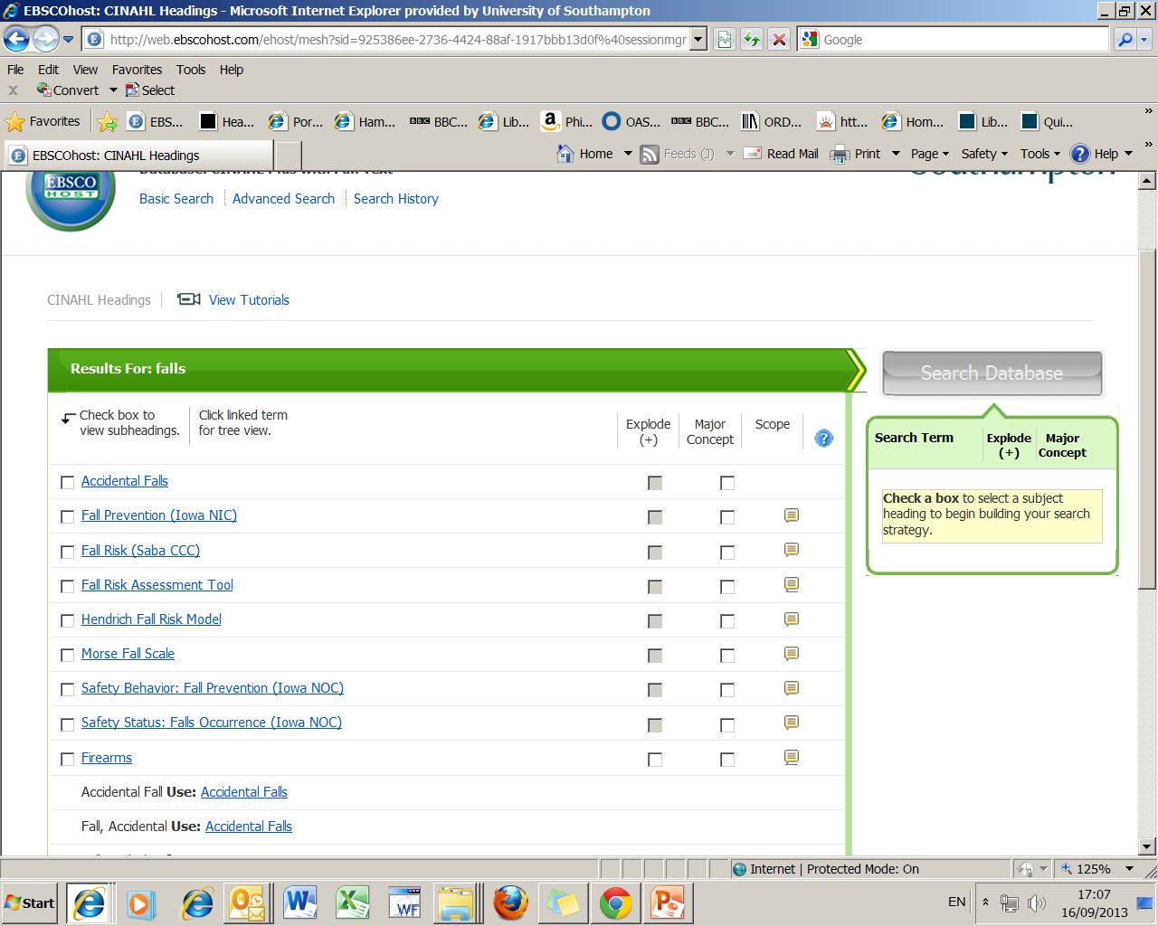
1. You are taken to a list of suggested subject terms

Slide 29
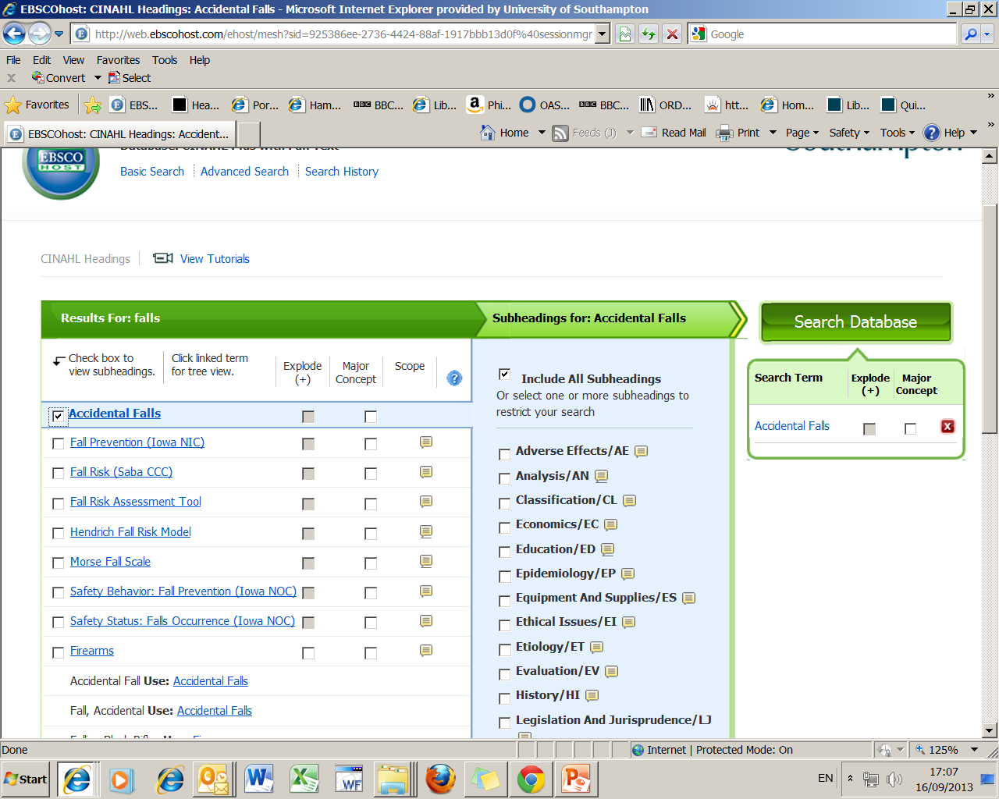
Placing a tick here tags the heading and also opens up
some more options….

Slide 30
Subheadings
Subheadings allow a search to be restricted to one or more facets, such as diagnosis, therapy, or psychosocial factors thereby providing more specific references.

Slide 31
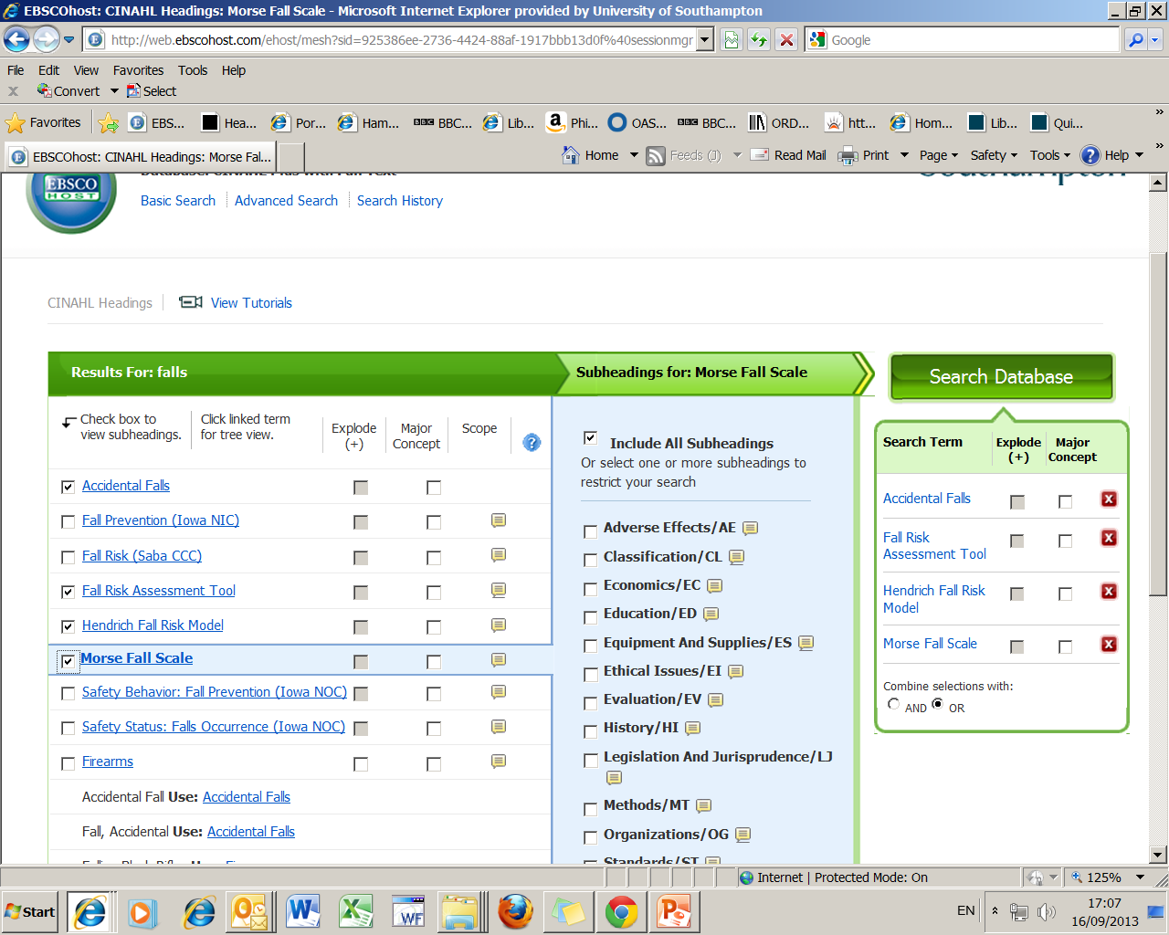
2. Then search
We will also add some
other useful headings

Slide 32
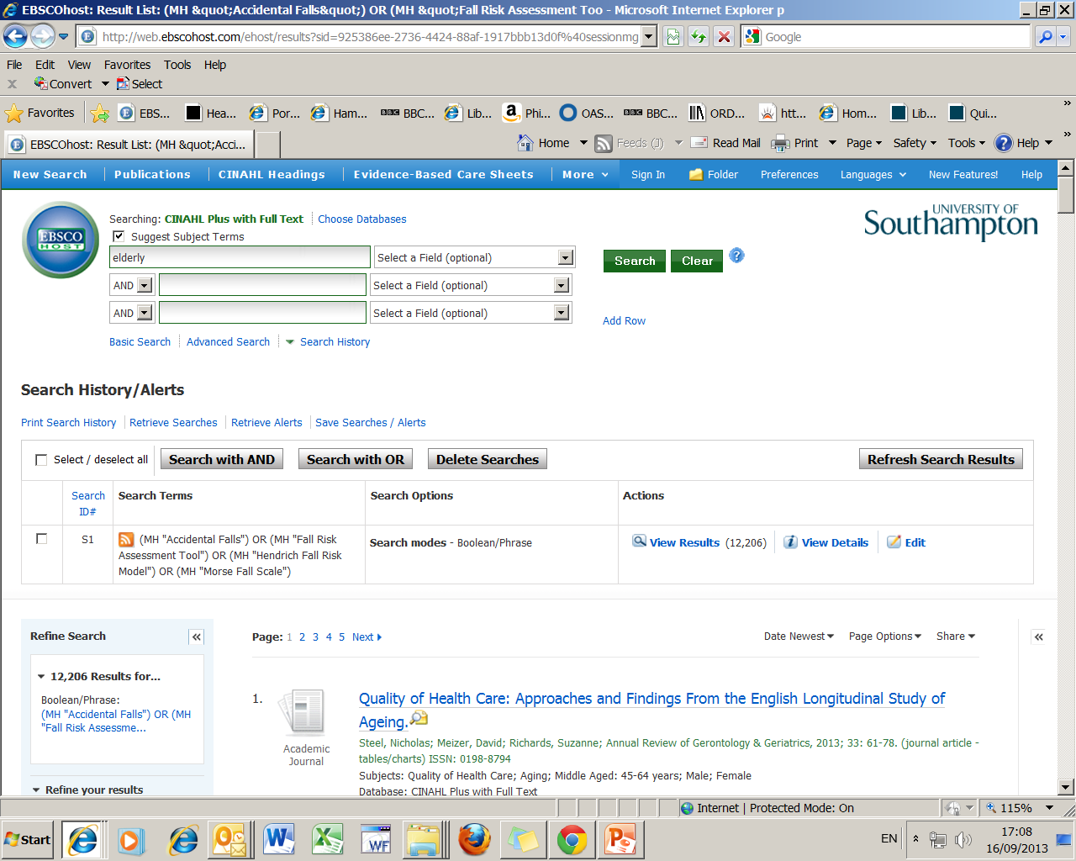
2. Tick box
3. Enter next term then search
1. Results of first search

Slide 33
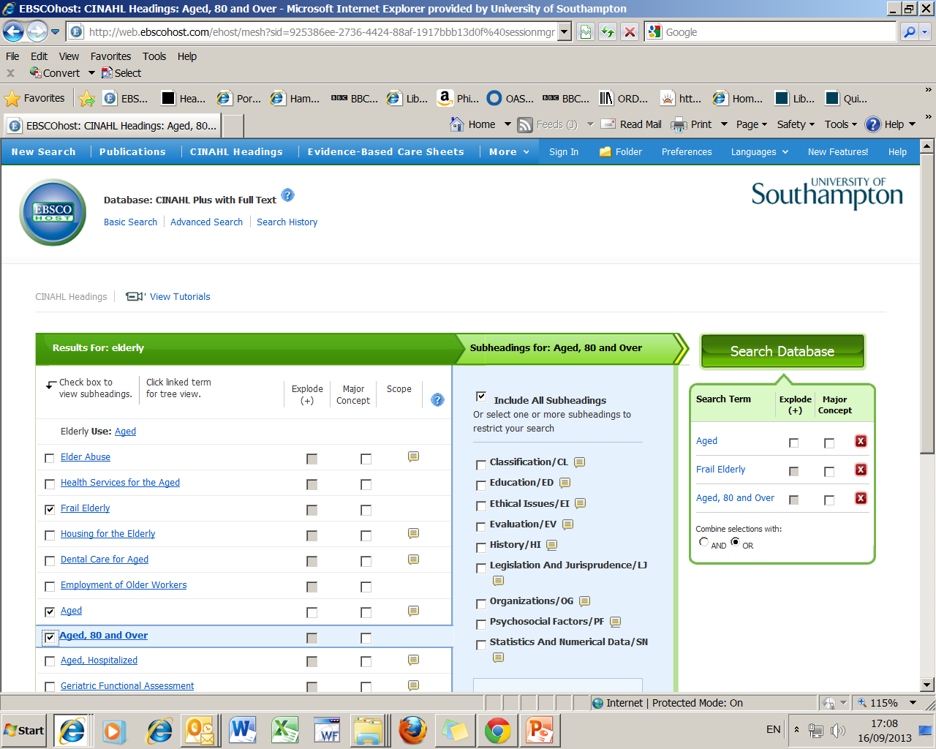
2. Search
Takes you to the suggested subject term Aged
1. Tick Aged and add other useful headings

Slide 34
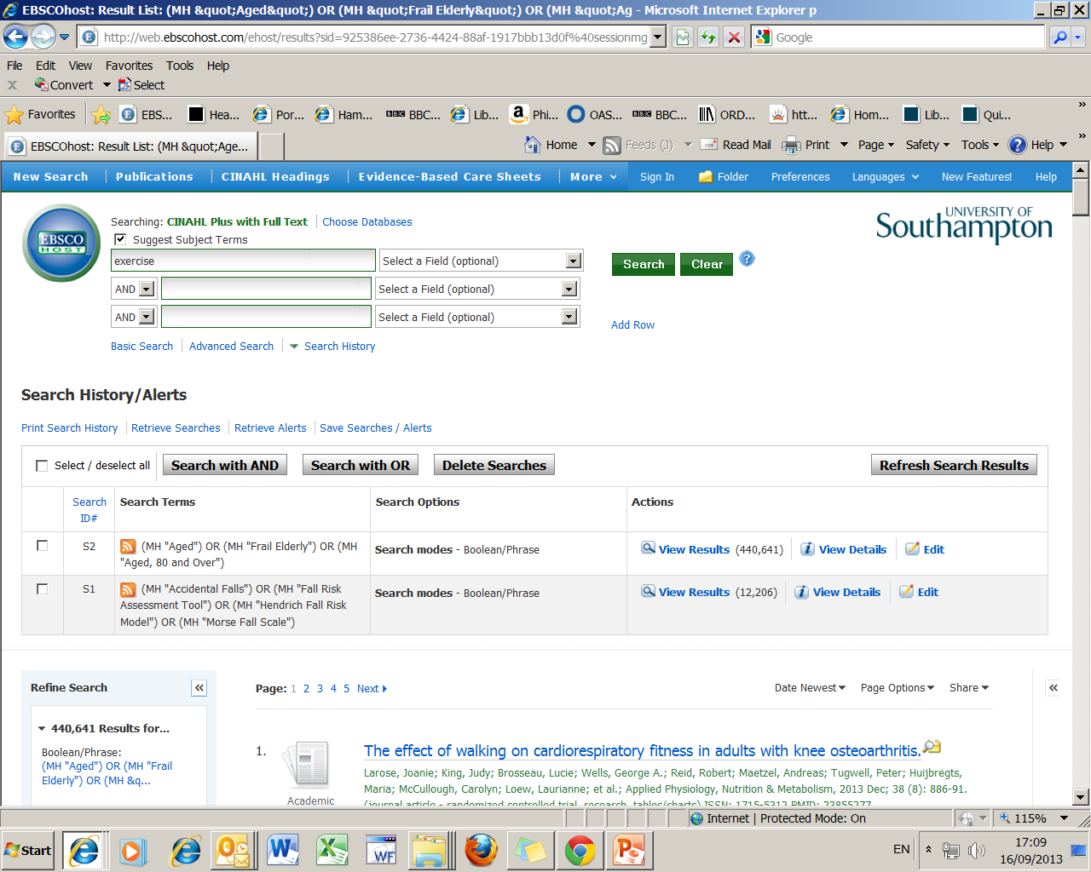
Tick box then enter final search term and search

Slide 35
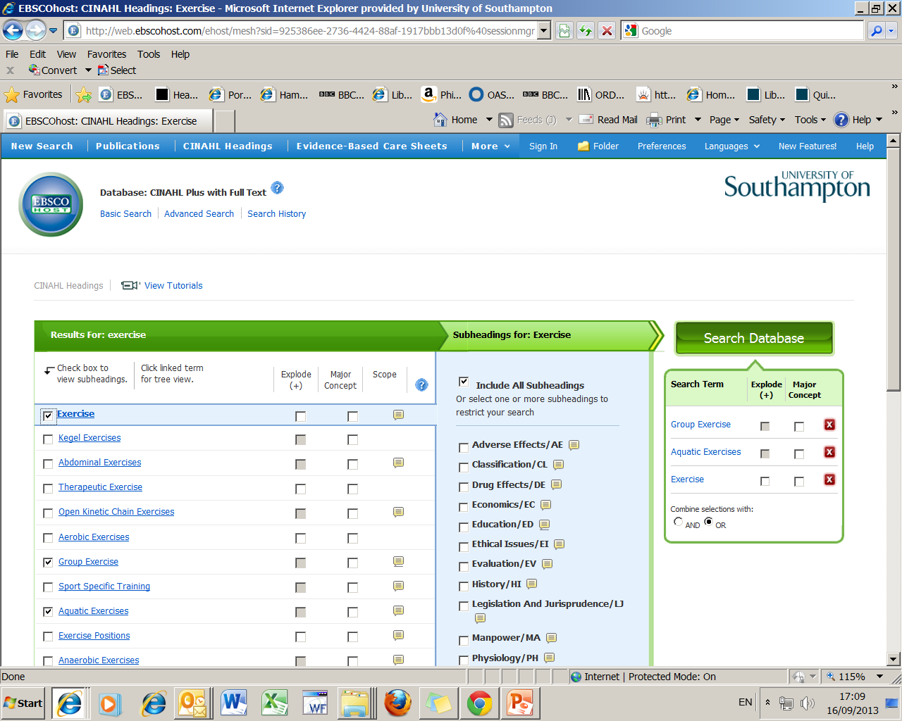
3. Then Search
1. Tick box next to exercise
2. Add some
other useful headings

Slide 36
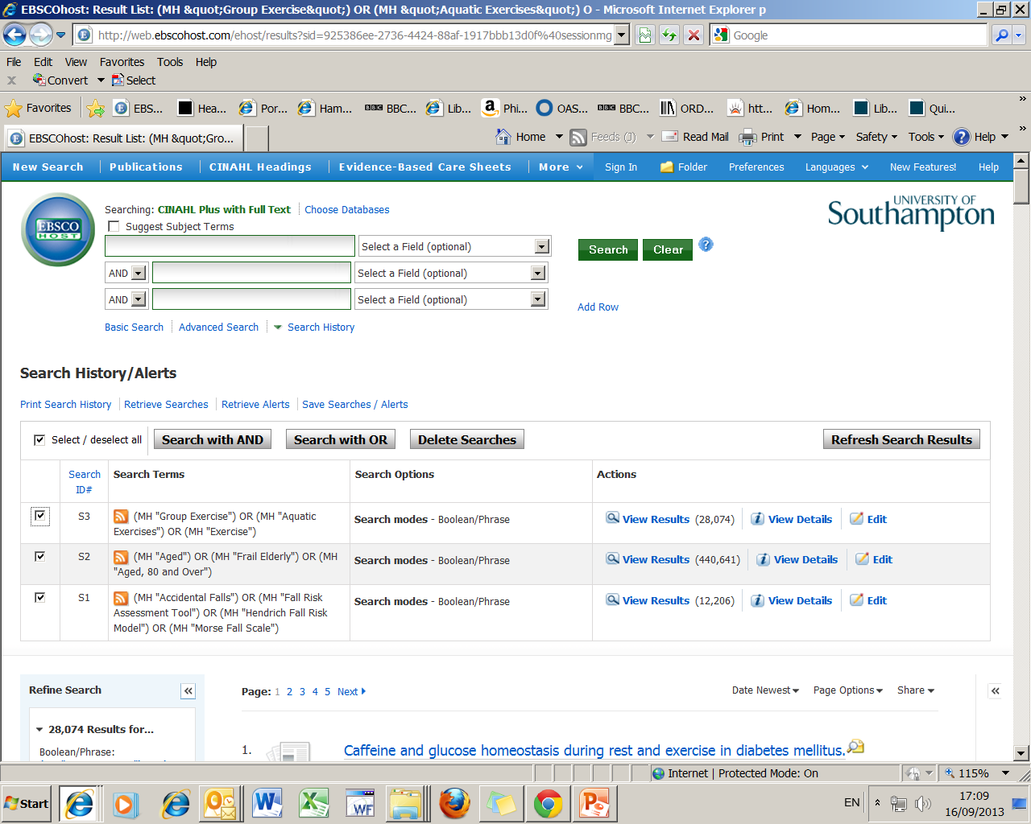
1. Combine searches 1, 2 and 3
together using AND

Slide 37
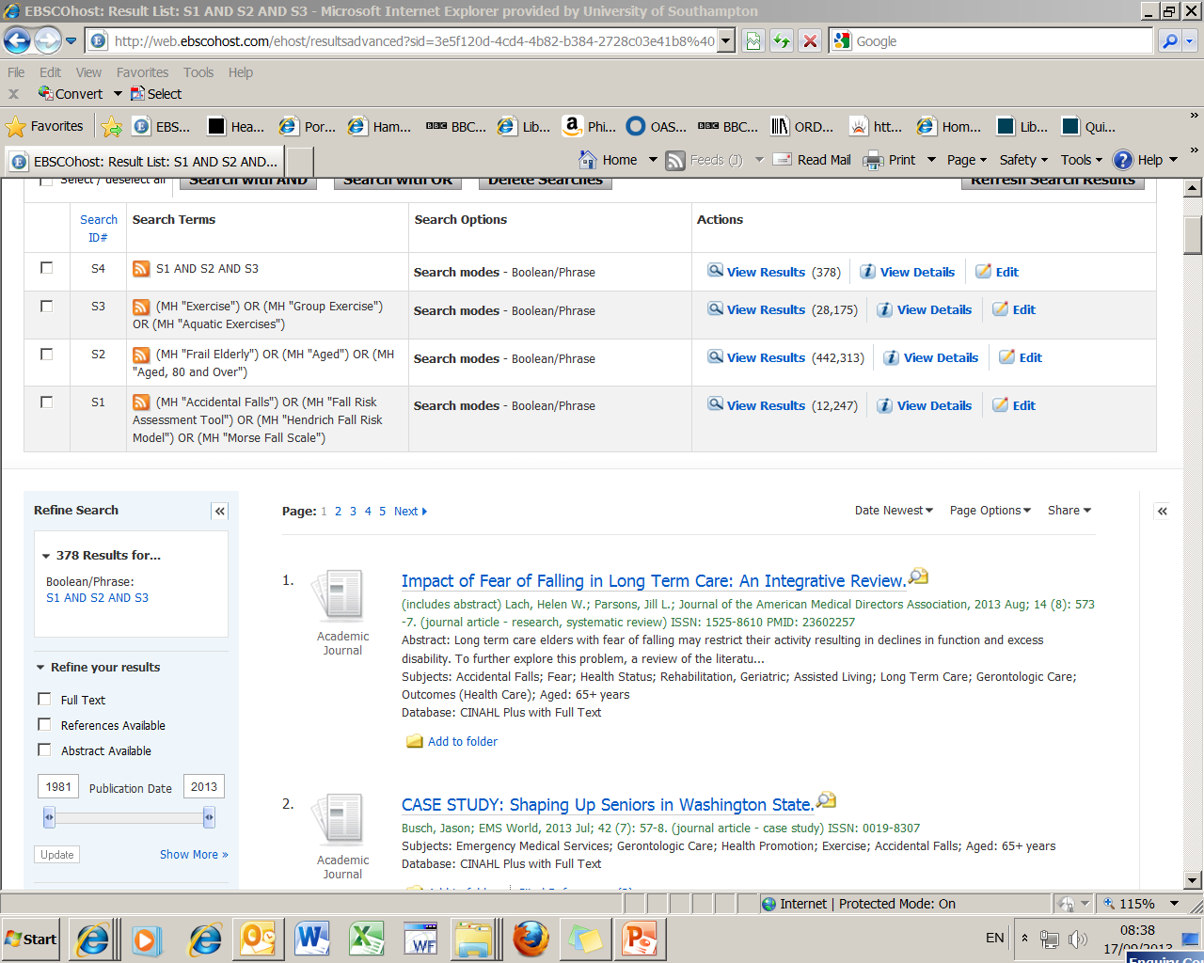
1. Results of final search
2. To cut your search results
down use the “show more” link

Slide 38
Refining (limiting) your search
You can choose limits such as:
Date of publication
Language
Age Group/s
Gender
Publication type i.e. journal
Journal subset i.e. English & Ireland journals
Notes:
.

Slide 39
We will narrow our search:
1. By year of publication
2. Research articles only
3. Abstract available
4. English language

Slide 40
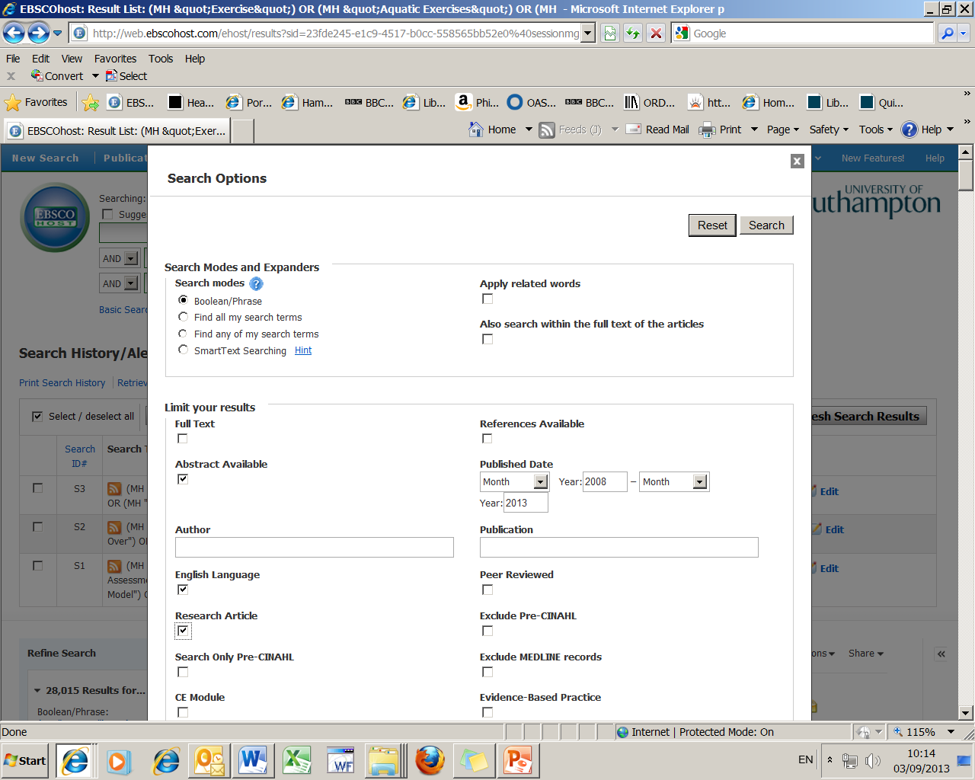

Slide 41
Viewing, marking and saving
references

Slide 42
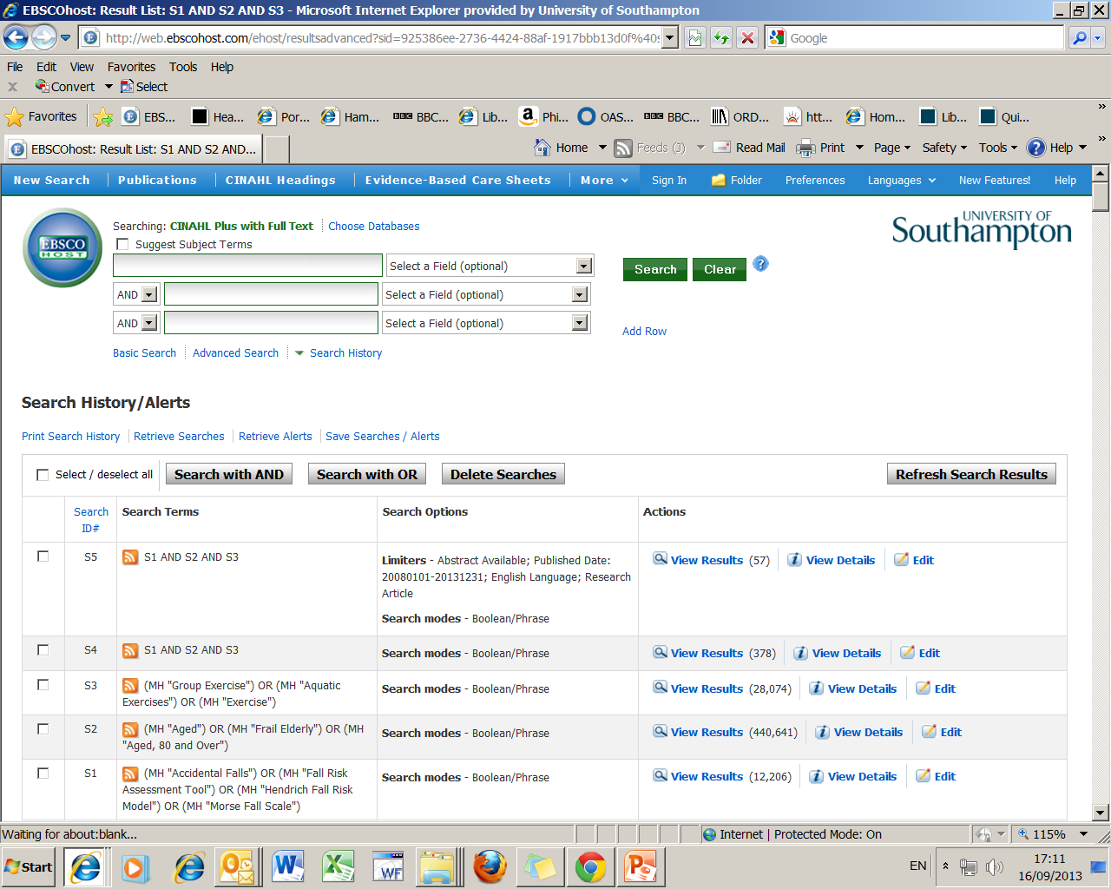
Final result.
To look at the references use this link or scroll down

Slide 43
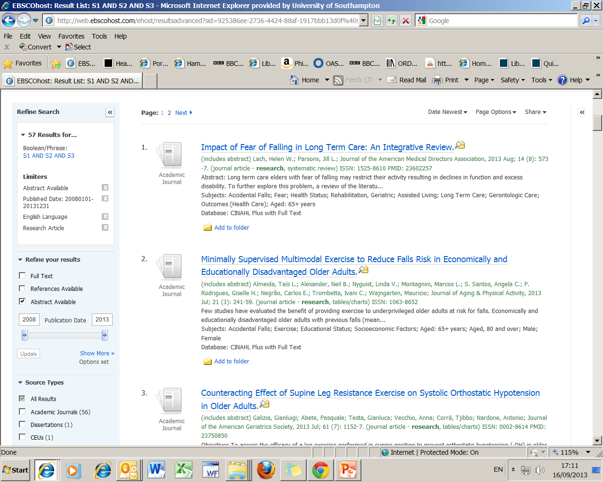
See full details of the reference by using this title link
If you just want to look at the abstract
hold mouse over magnifying glass

Slide 44
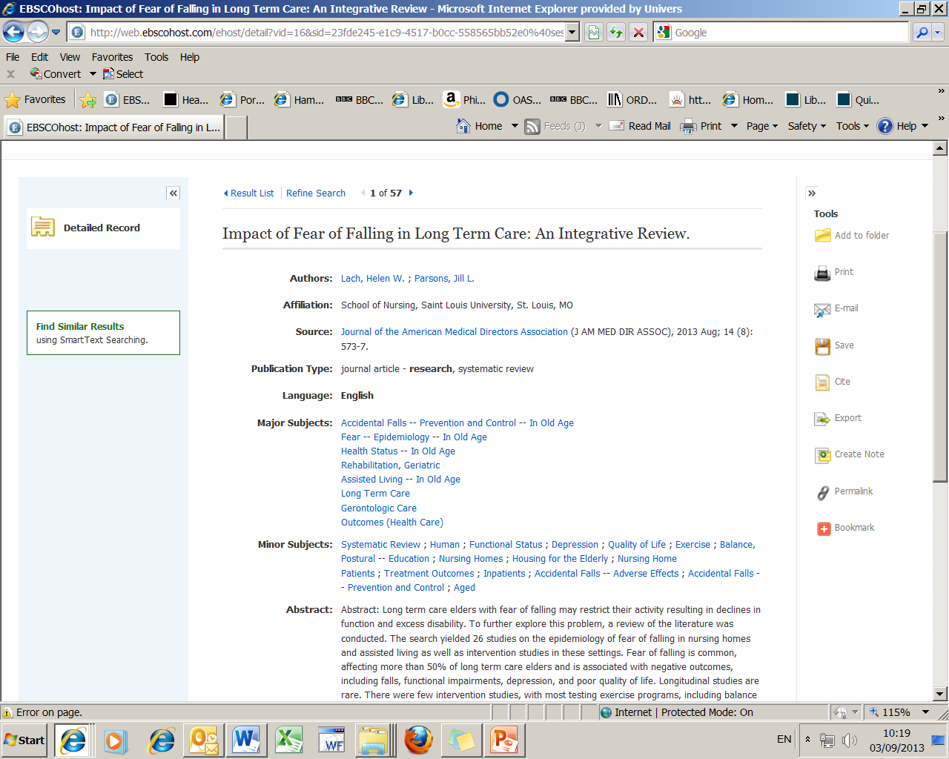
2. Return to results link at the top of the page
1. Subject terms added to this reference

Slide 45
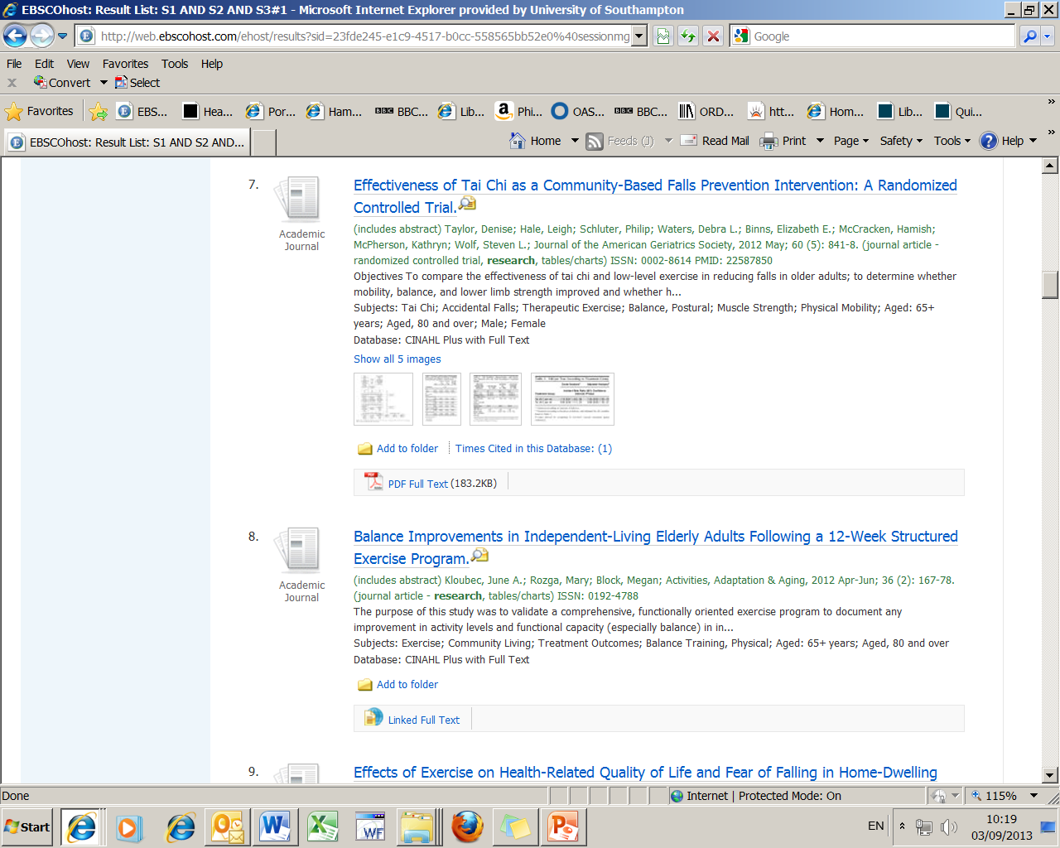
Either of these two links
will take you to the
full text of the article

Slide 46
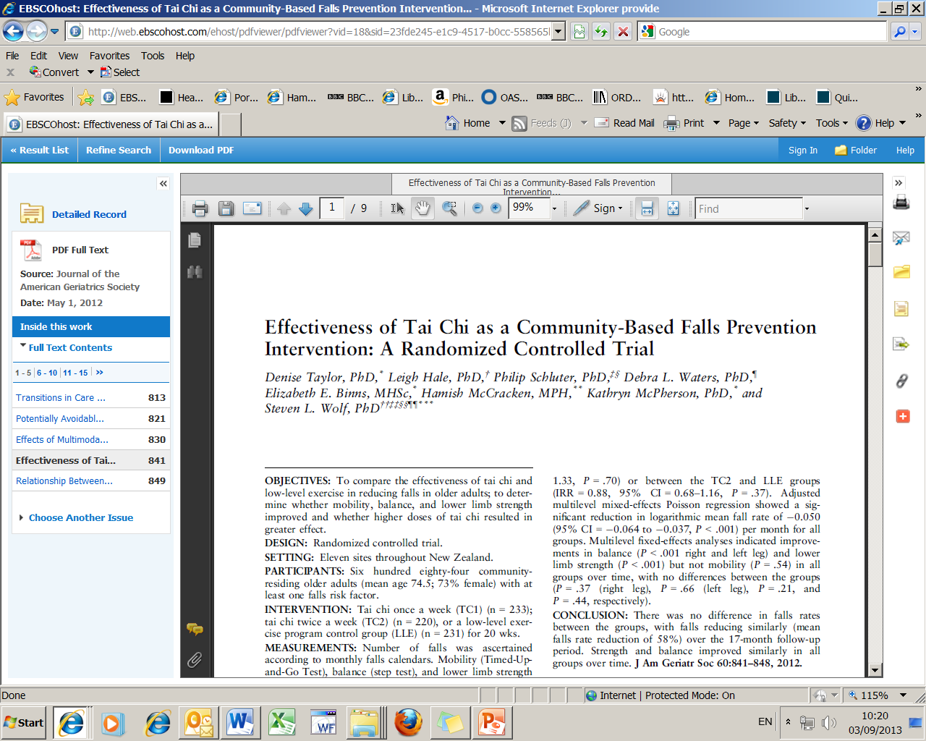
Use these icons to print, save or email article
Details of the reference

Slide 47
If we don’t have access to a reference which is really important then use our Inter-Library Loans service:
Login to WebCat
Go to:
  Requests: inter-library loans and stack
  Inter-library loan requests
  Choose the relevant form for the item you are requesting, complete the form then submit
Please check to see the number of inter-library loan requests your are entitled to at www.southampton.ac.uk/library/services/ill.html

Slide 48
Copying and Copyright
You should assume that everything is subject to copyright law, unless this is clearly stated otherwise
You should save, print or email only one copy of an article from an issue of a magazine or journal. In the case of a book, pamphlet or report, you should make single copies of not more than one chapter, or extracts amounting to no more than 5% of the entire work
For more information see:
  www.soton.ac.uk/library/about/regulations/ copyrightphotocopying. html

Slide 49
Saving the details of the references and your search history

Slide 50
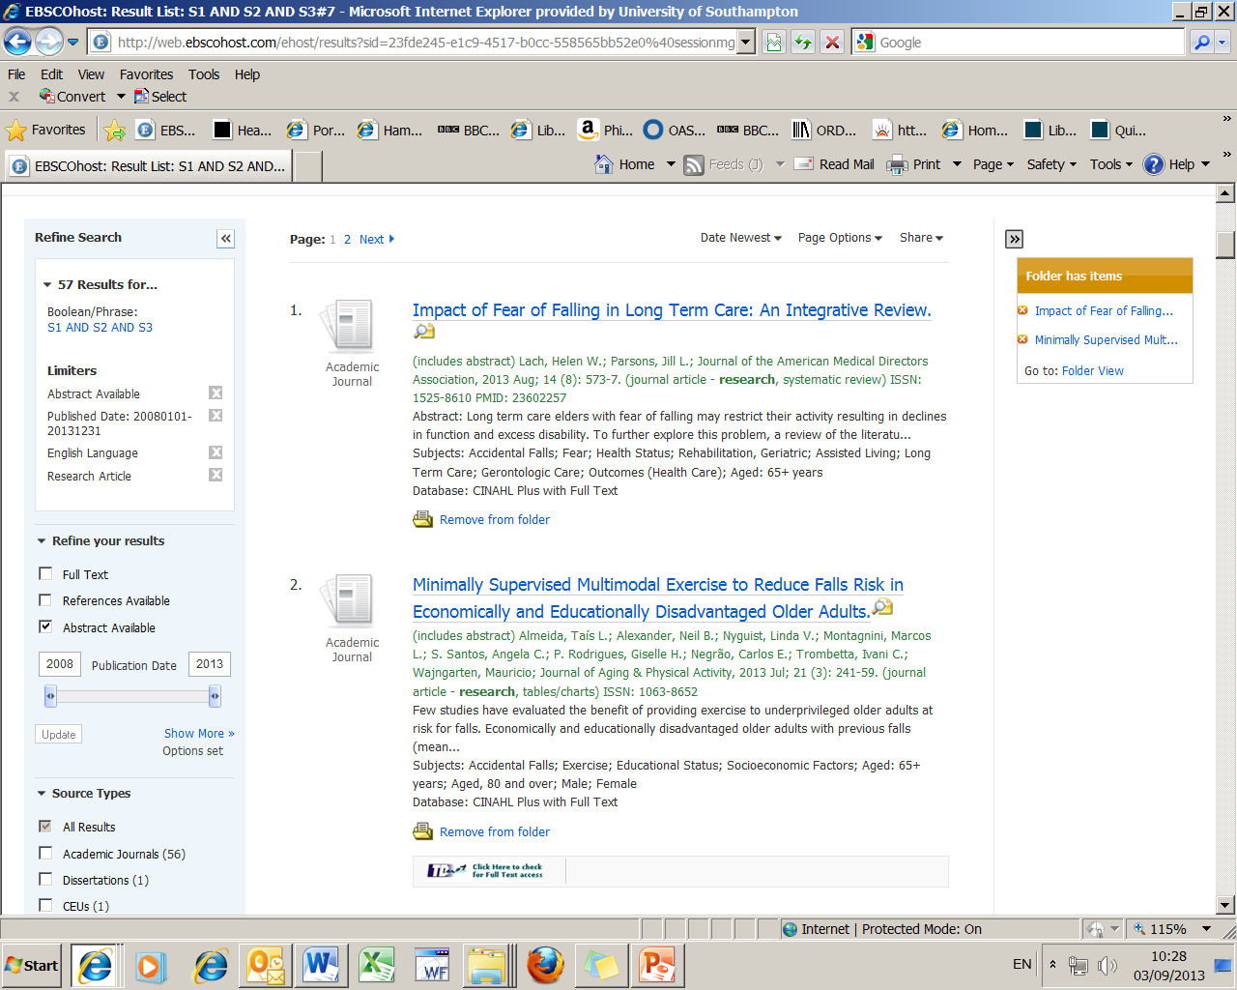
Then go to the folder view
at the top of the page, if the folder view is not showing use the << link to open it up
1. Add to folder those
references you want
to save, page by page…..
(it then changes to
‘remove from folder)

Slide 51
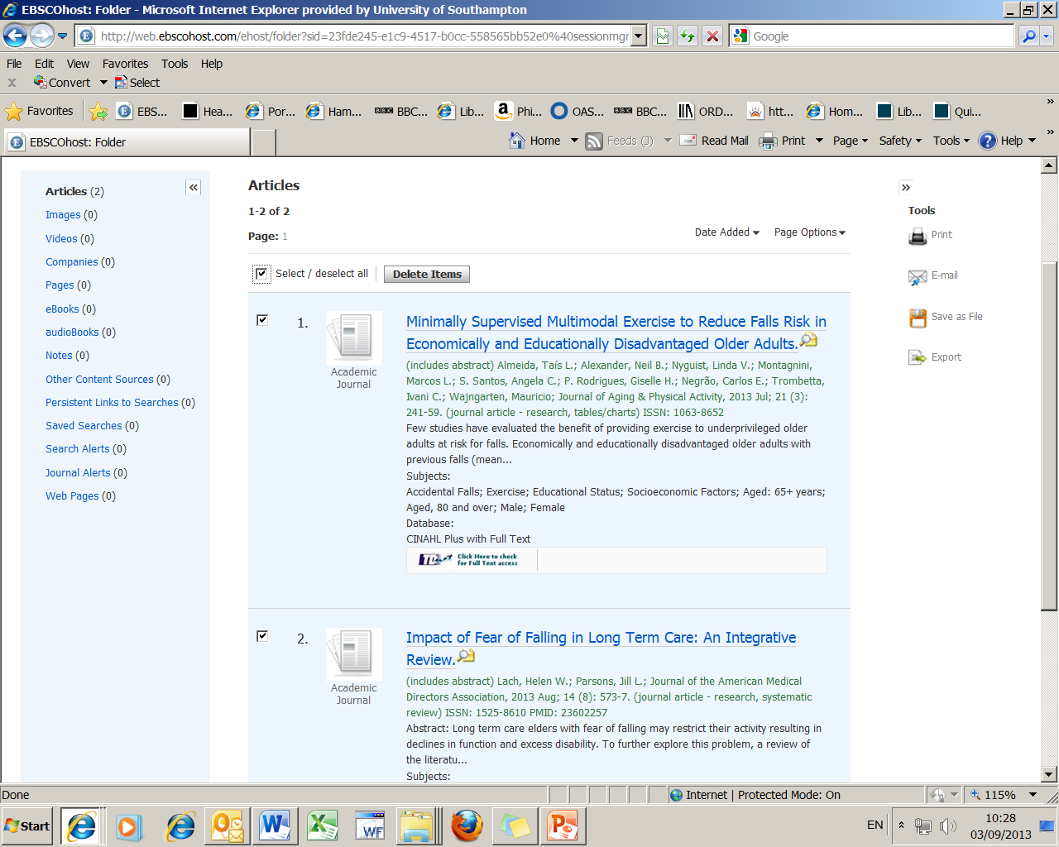
1. Select
references
(again)
2. Choose your method of output

Slide 52
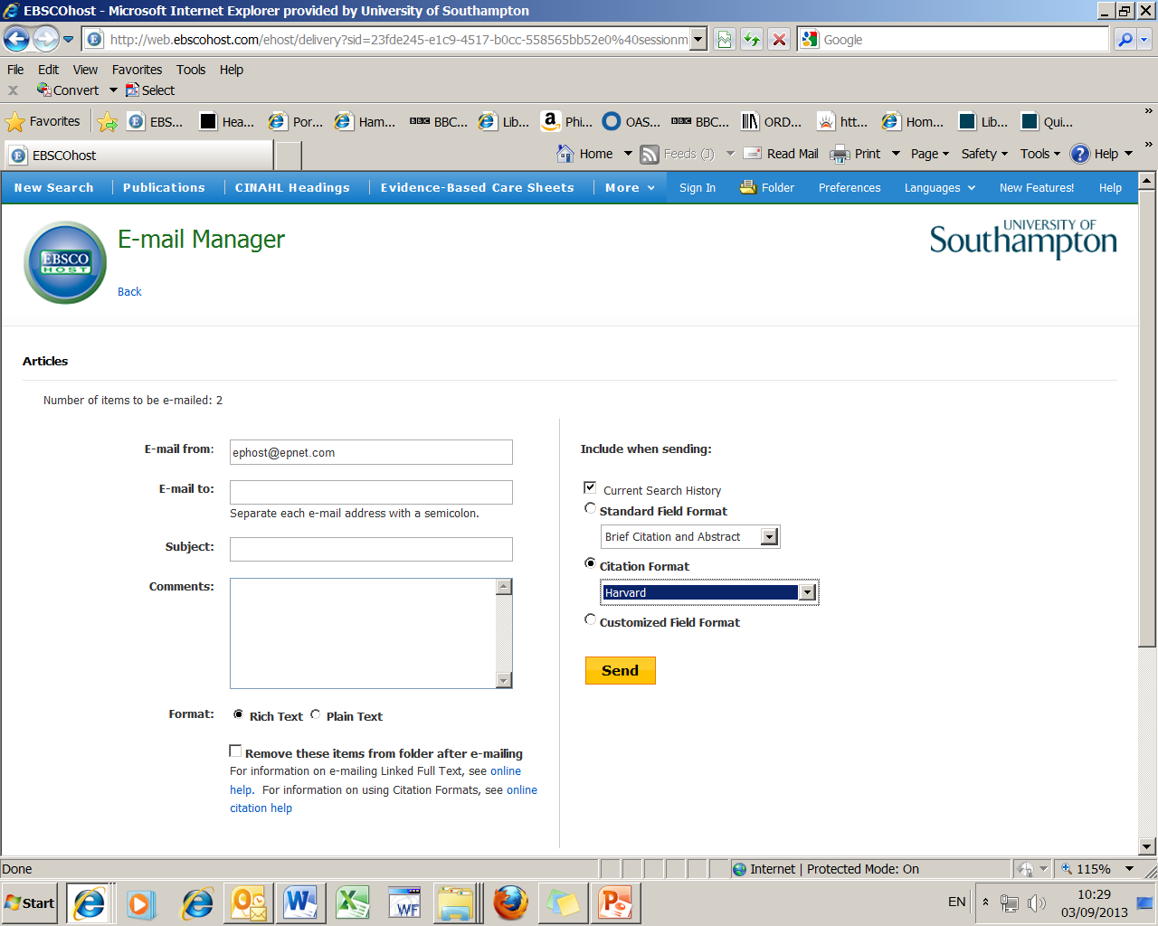
Change citation format
to Harvard as it is the
closest to the Health Sciences
Referencing guidelines

Slide 53
Warning!
Don’t send your results to a work address outside of the University, i.e. an NHS email account as the firewall set up by other organisations may block any attachments.

Slide 54
Getting Help
  Subject Enquiries
    Level 3, Hartley Library
  Or contact
    libenqs@soton.ac.uk

Slide 55
Updated 23.09.13 by smd

