Slide 1
How to use Turning Point zappers in a Common Learning Space
Adam Warren
a.j.warren@soton.ac.uk
Centre for Innovation in Technologies and Education

Slide 2
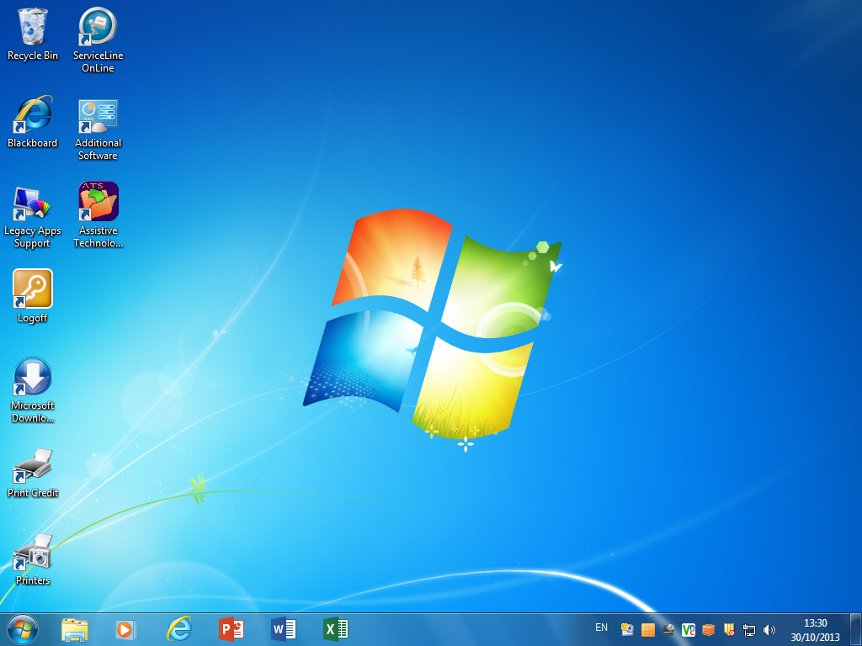
This guide shows you how to use Turning Point in Common Learning Spaces
Notes:
This guide shows you how to use Turning Point in Common Learning Spaces.

Slide 3
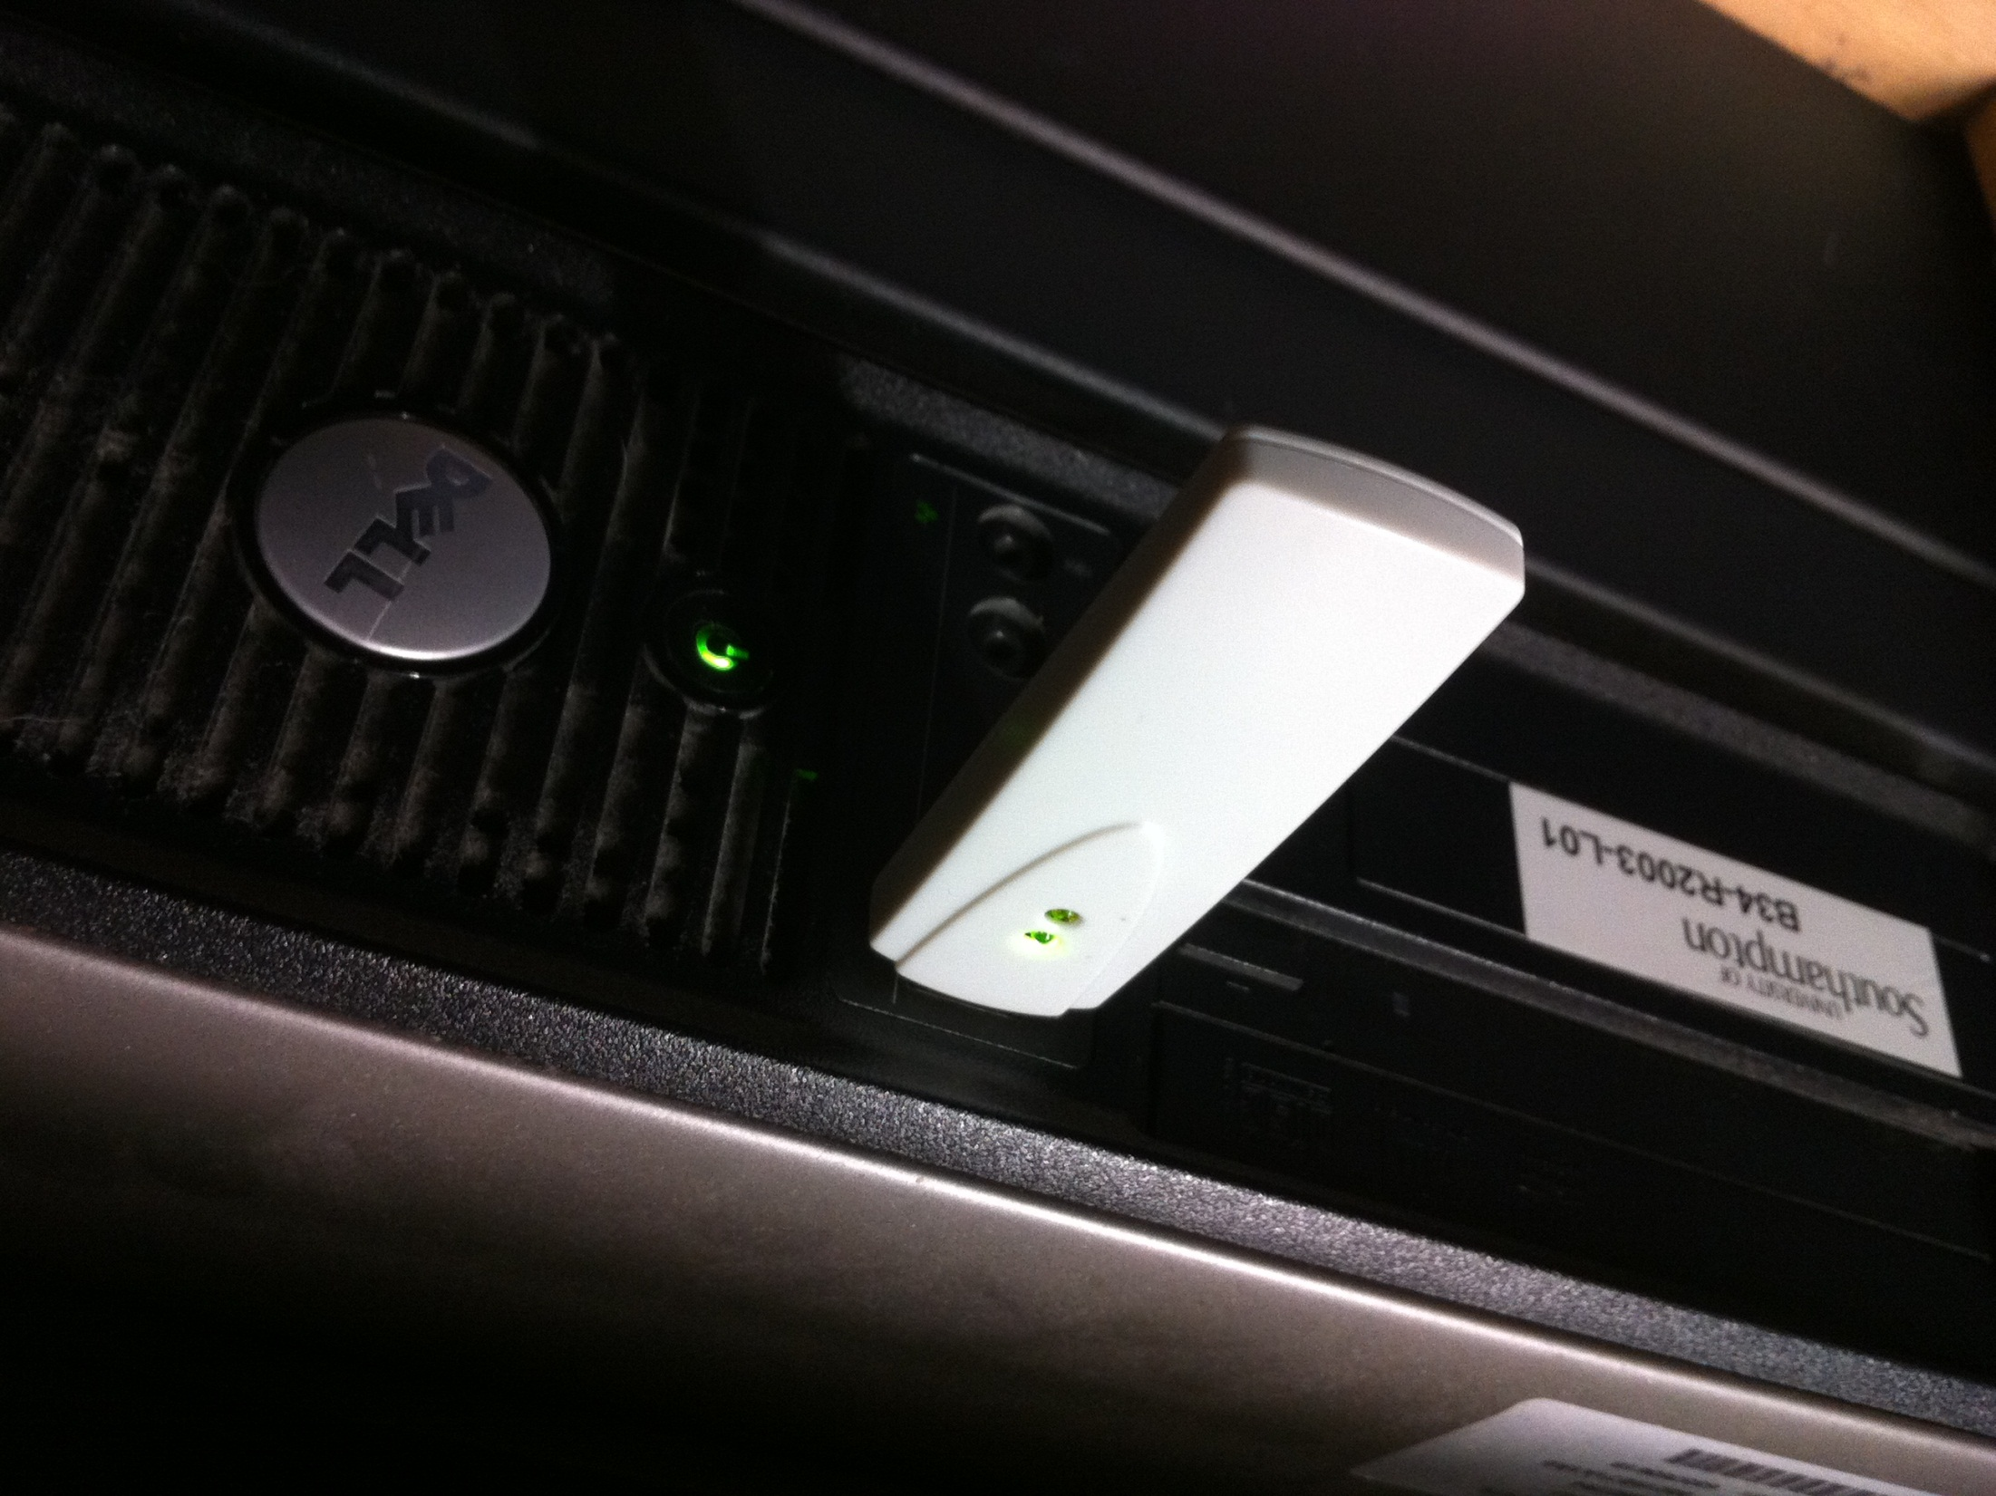
Insert the receiver into one of the PC’s USB ports.
Notes:
Insert the receiver into on of the PC’s USB ports.

Slide 4
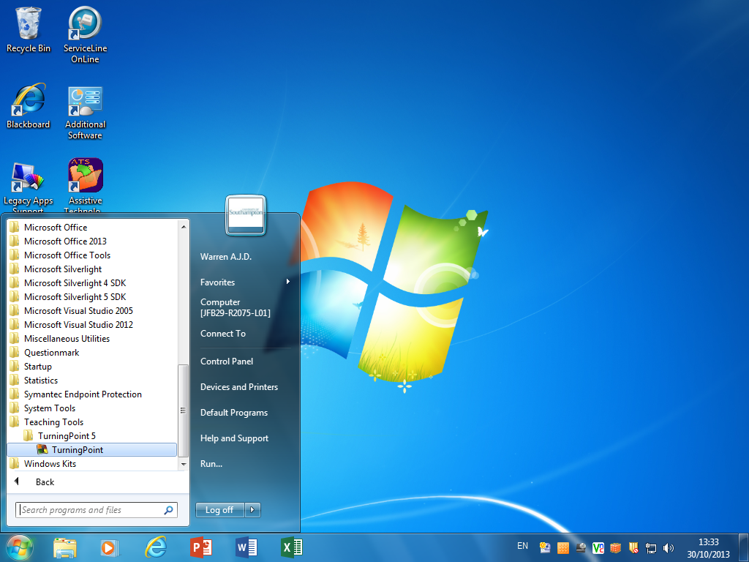
Log on to the bench PC and start Turning Point. You can find it on the Start menu under All Programs > Teaching Tools
Notes:
Log on to the bench PC and start Turning Point. You can find it on the Start menu under All Programs > Teaching Tools

Slide 5
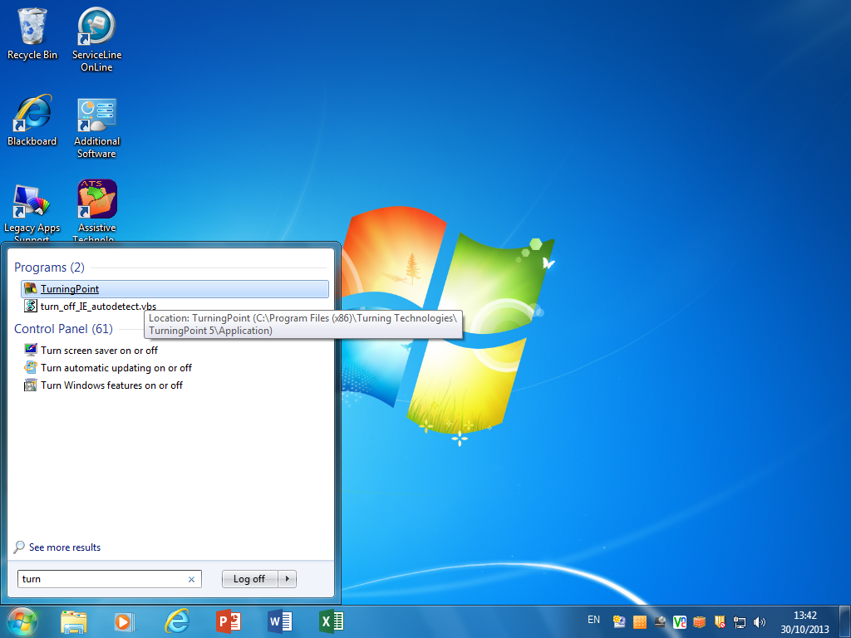
Alternatively, just type ‘turn’ into the Start menu’s Search box and click on Turning Point in the list of results.
Notes:
Alternatively, just type ‘turn’ into the Start menu’s Search box and click on Turning Point in the list of results.

Slide 6
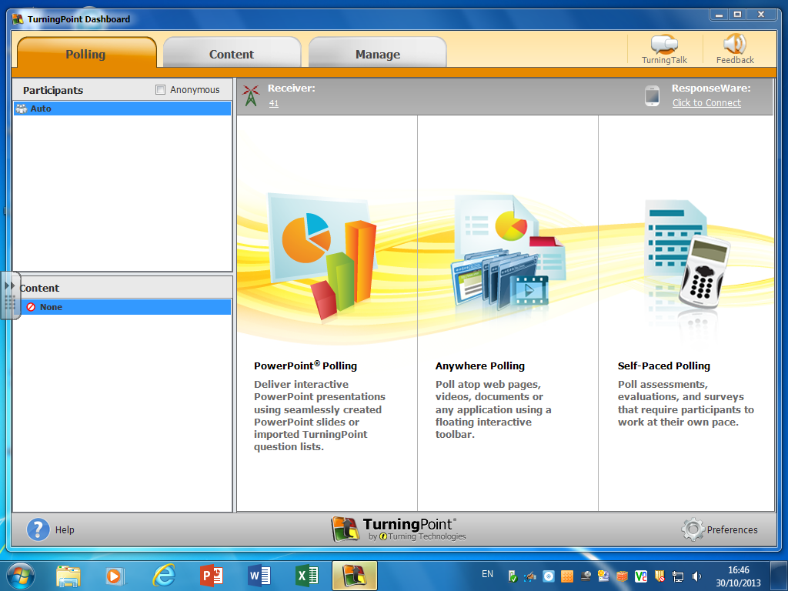
In a significant change from the previous version, Turning Point 5 now provides a unified interface to all of the program’s features. For example Anywhere Polling enables you to ask on-the-fly questions with any application, not just PowerPoint.
Notes:
In a significant change from the previous version, Turning Point 5 now provides a unified interface to all of the program’s features. For example Anywhere Polling enables you to ask on-the-fly questions with any application, not just PowerPoint.

Slide 7
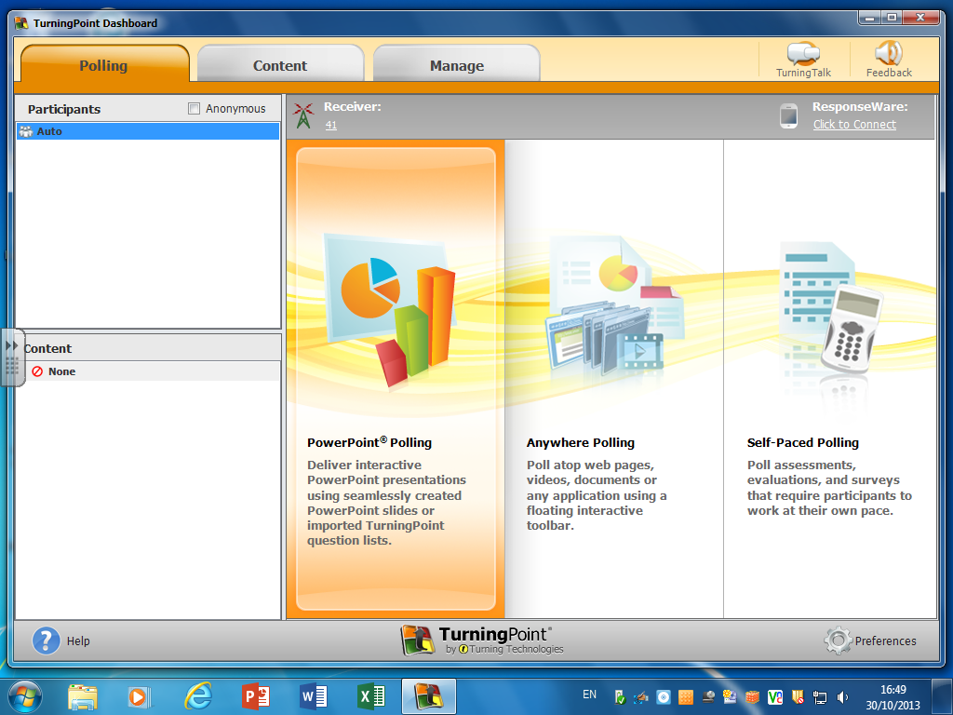
To use a PowerPoint presentation that includes question slides, click on PowerPoint Polling.
Notes:
To use a PowerPoint presentation that includes question slides, click on PowerPoint Polling.

Slide 8
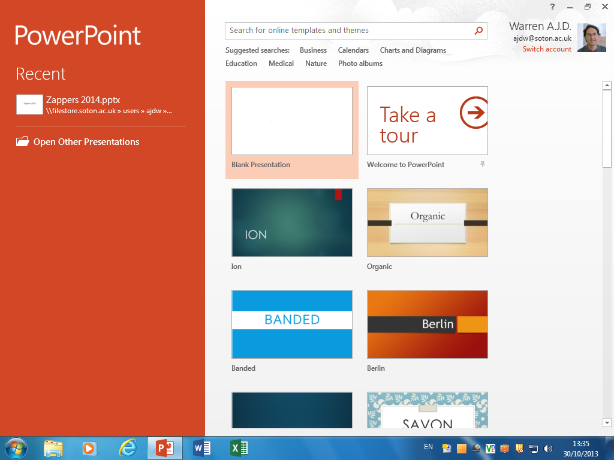
Office 2013 also has some significant interface changes to the previous version. Click on Open Office Presentations to locate and load your slides.
Notes:
Office 2013 also has some significant interface changes to the previous version. Click on Open Office Presentations to locate and load your slides.

Slide 9
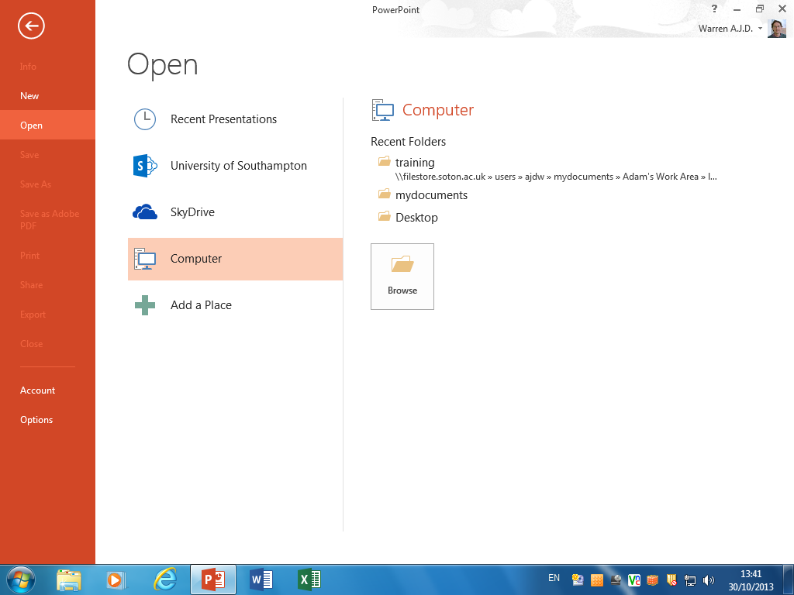
Click on Computer and then browse to locate and open the PowerPoint file.
Notes:
Click on Computer and then browse to locate and open the PowerPoint file.

Slide 10
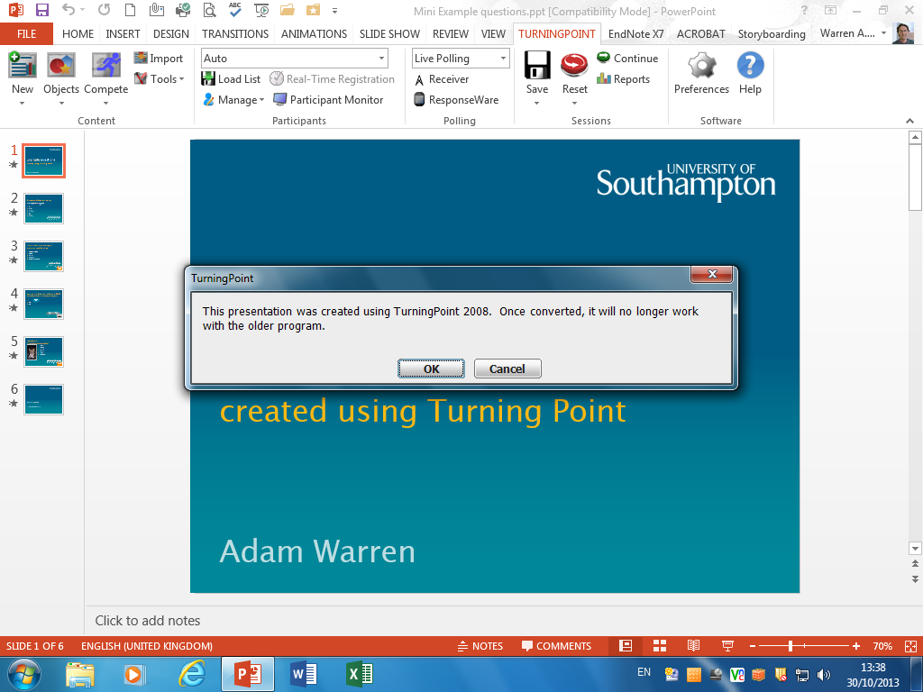
If your presentation was created using an older version of Turning Point, a dialog box warns you that the file will be automatically converted. If you save the file, it can no longer be opened by older versions. Make sure you upgrade your office PC or laptop to version 5 to avoid this being a problem.
Notes:
If your presentation was created using an older version of Turning Point, a dialog box warns you that the file will be automatically converted. If you save the file, it can no longer be opened by older versions. Make sure you upgrade your office PC or laptop to version 5 to avoid this being a problem.
The automatic conversion does not always work perfectly, especially for presentations created in Turning Point 2. We recommend that you convert your presentations on your office PC or laptop and check they work as expected before using them with students.

Slide 11
The automatic conversion does not always work perfectly, especially for presentations created in Turning Point 2. We recommend that you convert your presentations on your office PC or laptop and check they work as expected before using them with students.
Notes:
If your presentation was created using an older version of Turning Point, a dialog box warns you that the file will be automatically converted. If you save the file, it can no longer be opened by older versions. Make sure you upgrade your office PC or laptop to version 5 to avoid this being a problem.
The automatic conversion does not always work perfectly, especially for presentations created in Turning Point 2. We recommend that you convert your presentations on your office PC or laptop and check they work as expected before using them with students.

Slide 12
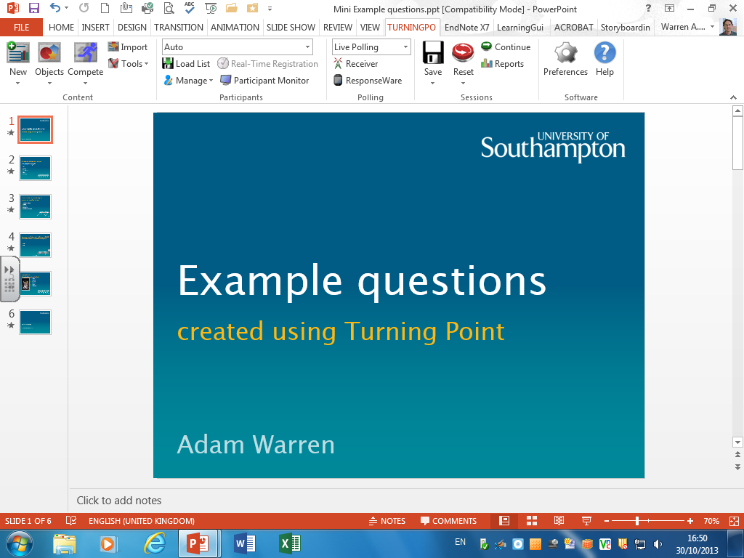
Note the new-look Turning Point ribbon, which organises and displays the controls using a clearer layout.
Notes:
Note the new-look Turning Point ribbon, which organises and displays the controls using a clearer layout.

Slide 13
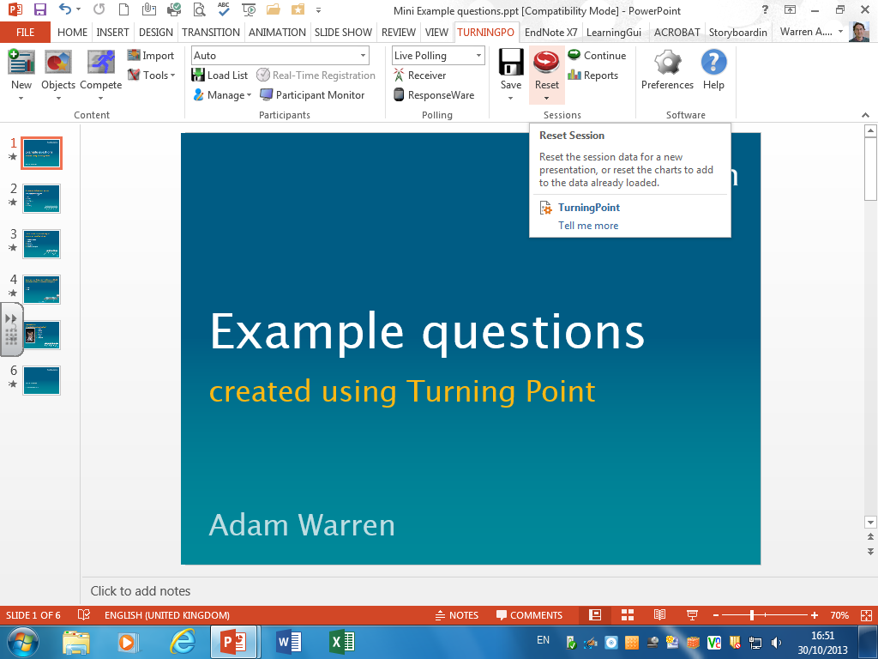
The Reset button should always be used at the start of a session to make sure that any previous voting data is cleared before your students vote.
Notes:
The Reset button should always be used at the start of a session to make sure that any previous voting data is cleared before your students vote.

Slide 14
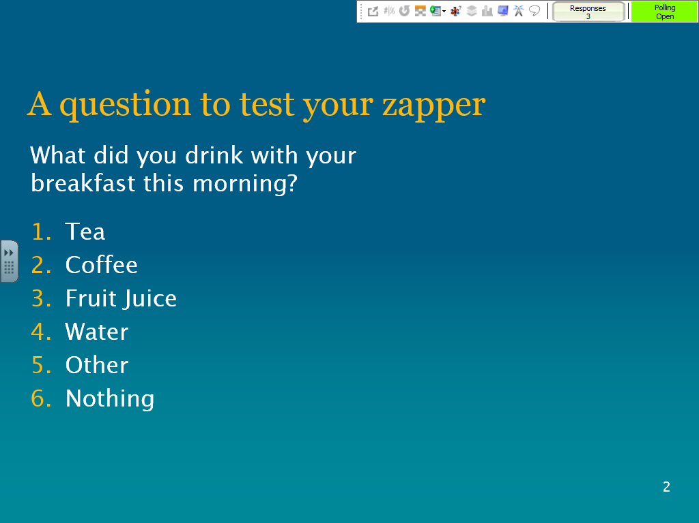
Note the showbar at the top of the screen which shows information about the voting. The green area shows that polling is open and students can vote.
You should always include a test question so your students can check that their zapper is working.
Notes:
You should always include a test question so your students can check that their zapper is working.
Note the showbar at the top of the screen which shows information about the voting. The green area shows that polling is open and students can vote.

Slide 15
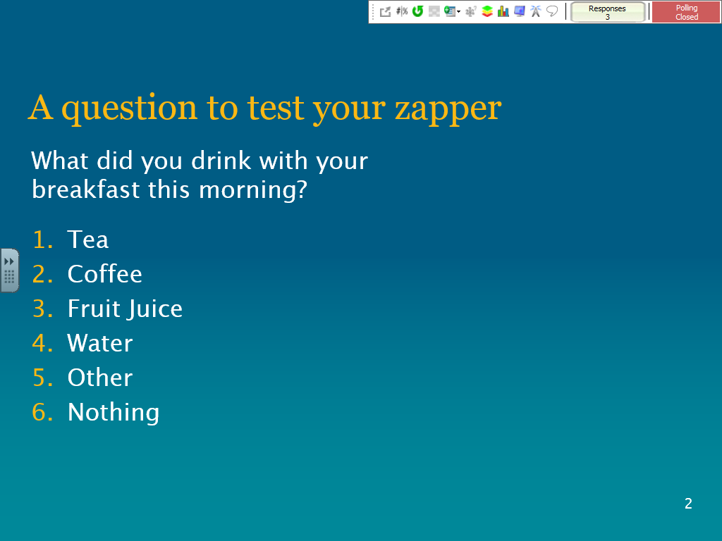
Click the mouse to close polling – note the green area turns red.
Notes:
Click the mouse to close polling – note the green area turns red.

Slide 16
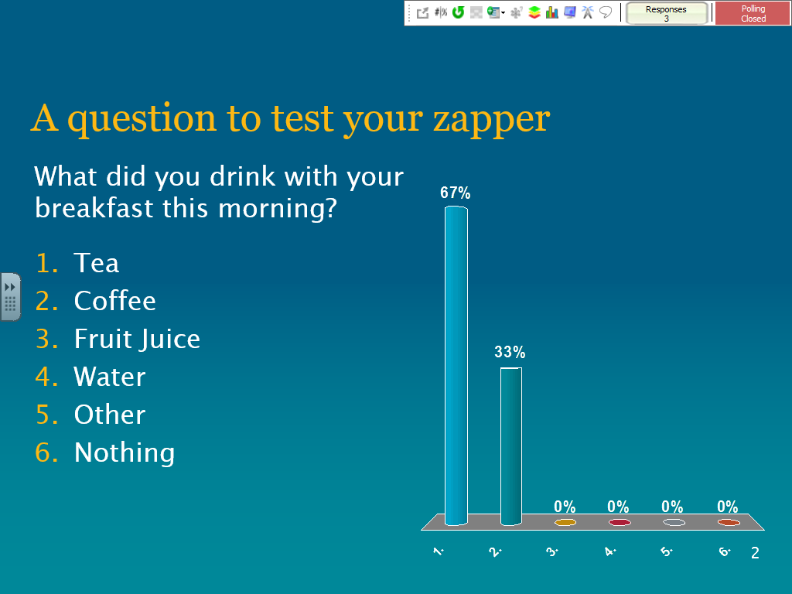
Click again to display the results of the vote.
The #|% button on the showbar can be used to display the number of votes or the percentage for each answer.
Notes:
Click again to display the results of the vote.
The #/% button on the showbar can be used to display the number of votes or the percentage for each answer.

Slide 17
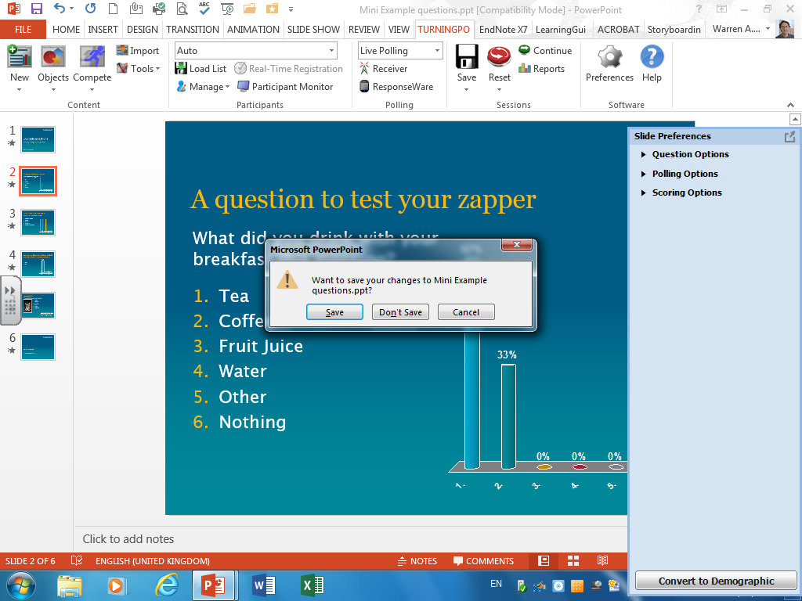
When you close PowerPoint at the end of the session, a dialog asks if you want to save the changes. In most cases, you can safely choose Don’t Save; only click Save if you want to save the voting charts as they appear.
Notes:
When you close PowerPoint at the end of the session, a dialog asks if you want to save the changes. In most cases, you can safely choose Don’t Save; only click Save if you want to save the voting charts as they appear.

Slide 18
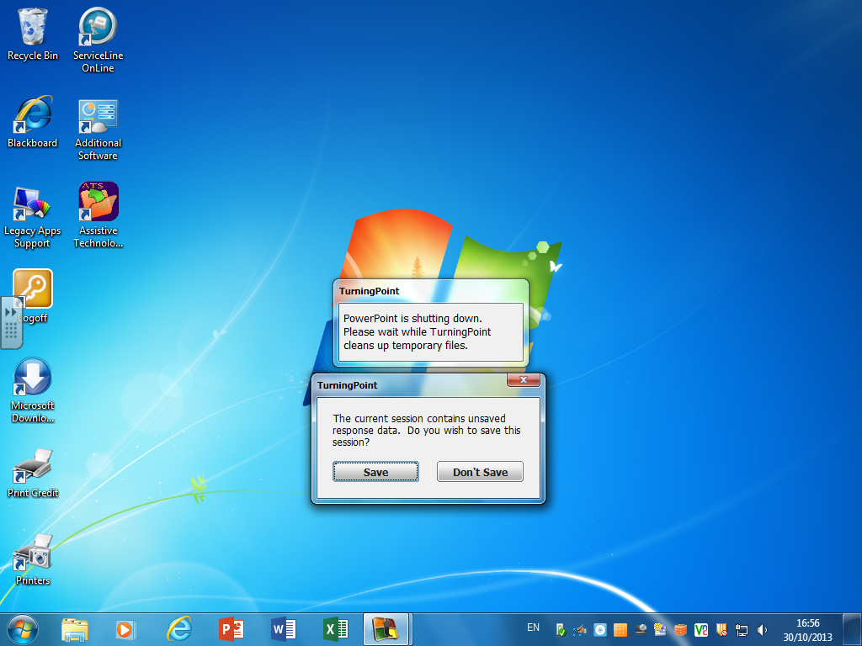
A second dialog asks if you want to save the response data. In most cases, click Save so you can review and analyse the voting data.
If you click Don’t Save, the voting data will be discarded and cannot be recovered later.
Notes:
A second dialog asks if you want to save the response data. In most cases, click Save so you can review and analyse the voting data.
If you click Don’t Save, the voting data will be discarded and cannot be recovered later.

Slide 19
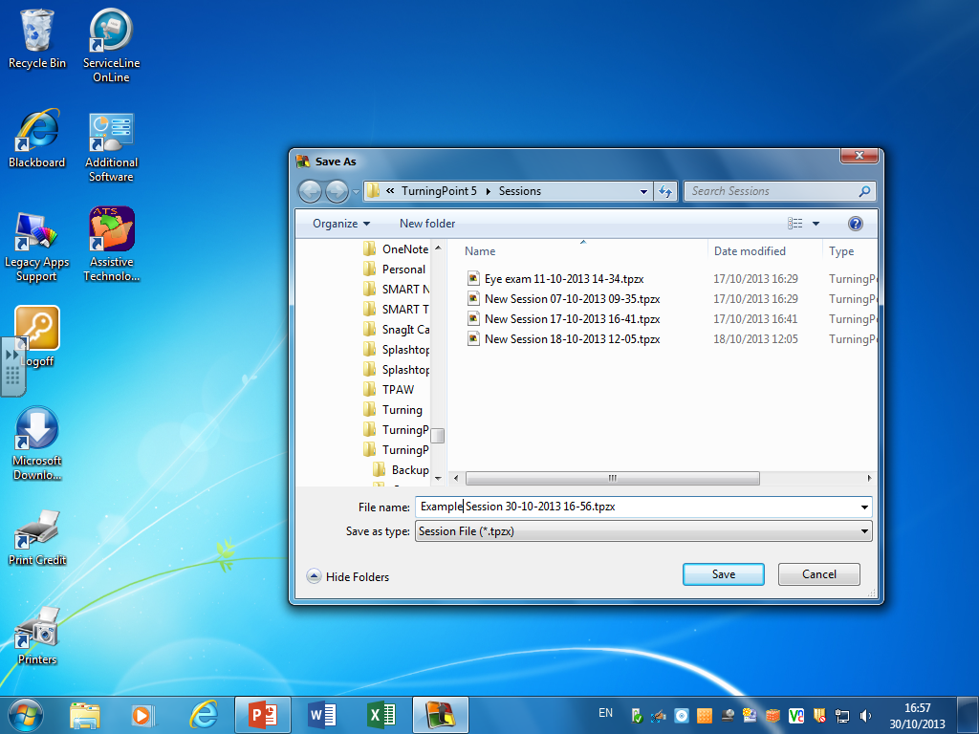
The voting data is saved by default to the Turning Point folder in My Documents. You should edit its name to make it easy to identify the session later.
Notes:
The voting data is saved by default to the Turning Point folder in My Documents. You should edit its name to make it easy to identify the session later.
You can save the data file to a USB drive instead if you prefer, but will need to import it into Turning Point before you can view or analyse it.

Slide 20
You can save the data file to a USB drive instead if you prefer, but will need to import it into Turning Point before you can view or analyse it.
Notes:
The voting data is saved by default to the Turning Point folder in My Documents. You should edit its name to make it easy to identify the session later.
You can save the data file to a USB drive instead if you prefer, but will need to import it into Turning Point before you can view or analyse it.

Slide 21
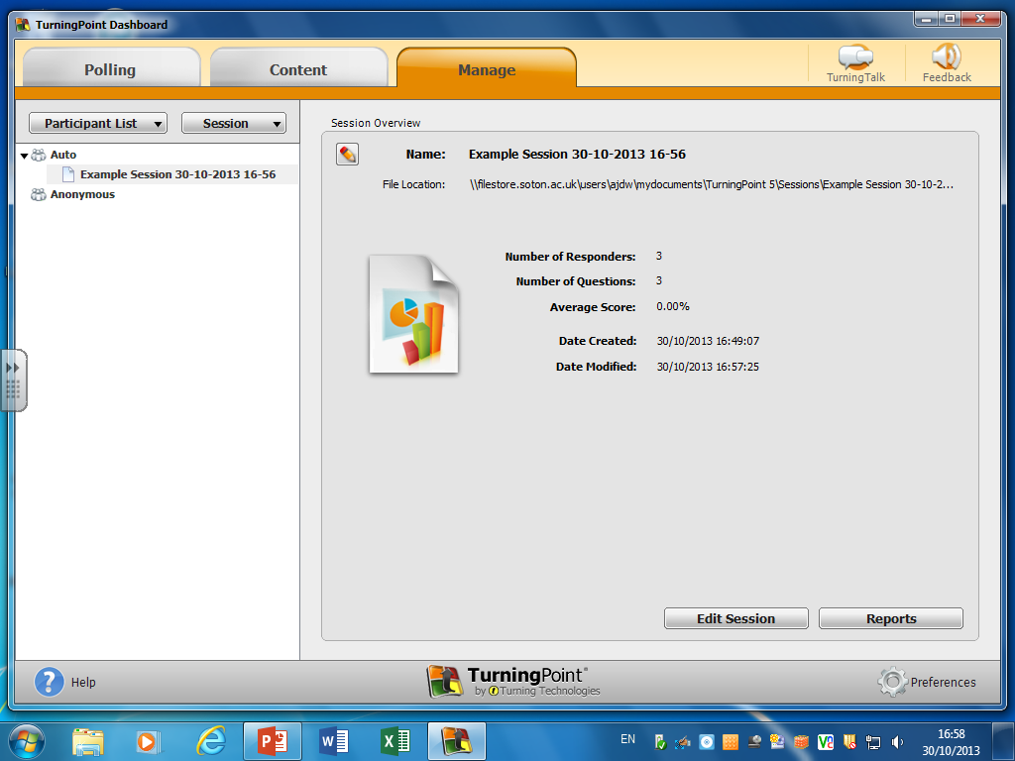
Click the Manage tab to see a list of the data files you have saved.
Select a file and click the Reports button to review the data.
Notes:
Click the Manage tab to see a list of the data files you have saved. Select a file and click the Reports button to review the data.

Slide 22
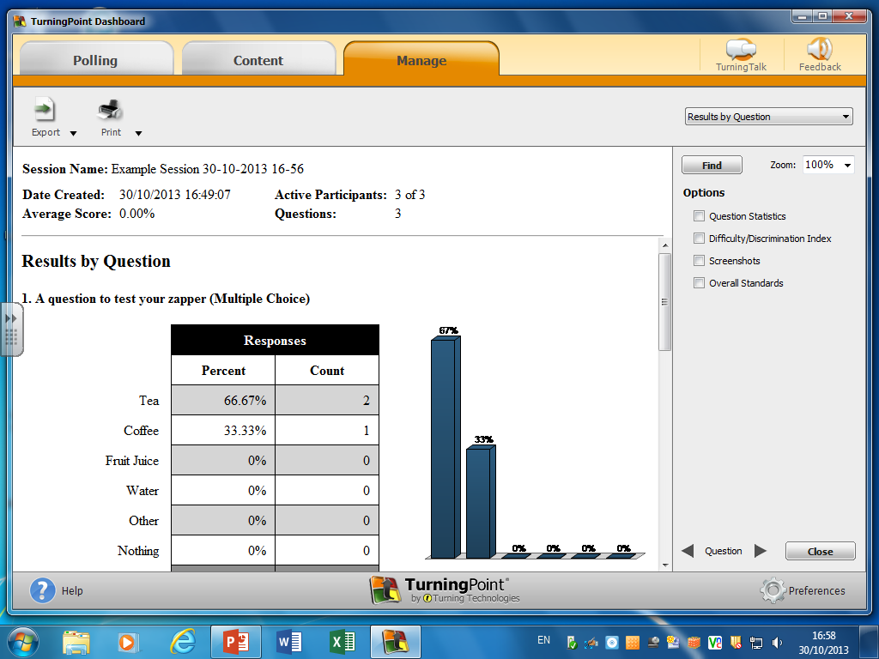
The default report is Results by Question. Use the dropdown list to select a different report.
Notes:
The default report is Results by Question. Use the dropdown list to select a different report.

Slide 23
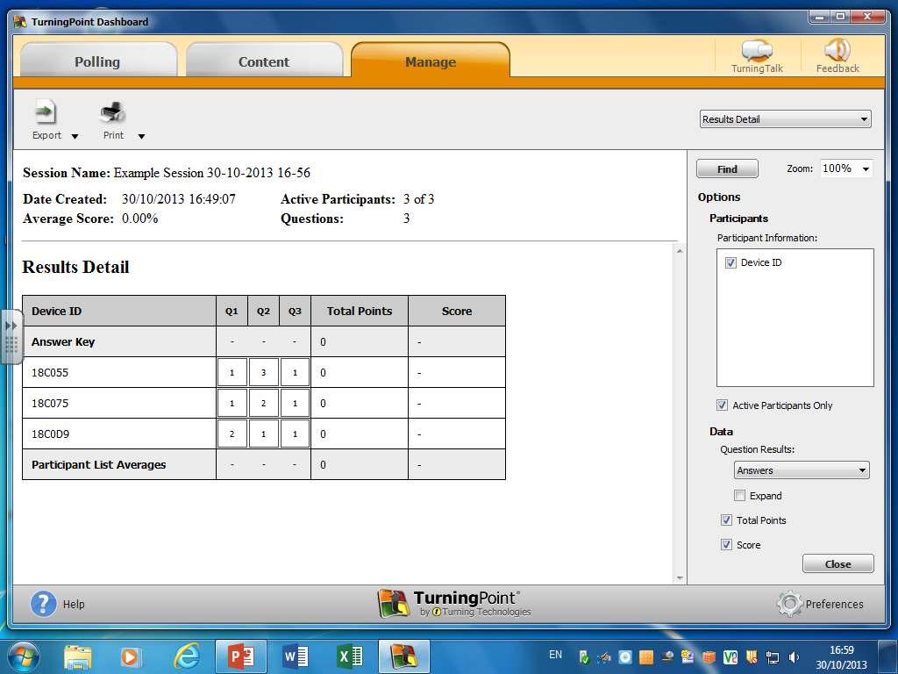
This is the Results Detail report, which shows how each zapper voted. Use the Export button to save this as an Excel file for further analysis.
Notes:
This is the Results Detail report, which shows how each zapper voted. Use the Export button to save this as an Excel file for further analysis.

Slide 24
Don’t forget to remove the receiver at the end of the session and replace it in the zapper case. These receivers are expensive to lose!
Notes:
Don’t forget to remove the receiver at the end of the session and replace it in the zapper case. These receivers are expensive to lose!

