Slide 1
How to vote using ResponseWare
Open the web browser on your phone/tablet/laptop
Go to www.responseware.eu
Type in the Session ID and click Join
You can now answer on-screen questions
OR download the free ResponseWare app:
Apple iOS – from the iTunes store
Android – from the Google Play store
You must select the European Region in the app’s Settings – the default is North America.

Slide 2
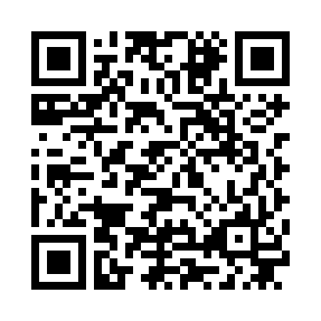
ResponseWare QR code
If you know how to use QR codes, use your phone camera to access the ResponseWare server www.responseware.eu

