Slide 1
Semantic Web in Depth
Web Ontology Language (OWL)
Dr Nicholas Gibbins - nmg@ecs.soton.ac.uk
2012-2013

Slide 2
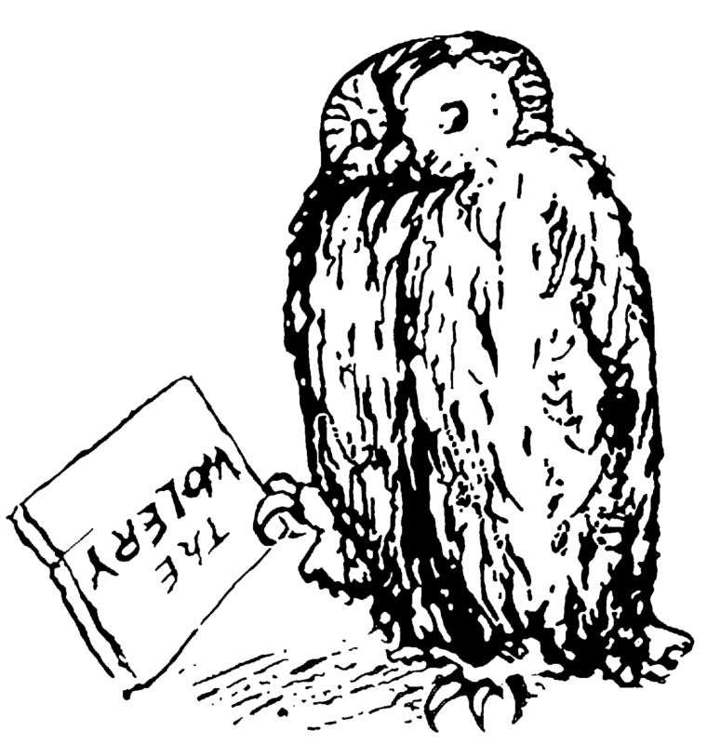
Introducing OWL
For many, RDF Schema is a sufficiently expressive ontology language
However, there are use cases which require a more expressive formalism:
Instance classification
Consistency checking
Subsumption reasoning

Slide 3
OWL Feature Summary
Necessary and sufficient conditions for class membership
Property restrictions
Local range, cardinality, value constraints
Equivalence and identity relations
Property characteristics
Transitive, symmetric, functional
Complex classes
Set operators, enumerated classes, disjoint classes

Slide 4
OWL Versions
Two versions of OWL:
OWL 1.0 (became Recommendation on 10 Feb 2004)
OWL 2 (became Recommendation on 29 Oct 2009)
OWL 2 is more expressive than OWL 1.0, and takes advantage of developments in DL reasoning techniques in the intervening time
We will initially concentrate on OWL 1.0

Slide 5
OWL 1.0 Species
Different subsets of OWL features give rise to the following sublanguages (colloquially known as species):
OWL Lite
OWL DL
OWL Full
“There is a tradeoff between the expressiveness of a representation language and the difficulty of reasoning over the representations built using that language.”
Brachman, R. J., and H. J. Levesque. (1984). The tractability of subsumption in frame-based description languages. In Proceedings of the 4th National Conference of the American Association for Artificial Intelligence (AAAI-84). Austin, TX, pp. 34-37.

Slide 6
OWL 1.0 Species
OWL Full
Increasing
expressivity
OWL DL
Increasing
complexity
OWL Lite
RDF(S)

Slide 7
OWL Lite
Description Logic-based
SHIF(D)
Less complex reasoning at the expense of less expressive language
No enumerated classes, set operators, or disjoint classes
Restricted cardinality restrictions (values of 0 or 1 – required, permitted and excluded)
No value restrictions
equivalentClass/subClassOf cannot be applied to class expressions

Slide 8
OWL DL
Description Logic-based
SHOIN(D)
Complete and decidable
Higher worst-case complexity than OWL Lite
Supports all OWL constructs, with some restrictions
Properties that take datatype values cannot be marked as inverse functional
Classes, properties, individuals and datatype values are disjoint

Slide 9
OWL Full
No restrictions on use of language constructs
All OWL DL and RDFS constructs
Potentially undecidable

Slide 10
OWL 1.0 Features and Syntax

Slide 11
Ontology header
Ontology header for metadata
<owl:Ontology rdf:about=“”> <owl:versionInfo>1.4</owl:versionInfo> <rdfs:comment>An example ontology</rdfs:comment> <owl:imports
rdf:resource="http://www.example.org/base"/> </owl:Ontology>

Slide 12
Versioning support
Version properties used in the ontology header
owl:versionInfo
Version number, etc
owl:priorVersion
Indicates that an ontology is a previous version of this
owl:backwardCompatibleWith
Indicates that the specified ontology is a previous version of this one, and that this is compatible with it
owl:incompatibleWith
Indicates that the specified ontology is a previous version of this one, but that this is incompatible with it

Slide 13
Versioning support
Classes and properties may be marked as deprecated
owl:DeprecatedClass
owl:DeprecatedProperty

Slide 14
OWL class types
owl:Class
Distinct from rdfs:Class – needed for OWL Lite/DL
owl:Thing (⊤)
The class that includes everything
owl:Nothing (⊥)
The empty class

Slide 15
OWL property types
owl:ObjectProperty
The class of resource-valued properties
owl:DatatypeProperty
The class of literal-valued properties
owl:AnnotationProperty
Used to type properties which annotate classes and properties (needed for OWL Lite/DL)

Slide 16
OWL versus RDF Schema
Recall that the semantics of a description logic is specified by interpretation functions which map:
Instances to members of the domain of discourse
Classes to subsets of the domain of discourse
Properties to sets of pairs drawn from the domain of discourse
Reflexive definitions of RDF Schema means that some resources are treated as both classes and instances, or instances and properties

Slide 17
OWL versus RDF Schema
Ambiguous semantics for these resources
Can’t tell from context whether they’re instances or classes
Can’t select the appropriate interpretation function
The introduction of owl:Class, owl:ObjectProperty and owl:DatatypeProperty eliminates this ambiguity

Slide 18
OWL’s Dirty Secret
OWL Full
OWL DL
OWL Lite
RDF(S)

Slide 19
OWL’s Dirty Secret Uncovered
OWL Full
OWL DL
OWL Lite
RDF(S)
RDF(S)’

Slide 20
OWL restrictions
Class expression formed by constraints on properties
Local cardinality constraints
≤ n R, ≥ n R, = n R
Local range constraints
∃R.C, ∀R.C
Local value constraints
∃R.{x}
Key concept in OWL

Slide 21
OWL restriction format
<owl:Restriction> <owl:onProperty rdf:resource=“property”/> constraint expression </owl:Restriction>

Slide 22
Local cardinality constraints
Defines a class based on the number of values taken by a property
owl:minCardinality (≥ n R)
“property R has at least n values”
owl:maxCardinality (≤ n R)
“property R has at most n values”
owl:cardinality (= n R)
“property R has exactly n values”
OWL Lite has restricted cardinalities

Slide 23
Local cardinality constraint example
Single malt whiskies are whiskies which are distilled by one and only one thing
<owl:Class rdf:about=“#SingleMaltWhisky”>
<owl:equivalentClass>
<owl:Class>
<owl:intersectionOf rdf:parseType="Collection"> <owl:Class rdf:about=“#Whisky”/> <owl:Restriction> <owl:onProperty rdf:resource=“#distilledBy”/> <owl:cardinality>1</owl:cardinality> </owl:Restriction> </owl:intersectionOf>
<owl:Class>
</owl:equivalentClass> </owl:Class>

Slide 24
Local range constraints
Defines a class based on the type of property values
Distinct from global range constraint (rdfs:range) in RDF Schema
owl:someValuesFrom (∃R.C)
“there exists a value for property R of type C”
owl:allValuesFrom (∀R.C)
“property R has only values of type C”
Can only be used with named classes or datatypes in OWL Lite

Slide 25
Local range constraint example
Carnivores are things which eat some things which are animals (∃eats.Animal)
<owl:Class rdf:about=“#Carnivore”> <owl:equivalentClass> <owl:Restriction> <owl:onProperty rdf:resource=“#eats”/> <owl:someValuesFrom rdf:resource=“#Animal”/> </owl:Restriction> </owl:equivalentClass> </owl:Class>

Slide 26
Local range constraint example
Vegetarians are things which eat only things which are plants (∀eats.Plant)
<owl:Class rdf:about=“#Vegetarian”> <owl:equivalentClass> <owl:Restriction> <owl:onProperty rdf:resource=“#eats”/> <owl:allValuesFrom rdf:resource=“#Plant”/> </owl:Restriction> </owl:equivalentClass> </owl:Class>

Slide 27
Local value constraints
Defines a class based on the existence of a particular property value
owl:hasValue (∃R.{x})
“property R has a value which is X”
Cannot be used in OWL Lite

Slide 28
Local value constraint example
Green things are things which are coloured green
(∃ R. { Green })
<owl:Class rdf:about=“#GreenThing”> <owl:equivalentClass> <owl:Restriction> <owl:onProperty rdf:resource=“#hasColour”/> <owl:hasValue rdf:resource=“#Green”/> </owl:Restriction> </owl:equivalentClass> </owl:Class>

Slide 29
Set constructors
owl:intersectionOf (C ⊓ D)
owl:unionOf (C ⊔ D)
owl:complementOf (¬ C)
Restrictions on use with OWL Lite
owl:unionOf and owl:complementOf cannot be used
owl:intersectionOf can be used with named classes (not bNodes) and OWL restrictions only

Slide 30
Set constructors example
<owl:Class rdf:about=“GreenApple”>
<owl:equivalentClass>
<owl:Class>
<owl:intersectionOf rdf:parseType=“Collection”>
<owl:Class rdf:about=“Apple”>
<owl:Restriction>
<owl:onProperty rdf:resource=“hasColor”/>
<owl:hasValue rdf:resource=“Green”/>
</owl:Restriction>
</owl:intersectionOf>
</owl:Class>
</owl:equivalentClass>
</owl:Class>

Slide 31
Equivalence and identity relations
Useful for ontology mapping
owl:sameAs
owl:equivalentClass (C≡D)
owl:equivalentProperty (R≡S)
<owl:Thing rdf:about=“#MorningStar”> <owl:sameAs rdf:resource=“#EveningStar”/> </owl:Thing>

Slide 32
Non-equivalence relations
owl:differentFrom
Can be used to specify a limited unique name assumption
OWL (and DLs in general) make the Open World Assumption
Knowledge of world is incomplete
If something cannot be proven true, then it isn’t assumed to be false
<rdf:Description rdf:about=“#HarryCorbett”> <owl:differentFrom rdf:resource=“#HarryHCorbett”/> </rdf:Description>

Slide 33
Non-equivalence relations
owl:AllDifferent and owl:distinctMembers
Used to specify a group of mutually distinct individuals
<owl:AllDifferent>
<owl:distinctMembers rdf:parseType=“Collection”>
<rdf:Description rdf:about=“#John”/>
<rdf:Description rdf:about=“#Paul”/>
<rdf:Description rdf:about=“#George”/>
<rdf:Description rdf:about=“#Ringo”/>
</owl:distinctMembers>
</owl:AllDifferent>

Slide 34
Necessary Class Definitions
Primitive / partial classes (⊑)
“If we know that something is a X, then it must fulfill the conditions...”
Defined using rdfs:subClassOf

Slide 35
Necessary and Sufficient Class Definitions
Defined / complete classes (≡)
“If something fulfills the conditions..., then it is an X."
Defined using owl:equivalentClass

Slide 36
Property types - Inverse
Defines a property as the inverse of another property
(R ≡ S⁻)
<owl:ObjectProperty rdf:about=“#hasAuthor”>
<owl:inverseOf rdf:resource=“#wrote”/>
</owl:ObjectProperty>

Slide 37
Property types - Symmetric
Symmetric properties satisfy the axiom
P(x,y) iff P(y,x)
<owl:SymmetricProperty rdf:about=“#hasSibling”/>

Slide 38
Property types – Transitive
Transitive properties satisfy the axiom
P(x,y) and P(y,z) implies P(x,z)
<owl:TransitiveProperty rdf:about=“#hasAncestor”/>

Slide 39
Property types – Functional
Functional properties satisfy the axiom
P(x,y) and P(x,z) implies y=z
(everyone has only one NI number)
<owl:FunctionalProperty rdf:about=“#hasNINumber”/>

Slide 40
Property types – Inverse Functional
Inverse functional properties satisfy the axiom
P(y,x) and P(z,x) implies y=z
(people with the same NI number are the same person)
Cannot be used with owl:DatatypeProperty in OWL Lite/DL
<owl:InverseFunctionalProperty rdf:about=“#hasNINumber”/>

Slide 41
Disjoint classes
owl:disjointWith
members of one class cannot also be members of some specified other class
Cannot be used in OWL Lite
<owl:Class rdf:about=“#MaleHuman”>
<rdfs:subClassOf rdf:resource=“#Human”/>
<owl:disjointWith rdf:resource=“#FemaleHuman”/>
</owl:Class>

Slide 42
Enumerated classes
Defines a class as a direct enumeration of its members
owl:one of (C ≡ {a,b,c})
Cannot be extended (closed set)
Cannot be used in OWL Lite

Slide 43
Enumerated classes example
<owl:Class rdf:about=“#Continents”>
<owl:oneOf rdf:parseType=“Collection”>
<owl:Thing rdf:about=“#Africa”/>
<owl:Thing rdf:about=“#Antarctica”/>
<owl:Thing rdf:about=“#Oceania”/>
<owl:Thing rdf:about=“#Europe”/>
<owl:Thing rdf:about=“#North-America”/>
<owl:Thing rdf:about=“#South-America”/>
<owl:Thing rdf:about=“#Asia”/>
</owl:oneOf>
</owl:Class>

Slide 44
Ontology modularisation
owl:imports mechanism for including other ontologies
Also possible to use terms from other ontologies without explicitly importing them
Importing requires certain entailments, whereas simple use does not require (but also does not prevent) those entailments

Slide 45
Ontology modularisation example
Ontology 1 (ont1) contains: BBB rdfs:subClassOf AAA
Ontology-2 (ont2) contains: ont2 imports ont1 CCC rdfs:subClassOf BBB
Ontology-2 must entail CCC rdfs:subClassOf AAA

Slide 46
Ontology modularisation example
Ontology 1 (ont1) contains: BBB rdfs:subClassOf AAA
Ontology-3 (ont3) contains: CCC rdfs:subClassOf ont1:BBB
Ontology-3 does not necessarily entail CCC rdfs:subClassOf ont1:AAA

Slide 47
OWL status
WebOnt working group formed Nov 2001
OWL Recommendations published in Feb 2004

Slide 48
OWL references
Web Ontology Working Group homepage
http://www.w3.org/2001/sw/WebOnt/

Slide 49
OWL 2

Slide 50
From OWL 1 to OWL 2
OWL 1 design based on contemporary understanding of techniques for decidable, sound and complete reasoning in description logics
Our understanding has improved since 2004
Some things that looked intractable have been shown to be possible

Slide 51
From OWL 1 to OWL 2
Changes between 1 and 2 fall into the following categories:
Syntactic sugar (making it easier to say things we could already say)
Constructs for increased expressivity
Datatype support
Metamodelling
Annotation

Slide 52
Syntactic Sugar: Disjoint Union
Allows us to define a class as the union of a number of other classes, all of which are pairwise disjoint
We’ll look at this modelling pattern more in later lectures

Slide 53
Syntactic Sugar: Disjoint Classes
OWL 1 lets us state that two classes are disjoint
OWL 2 lets us state that a set of classes are pairwise disjoint

Slide 54
Syntactic Sugar: Negative Property Assertions
OWL 1 lets us assert property values for an individual
OWL 2 lets us assert that an individual does not have a particular property value
<owl:NegativePropertyAssertion> <owl:sourceIndividual rdf:resource=“john”/> <owl:assertionProperty rdf:resource=“hasChild”/> <owl:targetIndividual rdf:resource=“susan”/> </owl:NegativePropertyAssertion>

Slide 55
New Constructs: Self Restriction
Define a class of individuals which are related to to themselves by a given property
<owl:Restriction> <owl:onProperty rdf:resource=“...”/> <owl:hasSelf rdf:datatype=“&xsd;boolean”>true</owl:hasSelf> </owl:Restriction>

Slide 56
New Constructs: Qualified Cardinality
OWL 1 lets us either specify the local range of a property, or the number of values taken by the property
OWL 2 lets us specify both together:
<owl:Restriction> <owl:onProperty rdf:resource=“hasPart”/> <owl:onClass rdf:resource=“Wheel”/> <owl:cardinality rdf:datatype=“&xsd;integer”>4</owl:cardinality> </owl:Restriction>
Similar construct for datatype properties

Slide 57
New Constructs: Reflexive Properties
Allows us to assert that a property is globally reflexive (relates every object to itself)
<owl:ReflexiveProperty rdf:about=“sameAgeAs”/>

Slide 58
New Constructs: Irreflexive Properties
Allows us to assert that a property relates no object to itself
<owl:IrreflexiveProperty rdf:about=“strictlyTallerThan”/>

Slide 59
New Constructs: Asymmetric Properties
Allows us to assert that a property is asymmetric:
If p(x,y), then not p(y,x)
<owl:AsymmetricProperty rdf:about=“strictlyTallerThan”/>

Slide 60
New Constructs: Disjoint Properties
Allows us to state that two individuals cannot be related to each other by two different properties that have been declared disjoint
<owl:ObjectProperty rdf:about=“connectedTo”> <owl:propertyDisjointWithrdf:resource=“contiguousWith”/> </owl:ObjectProperty>

Slide 61
New Constructs: Property Chain Inclusion
OWL 1 does not let us define a property as a composition of other properties
Example: hasUncle ≡ hasParent o hasBrother
OWL 2 lets us define such property compositions
<owl:ObjectProperty rdf:about=“hasUncle”> <owl:propertyChainAxiom rdf:parseType=“Collection”> <owl:ObjectProperty rdf:about=“hasParent”/> <owl:ObjectProperty rdf:about=“hasBrother”/> </owl:propertyChainAxiom> </owl:ObjectProperty>
Notes:
locatedIn ≡ part of o locatedIn

Slide 62
New Constructs: Keys
OWL 1 lets us define a property to be functional, so that individuals can be uniquely identified by values of that property
OWL 2 lets us define uniquely identifying keys that comprise several properties
<owl:Class rdf:about=“Person”> <owl:hasKey rdf:parseType=“Collection”> <owl:DatatypeProperty rdf:about=“hasSSN”/> <owl:DatatypeProperty rdf:about=“birthDate”/> </owl:hasKey> </owl:Class>

Slide 63
New Constructs: Datatype Restrictions
Allows us to define subsets of datatypes that constrain the range of values allowed by a datatype
For example, the datatype of integers greater than or equal to 5:
<owl:Datatype> <owl:onDatatype rdf:resource=“&xsd;integer”/> <owl:withRestrictions rdf:parseType=“Collection”> <xsd:minInclusive rdf:datatype=“&xsd;integer”>5</xsd:minInclusive> </owl:withRestrictions> </owl:Datatype>

Slide 64
Metamodelling: Punning
OWL 1 required the names used to identify classes, properties, individuals and datatypes to be disjoint
OWL 2 relaxes this
The same name (URI) can be used for both a class and an individual
However:
A name cannot be used for both a class and a datatype
A name cannot be used for more than one type of property (DataProperty vs ObjectProperty)

Slide 65
Language Profiles
OWL 1 has three dialects: OWL Lite, OWL DL and OWL Full
OWL 2 introduces three profiles with useful computational properties (reasoning, conjunctive queries):
OWL 2 EL (PTIME-complete, PSPACE-complete)
OWL 2 QL (NLOGSPACE-complete, NP-complete)
OWL 2 RL (PTIME-complete, NP-complete)
OWL 1 DL (NEXPTIME-complete, decidability open)

Slide 66
OWL2 references
OWL 2 New Features and Rationale
http://www.w3.org/TR/owl2-new-features/
OWL2 Primer
http://www.w3.org/TR/owl2-primer/

Slide 67
Manchester DL Syntax

Slide 68
A Plethora of Syntaxes
The DL syntax we’ve used so far is a ‘traditional’ syntax for logical expressions
Not well understood by non-logicians
The Manchester DL syntax was introduced as a more user-friendly syntax for use in tools
Used in Protégé 4 – the subject of our next lecture

Slide 69
Manchester Syntax Summary
Traditional DL Syntax | Manchester Syntax
 | C and D
 | C or D
 | not C
 | R some C
 | R only C
 | R min n
 | R max n
 | R exactly n
 | R value x
 | R min n C
Reflexive property | R Self
Datatype restrictions | int[>=2, <=15]

Slide 70
Further Reading
OWL2 Manchester Syntax
http://www.w3.org/TR/owl2-manchester-syntax/

Slide 71
The Protégé Ontology Editor

Slide 72
Protégé
Leading open source ontology editor
Download from http://protege.stanford.edu/
Early implementer of OWL (but was around before OWL)
Thriving user community
Annual user conference
Many third party plugins for visualisation, etc
Version 4.1 strongly recommended for coursework!

Slide 73
Protégé and DL Reasoners
Protégé integrates reasoning into the ontology design process
Checks your ontology for consistency, subsumption, etc
Uses DIG interface to communicate with the reasoner
Pellet
http://pellet.owldl.com/
FaCT++
http://owl.man.ac.uk/factplusplus/

Slide 74
ESSENTIAL READING!
Horridge et al, A Practical Guide to Building OWL Ontologies using the Protégé-OWL Plugin and CO-ODE Tools, 2009
http://owl.cs.manchester.ac.uk/tutorials/protegeowltutorial/

Slide 75
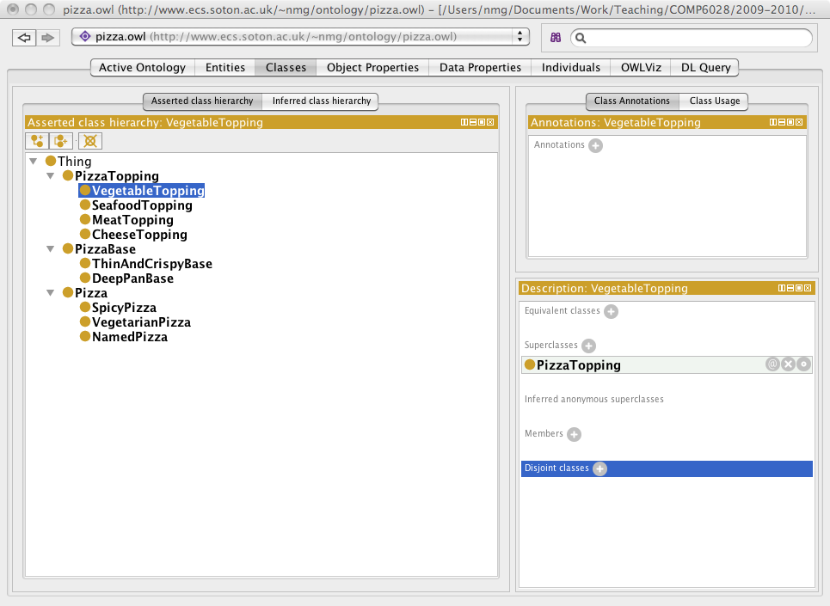

Slide 76
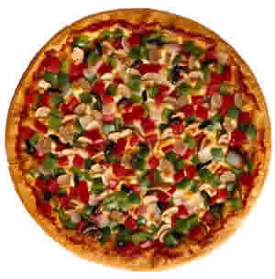
Example ontology: OWL Pizzas
Build an ontology for describing pizzas and their ingredients
Must be able to determine whether pizzas are vegetarian, spicy, etc

