Slide 1
IP and Networking Basics
Selection of slides taken from Internet Society Workshop Resource Centre:
http://ws.edu.isoc.org/data/2010/15678359774b67528c8924a/lecture-01-mon-tue-addressing-ios.pdf

Slide 2
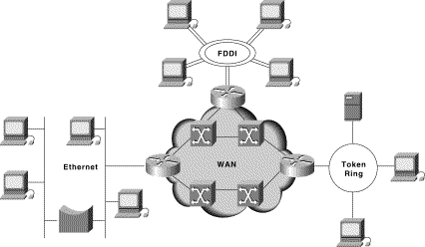
A small internetwork or (small “i”) “internet”

Slide 3
The principle of “Internetworking”
We have lots of little networks
Many different owners/operators
Many different types
  Ethernet, dedicated leased lines, dialup, optical, broadband, wireless, ...
Each type has its own idea of low level addressing and protocols
We want to connect them all together and provide a unified view of the whole lot (treat the collection of networks as a single large internetwork)‏

Slide 4
What’s the Internet: “nuts and bolts” view
millions of connected computing devices: hosts, end-systems
  PC’s workstations, servers
  PDA’s phones, toasters
  running network apps
communication links
  fiber, copper, radio, satellite
routers: forward packets (chunks) of data through network
router
workstation
server
mobile
local ISP
regional ISP
company
network

Slide 5
What’s the Internet: “nuts and bolts” view
protocols: control sending, receiving of messages
  e.g., TCP, IP, HTTP, FTP, PPP
Internet: “network of networks”
  loosely hierarchical
  public Internet versus private intranet
Internet standards
  RFC: Request for comments
  IETF: Internet Engineering Task Force
router
workstation
server
mobile
local ISP
regional ISP
company
network

Slide 6
What’s the Internet: a service view
communication infrastructure enables distributed applications:
  WWW, email, games,
  e-commerce, database,
  e-voting, more?
communication services provided:
  connectionless
  connection-oriented
router
workstation
server
mobile
local ISP
regional ISP
company
network

Slide 7
The OSI Model
Application
7
Presentation
Upper Layers
Application oriented
“End-to-End”-Layers
6
Session
5
Transport
4
Network
3
Lower Layers
Network oriented
“Hop-by-hop” layers
Data Link
2
Physical
1

Slide 8
Why layering?
Dealing with complex systems:
explicit structure allows identification, relationship of complex system’s pieces
  layered reference model for discussion
modularization eases maintenance, updating of system
  change of implementation of layer’s service transparent to rest of system
  e.g., change in gate procedure does not affect rest of system

Slide 9
The IP Hourglass Model
Application layer
SMTP
HTTP
FTP
Telnet
DNS
Audio
Video
TCP
UDP
RTP
Transport layer
IP
Network layer
Ethernet
PPP
ATM
Optics
ADSL
Satellite
3G
Physical and Data link layer

Slide 10
Layer Interaction:
TCP/IP Model
End to end
Application
Application
TCP or UDP
TCP or UDP
IP
IP
IP
IP
Hop by hop
Link
Link
Link
Link
Link
Link
Physical
Physical
Physical
Host
Router
Router
Host

Slide 11
End-to-end layers
Upper layers are “end-to-end”
Applications at the two ends behave as if they can talk directly to each other
They do not concern themselves with the details of what happens in between

Slide 12
Hop-by-hop layers
At the lower layers, devices share access to the same physical medium
Devices communicate directly with each other
The network layer (IP) has some knowledge of how many small networks are interconnected to make a large internet
Information moves one hop at a time, getting closer to the destination at each hop

Slide 13
Layer Interaction:
TCP/IP Model
Application
Application
TCP or UDP
TCP or UDP
IP
IP
IP
IP
Link
Link
Link
Link
Link
Link
Physical
Physical
Physical
Host
Router
Router
Host

Slide 14
Layer Interaction:
The Application Layer
Applications behave as if they can talk to each other, but in reality the application at each side talks to the TCP or UDP service below it.
Application
Application
TCP or UDP
TCP or UDP
The application layer doesn't care about what happens at the lower layers, provided the transport layer carries the application's data safely from end to end.
IP
IP
IP
IP
Link
Link
Link
Link
Link
Link
Physical
Physical
Physical
Host
Router
Router
Host

Slide 15
Layer Interaction:
The Transport Layer
The transport layer instances at the two ends act as if they are talking to each other, but in reality they are each talking to the IP layer below it. The transport layer doesn't care about what the application layer is doing above it.
Application
Application
TCP or UDP
TCP or UDP
IP
IP
IP
IP
The transport layer doesn't care what happens in the IP layer or below, as long as the IP layer can move datagrams from one side to the other.
Link
Link
Link
Link
Link
Link
Physical
Physical
Physical
Host
Router
Router
Host

Slide 16
Layer Interaction:
The Network Layer (IP)
The IP layer has to know a lot about the topology of the network (which host is connected to which router, which routers are connected to each other), but it doesn't care about what happens at the upper layers.
Application
Application
TCP or UDP
TCP or UDP
IP
IP
IP
IP
The IP layer works forwards messages hop by hop from one side to the other side.
Link
Link
Link
Link
Link
Link
Physical
Physical
Physical
Host
Router
Router
Host

Slide 17
Layer Interaction:
Link and Physical Layers
The link layer doesn't care what happens above it, but it is very closely tied to the physical layer below it.
All links are independent of each other, and have no way of communicating with each other.
Application
Application
TCP or UDP
TCP or UDP
IP
IP
IP
IP
Link
Link
Link
Link
Link
Link
Physical
Physical
Physical
Host
Router
Router
Host

Slide 18
Layering: physical communication
data
application
transport
network
link
physical
network
link
physical
application
transport
network
link
physical
data
application
transport
network
link
physical
application
transport
network
link
physical

Slide 19
Frame, Datagram, Segment, Packet
Different names for packets at different layers
  Ethernet (link layer) frame
  IP (network layer) datagram
  TCP (transport layer) segment
Terminology is not strictly followed
  we often just use the term “packet” at any layer

Slide 20
Encapsulation & Decapsulation
Lower layers add headers (and sometimes trailers) to data from higher layers
Application
Data
Transport
Header
Transport Layer Data
Network
Header
Network Layer Data
Network
Header
Header
Data
Data Link
Header
Link Layer Data
Trailer
Data Link
Header
Header
Header
Data
Trailer

Slide 21
Layer 2 - Ethernet frame
Preamble
Dest
Source
Type
Data
CRC
6 bytes
6 bytes
2 bytes
46 to 1500 bytes
4 bytes
Destination and source are 48-bit MAC addresses (e.g., 00:26:4a:18:f6:aa)
Type 0x0800 means that the “data” portion of the Ethernet frame contains an IPv4 datagram. Type 0x0806 for ARP. Type 0x86DD for IPv6.
“Data” part of layer 2 frame contains a layer 3 datagram.

Slide 22
Layer 3 - IPv4 datagram
Version
IHL
Differentiated Services
Total Length
Identification
Flags
Fragment Offset
Time to Live
Protocol
Header Checksum
Source Address (32-bit IPv4 address)‏
Destination Address (32-bit IPv4 address)‏
Options
Padding
Data (contains layer 4 segment)‏
Version = 4
If no options, IHL = 5
Source and Destination are 32-bit IPv4 addresses
Protocol = 6 means data portion contains a TCP segment. Protocol = 17 means UDP.

Slide 23
Basic Structure of an IPv4 Address
32 bit number (4 octet number):
(e.g. 133.27.162.125)‏
Decimal Representation:
Binary Representation:
Hexadecimal Representation:
133
27
162
125
10000101
00011011
10100010
01111101
85
1B
A2
7D

Slide 24
Layer 4 - TCP segment
Source Port
Destination Port
Sequence Number
Acknowledgement Number
Data Offset
Reserved
URG
ACK
EOL
RST
SYN
FIN
Window
Checksum
Urgent Pointer
Options
Padding
Data (contains application data)‏
Source and Destination are 16-bit TCP port numbers (IP addresses are implied by the IP header)‏
If no options, Data Offset = 5 (which means 20 octets)‏

Slide 25
The need for Packet Forwarding
Many small networks can be interconnected to make a larger internetwork
A device on one network cannot send a packet directly to a device on another network
The packet has to be forwarded from one network to another, through intermediate nodes, until it reaches its destination
The intermediate nodes are called “routers”

Slide 26
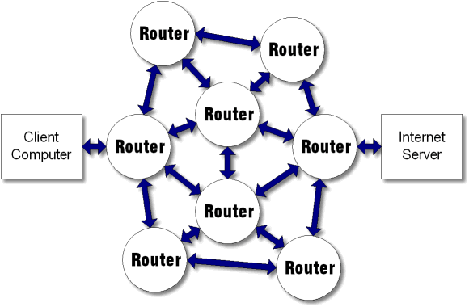
Hop by Hop Forwarding

