Slide 1
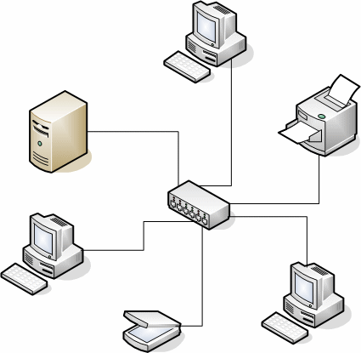
Network Systems
Introduction:
In this PowerPoint I will explain a variety of different network types and how they communicate to specific network standards and protocols.

Slide 2
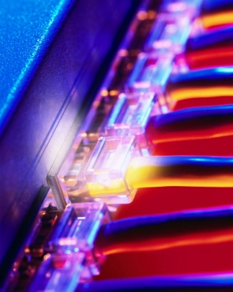
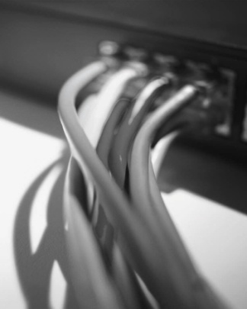
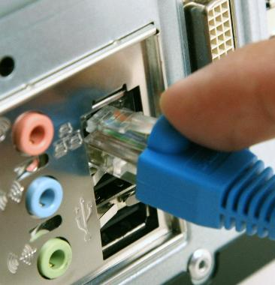
Network Types
Local Area Network (LAN):
A local area network (LAN) is a computer network covering a small physical area, it is commonly used in place such as homes, offices, or small group of buildings, like schools, or an airports. The unique properties of a LAN, is the contrast to wide-area networks (WANs), include their usually higher data-transfer rates, smaller geographic range, and lack of a need for leased telecommunication lines.
Wide Area Network (WAN):
Wide Area Network (WAN) is a computer network that covers a large area for example any network whose communications links cross metropolitan, regional, or national boundaries. In comparison to other network types including personal area networks (PANs), local area networks (LANs), or metropolitan area networks (MANs), WANs are not limited to a room, building, or specific metropolitan area like a county. The largest and most recognized example of a WAN is the Internet.
Value Added Network (VAN):
A Value-added Network (VAN) is a hosted service offering that acts as an go-between between business associates giving out standards based responsibilities and liabilities that relate to the profits of the business. A service such as this is referred to as "Value-added Network Service".

Slide 3
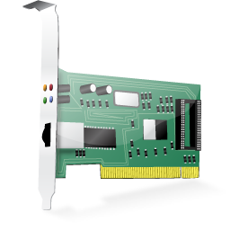
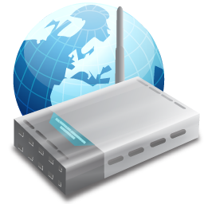
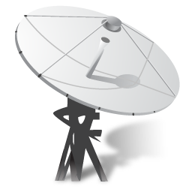
Technologies
Frame Relay:
A frame relay is used at the core of the WAN, where all traffic is directed from system to system. A frame relay is a packet switched network structure and can be configured to enable multiple systems to communicate on the same structure without any direct communication. This is accomplished by ensuring that every connection in the frame relay system is connected in a mesh and configuring the equipment to create the logical structure required for the customer.
ISDN:
ISDN (integrated switched digital network) is an older circuit switched network system. It is still found in older ‘legacy’ systems as well as areas not yet accessed by broadband and ADSL technology. The standards for ISDN differ in Europe and the USA. ISDN was the first solution used to attempt to bypass limitations set by the public telephone system to data transmission in the 1980s.
ATM:
ATM (asynchronous transfer mode) has many similarities to frame relay as a WAN-based packet switched network system. Its principal difference is the size of the packets (units of traffic) sent. In ATM, the packets are called cells and the data size is considerable smaller than most systems. This offers the advantage of speed, reliability and reduction in jitter (staggered loss of data), which affects voice communication systems such as Skype.

Slide 4
Logical and Physical Topologies
Logical and physical topologies are terms used to describe the layout of a network and its capability. Different networks suit different situations and this is why it is helpful to understand the commonly used ones.
Star:
With a central core to the system, all the nodes of the network are directly connected. The star also comes as an extended star where one of the nodes acts as the core of another star. As a logical structure, it is closely related to the switch structure on a bus network. The advantages of using this network is its easy to ad new nodes and if one node fails then the network is not effected. But if the core node fails the entire system fails.
Bus:
Bus networks use a common backbone to connect all devices. The backbone is a high capacity communications medium that joins networks and central network devices on the same floor in a building. A single cable functions as a shared communication line, that devices attach or tap into with an interface connector. A device wanting to communicate with another device on the network sends a broadcast message onto the wire that all other devices see, but only the intended recipient actually accepts and processes the message.
Ring:
The Ring network configuration is where each network computer and device are connected to each other forming a large circle (or similar shape). Each packet is sent around the ring until it reaches its final destination. An advantage of this configuration is if one node goes down packets can still be sent around the network.
Mesh:
Mesh networking is a way to route data, voice and instructions between nodes. It allows for continuous connections and reconfiguration around broken or blocked paths by “hopping” from node to node until the destination is reached. A mesh network whose nodes are all connected to each other is a fully connected network. Mesh networks differ from other networks in that the component parts can all connect to each other via multiple hops, and they generally are not mobile. Mesh networks can be seen as one type of ad hoc network.

Slide 5
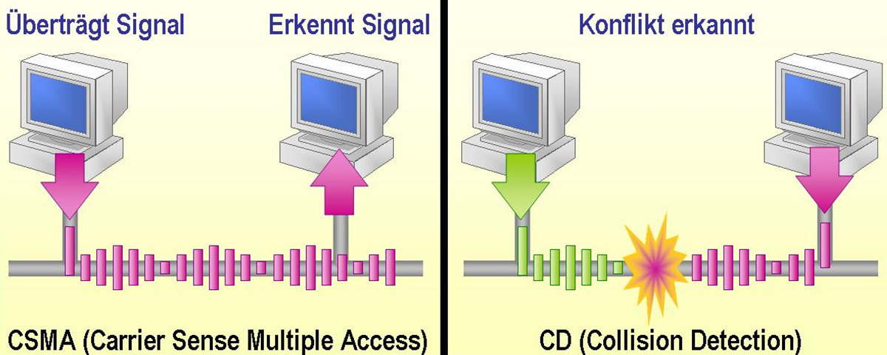
Network Access Methods
A network is a highly competitive environment because for a device to send data, it must find an open time slice. Token ring networks solve this problem by each device on the system waiting its turn to communicate fairly. When the device has received the token, it can send data. The problem arises when there are big talkers on the system that need more network time.
Ethernet overcomes the big talker problem with a best effort solution. Each device on the system can send data as and when it sees fit. The problem with this occurs when two devices contest for the same service there is a collision that prevents either of the data packets from being sent.
To overcome this annoyance it is recommend to use CSMA/CD a process that is perform when using Ethernet.
CSMA/CD:
CSMA/CD (Carrier Sense Multiple Access and Collision Detection) is commonly referred to as the back off algorithm and is applied by all devices on the system. Unless the network is too busy, the reattempt is normally successful.
CSMA/CA:
CSMA/CA (Carrier Sense Multiple Access and Collision Avoidance) is a alteration of the CSMA/CA, which is based on the detection of the signal before any data packets are sent. CSMA/CA is commonly used in wireless network systems. With more homes and businesses using wireless routers in today's world collisions are becoming an increasingly bigger issue as each network contends for a channel on the network.
http://www.telematik-shop.ch/images/CSMA_CD.png

Slide 6
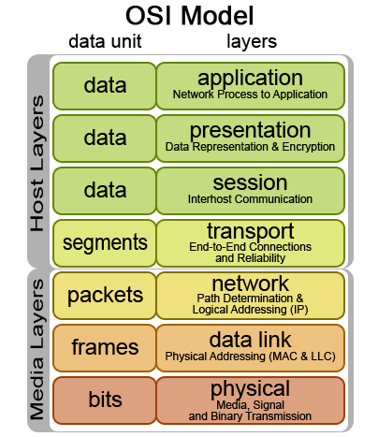
OSI 7 Layer Model
The Open Systems Interconnection Reference Model (OSI Model) is an conceptual description for layered communications and computer network protocol design. It was developed as part of the Open Systems Interconnection (OSI) plan. In its most basic form, it separates network architecture into seven layers which, from top to bottom, are the Application, Presentation, Session, Transport, Network, Data-Link, and Physical Layers. It is therefore often referred to as the OSI Seven Layer Model.
A individual layer is a collection of supposedly similar functions that provide services to the layer above it and receives service from the layer below it. For example, a layer that provides error-free communications across a network provides the path needed by applications above it, while it calls the next lower layer to send and receive packets that make up the contents of the path.
Choosing a Network System:
Selecting a network to meet a businesses need relies on:
The technical skills of those who are expected to support and maintain the system
What current technologies and architecture are available and the business can afford.
The region that the network will be introduced to, such as whether the current technology is compatible.
Overall cost to purchases and maintain the system.
http://home.earthlink.net/~tt4titans/sitebuildercontent/sitebuilderpictures/osi-model.jpg

Slide 7
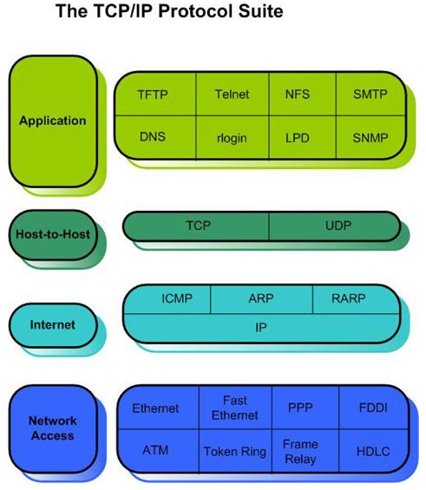
Network Protocols and Standards
For any device on a network to communicate, the system and each device must use a range of protocols. This ensures that communications is consistent and reliable for instance each protocol is used for different purpose depending on what data packets need to be transmitted.
TCP/IP:
Internet development was based on the standards of TCP/IP four-layer model and gained popularity because of its various protocols. This specific protocol is common used on LANs.
AppleTalk and IPX/SPX:
AppleTalk and IPX/SPX are historical protocol suites which lost the battle to the more dominant TCP/IP protocol suite. Some old systems still have to use these protocols for legacy restrictions, normally when there is an application or device which requires the use of these older protocols.
LAN standards:
The IEEE (Institute of Electrical and Electronic Engineers) maintains the LAN standards for communication at layer 2 of the OSI model. These are referred to as 802.2, 802.3, and 802.5.
802.2:
Manages Ethernet data packets and the link to the upper and lower halves of the OSI model.
802.3:
Is the bulk of the MAC addressing on a network card and data packet collision detection over a variety of different speeds and formats.
802.5
Manages the vital token passing of the token on a ring network layout.
http://www.trainsignaltraining.com/wpnew/wp-content/uploads/2007/10/TCP__OSI___Stelios/2_TCPI P_Protocol_Suite.jpg

Slide 8






Application Layer Protocols
When the internet is used for the purposes of sending an email, using a browser, or a variety of other different tasks different protocols are used to transfer the data. There are commonly know as application layer protocols. These protocols include the following:
HTTP (Hypertext Transfer Protocol):
Is used for retrieving inter-linked resources led to the establishment of the World Wide Web. Such as common web pages.
FTP (File Transfer Protocol):
Is a file transfer protocol for sharing and manipulating files over a TCP computer network. An FTP client may connect to an FTP server to manipulate files on that server. These can range from any format but it is most commonly used to manage web pages as well as edit them.
SMTP (Simple Mail Transfer Protocol):
Is used strictly for email services which require the ability to send strings of text from one computer to another.
Notes:
By: Joshua Barnett

Slide 9
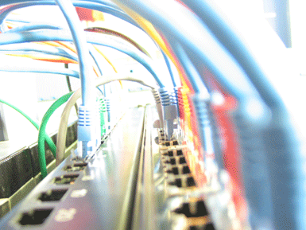
Networking Hardware & Software
A network is not simply the infrastructure and protocols that move the data around the system. The network offers many services, with specialist devices accessing and supporting the network

Slide 10
Network Devices
Workstations:
The workstation is the most commonly found device on a network infrastructure, whatever the size. The sole purpose of a network is to enable the user to access its wide range of services via a workstation.
In the last ten years the term work station has changed its definition, as new technologies are blurring what can be used on a network infrastructure. In its purest form, a workstation is a computer/terminal which enables you to access the network and the services it offers. Now, a workstation can range from a laptop to a small handheld device such as a PDA or mobile phone.
Servers:
A server is a specialist computer system that is designed to offer a dedicated service to other workstations and other servers on a network. Some of the server types you may encounter are:
Web Servers for the distribution of data, communication and e-commerce.
Email communication servers.
Servers for the management and maintenance of shard printing services, to centralise control, reduce printer investment and output costs for an organisation.
Servers for central management and storage of files and data.
Security Servers with the use of a proxy or firewall to prevent or limit internet access.
Network Addressing Servers including DNS and DHCP.
Chat discussion and conference servers.
Game clan management severs, for voice communication or IM.
To operate, most servers require considerable better hardware than a typical workstation. It is considered normal for most servers to have more memory, a large hard drive system and multi-core processor which are supported by the motherboard.

Slide 11
Network Devices
Network Interface Card (NIC):
To use the services of a network, the workstation will use a network interface card (NIC) and an operating system which may be XP, Vista or Linux, or may be a dedicated operating system like those found in some mobile phones, to communicate with the network and the protocols in operation.
The NIC’s sole purpose is to provide a workstation with network connectivity. The type of NIC will vary with the network topology and media type in use:
UTP network cards automatically detect the network speed, e.g. as 10 Mbps, 100 Mbps and 1000Mpbs.
Wireless adapters for 802.11a, b or g systems.
Bluetooth transceivers.
Fibre optic network cards.
External network adapters which can be plugged in via USB.
On board network adapters.
Features and functions:
A network is often designed and managed for a purpose; it could be high reliability and bandwidth for telecommunications or video, or robust data lines with backup services for critical data with many servers running backup technologies. How a network is implemented depends on the business needs of the organisation supporting it.

Slide 12
Interconnection Devices
To enable our computers and networks to communicate with each other, a wide range of interconnection devices are used according to the communication system and whether it is a WAN or LAN connection.
Modems:
The modern is among the oldest interconnection devices, enabling communication over a conventional telephone system. The term modem comes from modulator, demodulator, which describes the communication task it has to complete. While seldom used as a primary communication device in the age of broadband and ADSL, the modem is popular as a backup device to gain access to routers on systems which have communication issues, Modems are also popular in remote or underdeveloped locations with older phone exchanges.
Modems use a variety of technologies to assist and improve their communication. All modems an offer asynchronous and synchronous communication. For dial-up Internet connection, the transmission will be a timed and managed synchronised signal, where blocks of data will be sent and received via the ISP (Internet Service Provider). Modems offer asynchronous transmission to remote systems that require a permanent immediate connection. This may be a critical system which is found in some building security products, where the modems will contact a control room and feed all video, fire and alarm signals.
Wireless access points:
Wireless access points are also hubs but with a different technology and controlled by collision avoidance. Devices can connect together on a peer or ad hoc basis as well as look for a hub which will control and direct traffic, often to cabled network infrastructure.
Bridges and switches:
Bridges and switches are closely related, the bridge is a simple technology formerly used in networking. Its purpose was to separate segments of a network and reduce the number of network broadcasts. The bridge has enjoyed a minor renaissance some commercial VoIP (Voice over Internet Protocol) phones have internal bridges so a PC can be connected to the phone and the phone to the single outlet on the wall. A switch is a complex array of bridges which has developed as networking technology becomes more complex. The switch increases the speed of communication as it creates unique mini-networks.

Slide 13
Router:
A router is similar to a bridge but instead of connecting LAN segments the router will connect several networks such as WANs. A router allows any computer to connect to do this it connects the LAN to the greater WAN and forwards incoming traffic into the relative terminal on the network and directs out going traffic.
Gateways:
Gateways are devices on a network that act as an entry point to another network, this is usually referred to as the default gateway. The gateway as the capability to be a router, a switch, or a switch all with routing capabilities, a fire walls or a proxy sever.
Connectors and Cabling
Leased lines and dedicated lines:
Telecommunications organisations and ISPs selling network services to corporate and private customers usually offer two levels of services:
leased line, where the client leases time, bandwidth or download capacity, this is related to home broadband/ADSL and will be on a system shared with other clients.
dedicated line, where the customer pays for total possession of the communication on this line, while more costly the service is potentially unlimited and more secure as there are no other customers on this system.

Slide 14
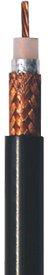
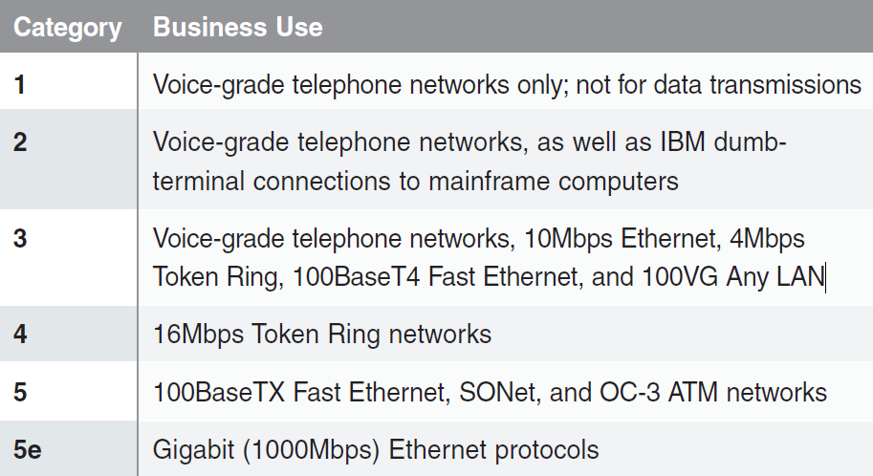
Connectors and Cabling
Media Types:
Coaxial cabling:
Coaxial is and previous method of cabling networks. It use to be the popular choice of medium for networking, but in the late 1980s and early 1990s, it was quickly replaced by UTP (unshielded twisted pair). Today it has currently made a comeback because of its use with broadband/ADSL service and the obvious terrestrial TV. Coaxial is so named because it has a copper core surrounded by a plastic sheath and then another copper braid. This inner line is used to send the data and the outer cable connects to earth.
UTP (Unshielded twisted pair) and STP (Shielded twisted pair):
UTP is by far the most popular cable type in use on the academic and commercial networks all over the globe. UTP and STP originated during a change in phone technology in the 1980s and has endured several evaluation since. UTP is bought in long rolls that contain 8 small cables inside one jacket these individual cables come in coloured pairs. Each cable generates a small magnetic field which will create interference for the neighbouring cable.
UTP is unfortunately sensitive to external interference and noise. Without protection, these external forces such as power supplies can corrupt the packets being sent. To prevent this annoyance, there is the option of STP which is shields the wires but this is a more expensive option. It works on similar principles as UTP, but has an extra layer of foil wrapping around the cables.
Different types of UTP are spilt into categories common LAN standards include the default choices of 5, 5e, 6, and 7. Categories 1 though 4 including coaxial are longer in circulation and not used in LANs but are still used in the realms of WAN technology, but these are often slower. With categories 6 and 7 cable, all the wiring is done within the factory or with specialist equipment. Although Cat5e cables are usually wired with a RJ45 plug or socket these is easily done with low-cost equipment.
http://www.processor.com/articles//P2747/31p47/31p47%20chart.pdf?guid=

Slide 15
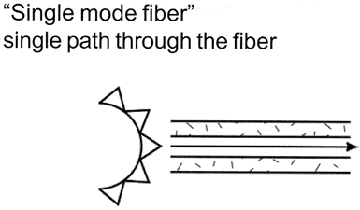
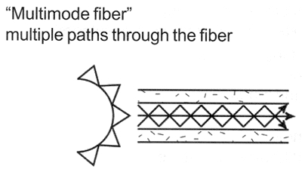
Fibre optic cabling:
Both coaxial and UTP cables depend on sending data through electrical pulses down a copper cable. Unlike those types of cabling fibre optic cables transfers the data through light which provides a much faster response times and it is more reliable over longer distances.
In total there are two types of cable used commonly these are:
Single-mode, which is has a diameter of 8.
Multi-mode, which is has a diameter of 125.
The light source is a LED (light emitting diode), which sends repeated pulses of light signals down the cable, a pulse read as a 1 and no pulse read as a 0. This light will travel around the cable depending on the various available densities of the medium it is currently travelling through. As the light bounces down the cable the excess light is refracted into the outer layer to prevent the signal doubling up.
Single mode cable is thinner and primarily uses Class 3 lasers to send the data. This smaller size of cable reduces the angles of reflection and consequently minimising refractions and loss of transmission. Class 3 lasers are considered dangerous do to the fact that the light produced by them is outside of the visible spectrum but when directly looked at can still destroy vital cells in the back of the retina in the eye, and can cause permanent blindness because of it.
This has a big advantage over the commonly used UTP cable because thru cable allows light to travel up to 3kms before the signal is to weak making it unusable in WANs but on LANs the cables are run usually less than 285ms, guaranteeing 1gbps.
http://www.arcelect.com/fibercable.htm

Slide 16
Infrared, Radio, Microwaves, and Satellite Communications
Infrared:
Infrared is technology which is used in line of sight communications between devices such as PDAs, mobiles, laptops, and game consoles such as the Wii. The is however one limitation of this technology with is the proximity is short and the speed is slow in comparison to other technologies as it can only support a 4mbps connection.
Radio and Microwave:
Radio and Microwaves operate in a similar bands on the electro-magnetic spectrum, with microwaves being nearer the higher end of radio frequencies. Communication over these methods are common done through technologies such as Bluetooth and WiFi.
Satellite Communications:
Satellite Communications are dependant on a local satellite being with range and geosynchronous orbit with receiving stations. In the UK unfortunately due our latitude, dishes used for communications with the satellite would have to be pointed in a lower direction on the horizon in line with the south of our position.
Cabling Standards:
Standards for instance 10Base-T are important as they define the common signalling, communication riles in relation to the speed of a cabled system. These standards are made definite by the IEEE which do no specify the length of a cable but are more focused upon the rule base to ensure correct communication between networks and devices alike.

Slide 17
Software
A network connect function purely on its own it is required to be given purpose and commands by software and applications, this is where server and client software come in to enable users to access and use a network.
Network Operating System:
A networking system is aimless except if there is software using, maintaining and overseeing the on going processes. In the usual use of a network infrastructure you may come across a network operating system, a virus checker on servers and workstations, firewalls and email clients and servers. Network operating systems offer two defined structures:
Peer networks such as a private network created at home to share an Internet connection or A small network in a company with less man ten computers. The most important advantage of peer-to-peer network is their technical simplicity, because they are simple to install, control and handle. But their capability to up scale is unfortunately limited, because it is common in the networking business that 20 workstations is a reasonable limit and 40 is uncommon
Client-server system has central control and administration, which allows a significantly larger number of access the system. Some examples of such as system are a web server being accessed by many clients or the file server at work or a centre of learning which is accessed via an internet browser. The server must run on a network operating system or that allows multiple connections and processes at once. It may need a system with a better specification computer and it needs a better quality Internet connection as it will be busier.
Anti Virus:
It is vital to make sure that your virus inspector is current. As new viruses are be created all the time meaning the virus software needs to be able to combats these.
Firewalls:
Firewalls, either dedicated or software-based, are necessary for all networks and network devices. The best implementation of a firewall is to make sure you are running one on your workstation. Also guarantee you are also running one on the edge of your network and have a firewall at the edge of each network section of a business network to warrant several layers of security.
Firewalls filter traffic using TCP and UCP ports at layer 4 of the OSI model. In theory all ports are blocked and a network administrator will open only those that are required.

Slide 18
Software
Email:
Email clients and servers systems have been functioning since the early I 970s. Email uses protocols such as SMTP (Simple Mail Transfer Protocol), IMAP (Internet Message Access Protocol) and POP3 (Post Office Protocol version 3). Email has contributed to the recognition of the Internet. The popularity of email has allowed organisations, workers and teachers to become more flexible in their messaging by making location and time zones becoming unrelated. Email can be accessed through many systems, with websites, mobile phones and television set top boxes providing all are connected to the internet.
Commercial Systems
Several examples of network operating systems are a variety of versions of Linux, Novell Netware, AppleShare, Windows 2000 and 2003 and IBM iSeries OS. OSs used on desktop computers such as Windows XP and more recently Vista can offer this resource but in a more restricted form as they are not entirely designed for the task.
The network operating system manages the server that provides a network service accessed by many other computers and users on the network. The services offered by network operating systems are wide and varied, common services include:
• Web servers
• File servers to share common resources
• Database servers
• Print servers
• Domain name servers (DNS)
• Firewalls.
• Proxy servers, which regulate access for many devices to the Internet.
• Content management systems, which will control what websites users may visit.
• Dynamic host configuration protocol (DHCP) servers.
• mail servers to manage email.
All of these services are accessible using Windows 2000/2003 and Novell NetWare. Linux and Unix also allow for the required services according to the needs of a particular organisation, allowing network managers to configure them to specific requirements.

