Slide 1
WLBR
Chasing
REST
Resources
Language Box
Tutors
EdShare
Collections
Teachers
Wisdom of Crowds
LORO
EdShare
Profiles
Wiki
Web 2.0
Students
Sharing
HumBox
Tags
Lecturers
In Pursuit of a Usable Teaching and Learning Repository
RSS
Digital
Identity
David Millard
LSL, ECS, Soton

Slide 2

What to do with a problem like teaching and learning repositories?

Slide 3
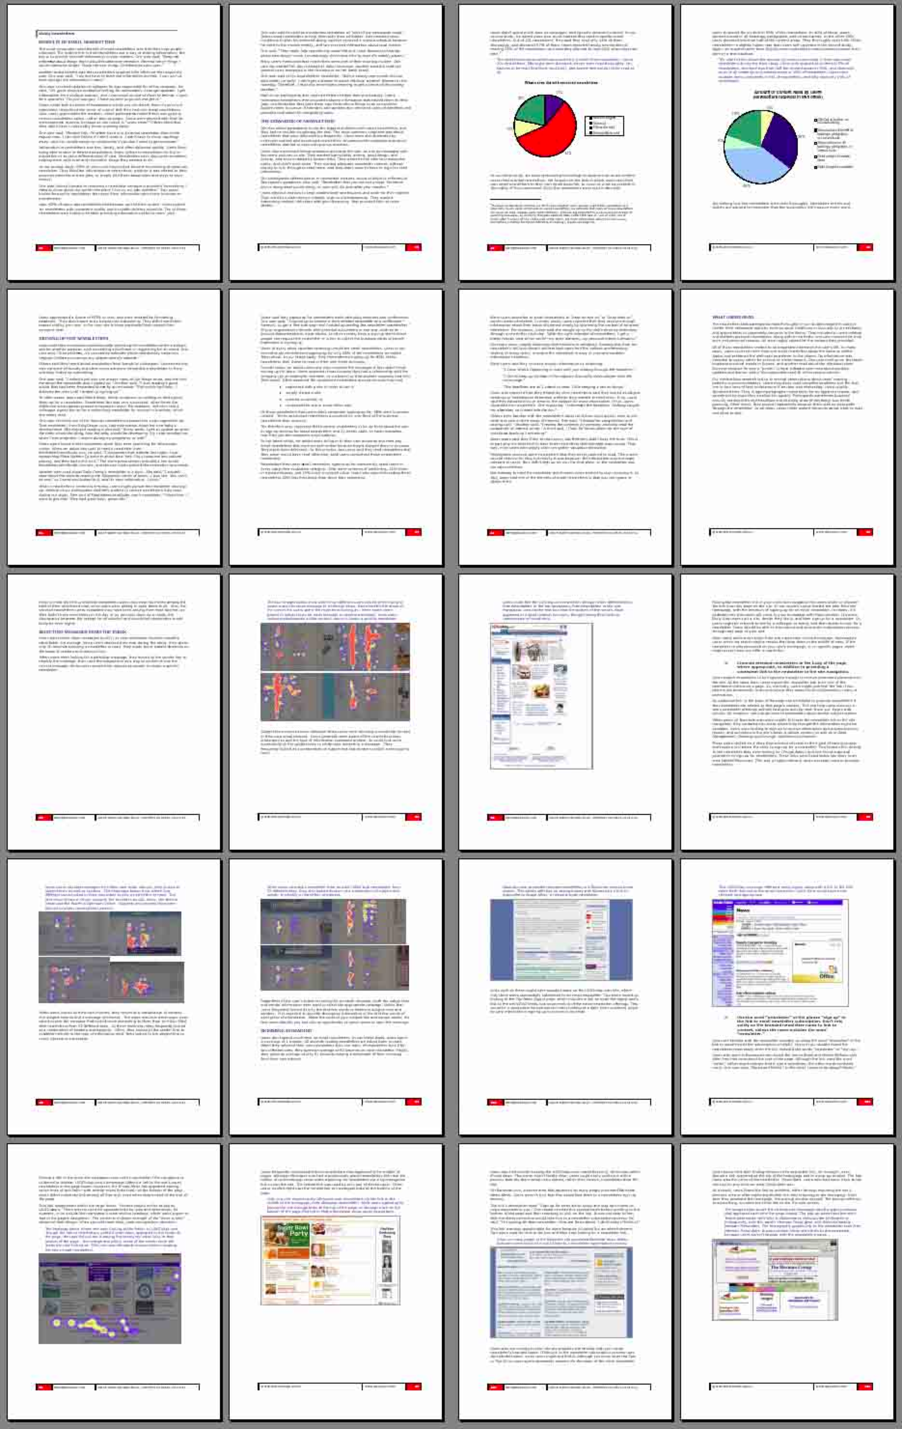



Learning Objects
Metadata:
Title
Description
Creator
Learn Stuff in 21 Days!
Language
Level
Keywords
Concepts
Length
Scaffolding
Text Type
Discourse structure
Copyright

Slide 4

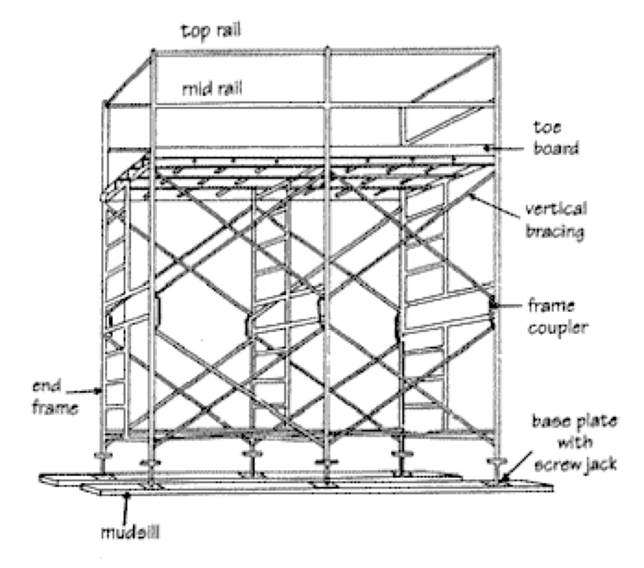

How Real Teachers Responded
“I recognise the zip file, but when I open it up I don’t know what to run to make it work.”
“I don’t know what half of these terms mean.”
“I don’t have digital resources to share. I print out my handouts and if I need them again I photocopy them or type them in again.”

Slide 5

What is a Repository?
Archiving
Storing
  Safe
  Permanent
  Official
Indexing
  Curated
  Monitored

Slide 6
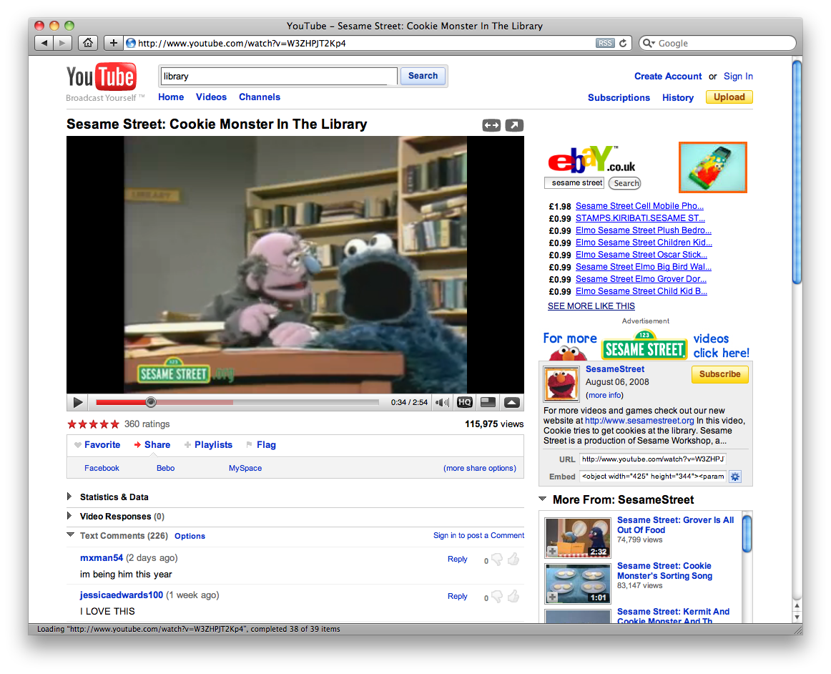
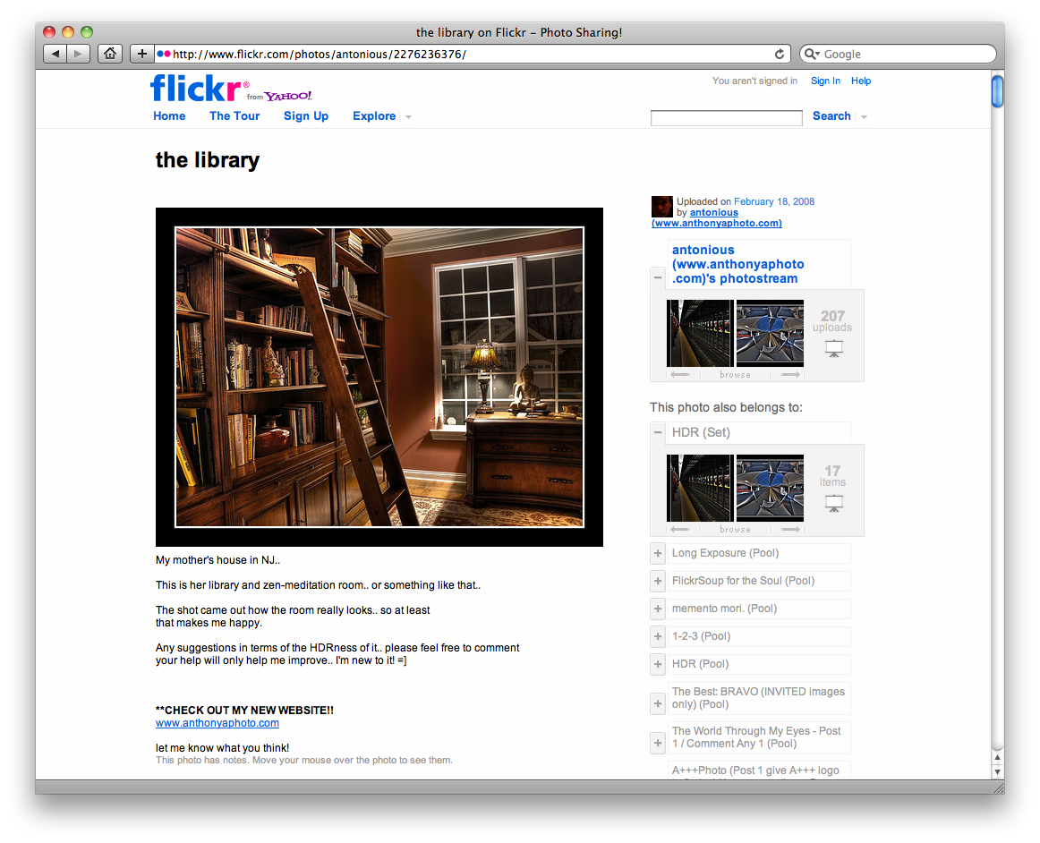
What About Sharing Sites?
Hosting
Organisation
Community
Altruism

Slide 7
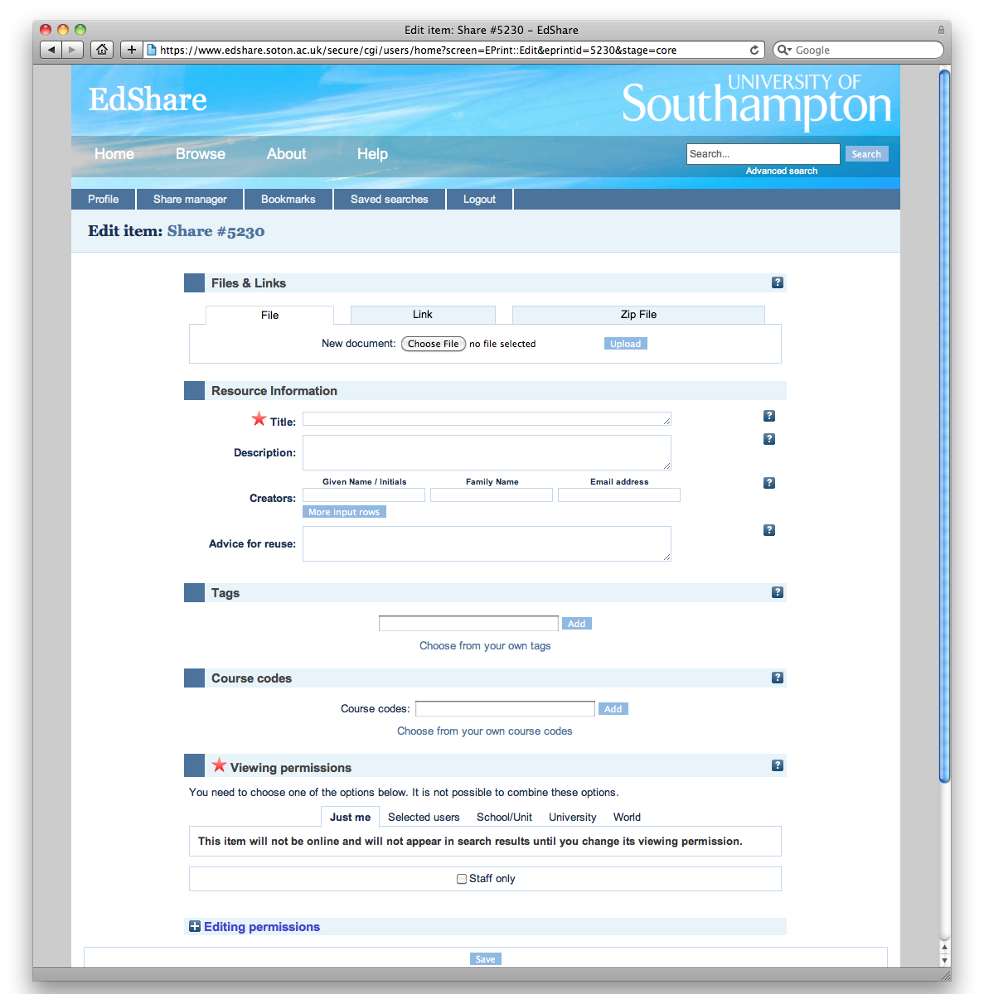
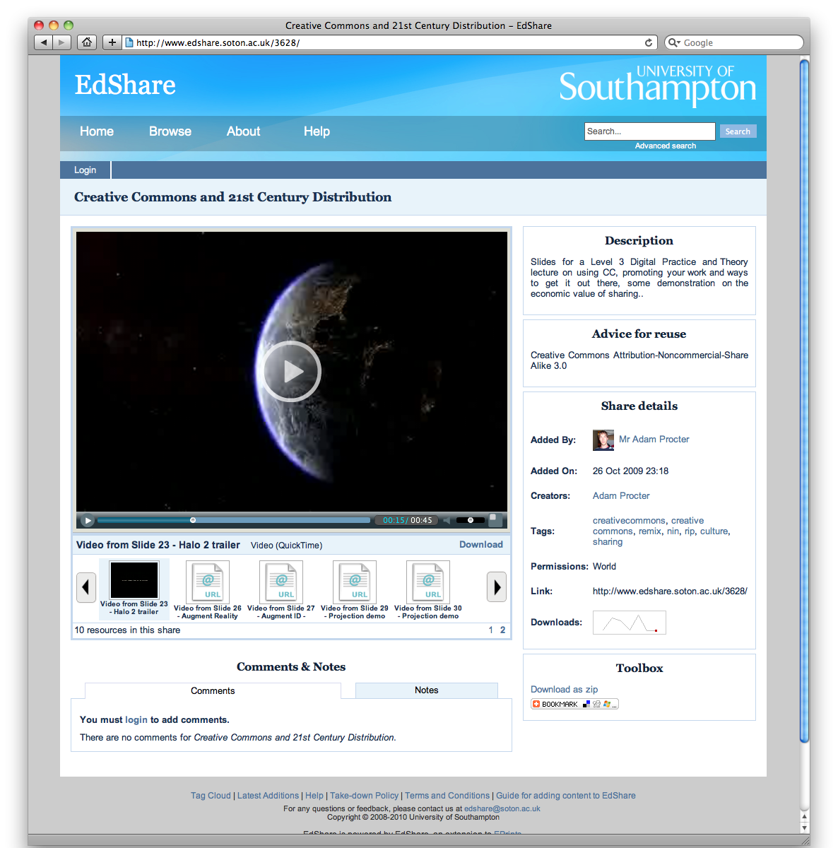
Hosting
Simple Metadata
Inline Preview

Slide 8
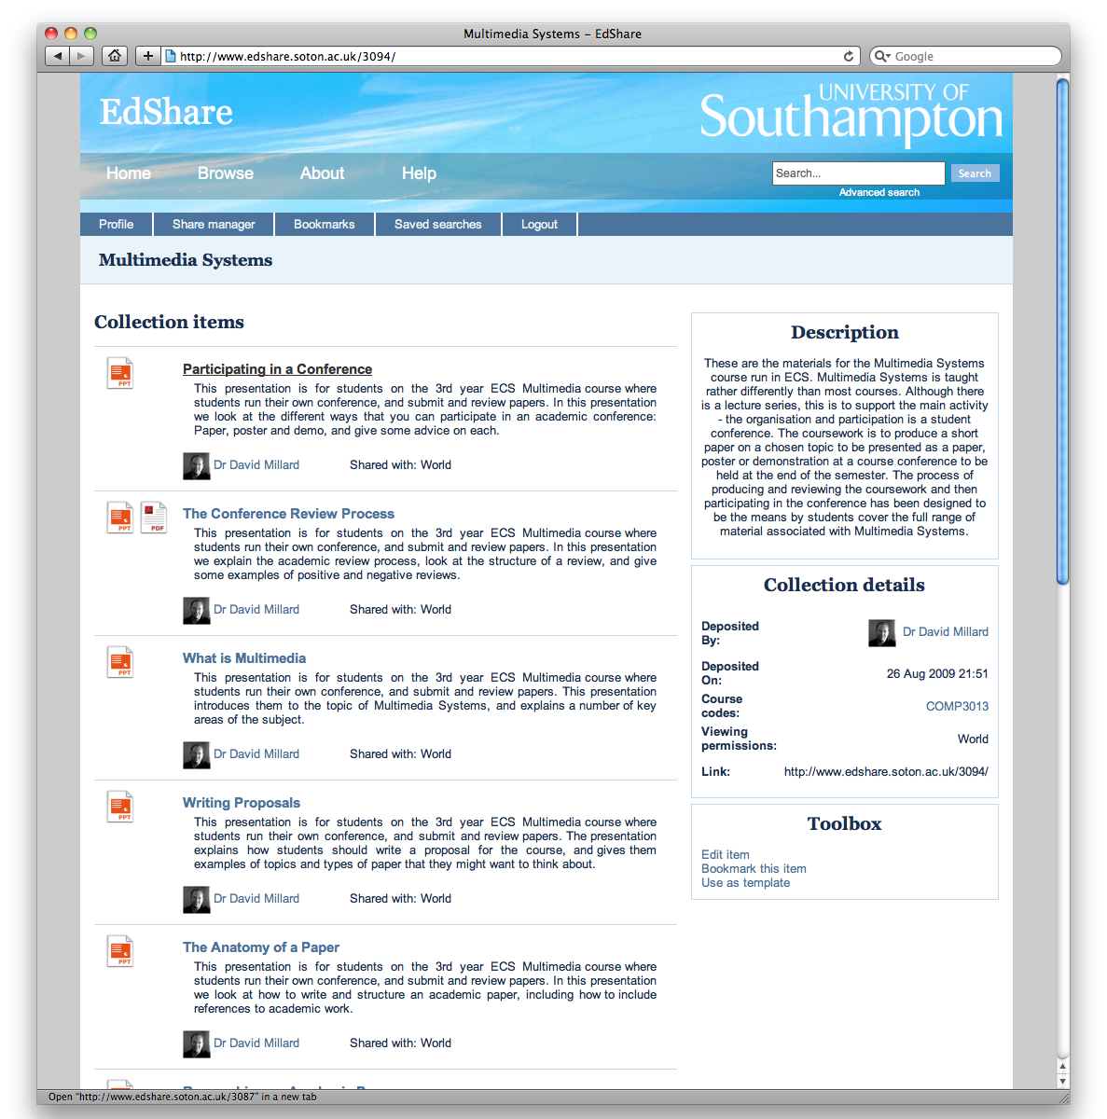
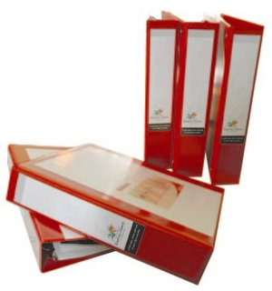



Organisation
Zip
Multi-file
Collections
Tags
Flexible
Emergent

Slide 9
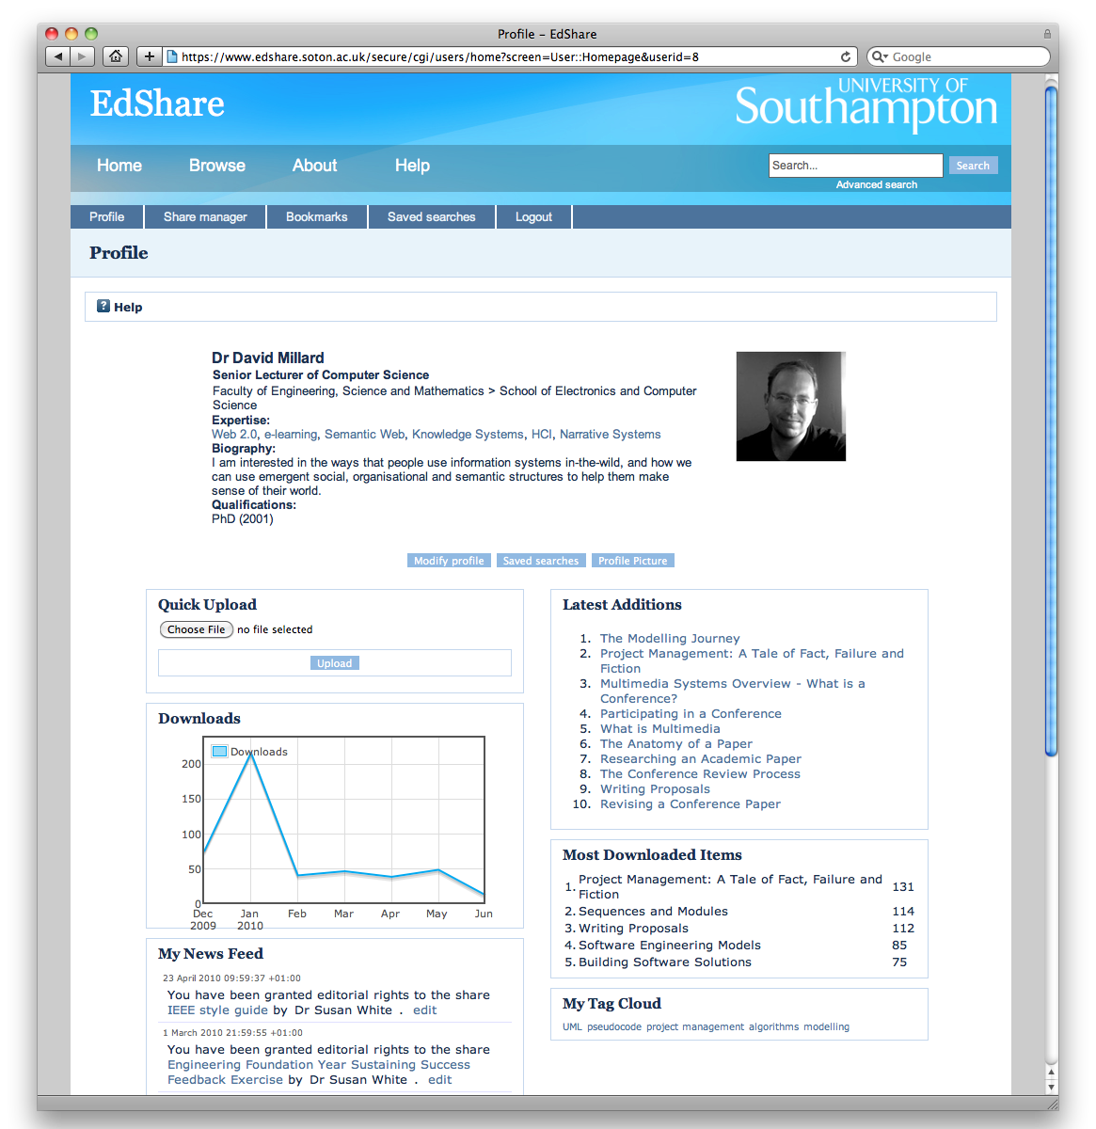
Community
Identity
Home
Awareness

Slide 10
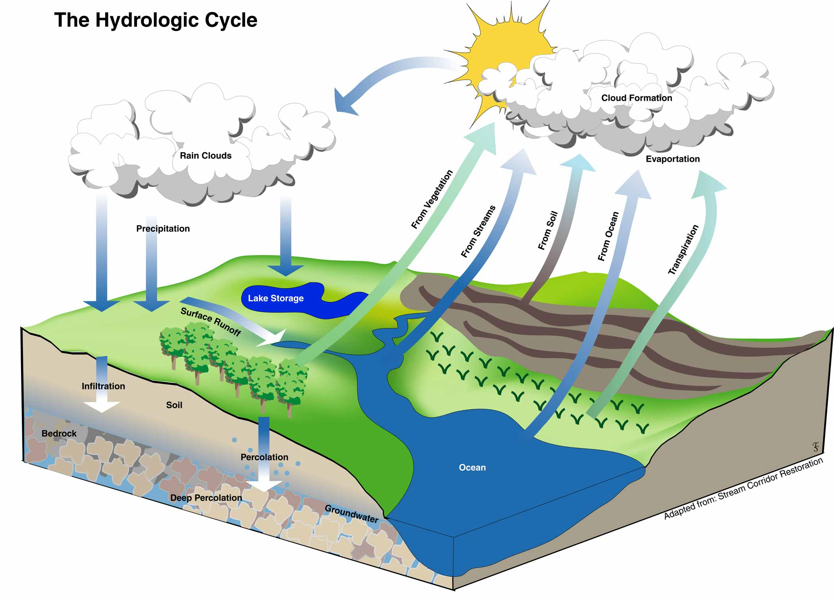
The Teaching Lifecycle
Faculty
Students
World
Supporting A Living Cycle

Slide 11

Now we are older and wiser, we worry about what it all means…

Slide 12








Something Open This Way Comes
OER
Open
Educational
Resources

Slide 13
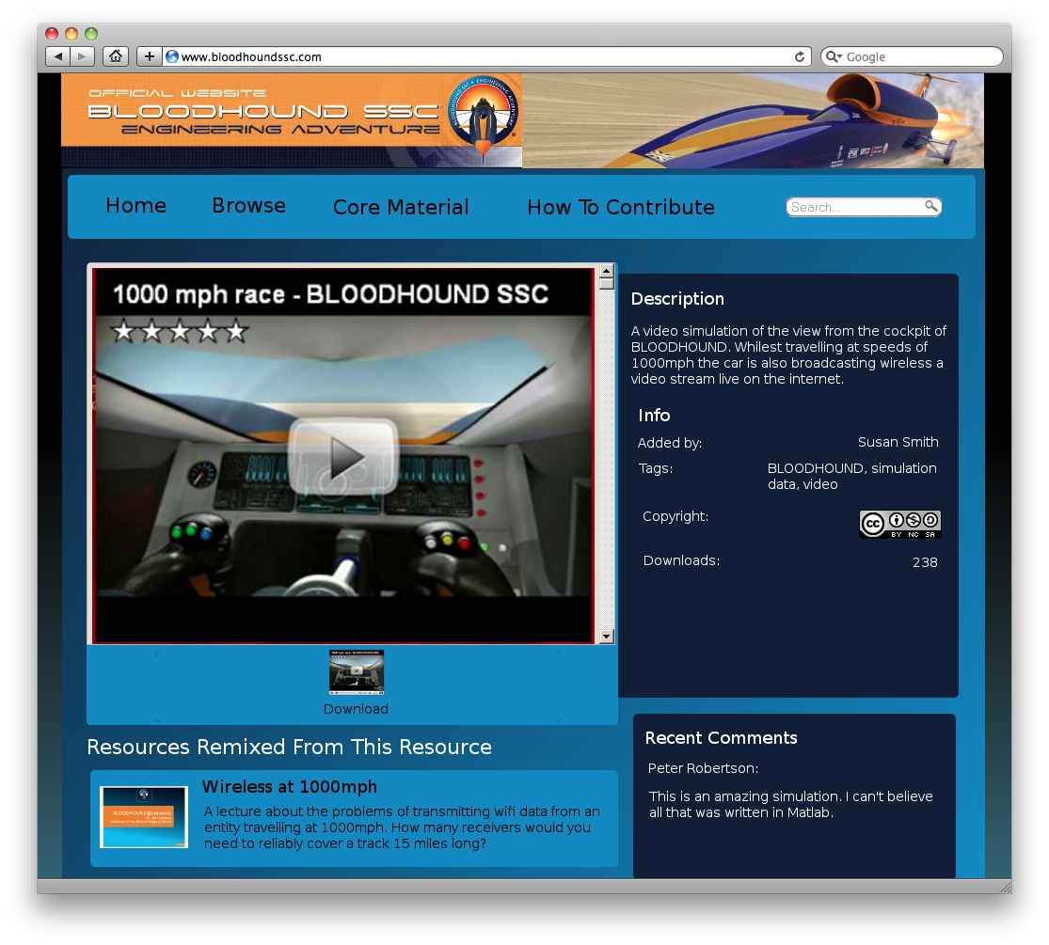
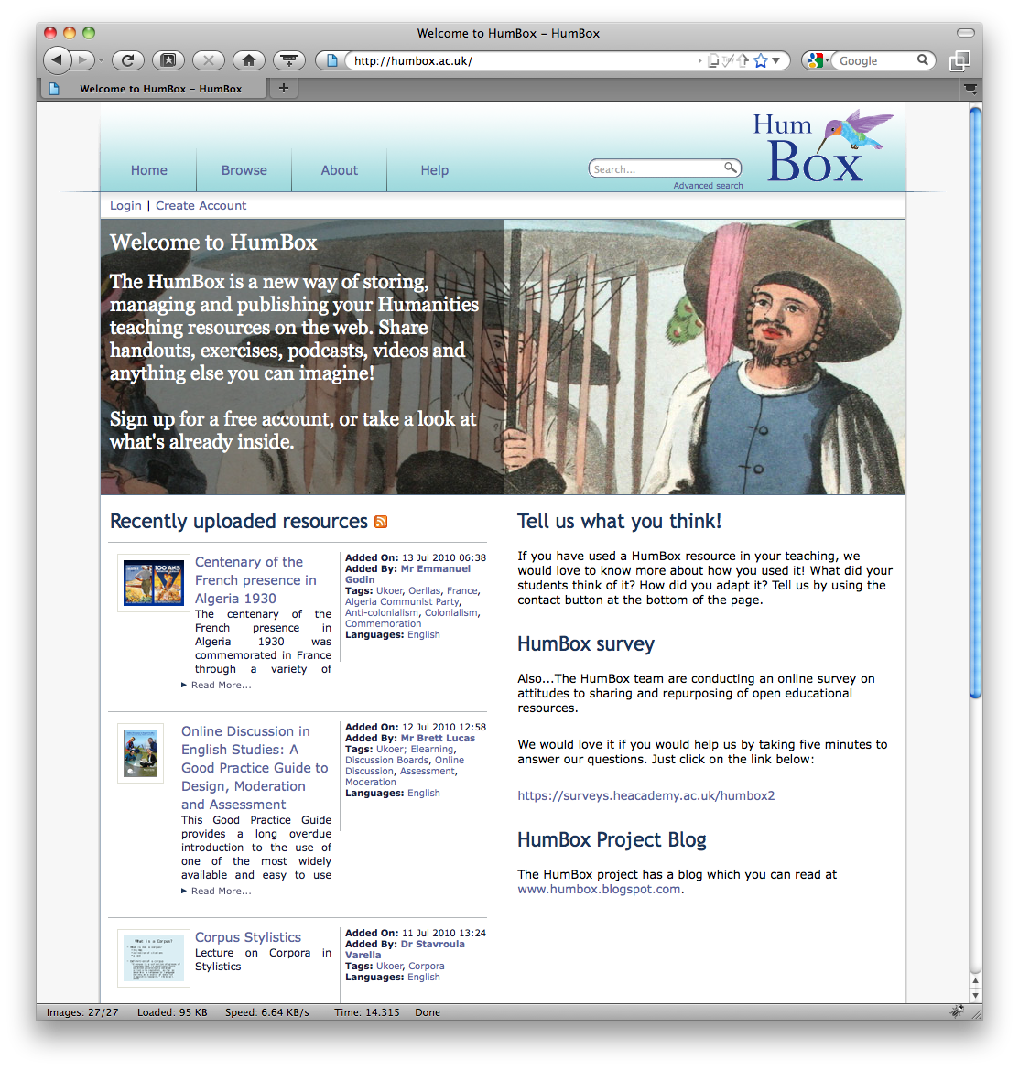
HumBox – OER for Humanities
18 Month JISC Project
4 Subject Centres
12 Universities
Emphasis on Peer Review
Aimed for 400 quality items
Now at 1250 (and still growing)
?

Slide 14
David Millard
LSL, ECS, Soton
dem@ecs.soton.ac.uk
WLBR
Chasing
REST
Resources
Language Box
Tutors
EdShare
Collections
Teachers
Wisdom of Crowds
LORO
EdShare
Profiles
Wiki
Web 2.0
Students
Sharing
HumBox
Tags
Lecturers
Digital
RSS
Identity
Thank You!

