Slide 1
Explaining and
Controlling Reasoning
Dr Nicholas Gibbins
nmg@ecs.soton.ac.uk
32/3077

Slide 2
How People Reason and
Solve Problems
Formal methods (logical deduction)
Heuristic reasoning (IF-THEN rules)
Focus: common sense related toward more or less specific goals
Divide and conquer
Parallelism

Slide 3
Reasoning Methods
Deductive reasoning
  Move from a general principle to a specific inference
  General principle is composed of two or more premises
Inductive reasoning
  Move from some established facts to draw general conclusions
Analogical reasoning
  Derive answer to a question by known analogy
  A verbalisation of internalized learning process
  Use of similar, past experiences

Slide 4
Reasoning with Logic
Modus Ponens
  P
  P ⇒ Q
  ⊢ Q
Modus Tollens
  P ⇒ Q
  ¬Q
  ⊢ ¬P
Resolution: combines substitution, modus ponens and other logical syllogisms

Slide 5
Reasoning with Rules
Firing a rule: When all of the rule's hypotheses (the ‘if parts’) are satisfied
Can check every rule in the knowledge base in a forward or backward direction
Continues until no more rules can fire, or until a goal is achieved

Slide 6
Rule Chaining
Linking a set of pertinent rules
Search process directed by a rule interpreter
Forward chaining
  If the premise clauses match the situation, then the process attempts to assert the conclusion
Backward chaining
  If the current goal is to determine the correct conclusion, then the process attempts to determine whether the premise clauses (facts) match the situation

Slide 7
Backward Chaining
Goal-driven
Start from a potential conclusion (hypothesis), then seek evidence that supports (or contradicts) it
Often involves formulating and testing intermediate hypotheses (or subhypotheses)
Used in diagnostic problems

Slide 8
Forward Chaining
Data-driven
Start from available information as it becomes available, then try to draw conclusions
Used if all facts available up front (as in auditing)

Slide 9
Forward or Backward?
State space in which backward chaining prunes extraneous states
goal
direction
of
reasoning
data

Slide 10
Forward or Backward?
State space in which forward chaining prunes irrelevant data and their consequents
goal
direction
of
reasoning
data

Slide 11
Bidirectional Search
In practice, many systems use a combination of forward and backward chaining
For example, search forwards until number of active states becomes too large, then search backwards to use possible subgoals to select from these states

Slide 12
The Inference Tree
Also known as the Goal Tree or Logical Tree
Schematic view of the inference process
Similar to a decision tree
Inferencing as tree traversal
Guides the Why and How explanations

Slide 13
Explanation

Slide 14
Explanation
Human experts justify and explain their actions
Expert systems should also do so
Explanation: Attempt by an ES to clarify reasoning, recommendations, other actions (asking a question)
Explanation facility (justifier)

Slide 15
Explanation Purposes
Make the system more intelligible
Uncover shortcomings of the rules and knowledge base (debugging)
Explain situations unanticipated
Satisfy users’ psychological and/or social needs
Clarify the assumptions underlying the system's operations

Slide 16
Rule Tracing Technique
‘Why’ provides a chain of reasoning
Good explanation facility is critical in large Expert Systems
Understanding depends on explanation

Slide 17
Rule Tracing Example
Initial knowledge base contains A, B, C, D, E
Rules:
  Rule 1:
  IF Y AND D
  THEN Z
  Rule 2:
  IF X AND B AND E
  THEN Y
  Rule 3:
  IF A
  THEN X

Slide 18
Rule Tracing Example
Inference Tree
3
A
X
2
B
Y
1
Z
E
D
Rule trace would show that Z resulted from the firing of rules 1, 2 and 3

Slide 19
Explanation Types
Two basic explanations
‘Why’ explanations
  Typically, why is a fact requested?
‘How’ explanations
  Typically to determine how a certain conclusion or recommendation was reached
  Some simple systems provide this only at the final conclusion
  Most complex systems provide the chain of rules used to reach the conclusion

Slide 20
Generating Explanations
Static Explanation
  Pre-insert pieces of English text (scripts) in the system
Dynamic Explanation
  Reconstruct explanation according to the execution pattern of the rules

Slide 21
Typology of Explanations
Trace, or Line of Reasoning
Justification
  Explicit description of the causal argument or rationale behind each inferential step taken by the expert system
Strategy
  High-level goal structure that determines how the expert system uses its domain knowledge to accomplish a task (or metaknowledge)

Slide 22
Truth Maintenance

Slide 23
Truth Maintenance
When our knowledge base changes, the premises for certain rules may no longer be valid
We should remove consequences that are no longer true (no longer supported by premises)
We need to keep track of inferred facts, and remove any that are no longer supported – truth maintenance
Two main approaches to truth maintenance
  Justification-based
  Assumption-based

Slide 24
Truth Maintenance
Rather than delete facts, TM systems maintain annotations on facts to indicate whether they’re currently believed to be true (IN) or disbelieved (OUT)
Building a TMS is largely a matter of efficient book-keeping

Slide 25
Doyle’s Truth Maintenance System
A Justification-based Truth Maintenance System (JTMS)
Uses dependency-based backtracking to maintain the list of facts (nodes) which are valid (IN)
  Any node which has at least one valid justification is said to be IN
  Any node with no valid justifications is said to be OUT
Algorithm explores justifications in a depth-first manner to determine consistent set of facts
  Backtracking is required

Slide 26
Justifications
Nodes have attached justifications
Justifications may be:
  Support list justifications (SL INlist OUTlist)
  Justification is valid if all nodes in INlist are IN, and all those in the OUTlist are OUT
  Conditional proof justifications (CP node INlist OUTlist)
  Valid if node is IN whenever all nodes in INlist are IN and all nodes in OUTlist are OUT

Slide 27
Nodes
Three types of node:
Premise nodes (SL () ())
Believed under all circumstances (can never be OUT)
Hypothesis nodes (SL () (…))
Believed under certain conditions
Non-empty OUTlist, zero or more nodes in INlist
Inference nodes
Can be inferred from what is already believed (what is IN)

Slide 28
Algorithm
Assume that the set of valid facts is inconsistent, and node N is decided to be the cause of the problem
Trace the dependencies back from N to find the set of hypotheses that support N
Form the maximal set of hypotheses that do not support other hypotheses: H₁…H_{n}
Create a new node – the no-good NG – to represent the occurrence of the contradiction
  Node contents are not(H₁ and … and H_{n})
  Node justification is (CP N (H₁ … H_{n}) ())

Slide 29
Algorithm
Pick H_{i} from H₁…H_{n}, so that if it were forced OUT, N would also be forced OUT
Since H_{i} is a hypothesis, it has a non-empty OUTlist. Find the set of nodes D₁…D_{m} which are currently OUT, such that if any one came IN, H_{i} would go OUT. Pick D_{j} from D₁…D_{m}
Give D_{j} a new justification so that it comes in:
(SL (NG H₁…H_{i-1} H_{i+1}…H_{n}) (D₁…D_{j-1} D_{j+1}…D_{m}))

Slide 30
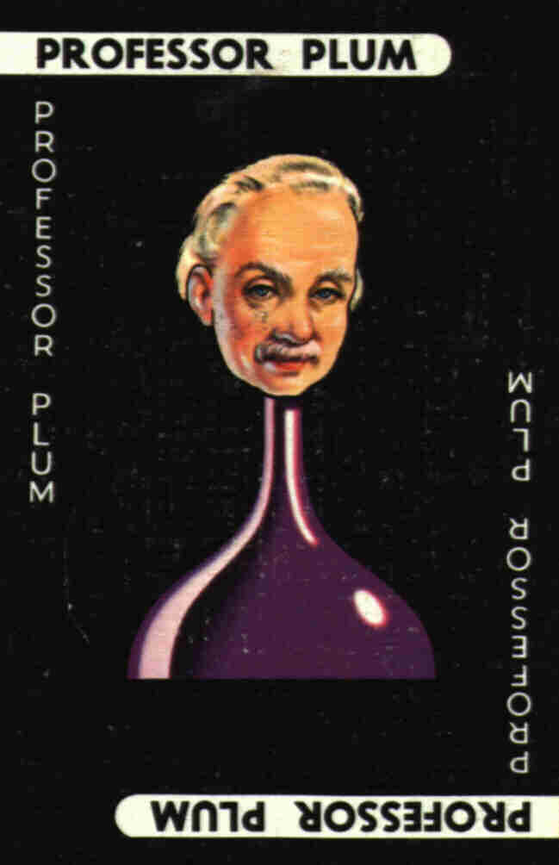

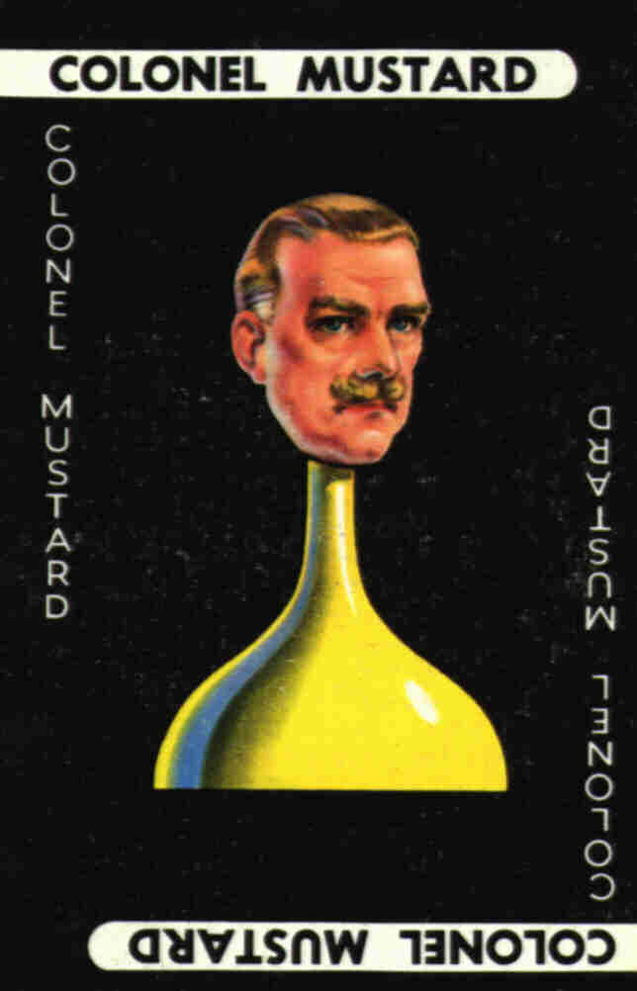
TMS Example
Consider a (simple) game of Cluedo:
  Three suspects for a murder:
  Three locations for the murder: study, library, ballroom
  Initially, we suspect Prof. Plum in the library

Slide 31
Type | Node | Content | Justification | IN/OUT
Hypothesis | n1 | killer = Plum | (SL () (n2 n3)) | IN
Hypothesis | n2 | killer = Peacock | (SL () (n1 n3)) | OUT
Hypothesis | n3 | killer = Mustard | (SL () (n1 n2)) | OUT
Hypothesis | n4 | place = library | (SL () (n5 n6)) | IN
Hypothesis | n5 | place = study | (SL () (n4 n6)) | OUT
Hypothesis | n6 | place = ballroom | (SL () (n4 n5)) | OUT

Slide 32
A Problem
Our initial hypothesis is incorrect, because one of the other players reveals that Prof Plum was not in the library
INlist is now n1, n4, n7
Inference | n7 | Plum not in library | (SL (n1 n4) ())

Slide 33
No-Good Node
Need to create a no-good node to represent this contradiction:
Inference | n8 | not(n1 and n4) | (CP n7 (n1 n4) ())

Slide 34
Resolving Inconsistency
Pick one of the inconsistent nodes to force OUT
  We choose n1 (killer=Plum)
  OUTlist for n1 is (n2 n3)
  We choose n3 to force IN
Create new justification for n3:
INlist is now n3 n4 n8
Inference | n3 | killer = Mustard | (SL (n4 n8) n(2))

Slide 35
Type | Node | Content | Justification | IN/OUT
Hypothesis | n1 | killer = Plum | (SL () (n2 n3)) | OUT
Hypothesis | n2 | killer = Peacock | (SL () (n1 n3)) | OUT
Hypothesis | n3 | killer = Mustard | (SL (n4 n8) (n2) | IN
Hypothesis | n4 | place = library | (SL () (n5 n6)) | IN
Hypothesis | n5 | place = study | (SL () (n4 n6)) | OUT
Hypothesis | n6 | place = ballroom | (SL () (n4 n5)) | OUT
Inference | n7 | Plum not in library | (SL (n1 n4) ()) | OUT
Inference | n8 | not(n1 and n4) | (CP n7 (n1 n4) ()) | IN

Slide 36
TMS Example
Type | Node | Content | Justification | IN/OUT
Premise | n1 | x is real | (SL () ()) | IN
Hypothesis | n2 | 2x² -3x +1 = 0 | (SL () (n4)) | IN
Hypothesis | n3 | 2x² +3x -2 = 0 | (SL () (n4)) | IN
Hypothesis | n4 | x² + 3x + 2 = 0 | (SL () (n3)) | OUT
Hypothesis | n5 | x< -1 | (SL () (n6)) | OUT
Hypothesis | n6 | x > -2 | (SL () (n5)) | IN
Hypothesis | n7 | x < 0 | (SL () (n8)) | OUT
Hypothesis | n8 | x > 0 | (SL () (n7)) | IN
Inference | n9 | x = -1 | (SL (n4 n6) ()) | OUT
Inference | n10 | x = -2 | (SL (n4 n5) ()) | OUT
Inference | n11 | x = -2 | (SL (n3 n7) ()) | OUT
Inference | n12 | x = 1 | (SL (n2 n8) ()) | IN

Slide 37
Doyle’s TMS Example
Reasoner makes another inference:
This is inconsistent with n12 (x = ½ and x =1)
INlist is now (n1 n2 n3 n6 n8 n12 13)
Select a node to blame for the inconsistency (choose n12)
Inference | n13 | x = ½ | (SL (n3 n6) ())

Slide 38
Doyle’s TMS Example
Trace the dependencies of n12 which are currently IN to find the hypotheses which support it
  n12 has justification (SL (n2 n8) ())
Maximal set of hypotheses (those which do not support other hypotheses) is (n2 n8)
Create a new node – the no-good node – to represent the contradiction
INlist is now (n1 n2 n3 n6 n8 n12 n13 n14)
Inference | n14 | not(x > 0) | (CP n12 (n2 n8) ())

Slide 39
Doyle’s TMS Example
Pick node n8 so that if it is forced OUT, n12 will also be forced OUT
OUTlist of justification for n8 is n7, which is currently OUT
If we bring n7 IN, n8 will will be forced OUT (which will also force n12 OUT)
Create new justification for n7
n7 can now be made IN and n8 OUT, and n12 will also go OUT
INlist is now (n1 n2 n3 n6 n7 n13 n14)
Hypothesis | n7 | x < 1 | (SL (n14 n2) ())

Slide 40
De Kleer’s Assumption-based
Truth Maintenance Systen
Justifications are always considered to be valid if they are made from rules and facts which hold true for some set of assumptions
ATMS records the set of assumptions for which each fact holds
  Each node has a label which consists of a set of sets of assumptions
ATMS maintains a no-good node whose value is false, which records the sets of assumptions which lead to inconsistency
Explores justifications in a breadth-first manner

Slide 41
Algorithm
Consider the addition of a new node “A and B imply C”
Form the cross product of the labels of A and B
Remove any resulting sets which have another set as a subset, or which have a contradictory set as a subset
Update label of C
  If C is a new node, the remaining sets become its label
  If C already exists, the remaining sets are added to its label (remove any supersets from the resulting label)
If other nodes depend on C, propagate the changes to those nodes in a similar fashion

Slide 42
ATMS Example
Node | Contents | Label
n0 | false | {a4 a5}
n1 | assumption 1 | {a1}
n2 | assumption 2 | {a2}
n3 | assumption 3 | {a3}
n4 | assumption 4 | {a4}
n5 | assumption 5 | {a5}
n6 | A | {a1} {a2 a4} {a5}
n7 | B | {a1 a2} {a3 a4}
n8 | C | {a1 a3 a5}

Slide 43
ATMS Example
Reasoner wants to add another justification: A ∧ B ⇒ C
Form the cross-product of the labels for A and B:
  {a1 a2}
  {a1 a3 a4}
  {a1 a2 a4}
  {a2 a3 a4}
  {a1 a2 a5}
  {a3 a4 a5}

Slide 44
ATMS Example
Remove any set which has another as a subset:
  {a1 a2}
  {a1 a3 a4}
  {a1 a2 a4} - remove
  {a2 a3 a4}
  {a1 a2 a5} - remove
  {a3 a4 a5}

Slide 45
ATMS Example
Remove any set which has a contradictory set as a subset
nogood label is {a4 a5}
  {a1 a2}
  {a1 a3 a4}
  {a2 a3 a4}
  {a3 a4 a5} - remove

Slide 46
ATMS Example
Label for C already exists {a1 a3 a5}
Add new labels to C, removing any which are a superset of existing labels
  {a1 a2}
  {a1 a3 a4}
  {a2 a3 a4}
  {a1 a3 a5} (existing label)

Slide 47
ATMS Example
Node | Contents | Label
n0 | false | {a4 a5}
n1 | assumption 1 | {a1}
n2 | assumption 2 | {a2}
n3 | assumption 3 | {a3}
n4 | assumption 4 | {a4}
n5 | assumption 5 | {a5}
n6 | A | {a1} {a2 a4} {a5}
n7 | B | {a1 a2} {a3 a4}
n8 | C | {a1 a2} {a1 a3 a4} {a2 a3 a4} {a1 a3 a5}

Slide 48
Comparison
Both Doyle’s TMS and De Kleer’s ATMS can be thought of as analogous to scaffolding in the construction of a building
  Necessary during construction, but the final building (proof) can stand by itself
Doyle’s TMS performs a depth-first search through the space of possible configurations of the knowledge base
  Less book-keeping overhead, but requires backtracking
De Kleer’s ATMS performs a breadth-first search
  Marginally more book-keeping
  No backtracking required
  Only works for forward-chaining systems

