Slide 1
Sustainability and Diversity
INFO1010
http://www.edshare.soton.ac.uk/6556/

Slide 2

Diversity
topic of this week’s scheduled lecture has been posted as sustainability and diversity
Note
  Already discussed and experienced diversity
    various times in previous lectures
    CVs comparing skills
    Team working

Slide 3
Diversity is pervasive
Think about it
  How are people different?
  How does difference make us stronger?
  How do businesses benefit from diversity?
First week
  The only thing I can be sure of about my students is that each one of them will be different
How can you make yourself aware of diversity?
Will you work for an international company?
Do you have different needs/ambitions?

Slide 4
Sustainability

Slide 5

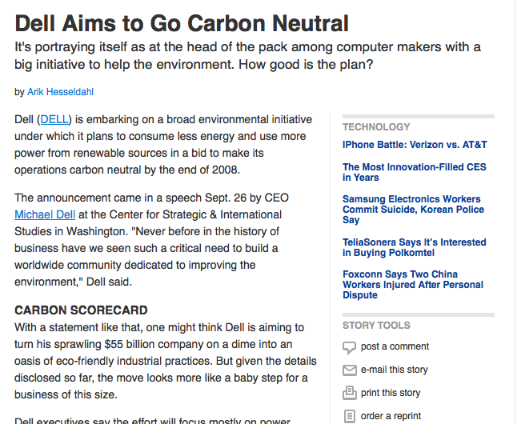
Aspirations

Slide 6
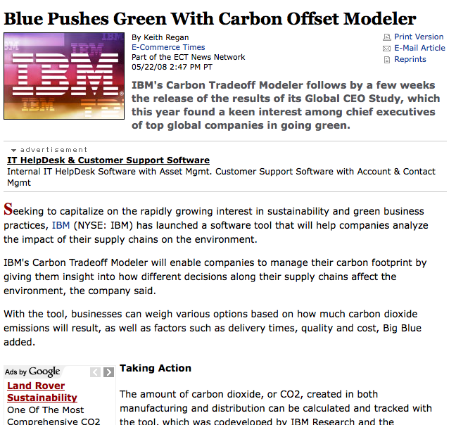
Tools

Slide 7
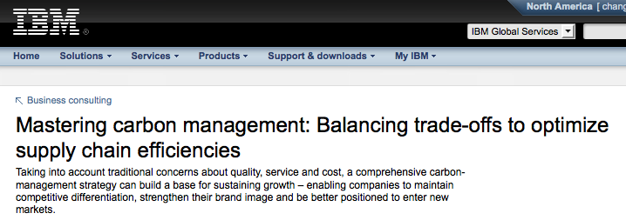
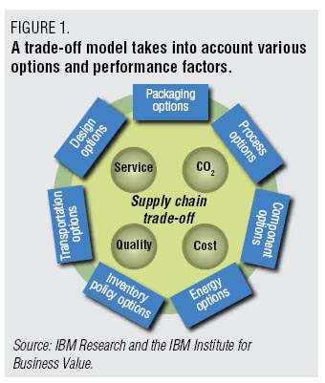
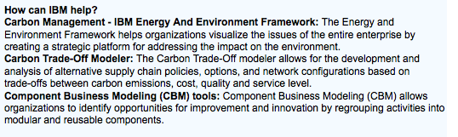

Slide 8
legislation
The Climate Change Act directs that emissions are to be reduced 80 per cent against 1990 levels by 2050 and at least 26 per cent by 2020

Slide 9
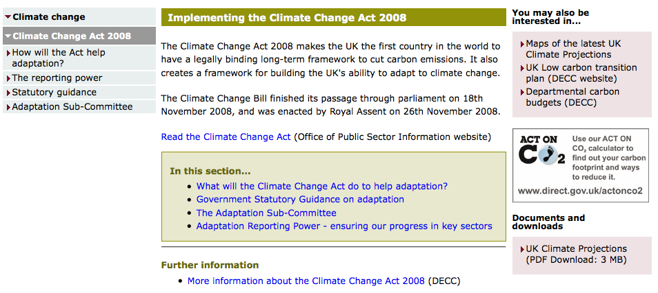
2008 Climate Change Act
http://www.defra.gov.uk/environment/climate/legislation/

Slide 10
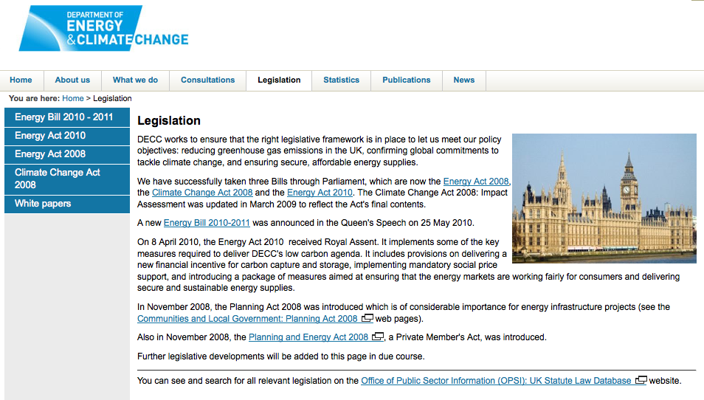
Legislation
http://www.decc.gov.uk/en/content/cms/legislation/legislation.aspx

Slide 11
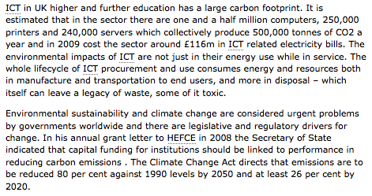
Sustainability closer to home

Slide 12
Class Activity
Consider a carbon audit
  In the Labs
  Across the University computer rooms
In pairs…
Using the handout
One or two of you will be asked to present your analysis – which will be entered live into the student wiki

Slide 13
In ECS labs/uni computing rooms
Identify items/activities which contribute to the carbon footprint
Discuss/analyse them according to the example
What technology tools could be used/devised to reduce our carbon footprint?
How could you quantify the value of the carbon footprint?
Can you think of activities/campaigns which might also be implemented?

Slide 14
Cloud farms
discussion

Slide 15
links
This slide set and supporting resources
  http://www.edshare.soton.ac.uk/6556/
  JISC links http://www.jisc.ac.uk/news/stories/2009/08/footprinttool.aspx
  http://www.jisc.ac.uk/supportingyourinstitution/cribsheets/greeningict.aspx

