Slide 1
Welcome to Social Networking Systems
David Millard
dem@ecs.soton.ac.uk
Thanassis Tiropanis
tt2@ecs.soton.ac.uk

Slide 2

This is NOT the Facebook course!

Slide 3
So What is It?
Our aim is that by the end of the course you should:
Understand the technical affordances of social networking systems, the graph and structural theory that governs their behaviour, and their social and philosophical context.
Three broad topics:
Technologies and Applications
Analysis and Structure
Social Factors

Slide 4
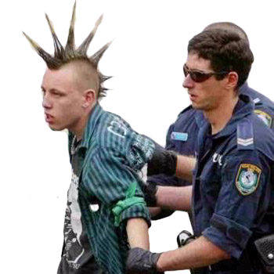
Technology and Applications
History and Value of Web 2.0
  How did we get here, and why does it matter?
The New Web Literacy
  Digital Natives, Immigrants and Edupunks
Interoperability
  Open ID, Open Social, and Linked Data
Social Enterprise
  E-business and marketing

Slide 5
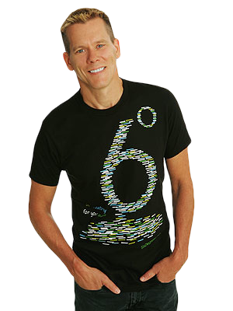
Analysis and Structure
Graph Theory and Social Networks
  Modeling, Small world phenomenon, Homophily, link formation, etc.)
Game Theory and Social Networks
  Equilibria, social optimality, principles of evolutionary game theory
Network Dynamics in Social Networks
  Information cascades, Network effects and diffusion

Slide 6

Social Factors
Trust
  Models and algorithms for provenance and reputation
Power
  Power vs. influence vs. action
Privacy
  Identity, anonymity, rights and the ergonomics of privacy

Slide 7
Who are You?
COMP6051 (Web Technologists and Software Engineers)
COMP6052 (Web Scientists)
Learning
Assessment
COMP6051
(20 credits)
COMP6052
(10 credits)
Ten week lecture series
Exam (100%)
Group Project
Portfolio (60%)
Personal Summary (20%)
Dragon’s Den Pitch (20%)

Slide 8
What happens next?
Monday 1400-1600 will be the regular lecture slot
We start our lecture series today
  A Brief History of the Web (dem)
  Value and Web 2.0 (tt2)
Tomorrow (Tues) 1000-1100 is the COMP6052 Project Launch
  Explain the project process
    Allocate groups (of six)
    Assign Mentors
  We will only occasionally use the Tuesday slot
    COMP6051 students will not need to attend tomorrow, but may be asked to act as critical friends in a future Tuesday slot

Slide 9
Questions…
?
Dave Millard (dem@ecs.soton.ac.uk)
Thanassis Tiropanis (tt2@ecs.soton.ac.uk)

