Slide 1
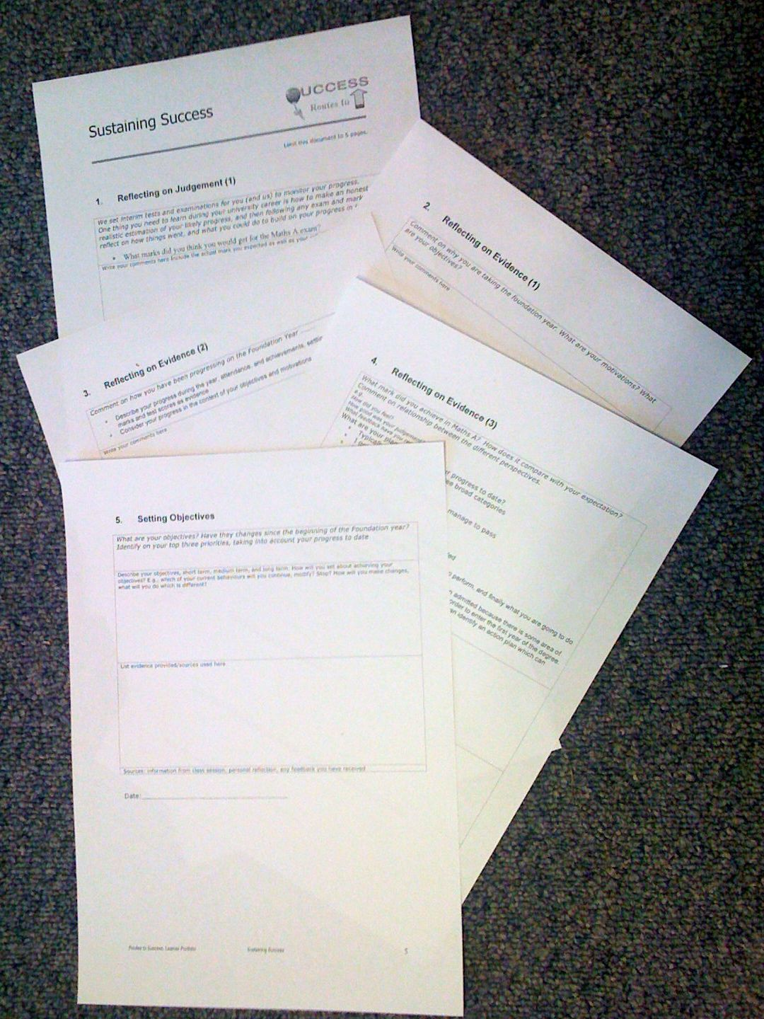
Foundation Year
Routes to Success
Part III - Sustaining Success
Su White
Semester 2
Week1 - Context
These slides in Edshare http://www.edshare.soton.ac.uk/4686/
Resource set in Edshare http://www.edshare.soton.ac.uk/4690/
Notes:
Objective to get to know the each other and establish framework for future sessions
Introduce think pair share
Establish expectations for portfolio contribution for this part of the course
Much of the session will be run via discussion and question and answer
The slides will be used according to need, but can form a useful note for review and revision.
They can also be used as reference by students who do not attend the session.

Slide 2

The Plan today
4. Task
1. Intros
3. About
feedback
2. Your
objectives
I expect to answer questions
as they arise
Notes:
Intros
Your Objectives
Thinking about personal objectives
Scoping out the area
About Feedback
How can we get feedback
Where can we get feedback
What can we do with feedback
Initial understanding
Task
Framing expectations for the portfolio
Tasks will include
Reflecting on examination result
Making an action plan
Developing frameworks for future reflections
Making explicit understandings of learning by creating advice and guidance for future students

Slide 3
Intros
Me, you, the module and us ☺
Notes:
Need to establish how the classes will be run
Eg Q&A
Think share pair
zappers

Slide 4
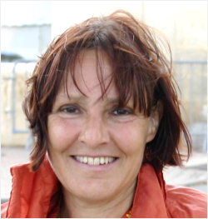
Intros: me and you?
What about you?
Me? Your lecturer
Dr Su White
Academic in ECS
saw@ecs.soton.ac.uk
Researcher in Learning Societies Lab
Why I am here
Senior tutor on the foundation year
Believe that all students can learn and succeed
Notes:
Objective to get some general feedback from the students – who are you, why are you here? This is also the opening question to the Portfolio interview
Establish the diversity of objectives, but also the commonality
Reminder – from induction….
Extra info - degree profile of students from FY same as that of A level point entry
Students may go on to do degree different to that first selected
Some students take the year a second time
Some students go on to study at another university
You have to pass the course to progress

Slide 5
Intros: Why We are here
Routes to success!
It’s a module
You have coursework
This is the lecture series
I want to make it useful
Each week we will
rehearse part of
the portfolio

Slide 6
Intros: The big picture
Notes:
1) Exam
2) Your motivations
3) Your progress
4) Self knowledge
5) Future Objectives
Explaining how the classes will be used to to fill out the portfolio

Slide 7
Intros: Look at the Portfolio
Notes:
Show the portfolio using the visualiser
Have a one page handout of the sections

Slide 8
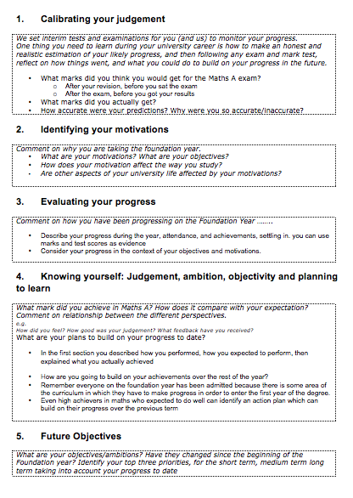
Intro Portfolio
Look at your handout
Why would you put in the sections?
Notes:
Each look at the handout individuall
Verbal questioning, do you have a problem with section?

Slide 9
Intros: what you have to think about
Notes:
What you have to think about
Exam (performance and progression)
Motivations
Progress
Self Knowledge
Future Plans

Slide 10
Intros:
What we will do
Weeks 1-5
Each week
  will rehearse thinking
  provide ideas for each section
Last two weeks of term
  Handin your portfolio 8th March
  Individual recorded interview
  10th-19th March
Remember:
no handin
no interview
no mark
Notes:
Explain and discuss the marking process

Slide 11
Intros: each section

Slide 12
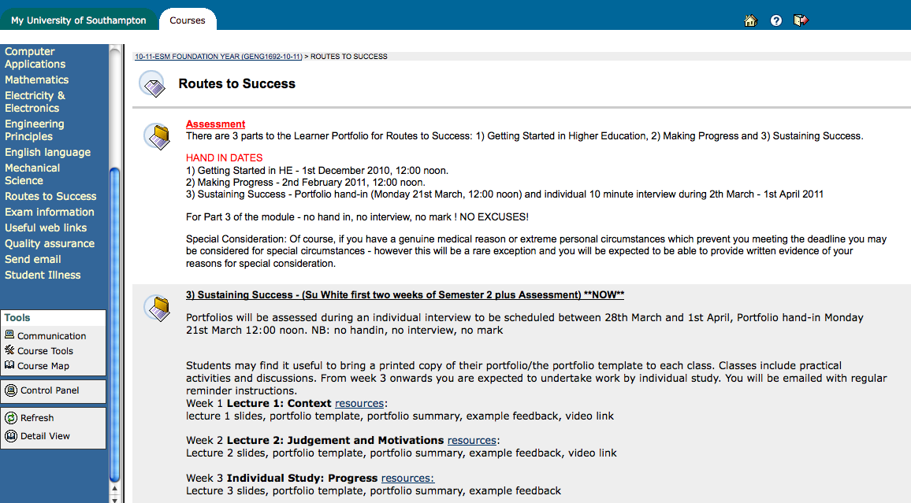
Where to find stuff: Blackboard
Notes:
Use blackboard to check details of the module, and background information which is still relevant

Slide 13
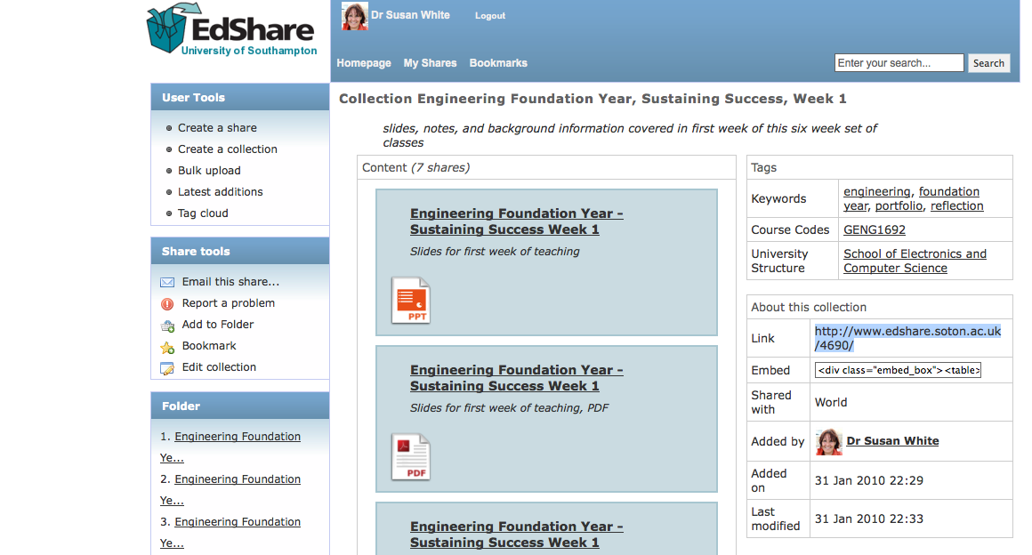
Where to find stuff: Edshare
Notes:
Resources are put into a collection in edshare, go and get them if you want copies

Slide 14
Your objectives
More about why you are here…

Slide 15
Your formal objectives:
The module - Sustaining Success
Three portfolio components
Getting Started in Higher Education:
November 2009 ✔
Making Progress:
February 2010 ✔
Sustaining Success:
24 March -1 April 2010
Notes:
Recap on what has gone, and what is expected
Gauging the level of engagement, and motivation

Slide 16
Objectives (task)
Ambition,
desire, need,
want….
Identify your own objectives
Think for a moment…
What do you want to achieve?
Today
Tomorrow
This semester, year,
During the life of your degree
Should relate to why you are here :-)
Notes:
Relate the whole routes to success class back to the personal

Slide 17
About Feedback
How do we get it?
How? When? So What?

Slide 18
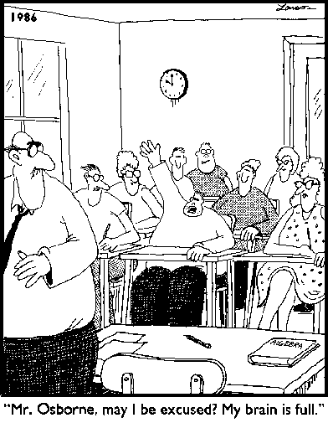
Varieties of Feedback:
Full Brain?
Notes:
Opening for discussion of the range of types of feedback
Learning taking place in three domains
Cognitive
Affective
Psycho-motor

Slide 19
Tell me about this module
What have you done?
How do you rate it so far?
Obviously useful
Surprisingly useful
Still not sure
Don’t think it is helping
Notes:
Interactive discussion, write feedback on board/acetate

Slide 20
Reflection and Feedback 1
True of False?
You can only get feedback on your work from the lecturers or demonstrators
Notes:
Ask the question, get a vote, have some discussion

Slide 21
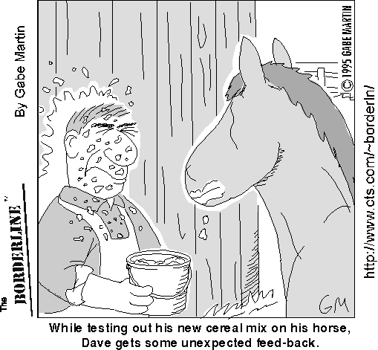
reflection and feedback 2
How can you get feedback from an exam?
Choose any which apply
Listen to the general feedback on how we all did
Think about how I did
Talk to fellow students about
how we did
Read and analyse at my marked
exam script
Attempt the exam a second time
Notes:
Discussion of different types of feedback
Relation between feedback and reflection
Peer learning

Slide 22
Your Tasks
Somethings for you…
And the portfolio ;-)

Slide 23
1) Progress review
Think about your progress so far this year
What will you continue?
What will you modify?
What will you stop?

Slide 24
Thank You :-)

Slide 25
Essential Activities..
Think about evidence…
Where will you get evidence?
What sort of evidence can you use?
Watch the video – think about *your* education
Take a look at EdShare - how could you use it to assemble evidence?

Slide 26

Video: A vision of students today
Swap to web browser! Linked from EdShare
Work by Michael Wesch of Kansas State University - Digital Ethnography Project
http://www.edshare.soton.ac.uk/67/
Notes:
This is a five minute video clip which looks at the student experience from the students perspective
Opens up discussion into the tensions between academic and non academic life
Need for work life balance

Slide 27
Week I resources
These slides
The portfolio template
Portfolio Summary (as handout)
Feedback from previous years
A vision of students today (video clip)
Edshare http://www.edshare.soton.ac.uk/4686/
Whole resource set http://www.edshare.soton.ac.uk/4690/
Notes:
Portfolio template handout on page with five boxes

