Slide 1
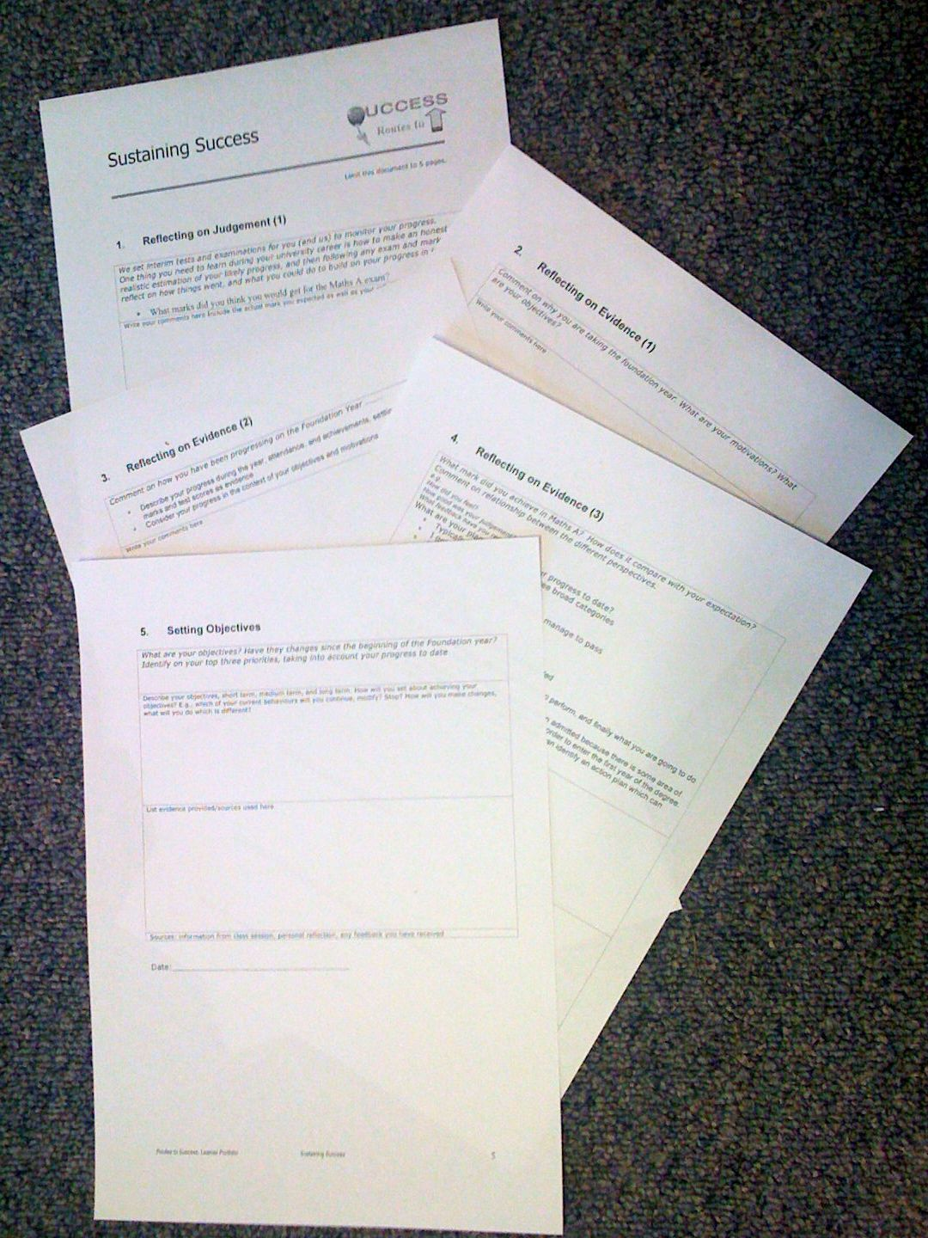
Foundation Year
Routes to Success
Part III - Sustaining Success
Su White
Semester 2
Week2 – Judgement and Motivations
http://www.edshare.soton.ac.uk/4723/
Notes:
Objective to get to know the each other and establish framework for future sessions
Introduce think pair share
Establish expectations for portfolio contribution for this part of the course
Much of the session will be run via discussion and question and answer
The slides will be used according to need, but can form a useful note for review and revision.
They can also be used as reference by students who do not attend the session.

Slide 2

The Plan today
Follow Up
Reminders
and Focus
Motivations
and
Targets
Degree
Classification
Notes:
Intros
Your Objectives
Thinking about personal objectives
Scoping out the area
About Feedback
How can we get feedback
Where can we get feedback
What can we do with feedback
Initial understanding
Task
Framing expectations for the portfolio
Tasks will include
Reflecting on examination result
Making an action plan
Developing frameworks for future reflections
Making explicit understandings of learning by creating advice and guidance for future students

Slide 3
Reminders
Quickly to help you focus
Notes:
Need to establish how the classes will be run
Eg Q&A
Think share pair
zappers

Slide 4
Reminder: Why We are here
Routes to success!
It’s a module
You have coursework
This is the lecture series
I want to make it useful
Each week we will
rehearse part of
the portfolio

Slide 5
Reminder: The big picture
✔
Notes:
1) Exam
2) Your motivations
3) Your progress
4) Self knowledge
5) Future Objectives

Slide 6
Reminder: Work on your Portfolio
A smart student will use these classes to work on their portfolio….
Notes:
Week by week

Slide 7
Reminder: what you have to think about
Notes:
What you have to think about
Exam (performance and progression)
Motivations
Progress
Self Knowledge
Future Plans

Slide 8
Reminder:
What we will do
Weeks 1-5
Each week
  will rehearse thinking
  provide ideas for each section
Week 6
  Handin your portfolio 21st March
  Individual recorded interview
  23rd March – 1st April
Remember:
no handin
no interview
no mark

Slide 9
Intros: each section

Slide 10
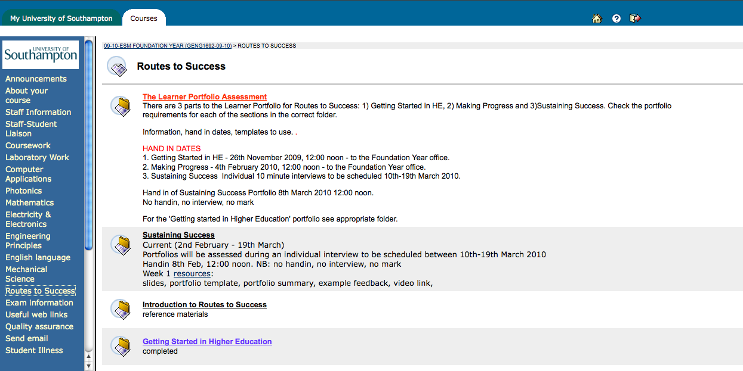
Where to find stuff: Blackboard
Notes:
Use blackboard to check details of the module, and background information which is still relevant

Slide 11
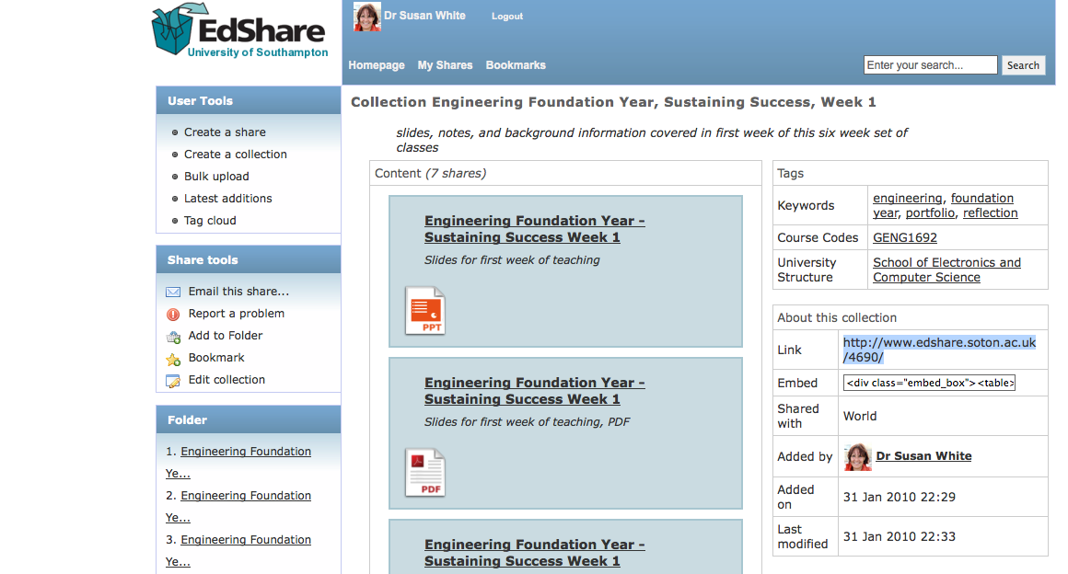
Where to find stuff: Edshare
Notes:
Resources are put into a collection in edshare, go and get them if you want copies

Slide 12
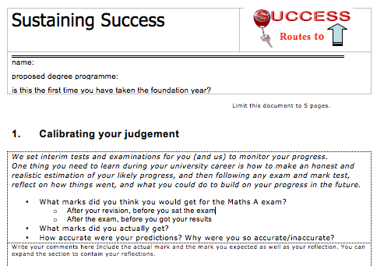
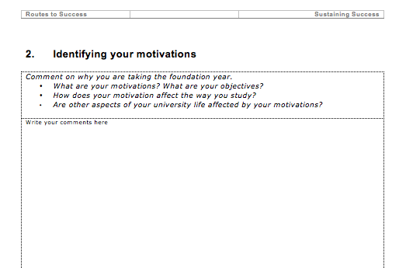
This week…

Slide 13
Working through the portfolio sections
Judgement and exams

Slide 14

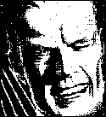
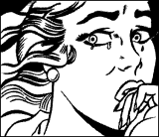
Maths A: How do we do it?

Slide 15
Building on last week – thinking about your exam :-)
Note the grade boundaries
Before you took the exam..
1) What mark do you/did you expect to get for the exam?
70% or more -(excellent pass)
60-69% (good pass)
50-59% (pass)
40-49% (bare pass)
30-39% (near miss)
29% or less (unfortunately low)
Notes:
Same as previous slide
But also, point out difference in perceptions before and immediately after, its about learning, we are fine tuning our judgement
Folks
I think you will agree that Its important you get the most out of all the work you have put into the course, and that you do well in your exams. As you may be aware, I will be taking the routes for success sessions at the start of the new term. I have a simple request which I think can help with your long term success. Can you please each have a think about these following simple questions. and make a note of your answers ready for our first session.
They are designed to help you get feedback from the exam. I don't need to know the answers individually, but I will ask you to anonymously use this info during our first lecture session.
1) ***before the exam*** What mark do you/did you expect to get for the exam?
a) 70% or more -(excellent pass)
b)60-69% (good pass)
c)50-59% (pass)
d)40-49% (bare pass)
e)30-39% (near miss)
f) 29% or less (unfortunately low)
supplementary question, how do you feel about it? eg please, good, ok, resigned, disappointed (use your own words/phrases)
Why do you feel that way?
2) ***immediately after the exam*** What mark do you expect to get for the exam
a) 70% or more -(excellent pass)
b)60-69% (good pass)
c)50-59% (pass)
d)40-49% (bare pass)
e)30-39% (near miss)
f) 29% or less (unfortunately low)
supplementary question, how do you feel about it? eg please, good, ok, resigned, disappointed (use your own words/phrases)
Why do you feel that way?
that's it :-) Its good training to go through this process with any exam you take, but I will discuss that with you more when I see you in February. Meanwhile I hope you all do well in the exam and look forward to meeting you all next term.

Slide 16
Thinking about your exam :-)
Immediately after you took the exam..
1) What mark do you/did you expect to get for the exam?
70% or more -(excellent pass)
60-69% (good pass)
50-59% (pass)
40-49% (bare pass)
30-39% (near miss)
29% or less (unfortunately low)
Notes:
Designed to make explicit evaluation
Also point out that the bounds relate to class of degrees
Most students at soton get 2.1 or above
……
Email sent before class
Folks
I think you will agree that Its important you get the most out of all the work you have put into the course, and that you do well in your exams. As you may be aware, I will be taking the routes for success sessions at the start of the new term. I have a simple request which I think can help with your long term success. Can you please each have a think about these following simple questions. and make a note of your answers ready for our first session.
They are designed to help you get feedback from the exam. I don't need to know the answers individually, but I will ask you to anonymously use this info during our first lecture session.
1) ***before the exam*** What mark do you/did you expect to get for the exam?
a) 70% or more -(excellent pass)
b)60-69% (good pass)
c)50-59% (pass)
d)40-49% (bare pass)
e)30-39% (near miss)
f) 29% or less (unfortunately low)
supplementary question, how do you feel about it? eg please, good, ok, resigned, disappointed (use your own words/phrases)
Why do you feel that way?
2) ***immediately after the exam*** What mark do you expect to get for the exam
a) 70% or more -(excellent pass)
b)60-69% (good pass)
c)50-59% (pass)
d)40-49% (bare pass)
e)30-39% (near miss)
f) 29% or less (unfortunately low)
supplementary question, how do you feel about it? eg please, good, ok, resigned, disappointed (use your own words/phrases)
Why do you feel that way?
that's it :-) Its good training to go through this process with any exam you take, but I will discuss that with you more when I see you in February. Meanwhile I hope you all do well in the exam and look forward to meeting you all next term.

Slide 17
Motivation/s: think
Think about the words
Motivated:
  To be motivated
Motivations:
  To have motivations
Lesson?
Read and think carefully
The questions
What are your motivations?
What are your objectives?
How does your motivation affect your objectives?
Are there other aspects of university life which affect your motivation

Slide 18
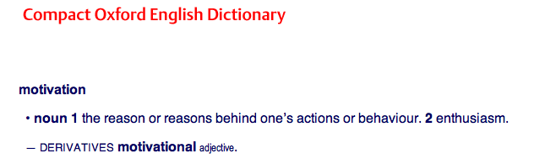
Think….
What are your motivations?
What are your objectives?
How does your motivation affect your objectives?
Are there other aspects of university life which affect your motivation?

Slide 19
Pair, share…
What are your motivations?
What are your objectives?
How does your motivation affect your objectives?
Are there other aspects of university life which affect your motivation?
Discuss your responses with your near neighbours
Ideally in pairs – you may have to move….
Then in fours (share)
And share again…
Feedback to the class
  Shout out a motivation
  Conduct a straw poll to see if this is a common motivation

Slide 20
Targets
A bit more calibration….from previous years

Slide 21
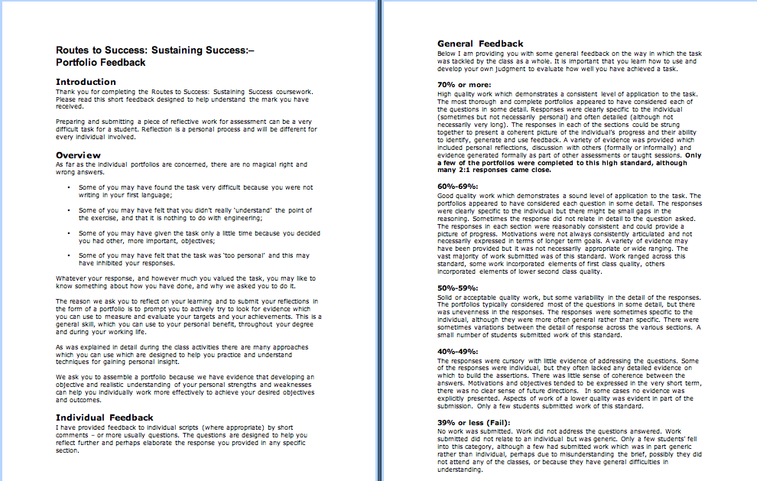
Feedback from previous years…
Available
on
EdShare
Notes:
This document is available from EdShare
Read through to identify feedback relevant to you

Slide 22
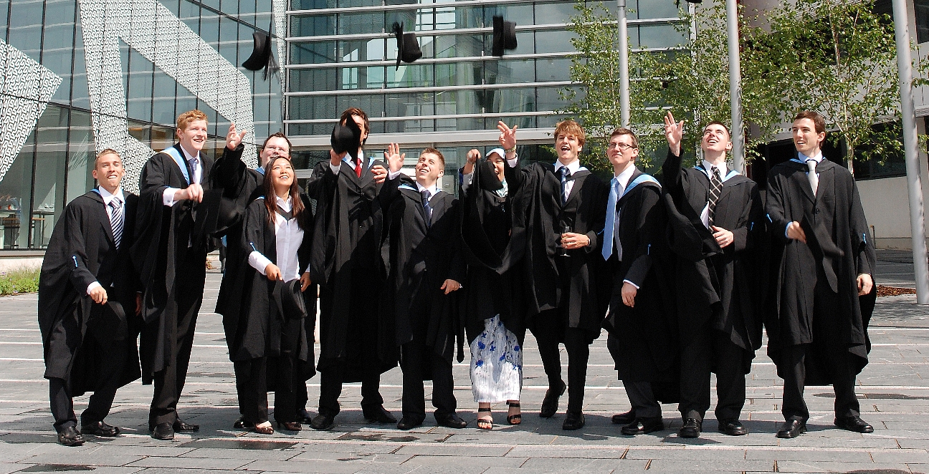
Targets/follow up activities
Decide what sort of mark/degree you want to get
  For the foundation year
  For your degree
Decide how and when you are going to do the work
Make good progress on your portfolio before next week
  Its OK to work with others in the class
  You may find it enjoyable
  You may find it helpful

Slide 23
Thank You :-)

Slide 24
Follow Up Activities..
Think about evidence…
  Where will you get evidence?
  What sort of evidence can you use?
Read through the upcoming portfolio questions
Think about the most thorough ways of explaining evidence
Take a look at EdShare
  could you use it to assemble/collect evidence?

Slide 25
Week 2 resources
These slides
The portfolio template
Portfolio Summary
Feedback from previous years
Edshare http://www.edshare.soton.ac.uk/
These slides http://www.edshare.soton.ac.uk/4723/
Collection (all of the above)
http://www.edshare.soton.ac.uk/4724/
Notes:
Portfolio template handout on page with five boxes

