Slide 1
COMP6049
Conducting Interviews and Focus Groups
November 2011
Dr Su White
http://www.edshare.soton.ac.uk/6439/

Slide 2
Introduction and Objectives
Should be a reminder by now ☺
How I will run this class – with you!
What I want – us all to think!
Keep trying to link this to other classes in this module
Notes:
This class is a bit different in its format
Use OHPs to explain interactive approach
Use OHPs to set thinking tasks
Use Coloured Cards to record student objectives

Slide 3
The plan
I may
skip over
some slides,
but use them
as notes
Interviews
  Why conduct them?
  what are they?
Linking design with methods
Conclusion/reflection
NB All the time… considering what we know already about research methods
Notes:
5/10 WK 1 Background and course structure by LC & SAW Susan White: anecdotal tales of an exemplar of interdisciplinary research.
12/10 WK 2 Comparison/ Social science methodologies (Gerry Stoker introduced by LC. SAW to listen.) BOTH LECTURES ACTUALLY ON THURSDAY 10-11:30
19/10 WK 3 Research design Su White?
Background and course structure by LC & SAW Su White: anecdotal tales of interdisciplinary research. Intro by CP Methodology & method, strategies and underlying philosophies Disciplinary and paradigm differences and how they influence research practice 12/10 Comparison/ Social science methodologies Prof Gerry Stoker . BOTH LECTURES ACTUALLY ON THURSDAY 10-11:30 Experiments /causality Prof Gerry Stoker 19/10 Research design

Slide 4
Interviews – why?
Why do we conduct interviews?
What format can interviews take?
Remember the definition of research?
  What contribution can interviews make to research?
Think about a classic abstract
This is the way the world is
This is what is wrong with the world
Here is my interesting idea/proposal
Here is what I have found

Slide 5
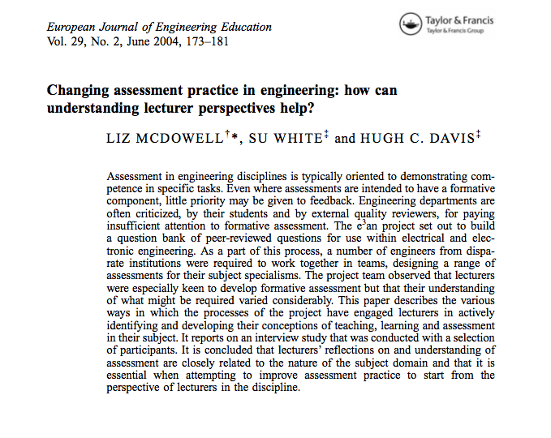
Interview Study
http://eprints.ecs.soton.ac.uk/12663/
Notes:
The project team observed that lecturers were especially keen to develop formative assessment but that their understanding of what might be required varied considerably. This paper describes the various ways in which the processes of the project have engaged lecturers in actively identifying and developing their conceptions of teaching, learning and assessment in their subject.
It reports on an interview study that was conducted with a selection of participants. It is concluded that lecturers’ reflections on and understanding of assessment are closely related to the nature of the subject domain and that it is essential when attempting to improve assessment practice to start from the perspective of lecturers in the discipline.

Slide 6
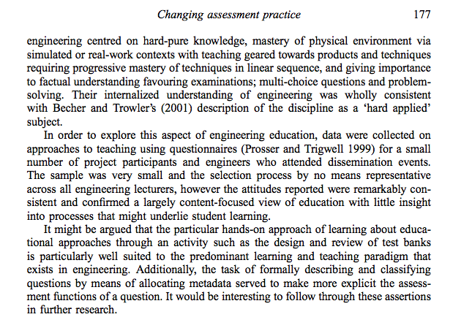
Explaining the method

Slide 7
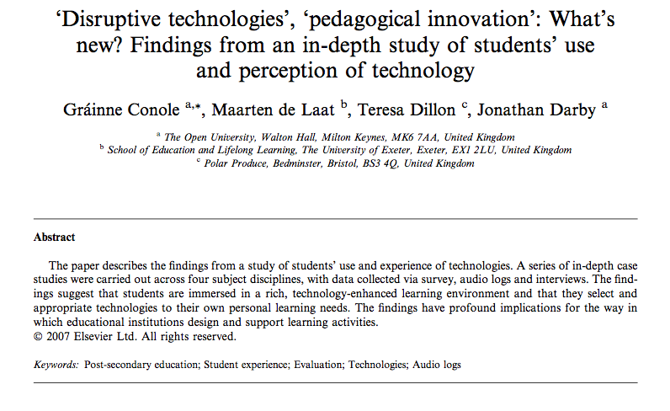
Case Study – mixed methods

Slide 8
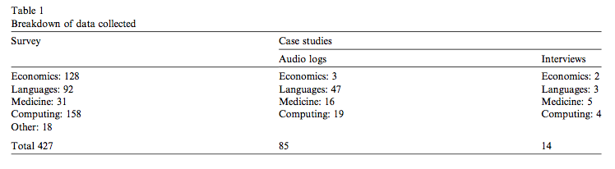
A mixed method approach

Slide 9
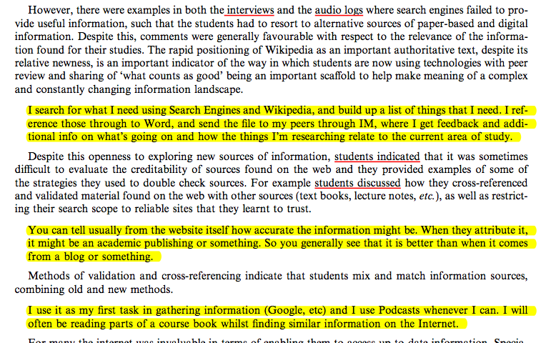
Situating the findings

Slide 10
Interviews, Focus groups and others
Interviews
Focus groups
One to one
Occasionally one to few
issues
  Time and scheduling
  Transcription and data analysis
Additional method
One to many
Perhaps
  Saves time
  But …
    scheduling may be complex
    Dangers of ‘group think’
Alternatives?
Nominal group technique
Delphi/ Modified Delphi
Consider as we progress…

Slide 11
Approaching an interview
Purpose
Protocols
Pragmatics
Paradigm

Slide 12
Purpose
Why do we conduct research?
  Validate
  Confound
  Generate new evidence
What sort of evidence
  Convincing
  Objective
  Valid
    Does this raise issues?
Enable analysis
Generate Conclusions
Publication
triangulation

Slide 13
Purpose: Ways of looking at change
identity
values
capabilities
environment
beliefs
What evidence can I use here?
Sullivan et al 2001
Aligning individual and organisational values to support change
Notes:
Sullivan et al 2001, SULLIVAN, W., SULLIVAN, R. & BUFFTON, B. (2001) Aligning individual and organisational values to support change. Journal of Change Management 2, 3 247-254.

Slide 14
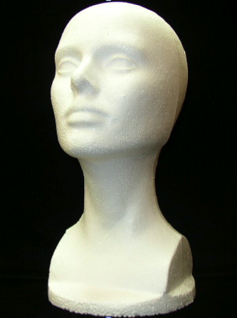
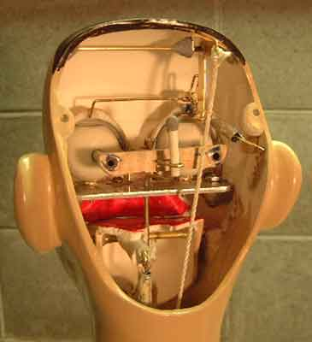
Purpose: What’s going on inside?
Survey
  Qualitative questions
Interviews
  One to one
    Structured
    Semi structured
  One to many
    Focus group
    Other ‘devised’ methods

Slide 15
Purpose: to publish…
This is the way the world is
(literature +survey?)
This is what is wrong with the world
(evidence?)
This is my startling idea
(paradigm/epistemology?)
This is what I found
(valid method, evidence and conclusions)
Its all research

Slide 16
Reminder – (w2) Paradigm
Epistemology
  Will determine where we start
  Where we want to engage in discourse
  May constrain our beliefs
  May determine the contents of our survey
Methodology
  How to administer interviews?
  How to retain consistency
  How to gather quality data?
  Analysis methods/load
  Anticipates analysis

Slide 17
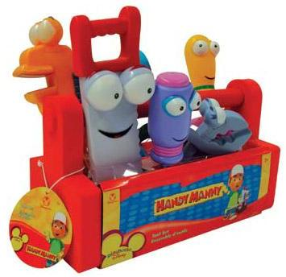
Paradigm: What tools do we have?
Its all research
Methodology – a way of thinking about or studying (social reality)
Method – a set of procedures and techniques for gathering and analysing data
Analytical Processes – the application of set techniques appropriate to quantitative or qualitative methodologies
Thanks (in part) to Strauss and Corbin
Notes:
Background and course structure by LC & SAW Su White: anecdotal tales of interdisciplinary research. Intro by CP Methodology & method, strategies and underlying philosophies Disciplinary and paradigm differences and how they influence research practice 12/10 Comparison/ Social science methodologies Prof Gerry Stoker . BOTH LECTURES ACTUALLY ON THURSDAY 10-11:30 Experiments /causality Prof Gerry Stoker 19/10 Research design

Slide 18
Plan and Prepare
Refer to existing practice – in your field
Refer to established practice – from a research methods overview
In the literature
  Books will provide theoretical overviews
  Your community may have investigated and discussed methods
Orlikowski, W.J. Using Technology and Constituting Structures: A Practice Lens for Studying Technology in Organizations, Organization Science, 11, 4, 2000: 404-428.

Slide 19
Protocols
Ethics, Privacy and Data Protection
Same old, same old…
Just think about the personal…
  You are asking for information
  Respect your contributors
  the challenge of retaining objectivity
    You may become a confidante!!

Slide 20

Protocols
Establishing ground rules
  Build rapport
Running the show
  Plan your questions
    Dry run
  Collect and record data
    Be professional
    Focus on interactions

Slide 21
Pragmatics
Constraints
  Timing and access
Selection method/sampling rationale
Consequences
  Data Volume
  (analysis tools)
Design
  Expertise
  Draft and Review
Process
  Pre-test/Trial/Pilot
  …then survey
  Follow up survey

Slide 22
Pragmatics – bringing it together
Planning
  What you want to explore/find out/prove/discover
  Who will you interview, how will you select them
  What you will ask
  Dry run
Process
  Conduct interviews ( review each session )
  Transcribe and Analyse data
  Interim conclusions/discussion/
  Draft, review, publish

Slide 23
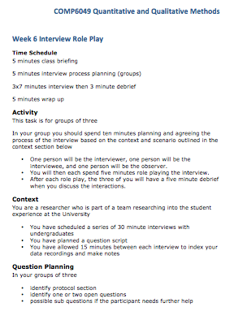
How you will learn this…
Next Class
Role play
Small group activities
Prepare
Take a look at the references
Look at the brief for next class
Prepare yourself ☺

Slide 24
References
for background and related material and references please see the course web page
  CRESWELL, J. W. (1998) Qualitative inquiry and research design choosing among five traditions, Thousand Oaks, Sage.
  CRESWELL, J. W. (2003) Research design qualitative, quantitative, and mixed methods approaches, Thousand Oaks, Calif. London, Sage Publications.
  GLASER & STRAUSS (1999) The discovery of grounded theory strategies for qualitative research, New York, Aldine de Gruyter.
  HUBERMAN, A. M. & MILES, M. B. (2002) The qualitative researcher's companion, Thousand Oaks, CA, Sage Publications.
  KVALE (1996) Interviews an introduction to qualitative research interviewing, Thousand Oaks, Calif., Sage.
  MYERS, M. D. & AVISON, D. E. (2002) Qualitative research in information systems : a reader, London, Sage.

Slide 25
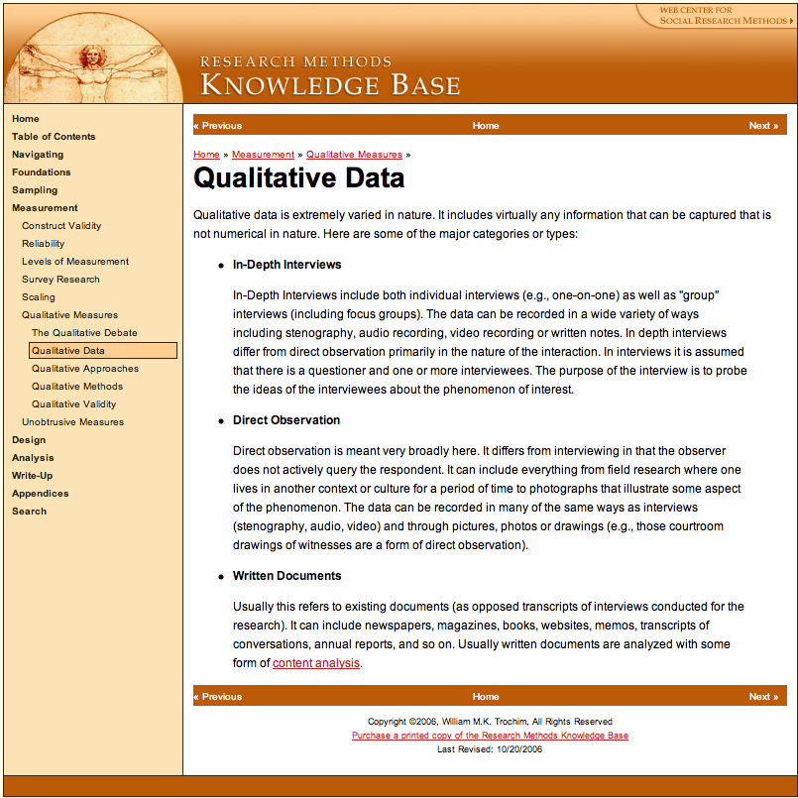
References
http://www.socialresearchmethods.net/kb/qualdata.php

Slide 26
Further details
Me
Dr Su White
saw@ecs.soton.ac.uk
+44 (0)23 8059 4471
http://www.ecs.soton.ac.uk/~saw
Slides, handout and class guide all available at
http://www.edshare.soton.ac.uk/6439/

