Slide 1
Preparing for your presentations
Su White
http://www.edshare.soton.ac.uk/6216/

Slide 2
resources
Handouts
  Task specification: one per group
  Marking sheet: one per student

Slide 3
Objectives
Think about the presentation task
Estimate the amount of work/preparation you will have to do
Familiarise yourselves with the marking scheme
Give you some practical experience of standing in front of the class
  Understand
    the different aspects which will be assessed when you make a presentation
  Identify
    the necessary tasks associated with preparing a presentation

Slide 4
Class Activity
Prepare for a presentation

Slide 5
Your task
In your groups
Make a list of advice/guidance for preparing and presenting information to an audience
Think of every possible perspective which you can imagine
Write the list down
Use this as a basis for a presentation….

Slide 6
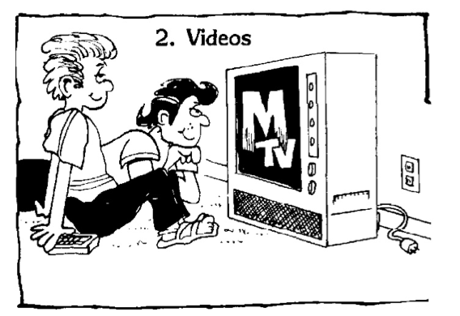
Spot the mistake….

Slide 7
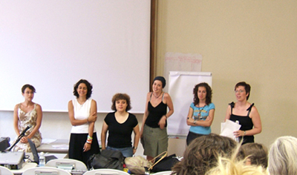
Your Task…
Prepare a very short ‘presentation’ where
  you do things wrong,
  thereby drawing attention to good practice
The catch
Each group will go in turn,
so try to adjust your presentation to do stuff differently to the previous groups!!
I will draw lots for the turn taking ☺

Slide 8
timings
First 5 minutes (now) briefing
Next 7 minutes (next) preparation/discussion
Then 5x4 minutes
Final 5 minutes – general feedback discussion
Note – this is a very quick event I will use the bell to keep you to time
Of course you could do it better with more time ☺ but please do your best!

Slide 9
Method and Pitch
In your groups use 7 minutes to plan a short
(4 minutes timed) joint presentation to the rest of the class
The pitch:
  Make a presentation which advises students how to make and excellent presentation and how to avoid making dreadful presentations:
      What are the aspects of a good presentation
      What are things which can go wrong in a presentation
      What are the challenges of a group presentation?
      How would you make sure you scored top points against the marking scheme?
  At the end (final 1 minutes)
  tell us what background tasks and preparation you would need to do to prepare a well researched and illustrated version of this presentation
  Remember the objective is to get you some practice at presenting

Slide 10
The coursework
The list of topics, method for selecting topic and schedule for presentations will all be formalised over the next week
You will receive an email when the coursework is available
Meanwhile
  the basic structure of the activity specified for previous years in available in Edshare at
  http://www.edshare.soton.ac.uk/4201/
  The markscheme is in Edshare at
  http://www.edshare.soton.ac.uk/6172/

Slide 11
Archive
Additional topic offered in previous years
Students were able to choose between each one

Slide 12
You choose….
Prospective Students
  What they can expect from the application procedure
  What will happen when they first arrive at university
  What its like being a student at Southampton in ECS generally
  What sort of teaching and individual study they can expect
Presentation Guide
  What are the aspects of a good presentation
  What are things which can go wrong in a presentation
  What are the challenges of a group presentation?
  How would you make sure you scored top points against the marking scheme?
tell us what you would need to do to actually prepare a well researched and illustrated version of this presentation
  Remember the objective is to get you some practice at presenting

Slide 13
Method and Pitch (1)
In your groups use 10 minutes to plan a short
(4 minutes timed) joint presentation to the rest of the class
The pitch one of two:
  Imagine you are presenting to a group of school or college students one or two years younger than yourself. The presentation is designed to explain things like:
      What they can expect from the application procedure
      What will happen when they first arrive at university
      What its like being a student at Southampton in ECS generally
      What sort of teaching and individual study they can expect
  At the end (final 1 minutes)
  tell us what you would need to do to actually prepare a well researched and illustrated version of this presentation
  Remember the objective is to get you some practice at presenting

