Slide 1
2011-12 Student Selected Units (SSU)
Evaluation survey

Slide 2
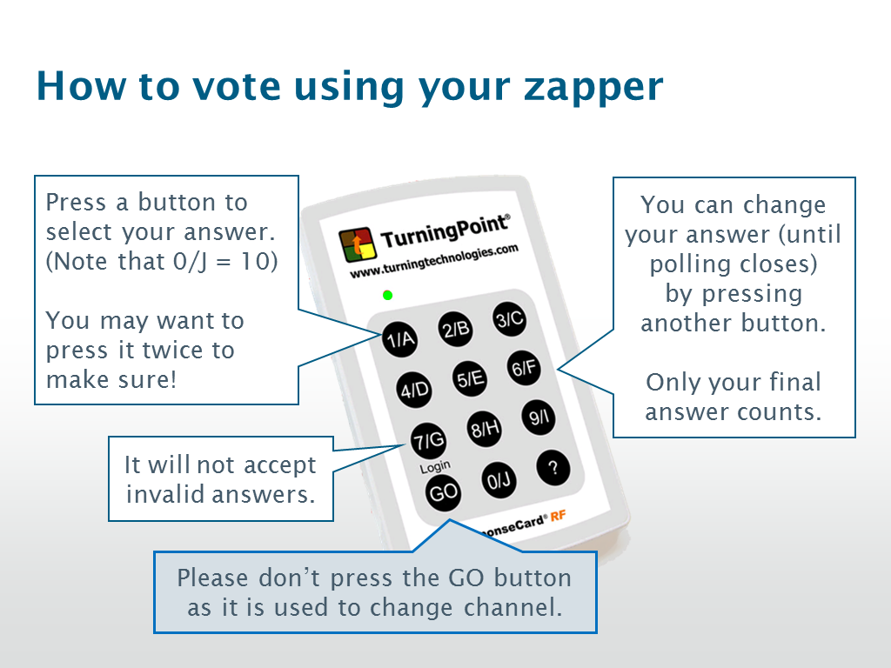

Slide 3
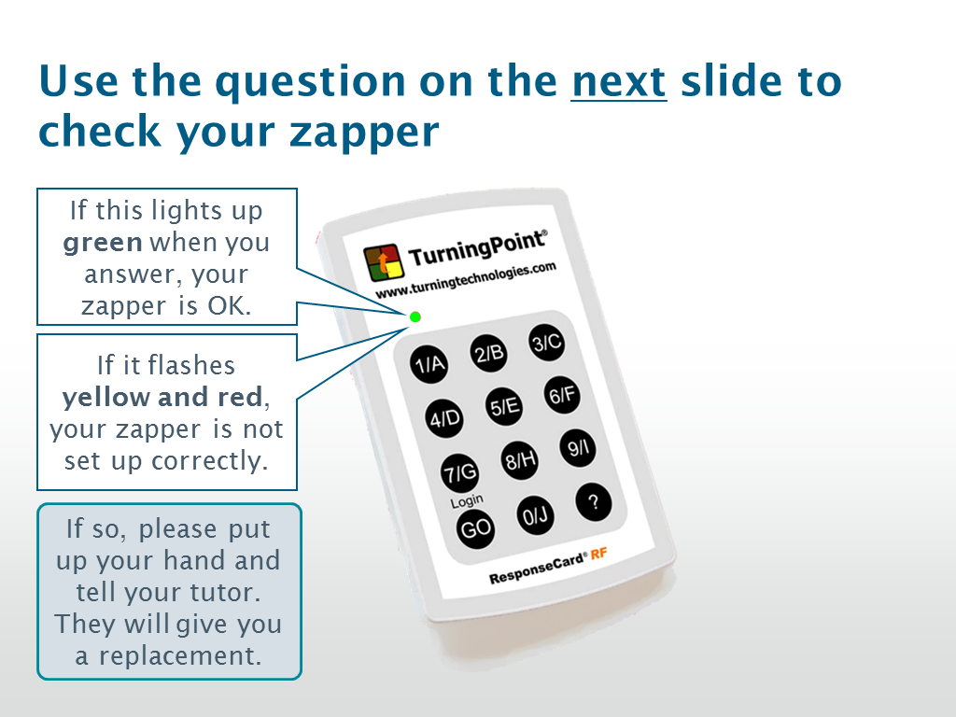

Slide 4
A question to test your zapper
What did you drink with your breakfast this morning?
What’s breakfast?
Coffee
Tea
Fruit Juice
Water
Nothing
Other
Remember to check that the light flashes green when you vote!

