Slide 1
University of Southampton Linked Open Data Architect
Christopher Gutteridge
@cgutteridge

Slide 2
University of Southampton Linked Open Data Architect
Christopher Gutteridge
@cgutteridge
Gardener!

Slide 3
"If HP knew what HP knows, we'd be three times more profitable."
Lew Platt

Slide 4
Allow the bearer to publish any non-confidential data in our realm without let or hindrance.

Slide 5


Slide 6
Where am I going?

Slide 7
Where am I going?
How can I get there?

Slide 8
Where am I going?
How can I get there?
Where do I get coffee on the way?

Slide 9
Places
  Buildings, Rooms, Campuses, Counties, Disabled Access
Organisation Structure
Products & Services
  Coffee, Sandwiches, Library Services, Recycle Points
Points of Service
  Coffee Shops, Swimming Pools, Libraries, Receptions
Teaching
  Courses, Modules, Statistics, Student Satisfaction

Slide 10
Travel
  Stations, Bus-Stops, Bus-Routes, Bus Times
Resources
  EPrints, Videos, Learning Objects
People
  Contact Information, Experts for the Media
Events
  Open Days, University History
Jargon

Slide 11
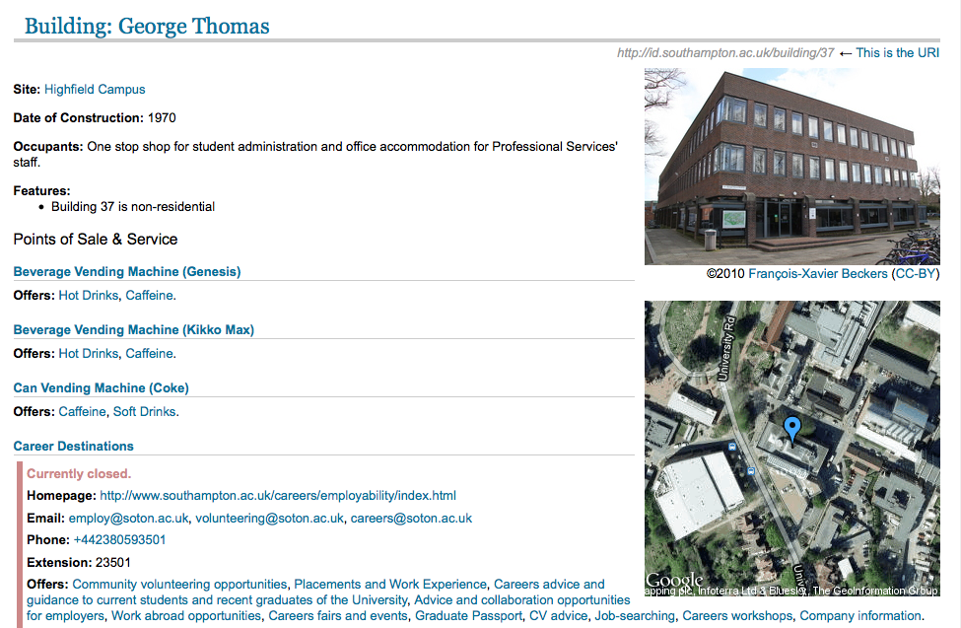

Slide 12
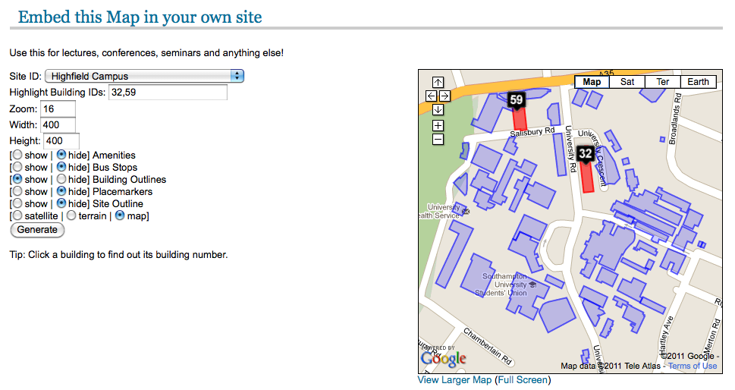

Slide 13
Database
RDF direct from application
RDF Dataset Document on DIsk

Slide 14
Google Docs
Spreadsheet
Database
RDF direct from application
RDF Dataset Document on DIsk

Slide 15
Google Docs
Spreadsheet
Database
RDF direct from application
GRINDER
RDF Dataset Document on DIsk

Slide 16
Google Docs
Spreadsheet
Database
RDF direct from application
GRINDER
+Boilerplate +Provenance
RDF Dataset Document on DIsk

Slide 17
RDF Dataset Document on DIsk
Triple Store

Slide 18
Triple Store

Slide 19
Triple Store
Web Page

Slide 20
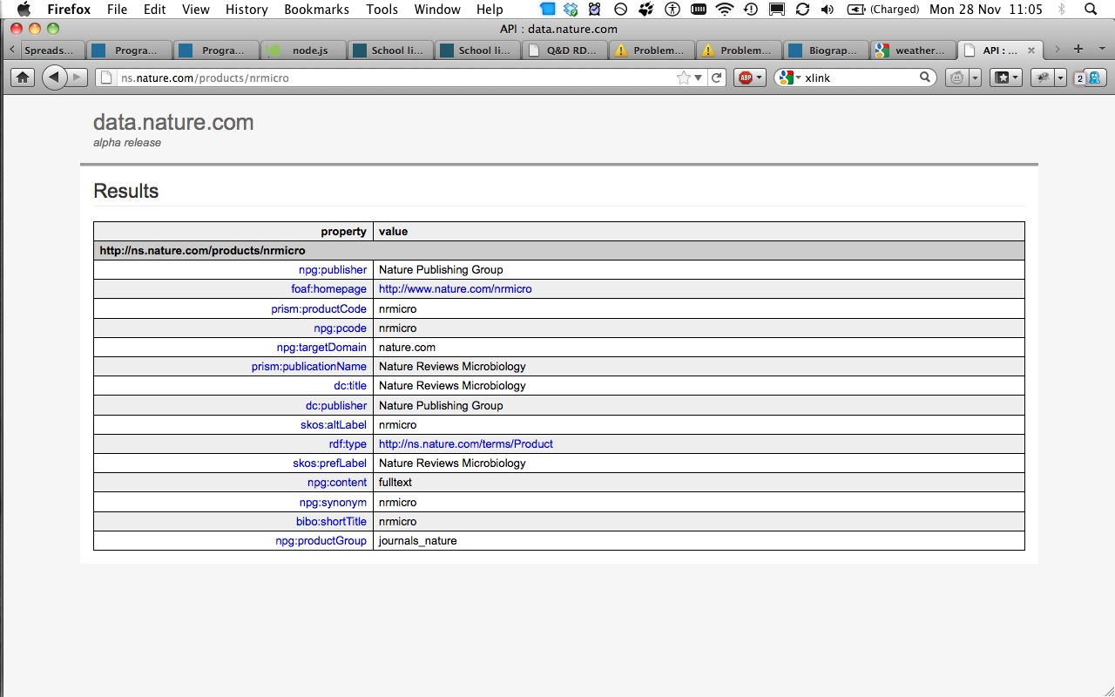

Slide 21
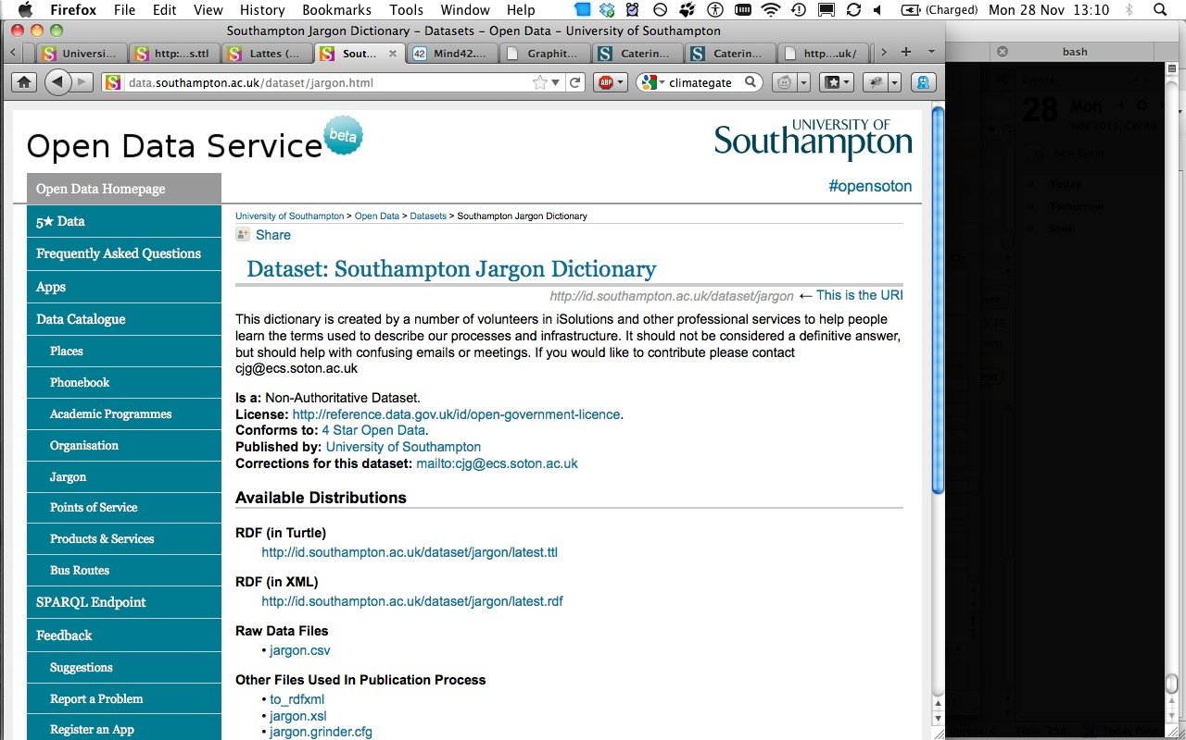

Slide 22
Triple Store
Web Page

Slide 23
Triple Store
RDF Document
Web Page

Slide 24
Triple Store
Map (KML)
RDF Document
Web Page
Spreadsheet (CSV)

Slide 25
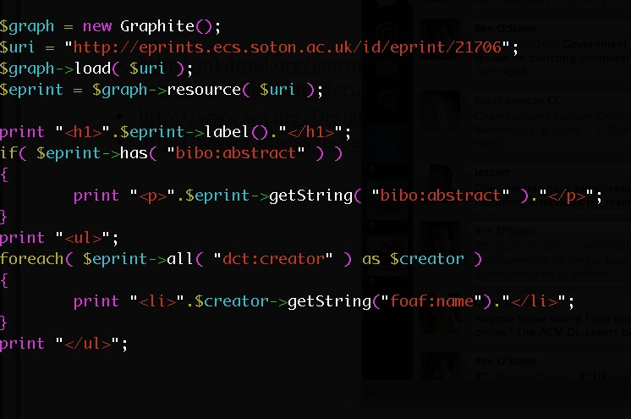

Slide 26
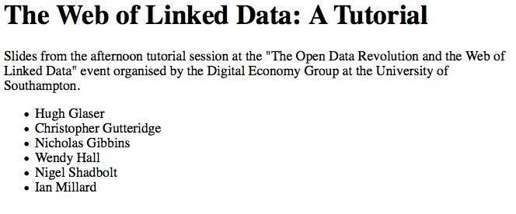

Slide 27
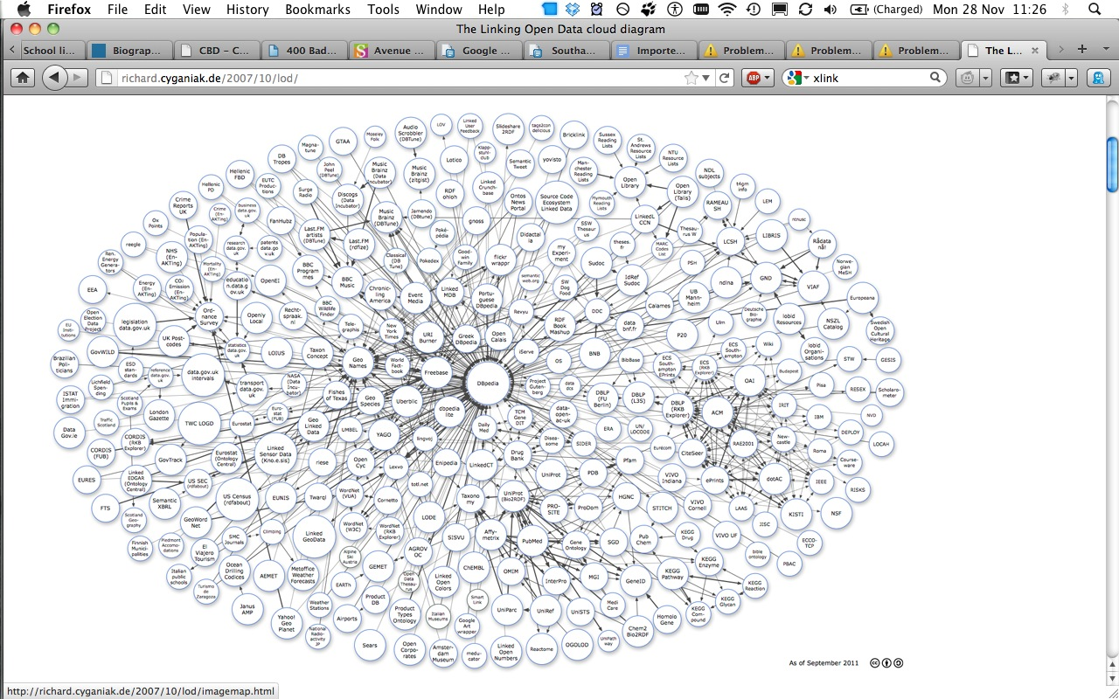

Slide 28
Room
Person
Building
Site
Learning Object
Research Output
Point of Service
Organisation Unit
Product / Service

Slide 29
People (Users, Librarians)
Groups of People (Organisations)
Services (with opening hours!)
Places
Collections
Individual Resources (Books, Journals…)

Slide 30
Grinder (publishing RDF)
https://github.com/cgutteridge/Grinder
Required skills:
RDF structure
RDF/XML
XSLT

Slide 31
Graphite (consuming RDF)
http://graphite.ecs.soton.ac.uk/
Required skills:
RDF structure
PHP

Slide 32
data.southampton.ac.uk http://blogs.ecs.soton.ac.uk/data/
@cgutteridge

