Slide 1
Digital Inequality
Susan Halford Sociology and Social Policy/Work Futures Research Centre
Susan.Halford@soton.ac.uk,
www.soton.ac.uk/wfrc
Notes:
Please use the dd month yyyy format for the date for example 11 January 2008. The main title can be one or two lines long.

Slide 2
Introduction
The Web as a force for democratization, egalitarianism:
  Access to vast quantities of information
  Ability to navigate this efficiently
  Low barriers to entry, as consumer
  Low barriers to entry, as producer (Web 2.0)
Transcending older, centralised power structures

Slide 3
A Digital Divide?
Inequalities of access
Inequalities in usage
Inequalities in advantages conferred
Inequalities in control of content

Slide 4
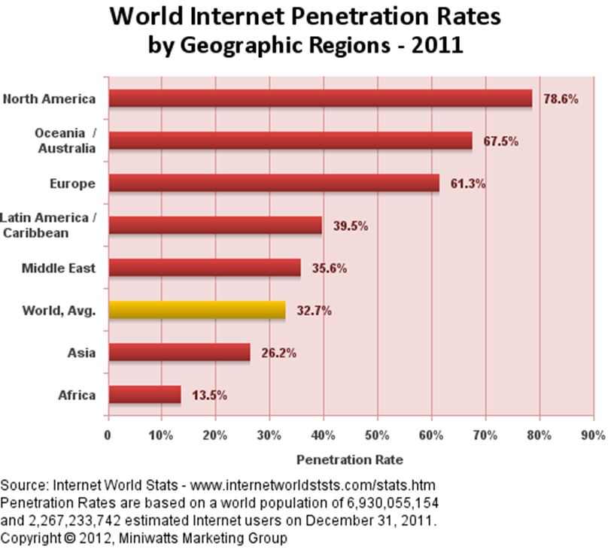
Inequalities of Access
Global inequalities
Majority of the world’s population does not have access to the Web
Access heavily weighted to US/ (Western)Europe/Australasia
Lack of access as a form of social exclusion?
Reproducing/exacerbating inequalities

Slide 5
Access to Hardware
Initial policy focus from mid-1990s
In international development and in national policy interventions
Not an individual matter: internet access disproportionately = wealthier, white, male, urban, higher levels of education.

Slide 6
For example, in the US in 1999 there was:
  A 20 fold lower level of internet access between the richest households ($75K+) and the poorest (under $15k)
  27% whites accessed the internet at home; the figure for blacks and Hispanics was 9%
  18-fold lower computer and internet access among female headed households with dependent children cf. households managed by married families with children
Source: Gilbert and Masucci 2011

Slide 7
interventions:
- library access
- community technology centres
- laptops for schoolchildren
To provide access to the ‘have nots’
But inequalities persist:

Slide 8
In the US (2007) 29% of the population does not use the internet (NITA 2007)
In the UK (2009) 15m people do not use the internet (BIS 2009)
Not evenly spread: age, socio-economic group and whether or not there are children in the household all make a big difference

Slide 9
Age | % with domestic internet access
75+ | 24%
65-74 | 47%
55-64 | 67%
45-54 | 87%
25-44 | 90%
SEC | % with domestic internet access
A, B, C1 | 87%
C2, D, E | 63%
Source: Ofcom (2008) Accessing the Internet at Home

Slide 10
In short:
  Access continues to be a problem, but
  Even given access people don’t necessarily use it
  There is a ‘core-resister’ (Ofcom 2008) group (of which more later)
  Questions of use maybe as important as access

Slide 11
Beyond Hardware?
Access model assumes that internet is a general good, with shared benefits for all
Idea of ‘core resisters’ assumes non-use is perverse
Cf. problematizing the Web, seeing the web from the point of view of individuals in the context of their everyday lives.
Gilbert and Masucci (2011) Strategies for Bridging the Digital Divide Praxis (e)press

Slide 12
Access alone is insufficient
Skills required – basic and more advanced
Eszter Hargittai (2008) - some uses are more likely to yield beneficial outcomes than others e.g. might increase access to advantageous resources – enabling users to acquire valuable labour market skills, economic benefits or social networks – others types of use might ‘downright disadvantage the uninformed’.

Slide 13
Gilbert and Masucci
  Social action research
  North Philadephia
  Exploring the web from the perspective of some of the most marginalised people in the US
  Harrison Plaza – CTC
  KWRU – campaign group
  Telemedicine for chronic heart disease
Power and inequality, not access or demographics

Slide 14
Implications beyond North Philadelphia?
  Reconceptualising core resisters as people making realistic decisions about their lives
  Reconceptualise normative accounts of the web: not a uniform good

Slide 15
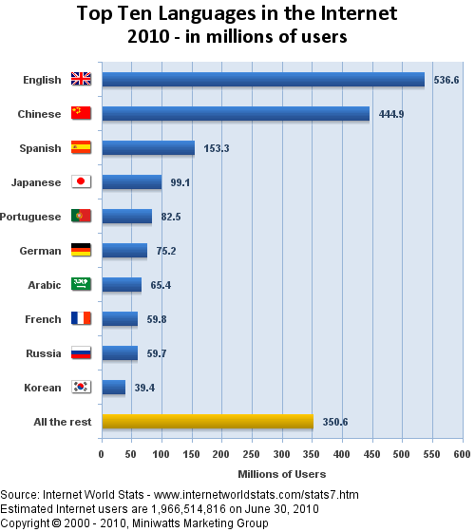
Content
Language

Slide 16
Media giants
http://news.bbc.co.uk/1/hi/technology/8562801.stm
The Filter Bubble – Eli Pariser http://www.ted.com/talks/eli_pariser_beware_online_filter_bubbles.html
-> calls for ever more skilled users

Slide 17
Conclusions
Unpicking and understanding if and how the web is linked to inequality means:
  Recognising that the access divide is not over
  Thinking beyond hardware
  Thinking beyond demographic variables
  Developing a conceptual and theoretical toolkit
    Beyond technological determinism
    Co-constitution
    Intersectionality
    Technical capital

Slide 18
Why/does this matter for Web Science?
  Who is the web ‘for’?
  Can the web be pro-human?
  How can we shape the evolution of the Web?

