Slide 1

HTML5
Requirement Driven Design
David Tarrant
davetaz@ecs.soton.ac.uk
Electronics and Computer Science

Slide 2
The Problem (Standards!)
XHTML vs HTML
IE/Opera/Safari/Chrome/…
Mobile vs Desktop
Add-ons to add functionality
  e.g. flash and custom built elements

Slide 3
HTML5
New features should be based on:
  HTML
  CSS
  DOM
  JavaScript
Markup to replace scripting
Device Independent
Make customisations accessibility ready

Slide 4
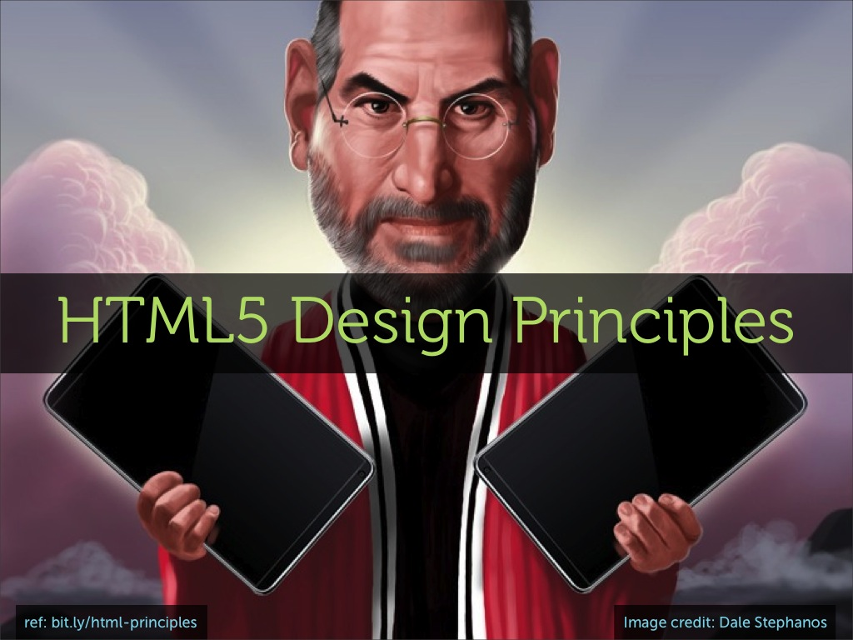
Notes:
Don’t be evil
2.1. Support Existing Content
2.2. Degrade Gracefully
2.3. Do not Reinvent the Wheel
2.4. Pave the Cowpaths
2.5. Evolution Not Revolution
3.1. Solve Real Problems
3.2. Priority of Constituencies
3.3. Secure By Design
3.4. Separation of Concerns
3.5. DOM Consistency
4.1. Well-defined Behavior
4.2. Avoid Needless Complexity
4.3. Handle Errors
5.1. Media Independence
5.2. Support World Languages
5.3. Accessibility

Slide 5
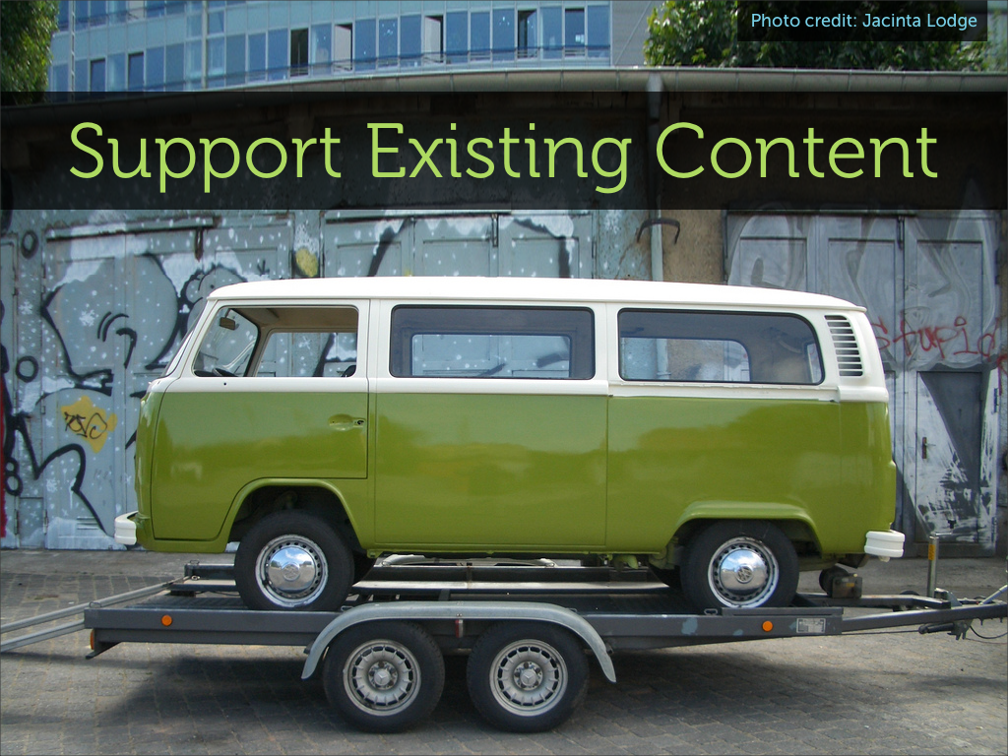

Slide 6
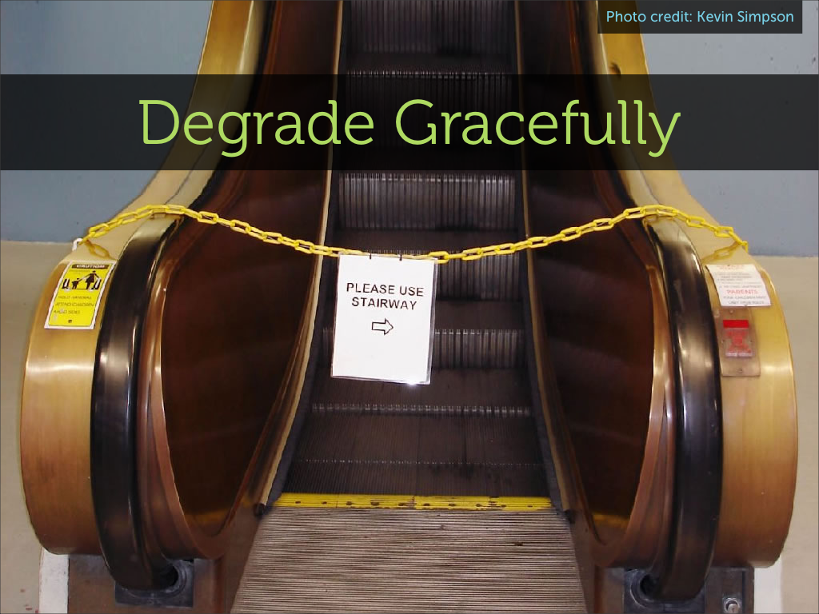

Slide 7
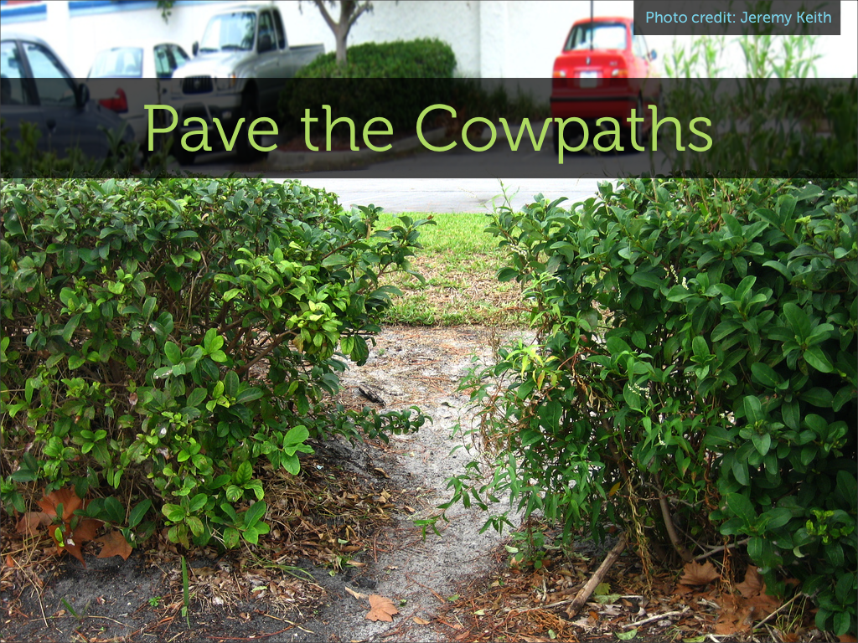

Slide 8
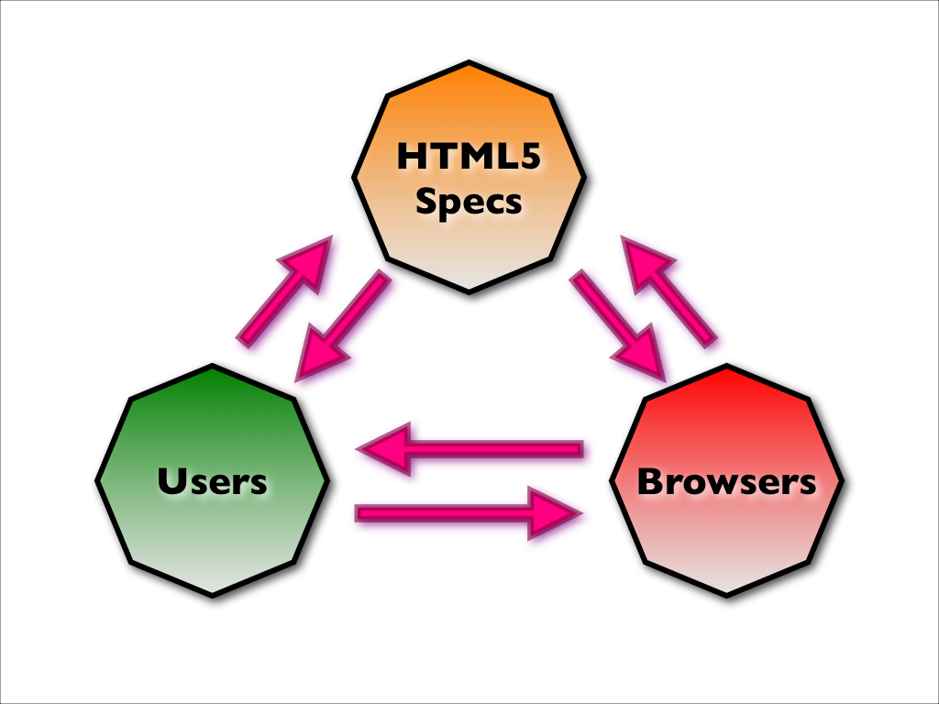

Slide 9
Power of Constituencies
XHTML
Notes:
Back to the roots of HTML

Slide 10
New Doctype
<!DOCTYPE HTML PUBLIC "-//W3C//DTD HTML 4.01//EN" "http://www.w3.org/TR/html4/ strict.dtd">
<!DOCTYPE html PUBLIC "-//W3C//DTD XHTML 1.0 Strict //EN" "http://www.w3.org/TR/xhtml1/ DTD/xhtml1-strict.dtd">
<!DOCTYPE html>

Slide 11
<!DOCTYPE html>
Very pragmatic
Need to support existing content
Browsers support features, not doctypes
DTD are meant for validators
Quirks mode vs Standards mode
Notes:
Quirks mode is about maintaining backward compatibility. More the case for IE etc.
Will still be errors.

Slide 12
Keep it Simple/Lazy
<meta http-equiv="Content-Type" content="text/html; charset=UTF-8">
<script type="text/javascript" src="file.js"></script>
<link rel="stylesheet" type="text/css" href="file.css">
<img src=”foo.png” alt=“foo”/>

Slide 13


Slide 14
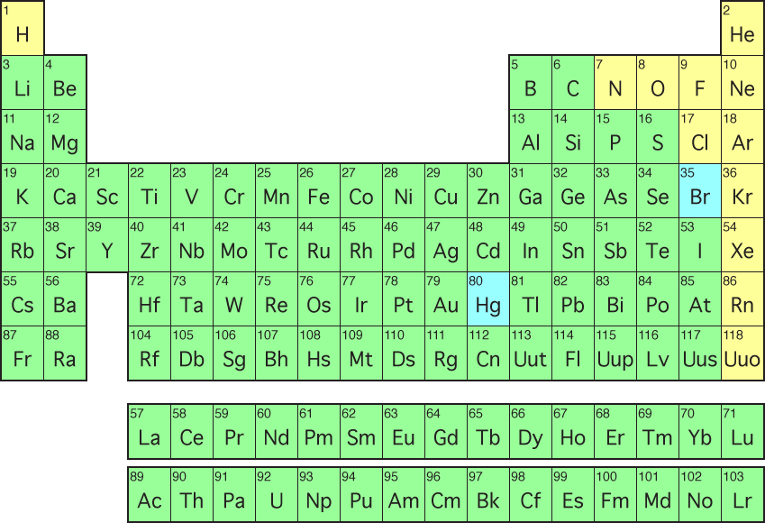
(1)
1
<Elements>

Slide 15
Popularity | Class/ID
1 | FOOTER
2 | MENU
3 | STYLE1
4 | MSNORMAL
5 | TEXT
6 | CONTENT
7 | TITLE
8 | STYLE2
9 | HEADER
10 | COPYRIGHT

Slide 16
Say no to <table> and <div>
More elements get tags
<header>
<footer>
<nav>
<aside>
<article>

Slide 19
Accessibility
Mark tag – Look for search terms
Details Tag (bit like alt)
  <details>
  <summary>
  A talk on HTML5
  </summary>
  <p>The details of the talk</p>
  </details>

Slide 20
Redefined Tags
<ol>
  <ol start=5>
  <ol reversed>
  <li>Luke Skywalker</li>
  <li>Admiral Ackbar</li>
  <li>Chewie</li>
  <li>Han Solo</li>
  <li>R2D2</li>
  </ol>

Slide 21
Removes Elements
Applet
Marque
big
font
frame
blink

Slide 22

(2) Forms

Slide 23
New Input Types
<input type=“email”>
<input type=“number”>
<input type=“tel”>
<input type=“url”>
<input type=“search”>

Slide 25
More Input Options
<input placeholder=“Your Name”>
<input required>
<article contenteditable>

Slide 26
Auto-Complete
<input type="text" list="planets"/>
<datalist id="planets">
<option value="Mercury">
...
<option value="Neptune">
</datalist>
</input>

Slide 27

2) Rich Media

Slide 28
Remember this:
<object classid="clsid:d27cdb6e-ae6d-11cf-96b8-444553540000" width="640" height="360" codebase="http:// download.macromedia.com/pub/shockwave/cabs/flash/ swflash.cab#version=6,0,40,0"><param name="flashvars" value="guid=BQtfIEY1&amp;width=640&amp;height=360&amp;locksiz e=no&amp;dynamicseek=false&amp;qc_publisherId=p-18- mFEk4J448M" /><param name="src" value="http://v.example.com/ media/plugins/video/flvplayer.swf?ver=1.21" /><param name="wmode" value="transparent" /><param name="allowfullscreen" value="true" /><embed type="application/x-shockwave-flash" width="640" height="360" src="http://v.example.com/media/plugins/video/flvplayer.swf? ver=1.21" allowfullscreen="true" wmode="transparent" flashvars="guid=BQtfIEY1&amp;width=640&amp;height=360&amp;loc ksize=no&amp;dynamicseek=false&amp;qc_publisherId=p-18- mFEk4J448M"></embed></object>

Slide 29
<video src="movie.mp4”>

Slide 30


But…
Movie formats still an argument (due to licensing)
<video controls width="360" height="240”>
<source src="movie.webm"
type='video/webm; codecs="vp8, vorbis"’>
<source src="movie.ogv"
type='video/ogg; codecs="theora, vorbis"’>
<source src="movie.mp4"
type='video/mp4; codecs="avc1.42E01E, mp4a.40.2"’>
</video>

Slide 32
Other Media
Javascript Canvas
SVG Support
WebGL

Slide 33
Browser Shims
Add this to your stylesheet:
section, article, header, footer, nav, aside, hgroup { display: block; }
Add this conditional comment to your head:
<!--[if IE]>
<script src="http://html5shim.googlecode.com/ ↩
svn/trunk/html5.js"></script>
<![endif]-->

Slide 34
More than Just Tags
HTML + CSS + JavaScript
=
Application

Slide 35


Slide 36
CSS 3
Support for Rounded Corners
  border-color
  border-image
  border-radius
  box-shadow
Multiple Backgrounds

Slide 37
CSS 3 - colors
Hugh, Saturation, Lightness, Alpha - HSL(A)
Red, Green, Blue, Alpha – RGB(A)
Opacity

Slide 38
CSS3 – Selected Others
text-shadow
Support for all HTML5 elements including:
  header
  footer
  nav-top, nav-right, nav-bottom and nav-left
  .article header
Speech module improvements:
  voice-volume: x-soft;
  voice-family: female;

Slide 39

JavaScript

Slide 40
New DOCUMENTED Javascript APIs
Documented APIs ensure browser compatibility, same influence as HTML5
New Features:
  Undo Manager
  Offline Storage
  Drag and Drop
    <input type=“file”>
    Move items in browser (CMS)
Notes:
Give examples of google docs, maps and file upload tags which support the drag and drop.

Slide 41
JS New Methods
Elements = getElementsByClassName(‘entry’);
querySelectorAll(“ul li:nth-child(odd)”);

Slide 42
(Web) Storage
Averts two cookie problems:
  Two tabs buying different rail tickets
  Storage large files (small numbers of MB) in cookies which get sent with every request.
Window.sessionStorage
Window.localStorage

Slide 43
(Web) Databases
var db = window.openDatabase(“name”,”version”)
db.transaction(function(tx) {
tx.executeSql(“SELECT * from test”, [],
successCallback, errorCallback);
});

Slide 44
Offline Storage
sessionStorage, localStorage and SQL are available if the client goes offline. Also need pages.
<html manifest=“cache.manifest”>

Slide 45
cache.manifest
CACHE MANIFEST
CACHE:
index.html
help.html
style/default.css
images/logo.png
images/backgound.png
NETWORK:
server.cgi
Not Cached

Slide 46
Others
Drag and Drop Elements
Geolocation
Audio and Video Manipulation
Canvas

Slide 47
Demos
http://www.adityaravishankar.com/projects/games/command-and-conquer/
http://www.cuttherope.ie/
http://www.apple.com/html5/

Slide 48
Less flashy shiny
http://data.southampton.ac.uk/bus.html
http://orthanc.ecs.soton.ac.uk/~davetaz/mpd.html

Slide 49
Resources
abookapart.com
diveintohtml5.org
http://html5rocks.com/
http://html5doctor.com/
Thanks to:
  Scott Vandehey (@spaceninja)
  Alex Bilbie (@alexbilbie)
  François Massart

