Slide 1

David Tarrant
davetaz@ecs.soton.ac.uk
Electronics and Computer Science

Slide 2
Separation of Concerns
HTML - Layout
CSS – Look and Feel (rounded corners)
JavaScript – Event Handling and Dynamic Behavior
AJAX – Remote access and dynamic data
  Doesn’t have to be XML.

Slide 3
jQuery
A JavaScript library that simplifies common tasks.
Abstracts away browser quirks.
Quick access to manipulate the dom to add/change content, display and animation.

Slide 4
Basic jQuery
$()
A factory method that create JQuery Objects
$(“table”) is a JQuery object containing all the table elements in the document (it’s actually just a function call)

Slide 5
Simple Uses
$(“dt”).addClass(“emphasize”)
  Changes all occurrences of <dt> to <dt class=“emphasize”>
  .removeClass does the opposite
$(“tr:nth-child(odd)”).addClass(“odd”);
  Zebra stripes tables

Slide 6
Which is better?
Function doEmph() {
$(“dt”).addClass(“emphasize”)
}
<body onLoad=“doEmph()”>
Function doEmph() {
$(“dt”).addClass(“emphasize”)
}
$(document).ready(doEmph);

Slide 7
Which is better?
Function doEmph() {
$(“dt”).addClass(“emphasize”)
}
<body onLoad=“doEmph()”>
Function doEmph() {
$(“dt”).addClass(“emphasize”)
}
$(document).ready(doEmph);
Structure and appearance should be separated (CSS and JavaScript).
Also onLoad waits until all images (etc) are loaded.

Slide 8
Which is better?
Function doEmph() {
$(“dt”).addClass(“emphasize”)
}
<body onLoad=“doEmph()”>
Function doEmph() {
$(“dt”).addClass(“emphasize”)
}
$(document).ready(doEmph);
$(document).ready( function () {
(“dt”).addClass(“emphasize”)
});

Slide 9
JQuery Selectors (CSS)
  p element name
  #id identifier
  .class classname
  p.class element with class
  p a anchor as any descendant of p
  p > a anchor direct child of p

Slide 10
JQuery Selectors (Xpath)
  /html/body//div
  paths
  a[@href]
  anchor with an href attr
  div[ol]
  div with an ol inside
  //a[@ref='nofollow']
  any anchor with a specific value for the ref attribute

Slide 11
JQuery Filters
  p:first first paragraph
  li:last last list item
  a:nth(3) fourth link
  a:eq(3) fourth link
  p:even or p:odd every other paragraph
  a:gt(3) or a:lt(4) every link after the 4th or
  up to the fourth
  a:contains(‘click’) links that contain the
  word click

Slide 12
jQuery Chaining
$(‘a:contains(“ECS”)’)
.parent()
.addClass(“emphasize”);

Slide 13
jQuery Chaining (input)
$document.ready( function() {
$(“.stripeMe tr”).mouseover( function() {
$(this).addClass(“over”);
});
$(“.stripeMe tr”).mouseout( function() {
$(this).removeClass(“over”);
});
$(“.stripeMe tr:even”).addClass(“alt”);
});

Slide 14
jQuery Chaining (output)
$document.ready( function() {
$(“.stripeMe tr”).mouseover( function() {
$(this).addClass(“over”);
}).mouseout( function() {
$(this).removeClass(“over”);
});
$(“.stripeMe tr:even”).addClass(“alt”);
});

Slide 15

Events

Slide 16
Events
bind(eventname,function)
  click
  change
  resize
$(“a[@href]”).bind(‘click’,function(){
$(this).addClass(‘red’);});
Notes:
Could also use a change event to update a data list

Slide 17
Dom Levels
Level 0
  element.onClick = doFirstThing;
  element.onClick = doSecondThing;
Level 2
  addEventListener (eventType,listener,useCapture)
  Asynchronous events, using listeners and similar to MQs

Slide 18

Effects

Slide 19
Effects
$(this).show(slow);
$(this).toggle(normal,CALLBACK)
  Callback is a function that is passed a reference to the calling element.
$(this).slideDown(fast);
$(this).stop();

Slide 20
Utility Functions
box model, float style flags
trim
each
grep
inArray, unique, extend
getScript

Slide 21
Examples
http://jqueryui.com/demos

Slide 22
AJAX
load
serialize(Array)
get
getJSON
post
ajax

Slide 23
AJAX - Tedious
function loadXMLDoc()
{
var xmlhttp;
if (window.XMLHttpRequest)
{// code for IE7+, Firefox, Chrome, Opera, Safari
xmlhttp=new XMLHttpRequest();
}
else
{// code for IE6, IE5
xmlhttp=new ActiveXObject("Microsoft.XMLHTTP");
}
xmlhttp.onreadystatechange=function()
{
if (xmlhttp.readyState==4 && xmlhttp.status==200)
{
document.getElementById(“result").innerHTML=xmlhttp.responseText;
}
}
xmlhttp.open("GET",“get_news.php",true);
xmlhttp.send();
}

Slide 24
AJAX - jQuery
$.ajaxSetup({
cache: false
});
$(“#load_basic”).click(function() {
$(“#result”).html(ajax_load).load(get_news.php);
});

Slide 25
The Problems with AJAX
Security Model
XML
  XML is tedious to parse and use
  So don’t use it (unless it is the correct or only solution).
  Try and parse objects you can use, e.g. JavaScript objects (JSON).

Slide 26
JSON – JavaScript Object Notation
Basic types are
  Number integer, real, or floating point
  String double-quoted Unicode with backslashes
  Boolean true and false
  Array ordered sequence of comma-separated values enclosed in square brackets
  Object collection of comma-separated "key":value pairs enclosed in curly brackets
  null

Slide 27
Example
{ "firstName": ”David", "lastName": ”Tarrant",
"age": 28,
"address": {
"streetAddress": “B32, ECS”,
"city": “University of Southampton"
},
"powers": [1, 2, 4, 8, 16, 32]
}
var p = eval("(" + JSON_text + ")");
alert(p.age);

Slide 28
JSON-P
Breaking the Security Model
$.getJSON(“http://my-other-domain.org.uk?p=1&q=2”,
function(data) {
$.each(thing) {
…
}
}

Slide 29
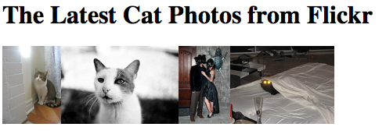
JSON/JQuery Flickr Example
$.getJSON("http://api.flickr.com/services/feeds/photos_public.gne?tags=cat&tagmode=any&format=json&jsoncallback=?",
function(data){
$.each(data.items, function(i,item){
$("<img/>").attr("src", item.media.m).appendTo("#images");
if ( i == 3 ) return false;
});
});

Slide 30
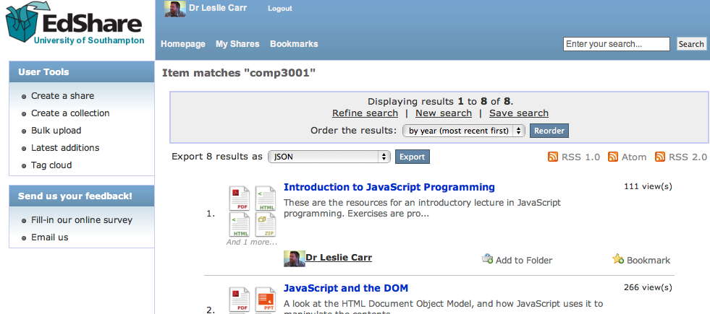
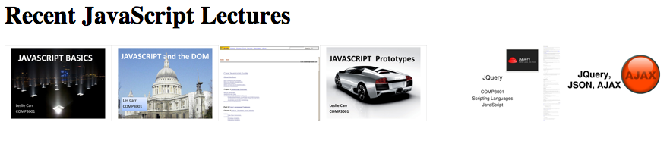

EPrints
$(document).ready(function(){
$.getJSON("http://www.edshare.soton.ac.uk/cgi/search/simple/export_edshare_JSON.js?exp=…..comp3001…&jsonp=?",
function(data){
$.each(data, function(i,item){
$("<a/>").
attr("href","http://edshare.soton.ac.uk/"+item.eprintid).append(
$("<img/>").
attr("src","http://edshare.soton.ac.uk/"+item.eprintid+"/thumbnails/1/preview.png").
bind("error",function(){$(this).addClass("hidden")})
).appendTo("#lectures");
});
});
});

Slide 31
Services with JSON API
Github
  https://api.github.com/repos/info6005/6005_cw1_2012/commits
Open Data Endpoints
  http://id.southampton.ac.uk/building/32
  http://reference.data.gov.uk/doc/mp/warley/john-spellar
BBC
  http://www.bbc.co.uk/music/artists/d24fb461-dee8-41fc-bb15-2f13bb2644a6

Slide 32
Content Negotiation
Ask a URI for a serialisation of a particular object.
GET /building/32 HTTP/1.1
ACCEPT application/json
HOST id.southampton.ac.uk

Slide 33

Debugging

Slide 34
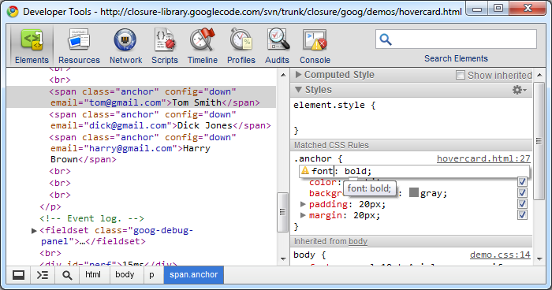
Debugging Web Apps
http://code.google.com/chrome/devtools/

Slide 35
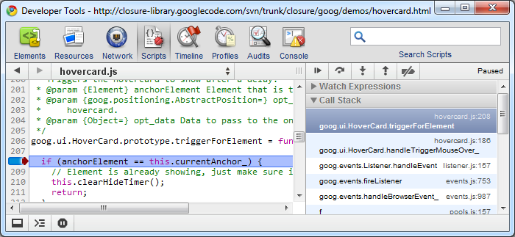
Debugging Javascript
http://code.google.com/chrome/devtools/docs/scripts.html

Slide 36
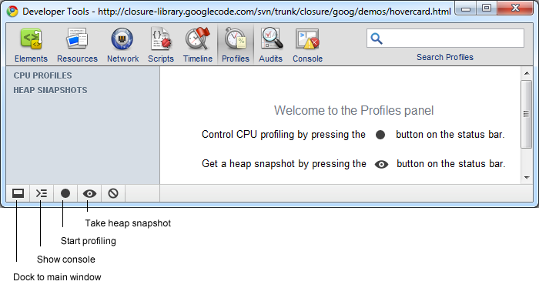
Execution Time
http://code.google.com/chrome/devtools/docs/profiles.html

Slide 37
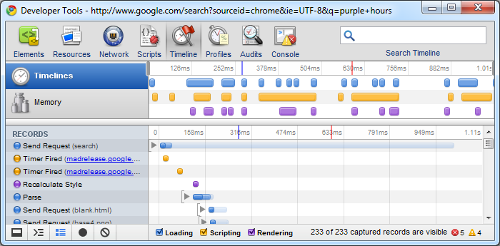
Performance!
http://code.google.com/chrome/devtools/docs/timeline.html

Slide 38
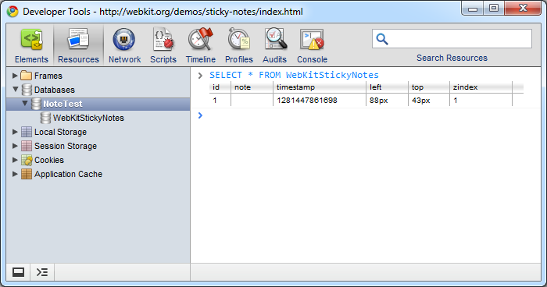
Explore Storage
http://code.google.com/chrome/devtools/docs/resources.html

Slide 39
Resources
abookapart.com
diveintohtml5.org
http://html5rocks.com/
http://html5doctor.com/
Thanks to:
  Scott Vandehey (@spaceninja)
  Alex Bilbie (@alexbilbie)
  François Massart

