Slide 1
Open Access: how progress has been made
Guest lecture: Interdisciplinary Thinking module, Web Science MSc course
School of Electronics & Computer Science, University of Southampton, 8 February 2011
Alma Swan
Enabling Open Scholarship
And
Key Perspectives Ltd

Slide 2
Open Access
Free, immediate access to the entire research literature
No restrictions on use
No restrictions on re-purposing
What are the implications of this for stakeholders?

Slide 3
Open Access – scientific reasons
Research moves faster and more efficiently
Greater visibility and impact
Better monitoring, assessment and evaluation of research
Enables new semantic technologies (text-mining and data-mining)

Slide 4
Open Access – moral arguments
Publicly funded research should be publicly available
Knowledge is a public good and should not be in private hands
The system is ineffective and penalises the less wealthy

Slide 5
Unaffordable system
Data: Lee Van Orsdel; Bill Hooker; American Research Libraries

Slide 6
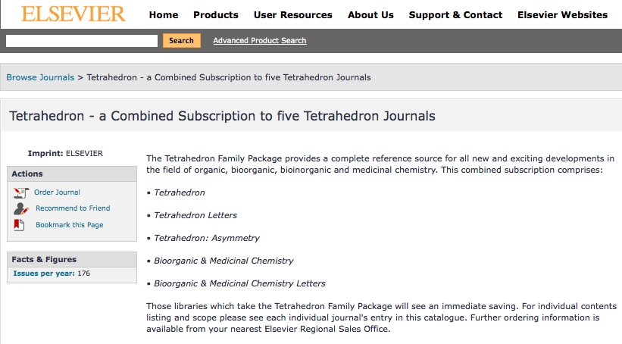

Slide 7
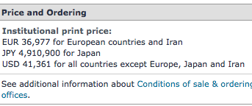

Slide 8

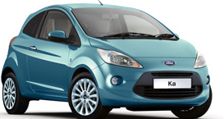
£31,000 =

Slide 9
Progressing a radical idea
Identify stakeholders (enactors, beneficiaries)
Identify their interests
Work out the messages
Deliver them effectively (with evidence as well as passion)
Do steps 3 and 4 again
Do steps 3 and 4 again ...

Slide 10
Stakeholders
Researchers
Research institutions
Research funders
Publishers
Governments (economic and societal benefit interests)
Society at large

Slide 11
Locked out
Civil engineers
Construction industry
Lawyers
Architects
Family doctor practices
Horticulturalists
Dentists
Consultants
Accountants
Teachers and school students
YOU

Slide 12
Arguments made
On multiple fronts (political, economic, societal, technical, legal)
On multiple scales
By multiple levels of proponent
To multiple stakeholders (authors, universities, research funders, governments)

Slide 13
Author advantages from Open Access
Visibility
Usage
Impact
Personal profiling and marketing
Research advantages

Slide 14
ECS Open Access repository

Slide 15
Impact
Range = 36%-200%
(Data: Stevan Harnad and co-workers)

Slide 16
Ray Frost’s impact

Slide 17
Professor Martin Skitmore
School of Urban Design, QUT
“There is no doubt in my mind that ePrints [his university repository] will have improved things – especially in developing countries such as Malaysia … many more access my papers who wouldn’t have thought of contacting me personally in the ‘old’ days.
While this may … increase … citations, the most important thing … is that at least these people can find out more about what others have done…”

Slide 18
Technology-based arguments
Exploiting the Web optimally
There are all sorts of technological tools and tricks to be used and enjoyed
Collaborative, interdisciplinary and ‘Big’ research needs an Open Access, Open Web-based system of communication

Slide 19
Technology-based developments
Led by researchers
Interoperability
Repository technology
Repository services
Vision for a joined-up system

Slide 20
Stakeholder: research-based institutions
Visibility, usage, academic impact
Utility/administration
Value to society
Philosophy-based
Circa 180 policies so far

Slide 21
Webometrics

Slide 22

Admin/management arguments
  “I am asked how many articles my researchers publish each year, and I have to say ‘I have no idea!’” (Professor Bernard Rentier, Rector, University of Liege, Belgium, explaining one of the reasons why he has built an institutional Open Access repository and introduced a mandatory policy on Open Access)
Research Excellence Framework 2014

Slide 23
Philosophical arguments
The mission of a (publicly funded) university is to create and disseminate knowledge
A university has a duty to serve the wider society that pays for it

Slide 24
“The case for Open Access within a university is not simply political or economic or professional. It needs to rest in the notion of what a university is and what it should be .... It is central to the university’s position in the public space”
Professor Martin Hall, Vice Chancellor of the University of Salford

Slide 25
Stakeholder: research funders
Research funders are most often Government-funded bodies
Some are private funders
Some are private companies (and are not expected to subscribe to the concept of OA)

Slide 26
The arguments to funders
There is better return on their investment in research if they require it to be Open Access
Open Access advances science
Open Access brings greater usage and impact
Open Access benefits the wider society

Slide 27
Some significant successes
Research funders:
  Wellcome Trust: http://www.wellcome.ac.uk/About-us/Policy/Spotlight-issues/Open-access/index.htm
  UK’s Research Councils (7 of them)
  US’s National Institutes of Health
  Other national-level funders
  European Research Council
  European Commission
52 funder policies so far

Slide 28
Stakeholder: governments
Economic
Societal

Slide 29
Economic arguments
Open Access would be a cheaper research communication system for nations

Slide 30
National pictures
(Houghton et al, 2009, 2010)
Annual € savings from moving to: | UK | Netherlands | Denmark | US federal agencies
OA journals (‘Gold’ OA) | 480 million | 133 million | 70 million | Value of benefit over 30 years amounts to some $1 billion, 6 times the cost of archiving the material
OA repositories with subscriptions (‘Green’ OA) | 125 million | 50 million | 30 million
OA repositories with overlay services | Circa 480 million | Circa 133 million | Circa 70 million

Slide 31
Economic arguments
Open Access would be a cheaper research communication system for nations
Open Access would better support:
  innovative industries
  professional communities
  practitioner communities

Slide 32
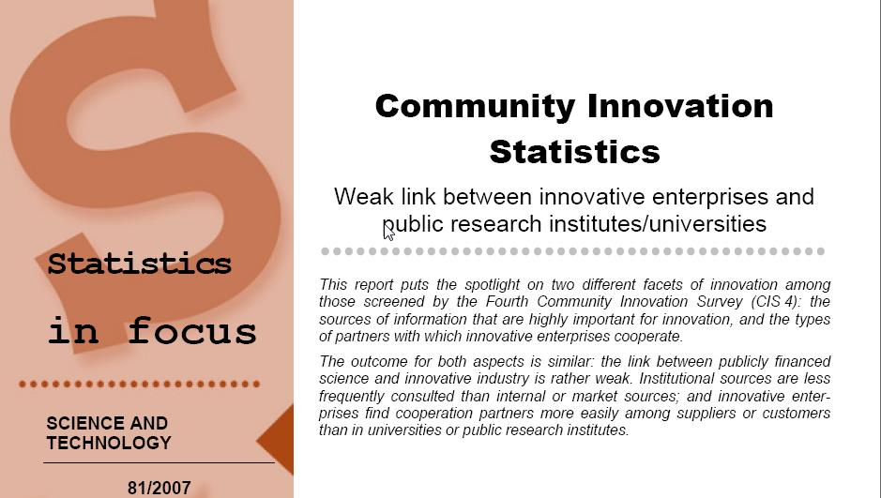
EU CIS studies

Slide 33
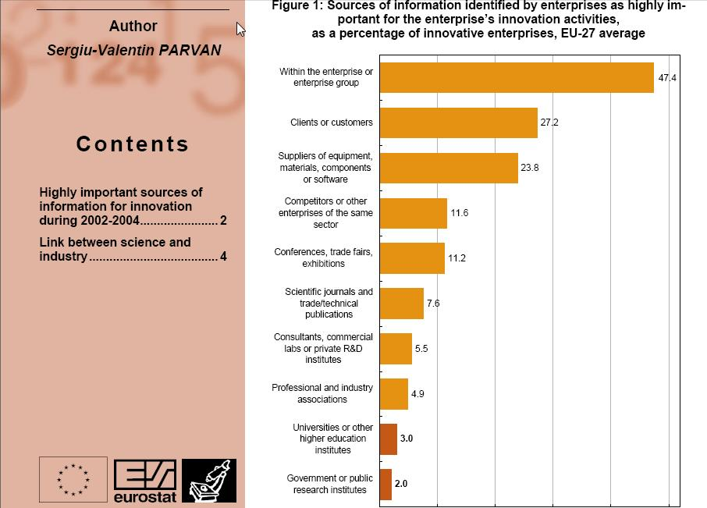

Slide 34
Economic implications in Denmark:
Cost to companies
Average delay to product or process development without access to academic research: 2.2 years
For new PRODUCTS, this would amount to around DKK 36 million per company
For new PROCESSES, delays would amount to around DKK 211 000 per company

Slide 35
Stakeholder: publishers
Open Access publishers
Subscription publishers:
  STM: http://www.stm-assoc.org/
  AAP: http://www.publishers.org/
  Publishers Association: http://www.publishers.org.uk/
Research Works Act (2011)

Slide 36
Recent developments
Danish policy underway: expected later this year
Federal Research Public Access Act reintroduced in the US Congress
Willetts ‘transparency’ Round Table (March 2011)
‘Finch group’: ongoing discussions

Slide 37
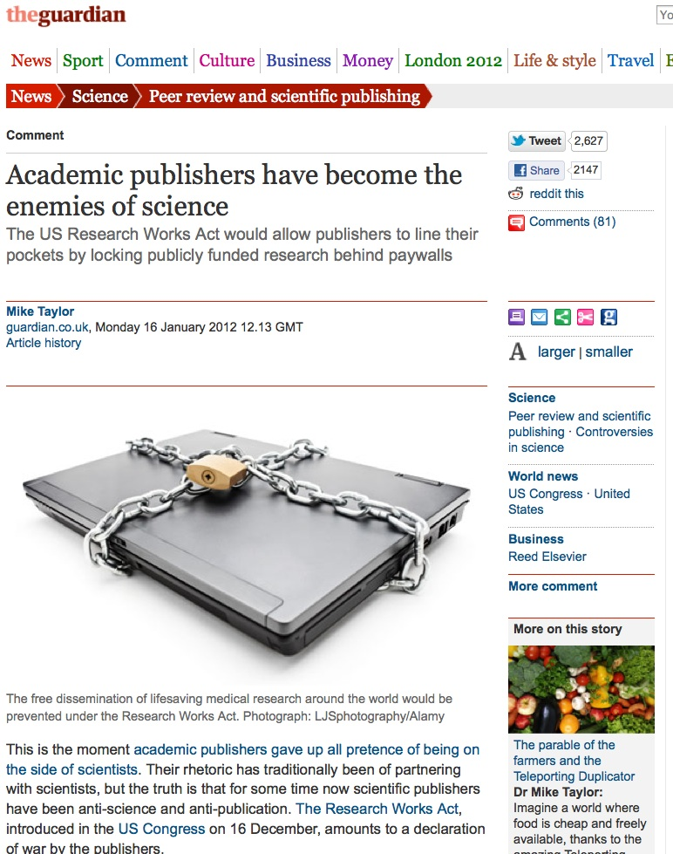

Slide 38
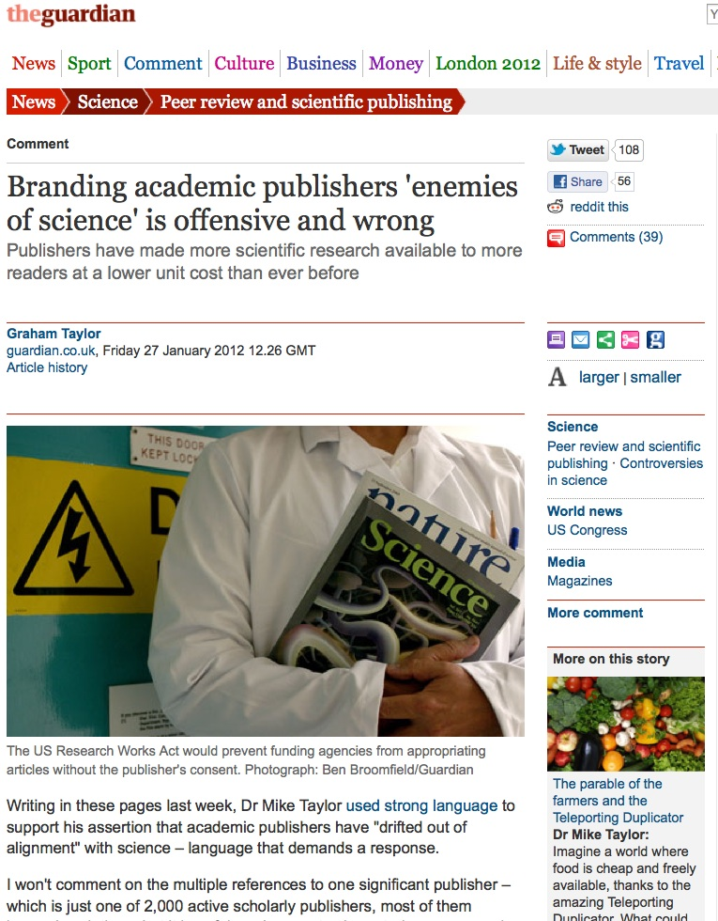

Slide 39
Mandatory policies on OA

Slide 40
The agenda is widening
Open Data
Advantages:
  Re-use by humans
  Re-use by machines
  A true semantic Web
More fun ahead in policy terms!

Slide 41
Alma Swan
Enabling Open Scholarship
www.openscholarship.org
Key Perspectives Ltd
Truro, UK
www.keyperspectives.co.uk

Slide 42
Readings
An overview of the Research Works Act, introduced in the US House of Representatives in December 2011 http://cyber.law.harvard.edu/hoap/Notes_on_the_Research_Works_Act
The National Institutes of Health policy review (February 2012): http://publicaccess.nih.gov/public_access_policy_implications_2012.pdf
The draft revised policy on Open Access from the UK Research Councils: http://www.openscholarship.org/jcms/c_7299/rcuk-proposed-policy-2012
A researcher’s view: http://www.guardian.co.uk/science/2012/jan/16/academic-publishers-enemies-science
A publisher’s response: http://www.guardian.co.uk/science/2012/jan/27/academic-publishers-enemies-science-wrong

Slide 43
Workshop task
You have been sent the draft of the revised policy on Open Access from Research Councils UK
Using the lecture, the readings and other material that you discover, and working in small groups of 3 or 4, develop responses to this policy
In each group different people should cover the following roles: a university researcher, a university vice-chancellor, a policy officer for the Norwegian Government, and a small learned society publisher. The person playing each of these roles should develop and present coherent, evidence-based arguments for their stated position on the issues

