Slide 1

System Design: Comp1209
David Millard
dem@soton.ac.uk
Yvonne Howard
ymh@ecs.soton.ac.uk

Slide 2
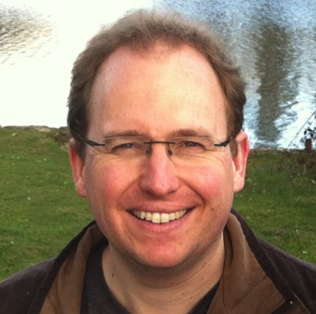

Your Lecturers…
David Millard
UML Modeling
Group Project
Yvonne Howard
Soft Systems Modeling
Software Engineering
Visual Paradigm Labs

Slide 3

This module is about Systems…
in the
Large
in the
Small
http://www.mariomorenophotography.com

Slide 4
This module is about Systems…
Soft Systems Modeling
Unified Modeling Language
in the
Large
in the
Small
http://www.mariomorenophotography.com

Slide 5
This module is about Systems…
Soft Systems Modeling
Unified Modeling Language
Software
Engineering
in the
Large
in the
Small
http://www.mariomorenophotography.com

Slide 6
This module provides the foundation for:
  Programming modules
  Software engineering modules
  Pretty much any project work

Slide 7
Sessions
12 double lectures:
  Mondays 1100-1300 (with a sanity break in-between)
  11 before Christmas
  1 after: to present your group work
2 Visual Paradigm Lab sessions
  Weeks 4 and 5
  1000-1200 on Friday mornings
Locations
  Lectures
    Normally in 58/1025
    Week 2 we are in 13/3017
  Labs
    Computer Labs 58/1043

Slide 8

Group Work?
The group activity is a major part of the course
You will need to prepare a case study on a business (or business unit) or your own choosing
  And select a key challenge faced by that business
You will then produce:
  A brief document that describes the business and key challenge
  A soft systems model of that business (weeks 2-3)
  Three UML models of the key challenge (weeks 4-6)
  A presentation (10 min) to be given in week 12

Slide 9
Group Work?
We will allocate groups, but they will be self-managed
  We will only intervene if needed!
You are responsible for finding a suitable business
  But we will help you in the selection
You will be marked as a group
  The exam (worth 50%) will form the individual element of assessment
Workshop next week to kick start the activity
  Tue Oct 9, 1000-1100, 07/3023
  Keep this slot clear, we may use it in future weeks too

Slide 10
Participation
You are required to attend lectures
  We do not check, but you will benefit by attending and lose out by not attending
You are required to contribute to your group
  Your contribution is worthwhile to you and your fellow students
  We will intervene if there are problems
You are required to attend lab sessions
  These are hands-on sessions where you will develop your modelling skills

Slide 11
Assessment
The module is worth 15 credits
  1/8 of your first year marks
The marks distribution is as follows
  UML Labs (unmarked, but needed for group work)
  Case study (40%)
  Presentation (10%)
  Exam (50%)

Slide 12
How to Succeed (and Avoid Failure)!
Come to the lectures
Join in the group work
  Enjoy the chance to discuss problems and solutions with people who think like you
  Put in enough time (self study)
Be a bit business like
  Know when and where the lectures are
  Understand what is required of you
  Plan for coursework
  Do your coursework and hand it in on time
  Prepare for your exam

Slide 13
Self Study
A normal working week is 36 hours
You do 4 modules; 9 hours per module
There are less than 3 hours of lectures so: about 6 hours per week of reading and working through directed tasks

Slide 14
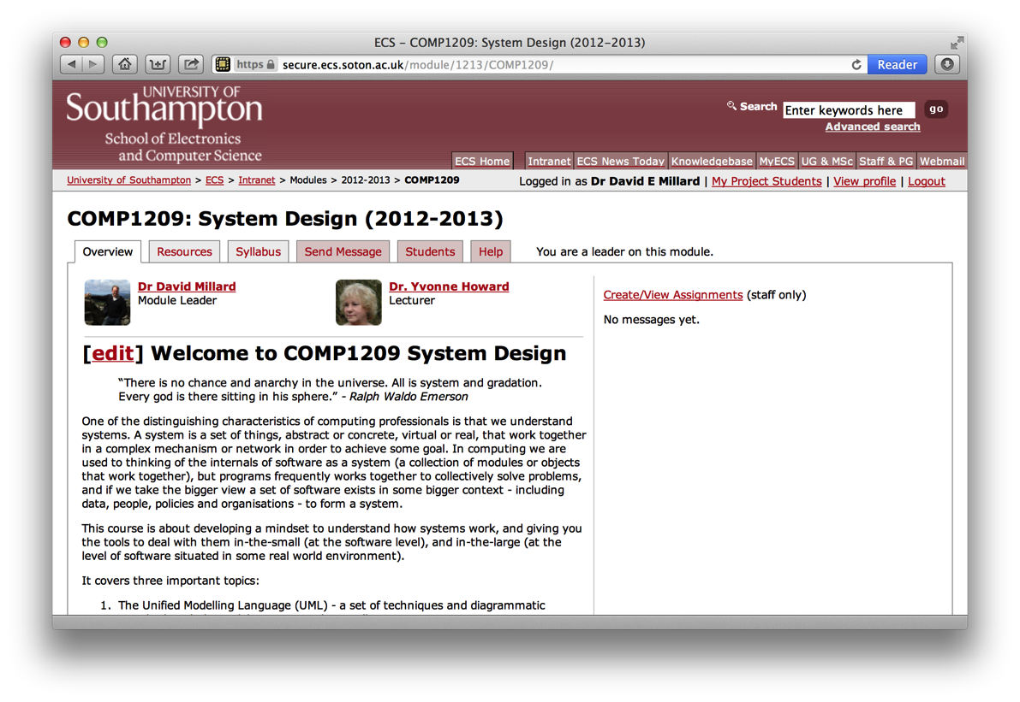
Resources
Everything is on the website:
https://secure.ecs.soton.ac.uk/module/COMP1209/

Slide 15
Introduction to Systems

Slide 16
Definitions
“A system is a set of interacting or interdependent components forming an integrated whole”
Wikipedia
“a regularly interacting or interdependent group of items forming a unified whole”
Merriam Webster
“A set or assemblage of things connected, associated, or interdependent, so as to form a complex unity; a whole composed of parts in orderly arrangement according to some scheme or plan”
- Oxford English Dictionary

Slide 17
Definitions
“A system is a set of interacting or interdependent components forming an integrated whole”
Wikipedia
“a regularly interacting or interdependent group of items forming a unified whole”
Merriam Webster
“A set or assemblage of things connected, associated, or interdependent, so as to form a complex unity; a whole composed of parts in orderly arrangement according to some scheme or plan”
- Oxford English Dictionary

Slide 18
Definitions
“A system is a set of interacting or interdependent components forming an integrated whole”
Wikipedia
“a regularly interacting or interdependent group of items forming a unified whole”
Merriam Webster
“A set or assemblage of things connected, associated, or interdependent, so as to form a complex unity; a whole composed of parts in orderly arrangement according to some scheme or plan”
- Oxford English Dictionary

Slide 19
Definitions
“A system is a set of interacting or interdependent components forming an integrated whole”
Wikipedia
“a regularly interacting or interdependent group of items forming a unified whole”
Merriam Webster
“A set or assemblage of things connected, associated, or interdependent, so as to form a complex unity; a whole composed of parts in orderly arrangement according to some scheme or plan”
- Oxford English Dictionary

Slide 20
System Science
Systems Theory
  The study of systems in general
  Searching for common laws, rules or patterns
Systems Engineering
  Processes to enable the development and organization of complex systems
System Dynamics
  Approaches for understanding the behavior of complex systems over time

Slide 21
Systems Design
The application of systems theories to the design, development and deployment of software
Tackling the problem of creating a software system (software, hardware, etc) in order to solve a set of requirements
Elements of analysis and engineering

Slide 22
Systems Analysis: Bloodhound SSC
Intel Video of Bloodhound to Play Here

Slide 23
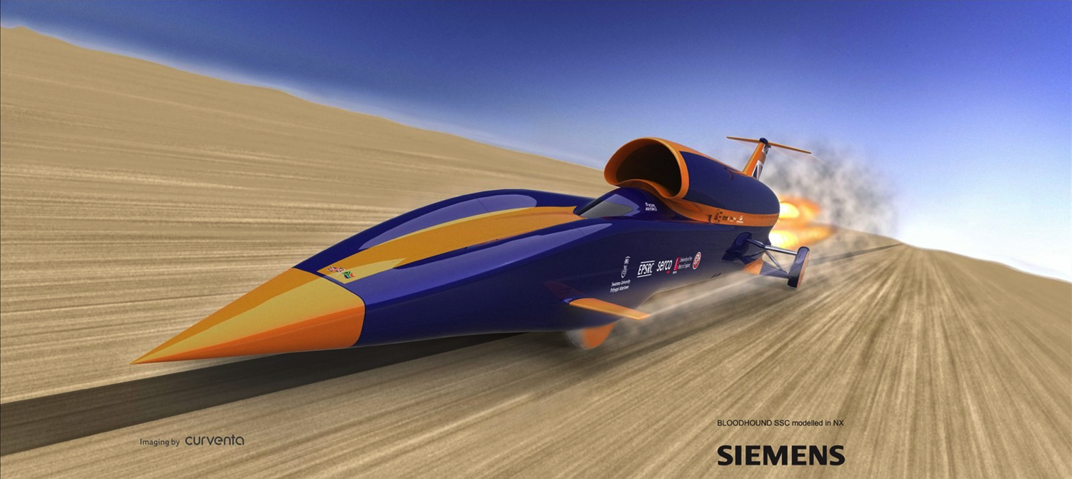
Systems Analysis: Bloodhound SSC
“A system is a set of interacting or interdependent components forming an integrated whole” - Wikipedia

Slide 24
Systems Analysis: Bloodhound SSC
Video of Clearing the Pan to Play Here

Slide 25
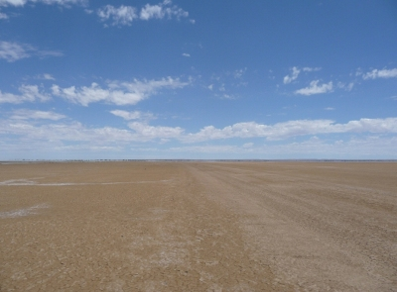
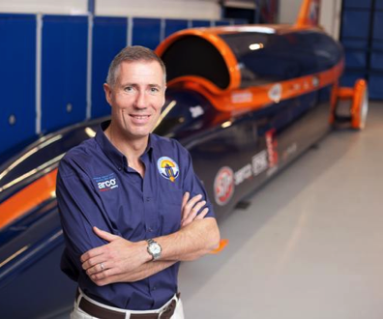
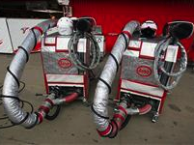
Systems Analysis: Bloodhound SSC
Are these part of the system?
The Surface
Hakskeen Pan, South Africa
The Driver
Wing Commander Andy Green
Refueling Rig
Refuel Jet
Replace Rocket

Slide 26
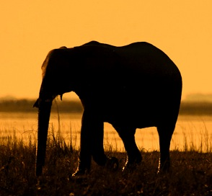

Different way to look at systems…
in the
Large
in the
Small
The Bigger Picture
The context: people, rules, organisations, beliefs and values
The Details
The specifics about a part of the system, what’s in it, how they are related

Slide 27
Different way to look at systems…
Will it work in practice?
How will the system work?
in the
Large
in the
Small
The Bigger Picture
Soft Systems Modelling
The Details
Unified Modelling Language

Slide 28
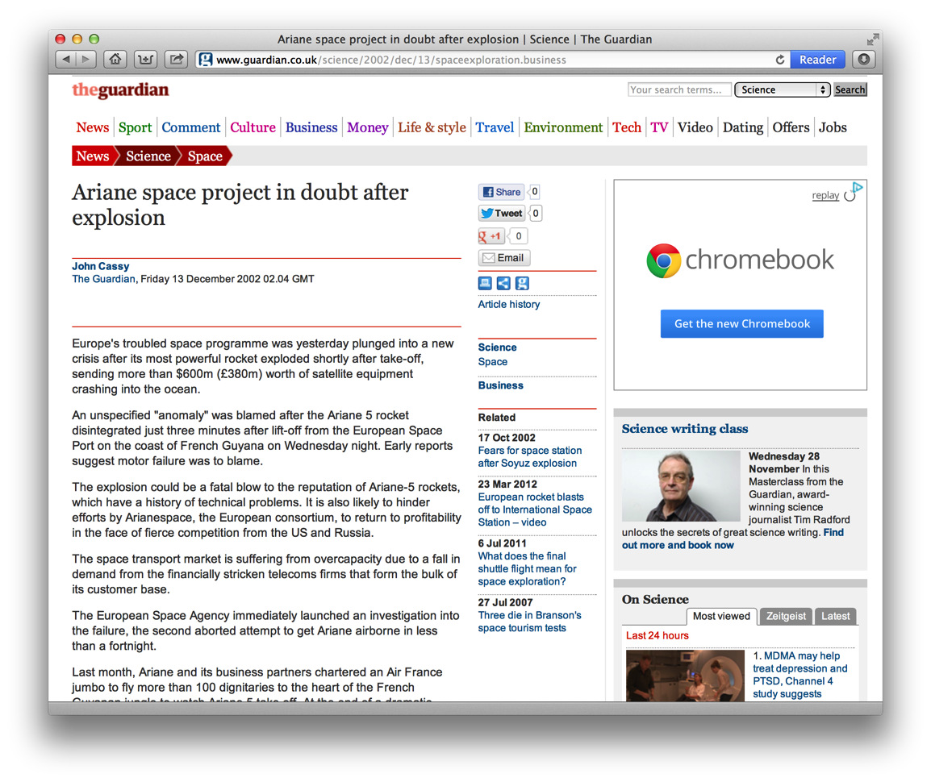
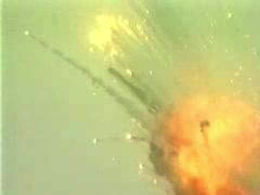
Why Does this all Matter?
Ariane 5
Guidance software failure
Rocket exploded shortly after takeoff
Cost: £500 million
A systems failure in the small

Slide 29
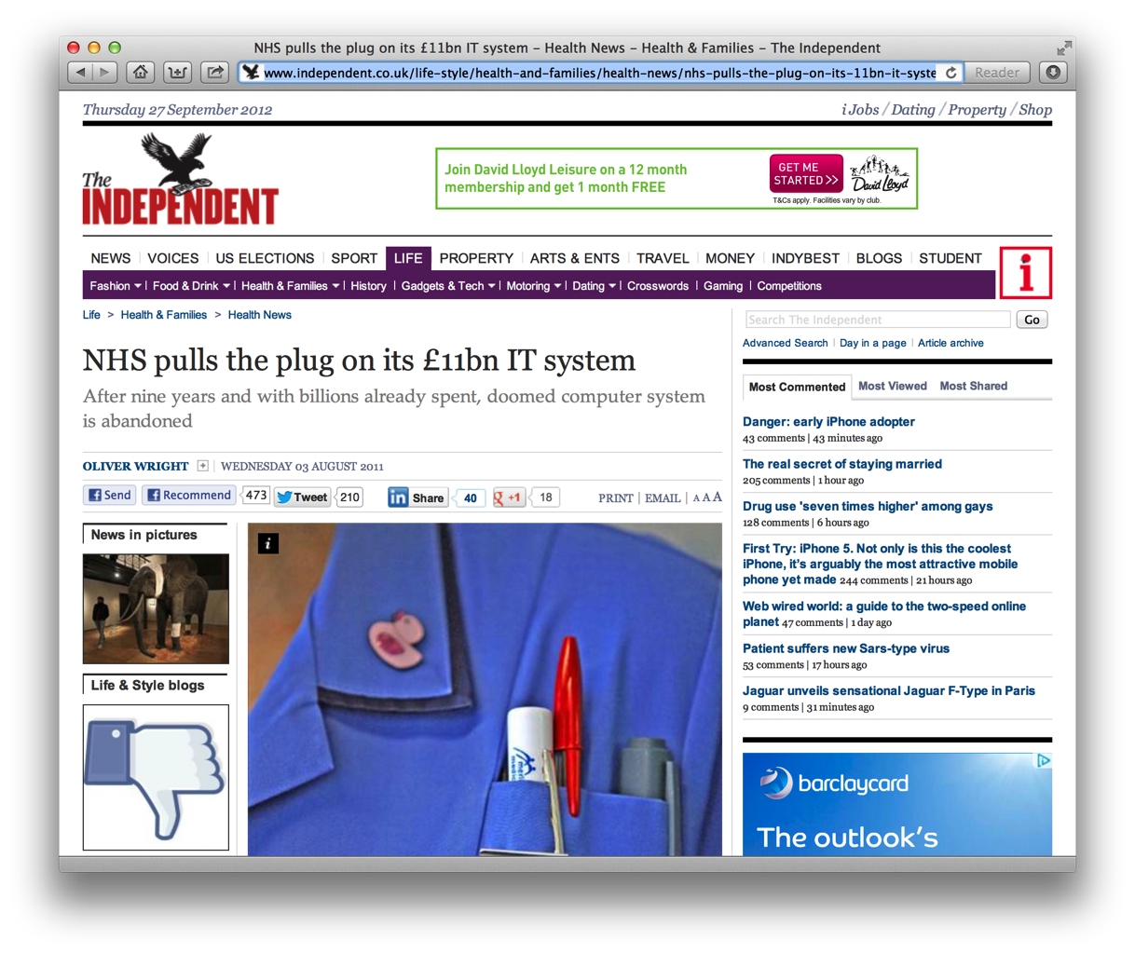
Why Does this all Matter?
NHS IT
Nine years in
Scrapped after problems with specification and suppliers
Cost: £11 billion
A system failure in the large

Slide 30
And it will only get harder…
Complexity and scale
 |  | Lines of code
1993 | Windows NT 3.1 | 6 million
1994 | Windows NT 3.5 | 10 million
1996 | Windows NT 4.0 | 16 million
2000 | Windows 2000 | 29 million
2002 | Windows XP | 40 million
2007 | Windows Vista | ~50 million
2009 | Windows 7 | ~50-80 million *
* Microsoft is not saying, but this is a good guess

Slide 31
Summary
Systems are:
  a set of things - interacting for - a unified purpose
Systems Design is
  Systems theory applied to software
  To allow us to build software to solve complex problems
Systems can be viewed
  In the large:
    holistic view of context, people and many other factors (SSM)
  In the small
    specific descriptions of how components interact (UML)

Slide 32
Summary
Systems are:
  a set of things - interacting for - a unified purpose
Systems Design is
  Systems theory applied to software
  To allow us to build software to solve complex problems
Systems can be viewed
  In the large:
    holistic view of context, people and many other factors (SSM)
  In the small
    specific descriptions of how components interact (UML)
Next Week: We start looking at SSM
Workshop (on Tues) to kick start group work

