Slide 1
ELEC6021 research methods
October 2012
Report Writing
or
a few useful things about writing
Dr Su White
http://www.edshare.soton.ac.uk/3451/

Slide 2
The plan
I will skip over
some slides,
but use them
as notes
Agree what we want to learn
Important report writing guidelines
Conclusion/reflection
but remember
I can only talk
you have to do
Learn to write by writing and reading example documents

Slide 3
Introduction and Objectives
How I will run this class
What I want
What do you want?
Notes:
This class is a bit different in its format
Use OHPs to explain interactive approach
Use OHPs to set thinking tasks
Use Coloured Cards to record student objectives

Slide 4

What do you want to learn today?
Think about how you write:
What can you already do well which will be useful?
Where are your weaknesses?
Based on this reflection
write down three things you would like to get out of the session today
Activity 1

Slide 5

You can go back to these notes
Remember these notes when you need to double check
Look at them again with friends to understand what I have been saying ☺

Slide 6
You need to learn how to…
Organise writing clearly and logically
Handle evidence appropriately in writing to present a structured and logical argument
Explain concepts in formal context
Structure your work for correctly for the appropriate audience
Understand strategies for revision at the document, paragraph and sentence levels
Understand grammatical and stylistic usage
Be able to edit and refine your own written work

Slide 7



Typical Wants
Layout
Proof reading
Referencing
IEEE conventions
…these are minor details – check out the regulations, follow the pointers in the lecture

Slide 8
Three things….
I asked you to think about how you write:
What can you already do well which will be useful?
Where are your weaknesses?
…and to decide on three objectives for today
Turn to a neighbour
  Explain your writing experience
  Discuss what you think will be important and why.
Activity 1

Slide 9
Feedback
Tell the rest of the class….
Examples of objectives
Why does it matter?

Slide 10
Sum wondeful peeple gt evrytng write 1st thyme
NB spell checkers
do not correct
all mistakes
This information/class is not for you!!
But you may be able to help your friends and colleagues
You may learn from helping them
Btw…
can you write down the correct version of my heading?
Activity 2
Notes:
Get feedback from class
Questions – did you get the corrections right first time?
Can someone write up the correct version
Simple example but shows how working with someone else can assist in revision

Slide 11
Sources of information
General University notes for academic skills
Topics include: reading academically, writing effectively, search strategies, bibliographic software, referencing your work, , giving a talk
See http://www.academic-skills.soton.ac.uk
Grammar: an introduction to traditional grammar
http://www.soton.ac.uk/~wpwt/notes/grammar.htm
Engineering Communication Centre, University of Toronto it offers a range of interactive tutorials
http://www.ecf.utoronto.ca/~writing/interactive.html
one is specifically a guide to writing lab reports,
http://bit.ly/toronto-lab-reports

Slide 12






Use good technical writing as a model
What sources of technical writing can you identify?
Read popular
science to help
Learn how to
write technically
Activity 3

Slide 13
This is not about
The process of doing your research
This is about
The process of how you
record and present
the process of doing your research
The good news,
you already know something about this…

Slide 14
Focus: academic writing
What experience do you have?
Technical reports
Technical letters
Conference papers
Journal papers
Project reports
?? Web pages
Informal writing
++
  Different formats need differing styles
What difficulties might you face?
Foreign language
Dyslexia
Lack of experience
Can’t spell
Don’t understand grammar /rules
Difficult to explain myself
…
  Different people have different issues

Slide 15
Last week I read something in the Guardian that said that tea was nothing like as popular a drink as it used to be. Apparently the general public think that is not particularly satisfying, and show an increasing preference for coffee. Certainly it looks that way in my office, although maybe coke is more hip. But it occurs to me that there could be a number of reasons, other than change in taste, for this decrease in popularity. Perhaps the quality of the tea has changed? Or perhaps people have forgotten how to make tea properly?
Certainly one of the things that bugs me is the American custom, when you order a tea, of bringing you a cup of hot (but certainly no longer boiling) water, and a selection of tea bags; the Americans are so obsessed by choice that they have forgotten taste. So I decided to conduct a survey. I made two cups of tea for everyone in the office – one from a big pot of tea, and for the other I put hot water into the tea cups, and tea bags on the saucer. Three quarters of the people expressed a firm preference for the tea from the pot, and no-one preferred the tea bag in the cup.
This certainly shows that one of the reasons people are going off tea is that it is often badly made.
What’s This?

Slide 16
Technical Report Writing
The purpose of a technical report is to communicate.
You wish to communicate
what you did,
why you did it
and
what you have found out.

Slide 17
Before Getting Started
You wish to communicate “What you have found out”. If you didn’t find anything out : STOP NOW!
Most technical reports are intended as communication of new knowledge.
“I had this hypothesis and I tested it like this; here are my results and this is what we learn from them”
BUT as a student you are asked to write technical reports about things that you know that the person who reads it (the marker) will already know. Don’t worry – your marker is not your audience (see later) – and your task is still to express what *you* found out.

Slide 18

What Sort of report are you producing?
Lab Report
Blog
Magazine Article
Essay
Technical Report <- what this lecture is about
Technical reports may be:
  Academic Papers
  Industry “White Papers”
  Description of a project undertaken
  Whether they are published on paper or on-line.
  The rules do not change.

Slide 19
Who is writing this report?
The convention is to write everything in the third person (objectively, not subjectively)
This does not apply to Blogs and Magazine articles which are often intentionally subjective
Can lead to unpleasant use of passive voice. Compare
  “I did a survey of one hundred web sites to ascertain….”
  “One Hundred web sites were surveyed to ascertain….”
  “The author surveyed one hundred web sites to ascertain….”
Some “expert writers” break the rules – just as some expert artists break the rules.
You need to learn now how to write in the third person
When you are an real expert maybe can break the rules

Slide 20
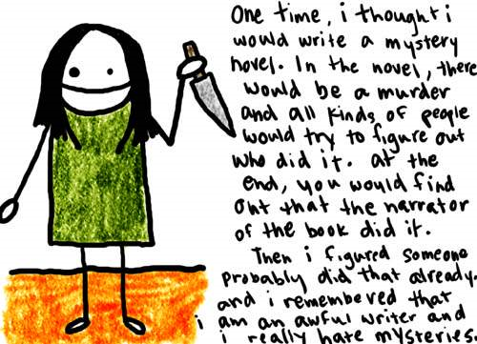
Reports are not personal
With thanks to nataliedee.com

Slide 21
Structure of a Technical Report
[Title page]
  name, affiliation, date, contact details, etc.
[Declaration]
  who did this work?
[Acknowledgement]
  to those who have helped or influenced your work
[Contents]
  sections, sub sections and page numbers (probably not sub sub sections)
Abstract
  stand-alone summary of report
Introduction
  provides the motivation and context and outlines other related work
Main technical sections
  theory, experimental method, results, discussion
Conclusions
  and appropriate future work
References
[Web References]
[Bibliography]
[Appendices]
  anything which would interfere with the continuity of the main report (typically detail)

Slide 22

Report function
  Abstract summarises the work presented
  Introduction (provides context)
  Itemise the key work(s)
  Identify where your contribution fits
  Present key ideas, describe methods
  Present Results
  Draw Conclusions
Remember Your report is not a detective novel!

Slide 23
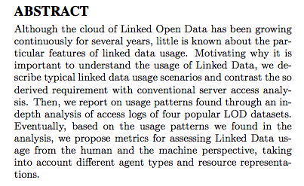
The Abstract
must be stand-alone
must not contain citations
is a concise summary – not a précis.
IS VERY IMPORTANT
Use four or five sentences.
  What is the problem, and why is it a problem?
  What is your idea for a suggested solution?
  How did test your idea?
  What results did you get?
  Why is that useful?
It’s a good idea to write the abstract before you begin (even if you re-write it after you finish)

Slide 24
Experimental Report Abstract
Tea drinkers report major differences in their satisfaction with cups of tea, even when they have been made from the same tea leaves. One possible cause of this variability is the temperature of the water at the time it is poured over the tea leaves. This report describes an experiment in which one hundred tea drinkers were asked their views on teas made with water at different temperatures. The results demonstrate a significant preference for tea made with boiling water. The perceived quality of tea, particularly in the USA, would be much enhanced if caterers observed this convention.
(5 sentences, 97 words)

Slide 25
An Abstract for a Possible Coursework?
You’ve been asked to write a report on Folksonomies…
Folksonomies are internet based collections of user assigned labels, or “tags”, for web resources. There is a debate within the Web Science community as to the importance of social tagging in general, and folksonomies in particular. This report surveys a range of current social tagging systems and distinguishes between true folksonomy systems such as Del.icio.us, which attempt to enhance the classification of resources, and simple tagging systems such as Flickr, which merely improve description. The report concludes by describing some research work in progress to extract semantic metadata from folksonomies in order to improve search engine performance.
(4 sentences. 97 words)

Slide 26
An Implementation Project Abstract
Experts in wine tasting like to keep structured records of their tasting notes and a number of well established PC database applications exist for this purpose. However, increasingly applications tend to be web service based applications and many focus on the benefits of social tagging. This report describes the specification, design and implementation of a web based application to store wine descriptions according to a standard ontology, which allows users to enter their tasting notes as tags. The report concludes by evaluating the new features that are facilitated by this novel implementation.
(4 sentences. 95 words.)

Slide 27
Introduction and Conclusion
Again they should (as a pair) be stand-alone. (Not everyone wants to read the detail)
The Introduction should motivate why you have done the work, and demonstrate your awareness of related literature. What are your objectives?
The conclusion should:
  make it clear what the “take away message is”.
  Demonstrate analysis and synthesis that you have undertaken
  Explain any limitations in your work
  Detail future work to be undertaken
On analysis and synthesis.
  There is no room for “I think..”, “I believe”. Technical reports should take an objective and scientific standpoint.

Slide 28
Citations, References and Bibliography
Learn how to format a reference and how to cite it.
There are two major formats which you are likely to use or encounter.
Harvard - Cite with Name and Date
  Much preferred for technical reports
IEEE – Cite with Number
  Much more compact so used is paper based IEEE and ACM journals
References are a list of the items which have been ‘cited’ in the document
Bibliographies are reading lists, that provide more background on the area, but which you have not specifically cited

Slide 29
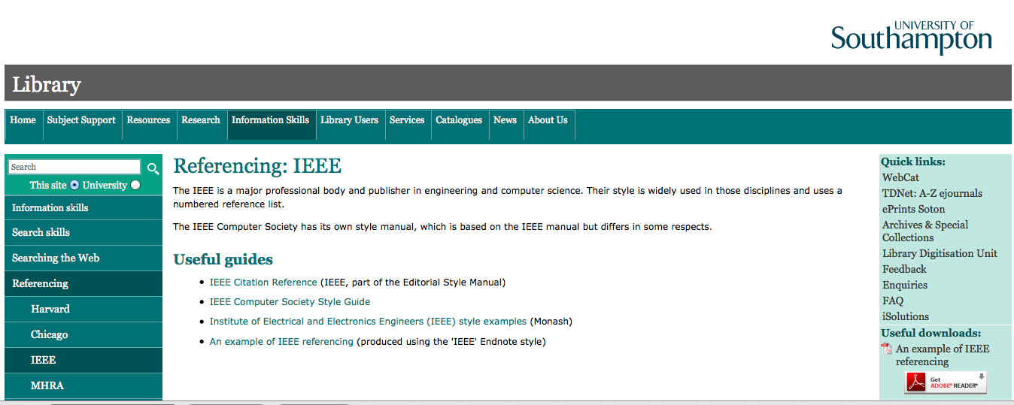
Citing in IEEE notation
http://www.southampton.ac.uk/library/infoskills/references/ieee.html

Slide 30
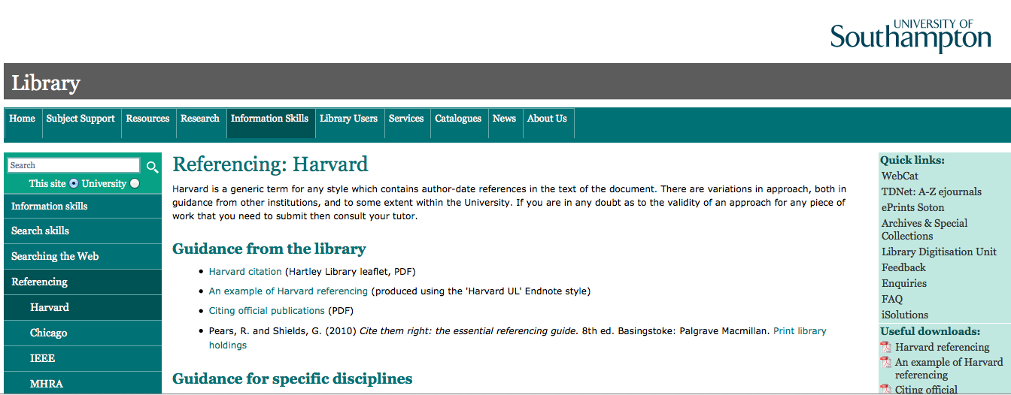
Citing in Harvard notation
http://www.southampton.ac.uk/library/infoskills/references/harvard.html

Slide 31
You must usually use IEEE conventions
References
Should provide a replicable audit trail
So…
They need to be
complete and in a standard format
IEEE convention
uses a single sequentially order note number to cite all references to each source mentioned in the text [1].
1 http://www.ijssst.info/info/IEEE-Citation-StyleGuide.pdf

Slide 32
Citation On-line and of the On-line
In these days when
  Many of the papers you cite are available on-line
  Your paper will in all likeliness be read on-line
  in addition to the normal reference, it is customary to hyperlink your references to the on-line version– making it much easier for your readers to follow.
A number of sources may only be available on-line. A good rule of thumb is – if you can identify the provenance (author(s) name, and a name for the on-line publication, date of publication) then cite and reference it in the normal way. (Stating date accessed)
If it is just a “web page”, then it should not be in your references. Maybe it should be a footnote – or if you have lots then consider a “Web Page References” section.

Slide 33
Academic Integrity and Plagiarism?
In some countries/cultures students may expect to copy
Teachers may want students to repeat exactly what is in text books or lecture notes.
At the University of Southampton all work you submit for marking must be your own original creation
Presenting another’s work as if it was your own is called "plagiarism" and is the wrong thing to do.
Plagiarism is what you do when you copy without acknowledging your sources
There are academic conventions to acknowledge sources
We have clear university regulations against plagiarism
Plagiarism is using someone else’s work
but not indicating that it is not your own

Slide 34
Avoiding Plagiarism
If you cut and paste words from anywhere else, and you do not attribute those words to the original author/webpage then that is plagiarism.
Plagiarism is cheating and an attempt to defraud, and
  We run programs to identify plagiarism
  ECS and the University have disciplinary procedures for people identified as cheats.
  https://secure.ecs.soton.ac.uk/ug/handbook/0809/SectionA07DM3.doc (section 5.1)
  http://www.calendar.soton.ac.uk/sectionIV/academic-integrity-procedures.html
  If you do cut and paste then you should “quote”
  e.g. As Doolittle (1966), says “the rain in Spain stays mainly on the plain”. For quotes of larger than a paragraph, indents are often used.
See
  https://secure.ecs.soton.ac.uk/notes/info1010/resources/AcademicIntegrity.ppt
When you hand in work or submit a paper to a conference you sign a declaration that this is *all* your own work. If you sign this and then plagiarise, not only will you be cheating but also acting dishonestly
Work through the academic integrity tutorial http://www.ait.ecs.soton.ac.uk/

Slide 35
Checklist before you submit
Have you followed the formatting instructions, and kept to length limitations.
Does the abstract tell me what you did, why you did it and what I will learn from it?
Are the Introduction and Conclusion stand-alone, and are there some “take away lessons” in the conclusions?
Have you adhered to a referencing / citation convention?
Have you ensured that there are no references without full provenance?
Does the writing “tell a story” without getting bogged down in unnecessary detail? (Detail -> Appendices)
Is the grammar and spelling checked?
Is the “voice” scientific and objective?
Are all arguments you make based on sound evidence?
Have you demonstrated awareness of others’ work on this topic?
Have you fully explained the research method you have used?
Could you have used tables or figures to replace some of the writing?
Are you *absolutely sure* that there is no (uncited) copied text in your report?
Do you think *you* would have found your report informative, understandable and interesting if you had read it before you did all that research?

Slide 36
Some Links
Hints on Technical Writing (John Ringwood) http://odtl.dcu.ie/wp/1999/odtl-1999-03.html
Writing Tips – Newcastle Chemical Eng Dept http://lorien.ncl.ac.uk/ming/Dept/Tips/writing/writeindex.htm
Writing Scientifically http://www.academic-skills.soton.ac.uk/studytips/science_writing.htm
Instructions on how to enrol on the blackboard course including academic writing skills
http://www.academic-skills.soton.ac.uk/toolkit.htm
Academic Integrity
https://secure.ecs.soton.ac.uk/notes/info1010/resources/AcademicIntegrity.ppt

Slide 37
Work and improve over time
Have a plan
Do good work
Record your work
Analyse the results
Capture the whole process
Meet your deadlines
Some aspects will apply equally to:
Every written task
Use opportunities to refine your process
these are skills for life

Slide 38
Record an Audit Trail
References
Provide an audit trail
Acknowledge others’ work
Are concise
Should be replicable
List references
consistently,
correctly,
completely
They need to be:
complete and in a standard format
They need to contain:
enough detail to locate the same source again
Do not include:
ISBN
Library call numbers

Slide 39
Work smarter not harder
One touch
Write your bibliography as you go
Always get full references
Record how and when
Collect to a standard format

Slide 40
Information needed
Gather information before and during writing
Begin to organise information as you obtain it
Information from others:
record full bibliographic details
Information you generate:
keep a complete logbook record
Notes:
Southampton University Computer Services or SUCS provide a large number of public

Slide 41
Keep track of your sources
With notes, copies of articles, useful diagrams, etc.,
NB
Authors, complete name of work, editors if any, publisher, year/month of publication, volume no., page numbers
URL plus any clues as to original paper source.
If class notes, is there a printed textbook?
If a self-contained paper, look for any and all clues to find the original citation (e.g. author’s publication list on Web page).
Activity 3

Slide 42
Learning and help
We will each need different kinds of help
We each learn and work in different ways
Learning by doing
(read and write - lots)
Language Support
Learning Differences Centre
Assistive technology centre
Self help (books, guides, the web)
Peer help (colleagues, friends)

Slide 43
Important Guidelines
Some details of what
you have to know

Slide 44
presenting results 1
what’s best? -graph, table, histogram, bar chart, scatter gram
does data highlight the scientific goal?
do labels reflect the scientific goal?
is the caption complete?

Slide 45
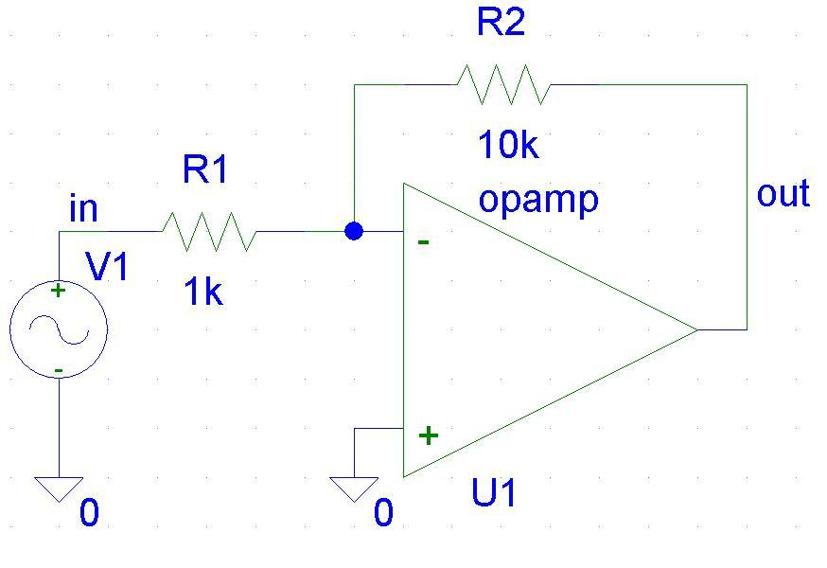
Presenting results 2
So what exactly is figure 1?
If you know
tell me
PLEASE
Figure 1
✓Use Labels
✓Speak the maths

Slide 46
presenting results 3
May be easier to draw by hand then scan
Describe the important features of your illustration in the results section of your report
Figures are labelled to form a cross reference
Can the reader find all your results easily?

Slide 47
Design of figures
  What needs to be in a graph?
  Axes must be labelled with
    Entity being measured (e.g. amplitude, frequency, no. errors, time…)
    Units of measurement
    Values in units along axis
  Meaning of curves or symbols must be shown: use legends or labels, caption
  Captions must be fully informative

Slide 48
citations and references (again)
there are standards...
You are expected to use numeric referencing
use that single standard throughout your report
ensure that all your references are complete – could a reader go to the source unaided?
some tools enable automatic formatting of citations
e.g.: endnote and bibtec

Slide 49
Revision
Reread it
Imagining yourself as the audience.
Does information come in the right order?
Are all parts present?
Is it complete?
NB: See notes for extra help
Notes:
Are terms defined before they’re needed?
Are methods of obtaining data explained before the data are discussed?
Are references unambiguous?
Is problem statement first, and clear?
Are the parts in proportion/appropriately sized?
Would some parts be more clear if you used a figure/table? Are all figures called for?
Do abstract and introduction need revision now that you know how it came out?
Are all figures present, and all present are referred to?
Are all references that are cited present? Are all present cited?
Check formatting instructions: is title page correct and complete, page numbering as requested, headings… margins…
Have you proofread it

Slide 50
Review, Revision and Proof Reading
WHAT:
Check systematically for errors of any sort in a document
HOW:
Read through more than once, each time checking for a different type of error
Use friends to help in this process
Notes:
Assembly -- are pages, figures all there, in correct order?
Typorgaphical errors errors
Continuity – cross-references, transition sections
Content – do captions match their figures? Are table entries correct? Does year match in citation and reference?

Slide 51
Further work
This class was just one of many beginnings
Its up to you now to do the work
Over the next week look at your action list – and initiate the actions!!
Whenever you write remember what the process is about

Slide 52
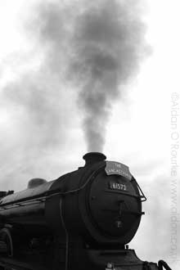
Learning is a continuous process
Train yourself ;-)

Slide 53
Recap on links
The Student Portal SUSSED has links to library, academic skills and student resource network
http://sussed.soton.ac.uk/
Electronic Journals and other online academic resources via the Library
http://www.soton.ac.uk/library/
Academic Skills Web Site http://www.academic-skills.soton.ac.uk/
In particular look at the guides entitled
  “Developing your Academic Skills”
  “Gathering information and Using the Library”
  “Referencing your Work”

Slide 54
Appendix
This part of the slides contains basic advice on style and grammar
It also contains exercises to go with the presentation which you can also complete right now

Slide 55
Writing and study skills
General University guidelines on academic skills
  Topics include: independent learning, your learning style, getting the most from lectures, reading academically, writing effectively, writing your dissertation, search strategies, bibliographic software, referencing your work, working in groups, giving a talk, preparing for exams.
  See http://www.academic-skills.soton.ac.uk
  Guidelines on spelling and punctuation, with exercises (the Aries project)
  http://www.arts.gla.ac.uk/SESLL/STELLA/ARIES/

Slide 56
Style - 1
Use the third person
Passive voice:
  “The transducer was calibrated…”
Neutral, informative tone
Avoid colloquialisms:
  POOR:
    “The final design was brilliant!”
  GOOD:
    “The final design had the best signal-to-noise ratio”
Be specific; refer to figures by number, not pronoun
Be concise
    Can you use more shorter sentences?
    Can you say it in less words

Slide 57
Style - 2
Use figures, diagrams, equations when they’re more concise and accurate than words would be
Choose figures carefully;
make points not decoration

Slide 58
Style - 3
Use standard mathematical notation;
variables should have a single-character name
  POOR: Imp = V/I
  GOOD: Z = V/I
Define variables
specify units
Use SI units
Capitalize and space numbers and units correctly:
6 kHz not 6KHz
50 mm
8.3 µFd, 60 dB not 60 Db

Slide 59
A bit about grammar
Create complete sentences.
  POOR:
    “A run-on is more than one sentence, it is often created by using a comma instead of a full stop or semi-colon, and did I remember to tell you about punctuation in general?”
  POOR:
    “Being as how it crashed.”
Watch for tricky subject-verb agreement:
    “The set of numbers is…”
    “These data are…”
Notes:
Avoid dangling participles: “While running through the forest, my eye fell on a stump.”

Slide 60
A bit more about grammar
Avoid ambiguous pronouns:
Define acronyms, abbreviations at first occurrence; use them for essential terms
  “This was then run through the other one.”
“…obtained by Magnetic Resonance Imaging (MRI).
The MRI scanner was
1.5 T…”

Slide 61
Examples Citing References
In text, pick the most graceful way to refer to reference(s) needed
“…as shown by Atal and Hanauer[1]. …”
“…Linear prediction is a commonly-used method [1,2,3]…
“…Smith used ultrasound to image the tongue[3] this was further developed Stone [4,5,6] and subsequently by Storey et al [7]
1 Atal, B. and Hanauer, S. (1972) Title of article. Title of Journal 32:4, 167-178.
2 Flanagan, J. (1975) Title of Book. Berlin: Springer-Verlag.
3 Smith, P. (1976) Title of chapter, in L. Jones, ed., Title of Book. Cambridge: Cambridge Univ. Press, 154-198.
4 Stone, M. (1983)…
5 Stone, M. (1984)…
6 Stone, M. (1989)…
7 Storey, M., Stone M, and Smith, P. (1992)…

Slide 62
How can you build on this lecture?
Think again!
What do you find easy?
What do you find difficult?
Write down a list of three aspects of writing skills which you think that it is important you improve
Make a plan of how you will make these changes

Slide 63
Conclusions and reflections
What are you going to take away?

Slide 64

conclusions reflection
learn by doing
reflection
think about the issues raised today
Are there any questions?

Slide 65
Think about the skills you need to develop
Reminder
What do you find easy?
What do you find difficult?
Write down a list of three aspects of writing skills which you think that it is important you improve

Slide 66
acknowledgments
Parts of this set of materials were drawn from related examples drawn up by colleagues particularly Hugh Davis, Christine Shadle, and Peter Gregson, with guidance from Simon Cox
I have also drawn from materials at the University of Toronto’s Centre for Engineering Communication

Slide 67
References
For background and related material and references please see the courses page
https://secure.ecs.soton.ac.uk/module/1213/ELEC6021/resources
Notes specific to this lecture are at EdShare
http://www.edshare.soton.ac.uk/3451/

Slide 68
my details
Dr Su White
saw@ecs.soton.ac.uk
+44 (0)23 8059 4471
http://www.ecs.soton.ac.uk/~saw

Slide 69
Further Reading
See the set of notes in EdShare
http://www.edshare.soton.ac.uk/3451/

