Slide 1
INFO2009
Week 7
Preparing your resources
http://www.edshare.soton.ac.uk/9779/

Slide 2
Sources of information?
Because I have pre-existing knowledge, I can provide you with exemplars… where else can you find info?
Searches
Advice
Expertise
Connections
…

Slide 3
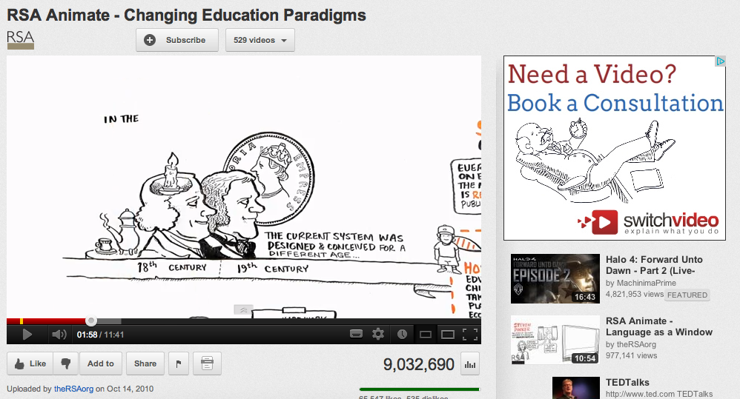
RSA Animate
11:41
http://bit.ly/INFO2009RSAAnimate

Slide 4
Networks
Twitter
Lazyweb

Slide 5

Get some inspiration
http://bit.ly/POV6mG
2:45

Slide 6
Information networks
Simple searches
Information networks
Some examples are better than others, but follow the clues….

Slide 7
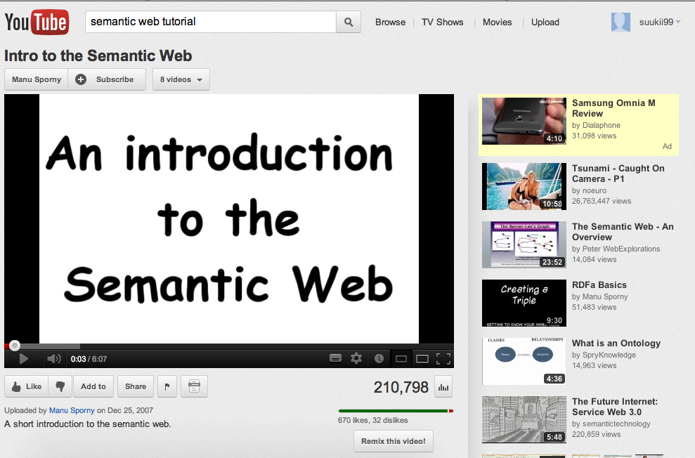
Some examples are better than others
6:07
http://bit.ly/INFO2009semweb

Slide 8
You don’t have to copy
Use examples as models…
Identify good practice
Be realistic
Play to your strengths

Slide 9
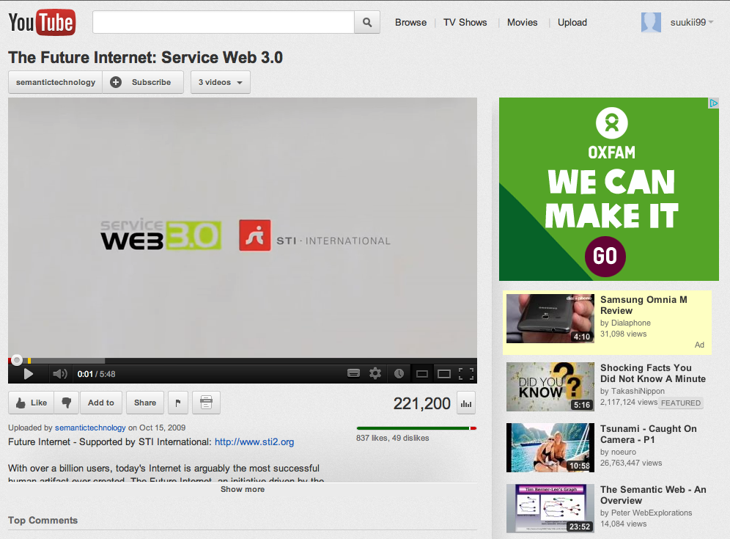
Some examples are better than others…
http://bit.ly/ZdXfdW
5:48

Slide 10
Web 2.0 approaches
Co-creation
Collaboration
Online tools

Slide 11
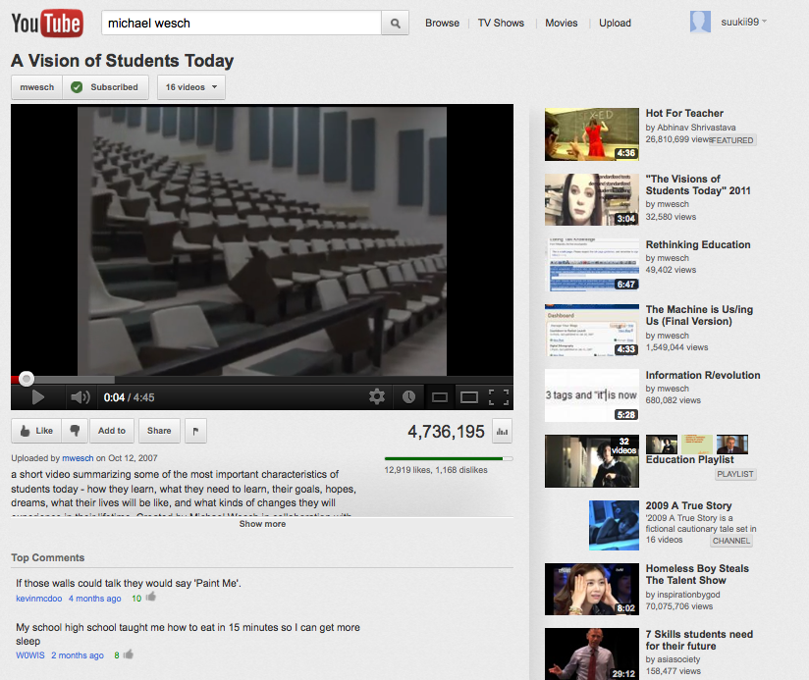
Vision of Students Today
4:45
http://bit.ly/MWeschVision

Slide 12
Don’t make things too complex
Classic planning
Name the topic you are going to explain
Create some structure
Say it
Summarise what you said
Talk and images might be enough…

Slide 13
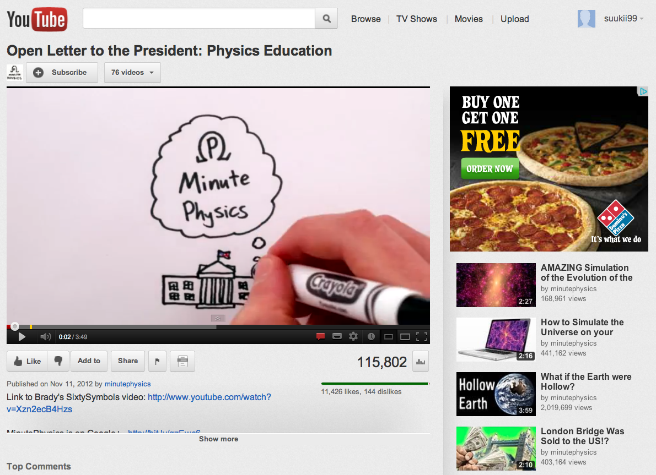
Simple can be effective
3:49
http://bit.ly/PicsAndTalk

Slide 14
Do some preparation
You will probably do some searching..
I recommend
Thinking
Talking
Planning
Prototyping
Remember your technical expertise
Use all you’ve learned so far in a different context ☺

Slide 15
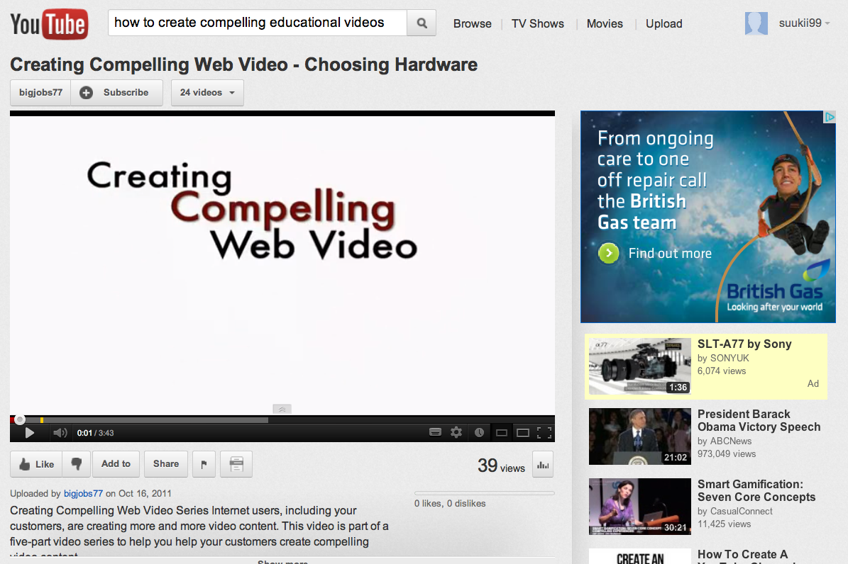
Compelling web videos?
3:43
http://bit.ly/CompellingVideos

Slide 16
You are the final arbiters
Use your knowledge and understanding
Apply critical thinking
Establish high quality standards
I trust you ☺
You ‘know’ what works
create something that works

Slide 17
acknowledgements
Awesome Chins: Group 14 2011
Falsetto Sock puppets from the Edinburgh Festival
Cybercrime Video Interview: Group 2 2010
ITO Radio: Group 6 2010

Slide 18
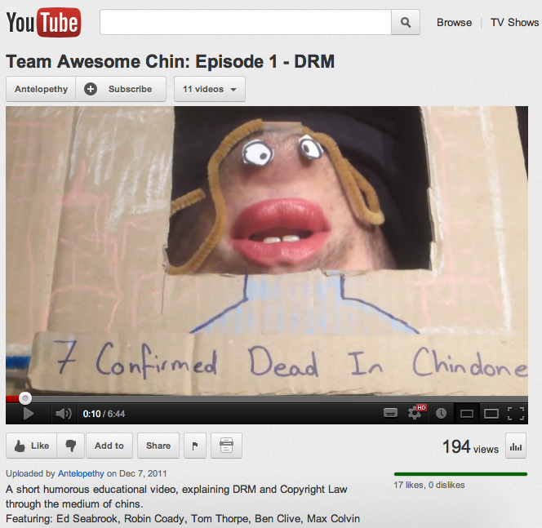
Use your imagination ;-)
http://www.edshare.soton.ac.uk/8267/

Slide 19
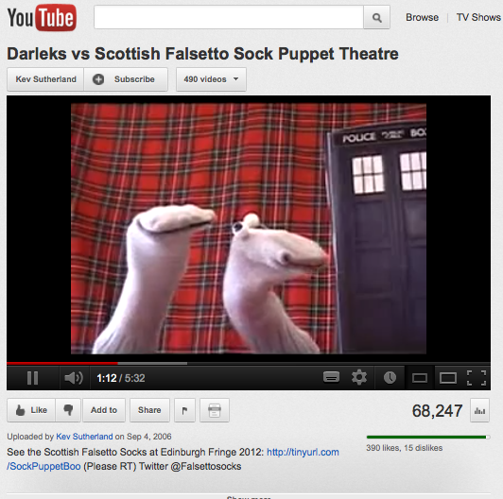
Sock puppets
You
will
need
to
do
something
on a more
technical
topic!
obviously
http://bit.ly/INFO2009SockPuppets

Slide 20
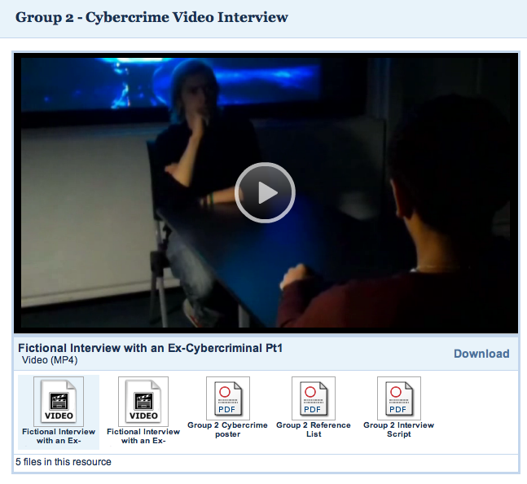
Interview
http://www.edshare.soton.ac.uk/6392/

Slide 21
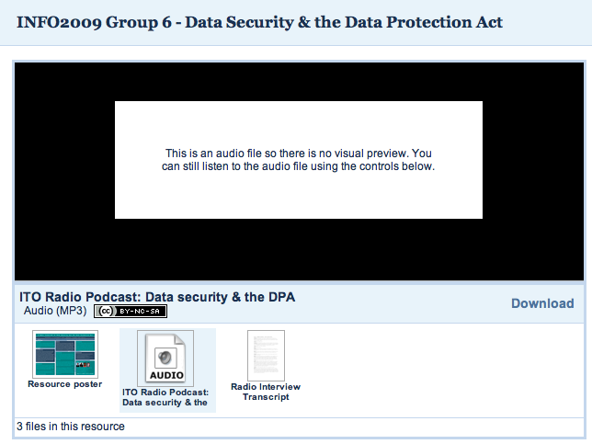
Radio show…
http://www.edshare.soton.ac.uk/6368/

