Slide 1
The Small World Phenomenon
Based on slides by Markus Strohmaier
Univ. Ass. / Assistant Professor, Knowledge Management Institute, Graz University of Technology, Austria
e-mail: markus.strohmaier@tugraz.at
web: http://www.kmi.tugraz.at/staff/markus

Slide 2
Overview
Definition of Small Worlds
Results from a social experiment
The importance of weak ties

Slide 3
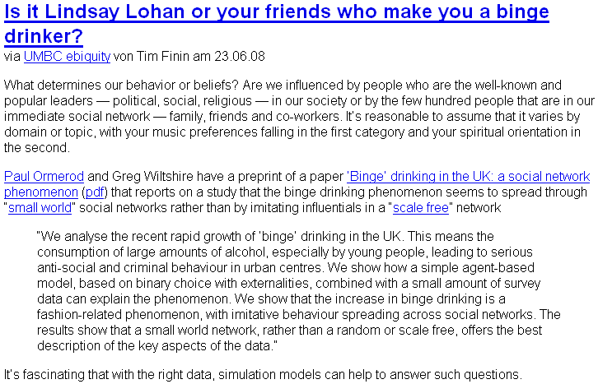
http://arxivblog.com/?p=484
http://arxiv.org/pdf/0806.3176

Slide 4

Do I know somebody in …?

Slide 5
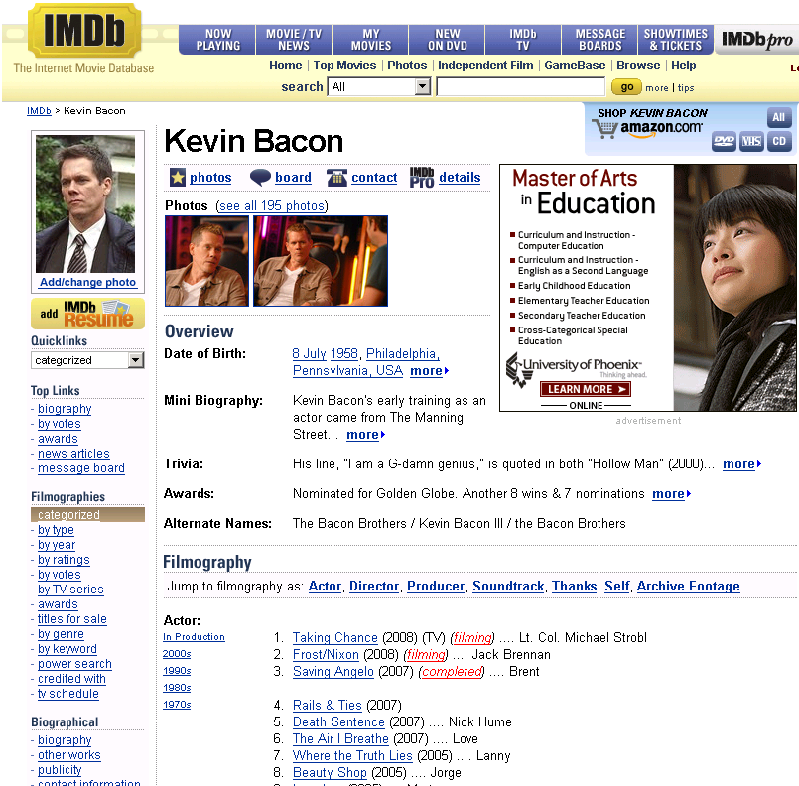
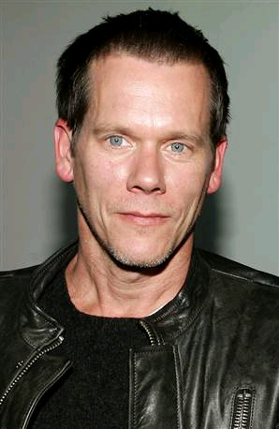
The Bacon Number

Slide 6
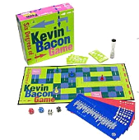
The Kevin Bacon Game
The oracle of Bacon
www.oracleofbacon.org

Slide 7
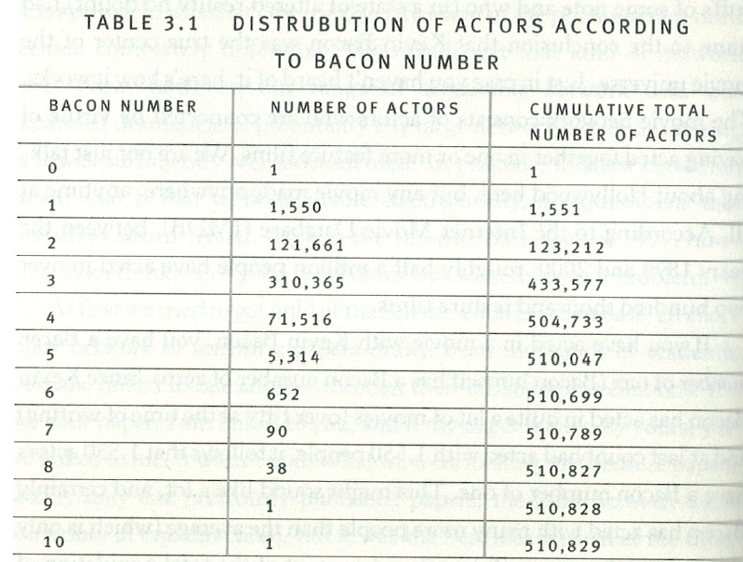
The Bacon Number
[Watts 2002]

Slide 8
The Erdös Number
Who was Erdös? http://www.oakland.edu/enp/
A famous Hungarian Mathematician, 1913-1996
Erdös posed and solved problems in number theory and other areas and founded the field of discrete mathematics.
511 co-authors (Erdös number 1)
~ 1500 Publications

Slide 9
The Erdös Number
Through how many research collaboration links is an arbitrary scientist connected to Paul Erdös?
What is a research collaboration link?
Per definition: Co-authorship on a scientific paper -> Convenient: Amenable to computational analysis
What is my Erdös Number? ➔ 5
me -> W. Hall -> D. Singerman -> G. A. Jones -> P.J. Cameron -> P. Erdös

Slide 10
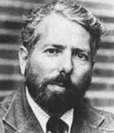
Stanley Milgram
A social psychologist
Yale and Harvard University
Study on the Small World Problem,
beyond well defined communities
and relations
(such as actors, scientists, …)
Controversial: The Obedience Study
What we will discuss today:
An Experimental Study of the Small World Problem
1933-1984

Slide 11
Introduction
The simplest way of formulating the small-world problem is: Starting with any two people in the world, what is the likelihood that they will know each other?
A somewhat more sophisticated formulation, however, takes account of the fact that while person X and Z may not know each other directly, they may share a mutual acquaintance - that is, a person who knows both of them. One can then think of an acquaintance chain with X knowing Y and Y knowing Z. Moreover, one can imagine circumstances in which X is linked to Z not by a single link, but by a series of links, X-A-B-C-D…Y-Z. That is to say, person X knows person A who in turn knows person B, who knows C… who knows Y, who knows Z.
[Milgram 1967, according to
]http://www.ils.unc.edu/dpr/port/socialnetworking/theory_paper.html#2]

Slide 12
An Experimental Study of the Small World Problem [Travers and Milgram 1969]
A Social Network Experiment tailored towards
Demonstrating, Defining and Measuring
Inter-connectedness in a large society (USA)
A test of the modern idea of “six degrees of separation”
Which states that: every person on earth is connected to any other person through a chain of acquaintances not longer than 6

Slide 13
Goal
Define a single target person and a group of starting persons
Generate an acquaintance chain from each starter to the target
Experimental Set Up
Each starter receives a document
was asked to begin moving it by mail toward the target
Information about the target: name, address, occupation, company, college, year of graduation, wife’s name and hometown
Information about relationship (friend/acquaintance) [Granovetter 1973]
Constraints
starter group was only allowed to send the document to people they know and
was urged to choose the next recipient in a way as to advance the progress of the document toward the target

Slide 14
Questions
How many of the starters would be able to establish contact with the target?
How many intermediaries would be required to link starters with the target?
What form would the distribution of chain lengths take?

Slide 15
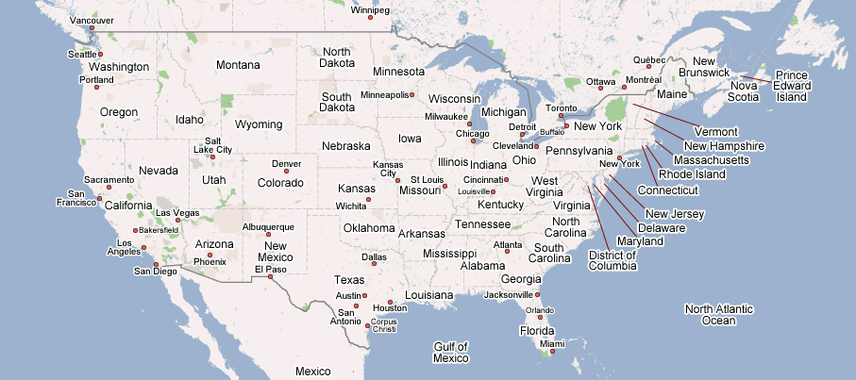
Set Up
Target
Boston stockbroker
Target person:
  A Boston stockbroker
Three starting populations
  100 “Nebraska stockholders”
  96 “Nebraska random”
  100 “Boston random”
Nebraska random
Boston random
Nebraska stockholders

Slide 16
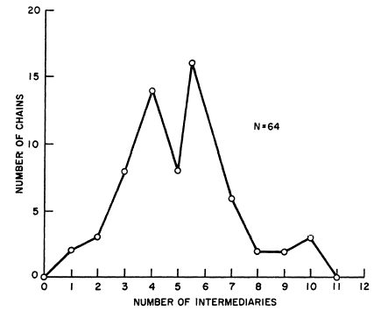
Results I
How many of the starters would be able to establish contact with the target?
  64 (or 29%) out of 296 reached the target
How many intermediaries would be required to link starters with the target?
  Well, that depends: the overall mean 5.2 links
  Through hometown: 6.1 links
  Through business: 4.6 links
  Boston group faster than Nebraska groups
  Nebraska stakeholders not faster than Nebraska random

Slide 17
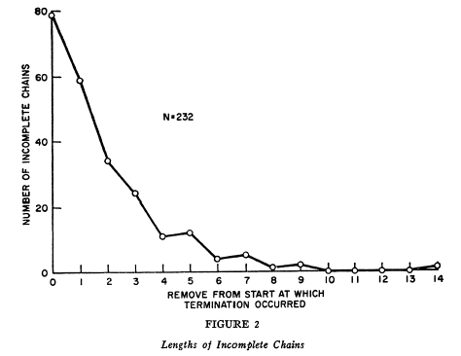
Results II
What reasons can you think of for incomplete chains?
Incomplete
chains

Slide 18
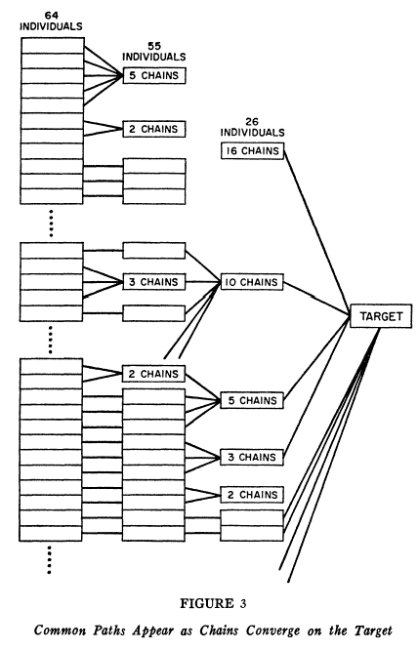
Results III .
Common paths
Also see:
Gladwell’s “Law of the few”

Slide 19
6 degrees of separation
What kind of problems do you see with the results of this study?
So is there an upper bound of six degrees of separation in social networks?
  Extremely hard to test
  In Milgram’s study, ~2/3 of the chains didn’t reach the target
  1/3 random, 1/3 blue chip owners, 1/3 from Boston
  Danger of loops (mitigated in Milgram’s study through chain records)
  Target had a “high social status” [Kleinfeld 2000]

Slide 20
Follow up work (2008) http://arxiv.org/pdf/0803.0939v1
  Horvitz and Leskovec study 2008
  30 billion conversations among 240 million people of Microsoft Messenger
  Communication graph with 180 million nodes and 1.3 billion undirected edges
  Largest social network constructed and analyzed to date (2008)

Slide 21
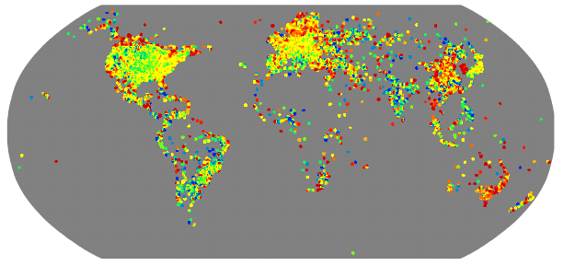
Follow up work (2008) http://arxiv.org/pdf/0803.0939v1

Slide 22
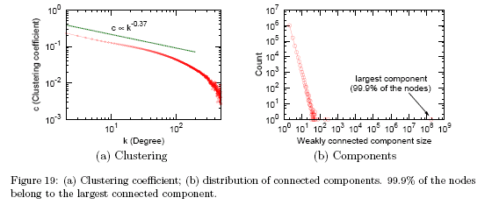
Follow up work (2008) http://arxiv.org/pdf/0803.0939v1
  the clustering coefficient decays very slowly with exponent −0.37 with the degree of a node and the average clustering coefficient is 0.137.
  This result suggests that clustering in the Messenger network is much higher than expected—that people with common friends also tend to be connected.

Slide 23
Follow up work (2008)
  Approximation of “Degrees of separation”
  Random sample of 1000 nodes
  for each node the shortest paths to all other nodes was calculated. The average path length is 6.6. median at 7.
  Result: a random pair of nodes is 6.6 hops apart on the average, which is half a link longer than the length reported by Travers/Milgram.
  The 90th percentile (effective diameter (16)) of the distribution is 7.8. 48% of nodes can be reached within 6 hops and 78% within 7 hops.
  we find that there are about “7 degrees of separation” among people.
  long paths exist in the network; we found paths up to a length of 29.
Notes:
To approximate the distribution of the distances, we randomly sampled 1000 nodes and calculated for each node the shortest paths to all other nodes. We found that the distribution of path lengths reaches the mode at 6 hops and has a median at 7. The average path length is 6.6.
This result means that a random pair of nodes in the Messenger network is 6.6 hops apart on the average, which is half a link longer than the length measured by Travers and Milgram.
The 90th percentile (effective diameter (16)) of the distribution is 7.8. 48% of nodes can be reached within 6 hops and 78% within 7 hops. So, we might say that, via the lens provided on the world by Messenger, we find that there are about “7 degrees of separation” among people. We note that long paths, i.e., nodes that are far apart, exist in the network; we found paths up to a length of 29.

Slide 24
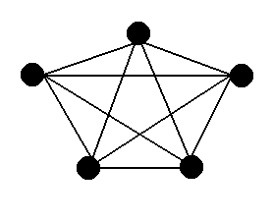
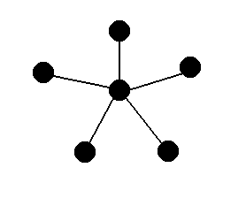
Small Worlds http://www.infosci.cornell.edu/courses/info204/2007sp/
Every pair of nodes in a graph is connected by a path with an extremely small number of steps
(low diameter)
Two principle ways of encountering small worlds
  Dense networks
  sparse networks with well-placed connectors

Slide 25
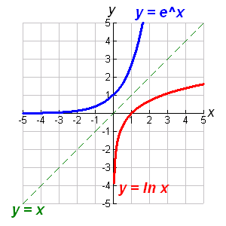
Small Worlds
[Newman 2003]
Example for base e
The small-world effect exists, if
  The number of vertices within a distance r of a typical central vertex grows exponentially with r (the larger it get, the faster it grows)
  In other words:
  Networks are said to show the small-world effect if the value of l (avg. shortest distance) scales logarithmically or slower with network size for fixed mean degree
Number of nodes
Shortest path

Slide 26
Contemporary Software
Where does the small-world phenomenon come into play in contemporary software, in organizations, ..?
Xing, LinkedIn, Myspace, Facebook, FOAF, …
Business Processes, Information and Knowledge Flow
How do Small World Networks form?

Slide 27
Preferential Attachment [Barabasi 1999]
The rich getting richer
Preferential Attachment refers to the high probability of a new vertex to connect to a vertex that already has a large number of connections
a new website linking to more established ones
a new individual linking to well-known individuals in a social network

Slide 28
Preferential Attachment
Example
Which node has the highest probability of being linked by a new node in a network that exhibits traits of preferential attachment?
Example
F
G
A
Why?
E
B
New Node
H
C
D
[Newman 2003]

Slide 29
Assortative Mixing (or Homophily)
[Newman 2003]
Assortative Mixing refers to selective linking of nodes to other nodes who share some common property
E.g. degree correlation
high degree nodes in a network associate preferentially with other high-degree nodes
E.g. social networks
nodes of a certain type tend to associate with the same type of nodes (e.g. by race)

Slide 30
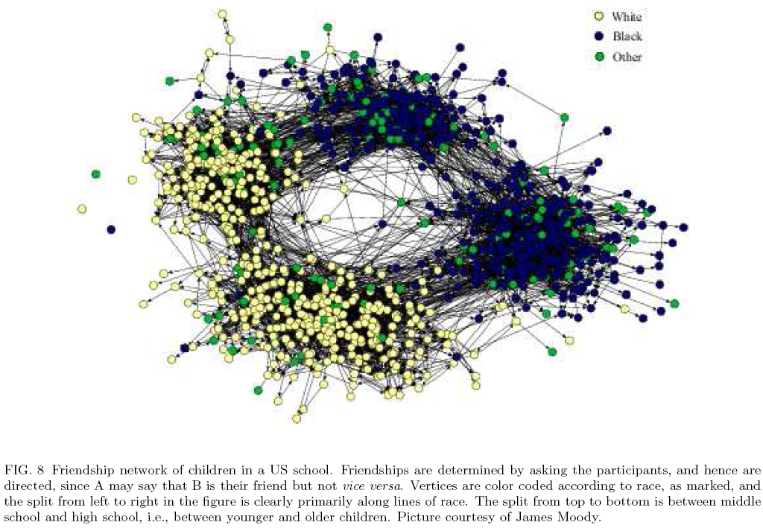
Assortative Mixing (or Homophily)
[Newman 2003]

Slide 31
Disassortativity
[Newman 2003]
Disassortativity refers to selective linking of nodes to other nodes who are different in some property
E.g. the web
low degree nodes tend to associate with high degree nodes

Slide 32
Network Resilience
[Newman 2003]
The resilience of networks with respect to vertex removal and network connectivity.
If vertices are removed from a network, the typical length of paths between pairs of vertices will increase – vertex pairs will be disconnected.
Examples:
Deletion of a hub
Deletion of a leaf node element
The web is highly resilient against random failure of vertices, but highly vulnerable to deliberate attack on its highest-degree vertices

Slide 33
Network Resilience
[Newman 2003]
Connectivity: a function of whether a graph remains connected when nodes and/or lines are deleted. [Wassermann 1994]
Delete the node with the highest degree, what happens to the network?
Deleting which nodes introduces a new component?
Example
F
G
A
B
E
C
H
D
[Newman 2003]

Slide 34
Network Resilience
[Newman 2003]
Removal of high degree nodes first
Removal of random nodes

Slide 35
Connectivity of the Web
[Newman 2003, Broder et al 2000]
What does it need to destroy the connectivity of the web?
According to Broder et al 2000, you need to remove all vertices with a degree greater than five.
Because of the highly skewed degree distribution of the web, the fraction of vertices with degree greater than five is only a small fraction of all vertices.

Slide 36
But …
  Isn‘t all of this an over simplification of the world of social systems?
  Ties/relationships vary in intensity
  People who have strong ties tend to share a similiar set of acquaintances
  Ties change over time
  Nodes (people) have different characteristics, and they are actors

Slide 37

The Strength of Weak Ties
[Granovetter 1973]
  The strength of an interpersonal tie is a
  (probably linear) combination of the amount of time
  The emotional intensity
  The intimacy
  The reciprocal services which characterize the tie
  Can you give examples of strong / weak ties?
Mark Granovetter,
Stanford University

Slide 38
The Strength of Weak Ties and Mutual Acquaintances [Granovetter 1973]
  Consider:
  Two arbitrarily selected individuals A and B and
  The set S = C,D,E of all persons with ties to either or both of them
  Hypothesis:
  The stronger the tie between A and B, the larger the proportion of individuals in S to whom they will both be tied.
  Theoretical corroboration:
  Stronger ties involve larger time commitments – probability of B meeting with some friend of A (who B does not know yet) is increased
  The stronger a tie connecting two individuals, the more similar they are

Slide 39
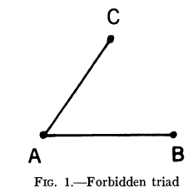
The Strength of Weak Ties
[Granovetter 1973]
  The forbidden triad
Strong tie
Why is it called the forbidden triad?

Slide 40
Bridges [Granovetter 1973]
  A bridge is a line in a network which provides the only path between two points.
  In social networks, a bridge between A and B provides the only route along which information or influence can flow from any contact of A to any contact of B
A
C
G
E
Which edge represents a bridge? Why?
B
F
D

Slide 41
Bridges and Strong Ties [Granovetter 1973]
  Example:
  Imagine the strong tie between A and B
  Imagine the strong tie between A and C
  Then, the forbidden triad implies that a tie exists between C and B
  (it forbids that a tie between C and B does not exist)
  From that follows, that A-B is not a bridge (because there is another path A-B that goes through C)
Why is this interesting?
Strong ties can be a bridge ONLY IF neither party to it has any other strong ties
Highly unlikely in a social network of any size
Weak ties suffer no such restriction, though they are not automatically bridges
But, all bridges are weak ties
2
3
1

Slide 42
In Reality …. [Granovetter 1973]
  it probably happens only rarely, that a specific tie provides the only path between two points
  Bridges are
  efficient paths
  Alternatives are
  more costly
  Local bridges of
  degree n
  A local bridge is more
  significant as its
  degree increases
Alternative
Local bridges: the shortest path between its two points (other than itself)
Bridge of degree 3
What‘s the degree of a bridge in an absolute sense?
Alternative

Slide 43
In Reality …
  Strong ties can represent local bridges BUT
  They are weak (i.e. they have a low degree)
  Why?
What‘s the degree of the local bridge A-B?
2
3
1

Slide 44
Implications of Weak Ties [Granovetter 1973]
  Those weak ties, that are local bridges, create more, and shorter paths.
  The removal of the average weak tie would do more damage to transmission probabilities than would that of the average strong one
  Paradox: While weak ties have been denounced as generative of alienation, strong ties, breeding local cohesion, lead to overall fragmentation
Can you identify some implications for social networks on the web / for search in these networks?
How does this relate to Milgram‘s experiment?
What are sources of weak ties/bridges?
Completion rates in Milgram‘s experiment were reported higher for acquaintance than friend relationships [Granovetter 1973]

Slide 45
Implications of Weak Ties [Granovetter 1973]
  Example: Spread of information/rumors in social networks
    Studies have shown that people rarely act on mass-media information unless it is also transmitted through personal ties [Granovetter 2003, p 1274]
    Information/rumors moving through strong ties is much more likely to be limited to a few cliques than that going via weak ones, bridges will not be crossed
How does information spread through weak ties?

