Slide 1
The OHS Models of Hypertext
Hugh Davis
hcd@ecs.soton.ac.uk
Notes on https://secure.ecs.soton.ac.uk/module/0910/COMP3016/

Slide 2
Eight key questions you should ask yourself as you study:
What is hypertext? Nodes and Links with blue stuff to click on? How are links represented and what do they mean?
To what extent has the vision of the original pioneers been realised?
Where did the research themes in open hypertext, spatial hypertext and time based hypertext lead us to?
What have been the critical success factors for the Web?
What can we do with semantics, and how can we get the semantic data?
Social Hypertext and Web 2.0: is this anything new?
What is the future for hypertext? What are the outstanding research issues?
Is Web Science anything new? Is it Science?

Slide 3
The Need for OHS
Malcolm et al. 91 used a scenario to show that current systems needed
  Interoperability
  Shared Workspaces
  Interactive Authoring
  Links, Anchors and Object Attributes (and link types)
  Private and Public links
  Templates
  Navigational Aids
  Configuration Control
  Programmability
  True Distribution

Slide 4
What is Open Hypertext?
An open system generally implies that
  There is some interface by which third party programs may access the functionality of the system.
  The system may be accessed from applications on heterogeneous architectures.
The hypertext community has generally taken the term “open” to refer to the possibility of including hypertext features within the whole environment.
  A corollary of this is that links and anchors must be kept separately from documents: The LinkService.

Slide 5
OHS systems should be open with respect to
Applications
Data Formats
Functionality
  The hypermedia system should not impose a single view of what constitutes hypermedia but should be
    configurable
    extensible
Other OHS Systems
Platforms
Users

Slide 6
Hyper-G 1
Basically a Client Server System like the Web.
Connections persistent for session
Server models nodes, links, anchors as separate first class entities
Links are bi-directional
Data model ensures link integrity
A notion of composites (collections)

Slide 7
Hyper-G 2
Users can author
Support for collaboration
Own internet protocol (HG-CSP)
Own Markup language (HTF)
Own Browser (and other tools) (Harmony) - though simple browsing through a web browser too
Early support for Multimedia

Slide 8
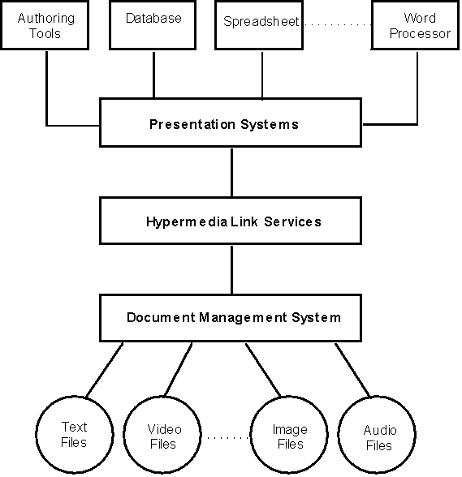
The Microcosm philosophy

Slide 9
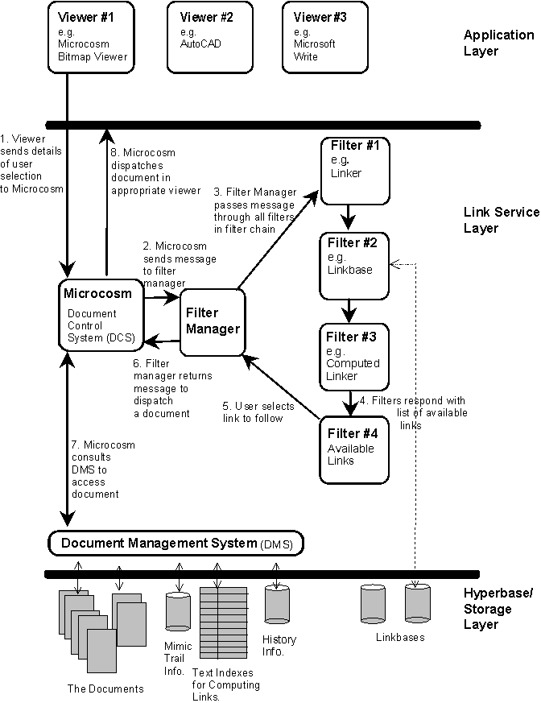
The Microcosm
Model

Slide 10
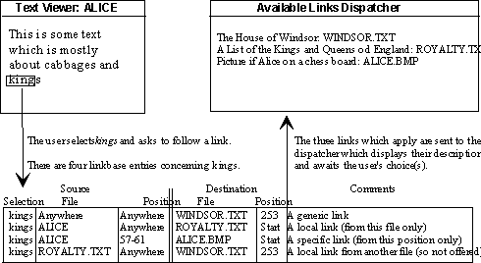
Specific, Local and Generic Links
The idea that the source anchor of a link is not embedded in the source document, but its position, or positions, are described in the linkbase

Slide 11
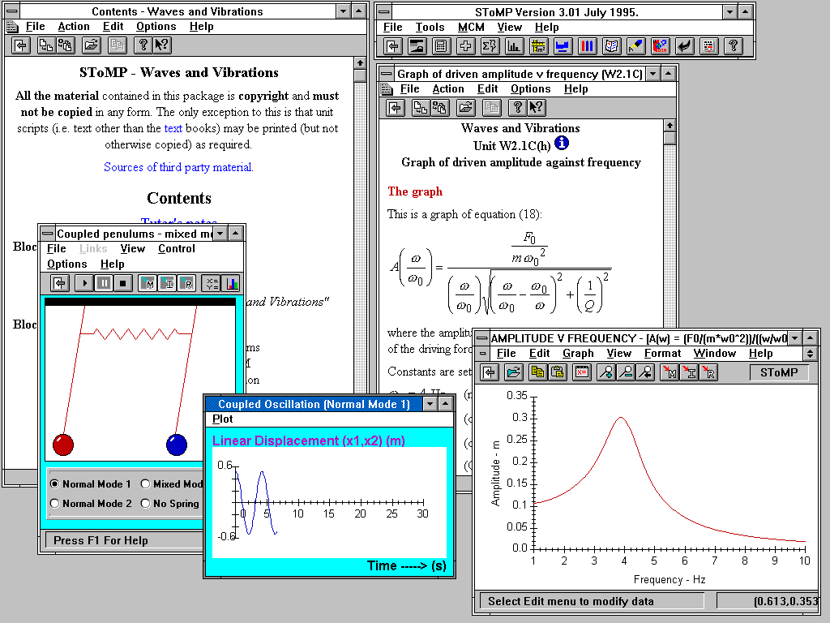

Slide 12
Microcosm Protocols 1
1. Launch document
  execute a viewer program with a given data set loaded
2. Display Buttons
3. Start-Up Options
  e.g. set display options,scroll to anchor
4. Check Link Integrity

Slide 13
Microcosm Protocols 2
5. Service User Actions
  providing an action menu
  identify selection made (or button clicked)
  identifying the current data file
  packaging all of the above into message to MCM
  If the application is unable to identify the position of the selection, then Microcosm will only be able to provide local and generic links: specific links would be impossible.
Note: This work was extended by the OHP protocol.

Slide 14
Hyper-G and Microcosm
So they were so good, why are we not all using them?
WWW

Slide 15
Open Hypertext on the Web
We lose the goal of hypertext across the entire desktop (unless everything becomes web aware? => the Web *is* the platform)
Current browser (c. 1995) implementations did not allow easy control of anchor positions
But we could have separate links and annotations – link injection

Slide 16
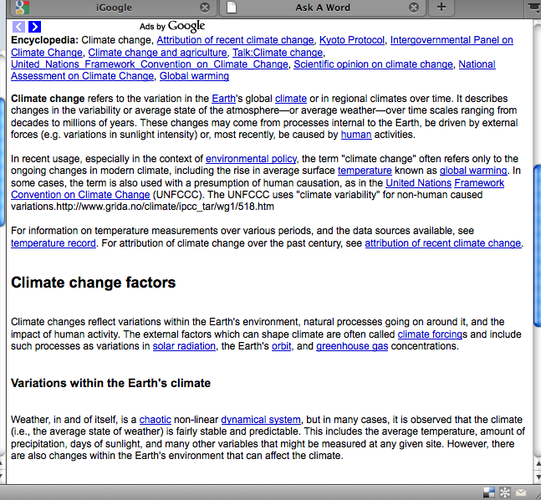
Google Link Injection (2009)

Slide 17
Linkbase Creation
Theming technology extracts key phrases from documents based on location and frequency
Create generic links to those documents based on the extracted themes
Interactive Linkbase Editor tool deletes the unwanted links

Slide 18
Link Presentation
Links can be rendered using different colours etc. to distinguish from authored links - but always has potential to clash with a style sheet
Where a link has more than one destination, use JavaScript to pop up a menu

Slide 19
Keeping links and anchors separately: advantages
Applications do not have to be responsible for maintaining "foreign" markup
You can tailor your linkbases to your needs (contexts)
You can have generic links
You don’t have to write spiders
On read only media (e.g. CD-ROM, no permission) keeping links separately is the only way to do it!

Slide 20
Keeping links and anchors separately: disadvantages
Keeping links separately introduces potentially consistency issues
The integration with existing applications can be difficult (sometimes impossible)
For streaming, data links as well as data have to be synchronised

Slide 21
Approaches to link injection
Do it before you serve the documents (Batch process )
Do it at the point the documents are served – On – demand. (Active Navigation)
Do it with a proxy (DLS - Active Navigation)
Do it within the browser/client (See Bouvin 1999)

Slide 22
So What are the Pros and Cons
…of the Different approaches to link injection?

Slide 23
Batch Processing
Generate static HTML pages for use with any web server
Fastest way to serve pages - and most cache friendly approach
Need to reprocess all pages in the event of a linkbase (link database) update to ensure currency
No opportunity to personalise content

Slide 24
On Demand Link Injection
Careful choice of data structures and algorithms needed to ensure good performance
New material can immediately be viewed with hyperlinks from the linkbase
User can choose linkbases to apply
Higher run-time memory requirements, search capability can use same data

Slide 25
Using a Proxy (explicit)
User configures their browser to proxy through the link injector
Can apply link database to almost any content
Can also perform other conversions e.g. Word -> HTML
Casual site users won’t want to reconfigure their browsers

Slide 26
OHP
Initially a naïve attempt to “shim” existing linkservers so that they could be used by standard client integrations
An early realization by the community that writing clients is far harder than writing servers
And far less interesting
Later OHP became emboddied in FOHM

Slide 27
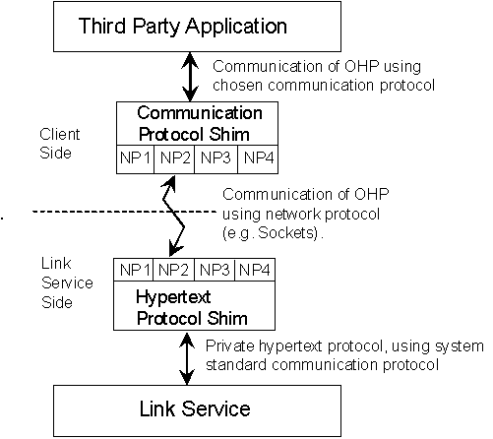
Assumed Architecture

Slide 28
OHP Data Model

Slide 29
LocSpec for anchor position
LocSpec ::=
{\ContentType MimeType
\Content Mime encoded text string
\Count [Comma separated list of numbers]
\ReverseCount [Comma separated list of numbers]
\Name [Mime encoded text string]
\Script [Viewer Executable Script]}
Note the use of “Opaques”

Slide 30
Client Side Communication Shim
Accept OHP messages from network and communicate message to correct viewer/editor and vice versa
Maintain table of applications on this platform which should be used for each data type.
Maintain table of level of protocol can be expected from each viewer/editor.
Handle LaunchDocument messages at the client end,.
For level 0 applications, handle CloseNode messages

Slide 31
Levels of the Protocol
Level 0: Only LaunchDocument and CloseNode messages from linkserver to client. No communication. No hypertext. Any application should run as a Level 0 viewer.
Level 1: Supports the above functionality maybe by adapting third party applications.
Level 2: Not defined, but envisaged to support extensions to deal with content manipulation, presentation and standard client end scripts - specialised applications.

Slide 32
Good points and Bad
On the Good side
  OHP has been used in demos and prototype systems
  The Data Model specified has been the most accepted
  A formalised version of the data model (FOHM) is widely used in the community
On the Bad
  The shim architecture was naïve and was replaced by middleware
  The message overhead is very high

Slide 33
Link Integrity
The endpoint of a link (source or destination) needs to define
  a node
and optionally
  a position with a node (locspec)

Slide 34
Broken Links
If an endpoint fails to resolve to the place intended by the author then it is broken (we often say the link is broken)
  If the endpoint refers to an invalid node then we have a dangling endpoint (link)
  If the endpoint refers to the wrong part of the node content then we have a content reference problem

Slide 35
Solutions to Dangling Link Problem
User Onus (fine them if they don’t keep them up to date?)
Stop people linking to things that may move
Forward References
Guaranteed Names Names (PURL servers, DMS)
The Hyperbase approach (See Hyper-G)
Link Integrity Checking Agent (Spider)

Slide 36
Solutions to the content reference problem
The Publishing Model
Manual Link Editor
Link Service Aware Editing Tools
Just-in-time link repairs
Express specific link positions using queries
Avoid specific links anchors
Versioning
Use of Diff Files

Slide 37
Responsible link owner or responsible system? Approaches
Don’t bother: the Californian approach – it’s a social issue.
Avoid the problem: use declarative link definitions
Loosely coupled: give the author tools to sort the problem if they want
Automated link repairs: just-in-time
Tightly coupled: the Germanic approach – don’t let users have this freedom

Slide 38
html linking limitations
Addressing
  Only A elements
  Only pre-marked up (embedded) elements
Closed Tag Set (A and IMG)
Fixed semantics (replace and include), single ended unidirectional.
No Stylesheet to express semantics

Slide 39
XML Linking
XPath provides syntax for addressing existing nodes or elements within an XML parse tree (which could be used as anchors)
XPointer provides a syntax for addressing arbitrary ranges within XML documents (which could be used as anchors)
XLink is for specifying the connections between anchors, their semantics and their types

Slide 40
XPath
Allows specification of a Path to the required parse tree node or element by one or more location steps
A location step requires
  An axis (e.g. child, parent, sibling etc.)
  A node test (what types of nodes)
  An optional predicate (filter the above)

Slide 41
XPath Examples
child::LISTITEM
  Selects all LISTITEM elements that are children of the current node
child::*
  Selects all children of the current node
child::*[self::blockquote or self::quote]
  Selects all children of current node that are either element type blockquote or quote
Id(“chap1”)/child::ABSTRACT
  Selects the ABSTRACT elements(s) of the children of the element with ID attribute chap1 within the current node

Slide 42
XPath and Referential Integrity
ID Attributes are robust pointing mechanisms; better tan measures such as “3rd child”
E.g. even after editing a document
  Id(“chap1”)/child::ABSTRACT
  Is likely to continue to point to the correct thing unless someone changes the ID attributes deliberately or they insert more ABSTRACT elements into the chapter.

Slide 43
XPointer
  XPointer can locate any node, point, or selection in an HTML, or XML document.
  XPointer is expected to be the normative fragment identifier syntax.
  But not all documents are XML (e.g. BMPs)
  Full XPointer is intended to allow schemes for identifying selections in non XML documents
  XPointer expressions are used as the fragment identifier portion of a URI (the bit after the #)

Slide 44
XLink
standardizes a way to indicate that a given element is a link,
standardizes a way to identify certain metadata specific to links as a class
provides certain link sub-classes that have proven widely useful.
provides means to identify roles and titles for anchors
permits authors to associate arbitrary additional metadata with the various parts of links.

Slide 45
XLink
Separates two major axes:
  whether the link is automatic or user-actuated,
  what happens to the display contexts involved such as
    open a new context
    embed in place
    replace the origin context
These are broad categories of behaviour, in contrast to formatting and style issues such as
  Window placements
  choice of control styles etc.

Slide 46
XLink
Identifies linking elements beyond A and IMG;
Attaches links to documents without modifying them (annotations, "stand-off" tagging, etc.);
Provides external, symmetrical, and multi-ended links;
Separates traversal semantics from link type;
Identifying basic link semantics such as transclusion, expand-in-place, etc.

Slide 47
Xlink Examples
<mylink xlink:type="simple“ href="students.xml“ role="detail“ title="Student List“ show="replace" actuate="user“ See also the current List of Students
</mylink>
Actuate = user|auto
Show = replace|new|embed
For full explanation of this evolving spec see w3c.org

