Slide 1
Web 2.0
The Read/Write Web
From Slides by Hend Al-Khalifa
Hugh Davis
Learning Societies Lab
ECS
The University of Southampton, UK
www.ecs.soton.ac.uk/~hcd

Slide 2
The Research Question
What is Web 2.0?
Is it anything new?
Context – Tim Berners Lee….http://arstechnica.com/business/news/2006/09/7650.ars
When asked if it's fair to say that the difference between the two might be fairly described as "Web 1.0 is about connecting computers, while Web 2.0 is about connecting people," Berners-Lee replied, "Totally not. Web 1.0 was all about connecting people. It was an interactive space, and I think Web 2.0 is of course a piece of jargon, nobody even knows what it means. If Web 2.0 for you is blogs and wikis, then that is people to people. But that was what the Web was supposed to be all along. And in fact, you know, this 'Web 2.0,' it means using the standards which have been produced by all these people working on Web 1.0."
He's big on blogs and wikis, and has nothing but good things to say about AJAX, but Berners-Lee faults the term "Web 2.0" for lacking any coherent meaning. A quick look at a list of alleged Web 2.0 sites is enough to illustrate what he's talking about. In what sense do all the sites do something qualitatively different than the sites which came before? In what sense do these sites do anything similar enough that they can all be lumped into a single category?

Slide 3
Outline
What is Web2.0?
Characteristics
Web1.0 Versus Web2.0
The Three Trends of Web2.0
Web2.0 Technologies
Summing up
References

Slide 4
What is Web 2.0?
user to user communication
decentralized networks
web accessible and server mounted applications
multi-platform applications
non-hierarchical organizations

Slide 5
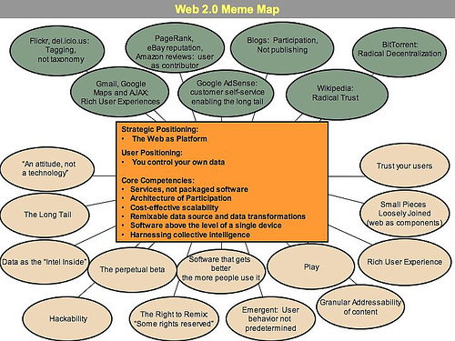
Web As a Platform

Slide 6
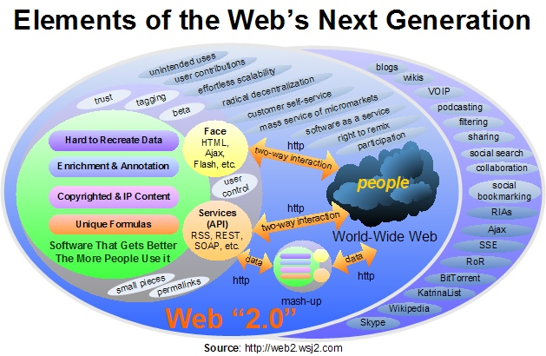
What is Web 2.0?

Slide 7
Web 2.0 Characteristics
Rich User Experience
User Participation
Dynamic Content
Metadata
Web Standards – Valid Markup
Scalability, ’The Long Tail’

Slide 8
Web1.0 Versus Web2.0
(By Tim O'Reilly)
Web 1.0 | Web 2.0
Personal Web Sites | Blogs
Britannica Online | Wikipedia
Content Management Systems | Wikis
Directories (Taxonomy) | Tagging (“Folksonomy”)
Screen Scraping | Web Services
Etc. | Etc.

Slide 10
Social Trends
Spread of Broadband
  Increasingly ubiquitous connections
A generation of “web natives”
  Living on the web
  Social networking; blogging; instant messenger
Create, not just consume
Some hard lessons about data ownership
  Don’t steal my data; don’t lock me in

Slide 11
Business Trends
Exploit the Long Tail
  At internet scale even niche communities are very large
  “We sold more books today that we didn't sell at all yesterday, than we sold today of all the books that did sell yesterday.”
      Amazon employee quoted on Wikipedia
Success of web services
  No need to own the user interface. It's your data that they want
Users can enrich your data
  “Harnessing collective intelligence of users”
  Review and Recommend; Social Bookmarking; Folksonomies

Slide 12
Technology Trends
The Power of XML
  Easier to exchange and process application independent data
Agile Engineering
  Incrementally develop your product; short release cycles
  Continually adapt to user needs
  “The Perpetual Beta”
Maturation of the browser
  XHTML, DOM, CSS, Javascript
  Browser as platform, not just document viewer

Slide 13
Web 2.0 Technologies

Slide 14
CSS
Content with Style

Slide 15
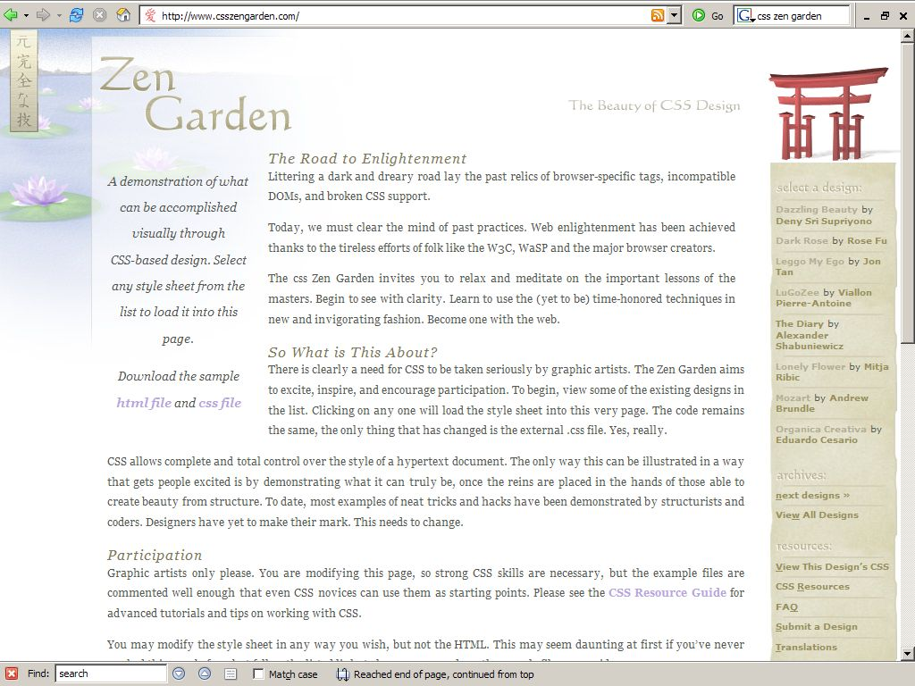

Slide 16
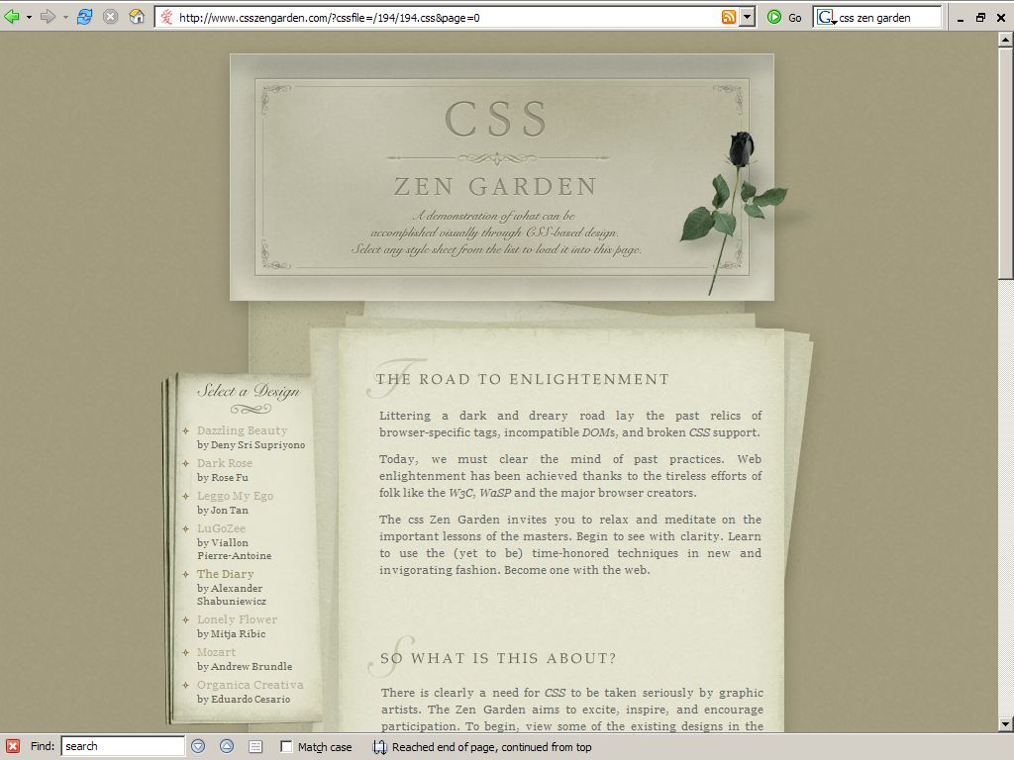

Slide 17
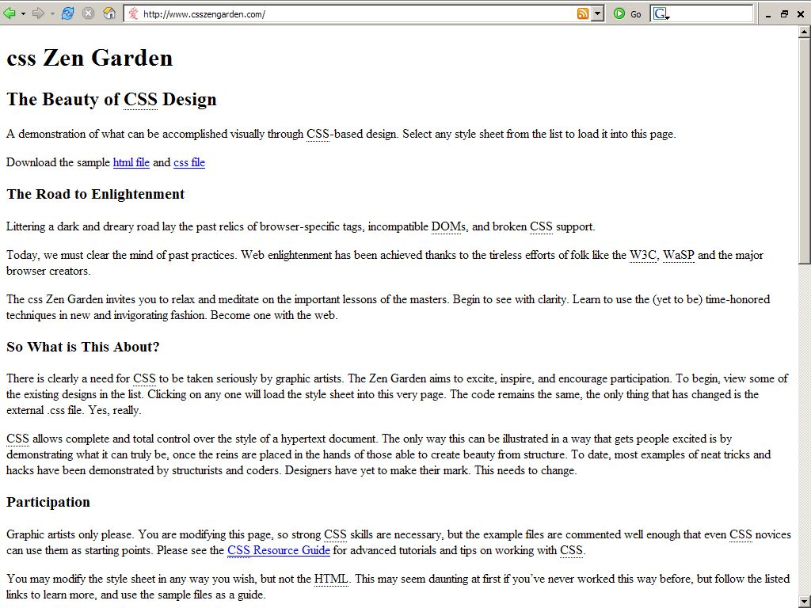

Slide 18
RSS : Content Syndication

Slide 19
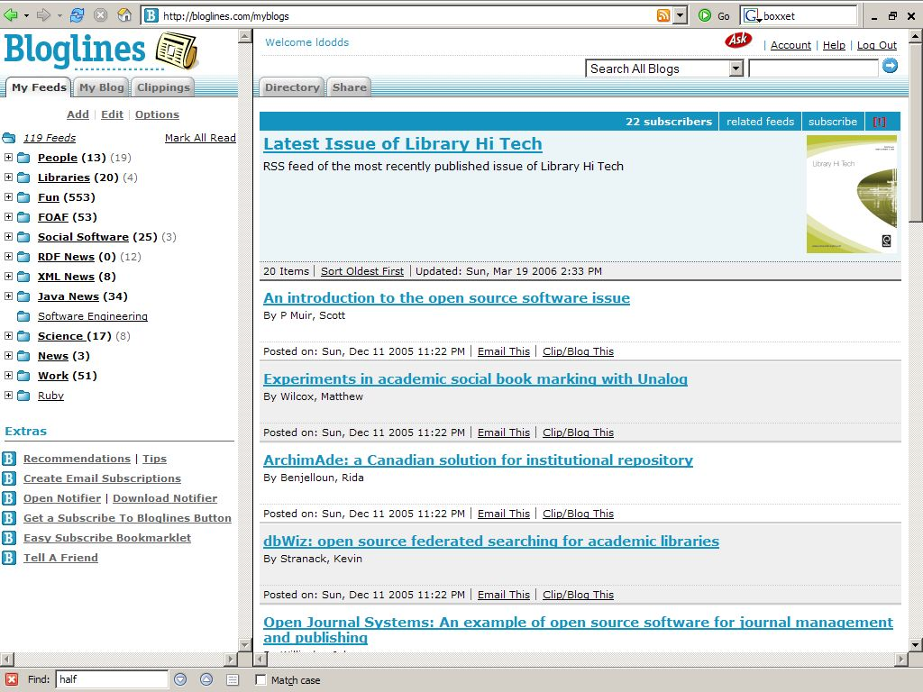

Slide 20
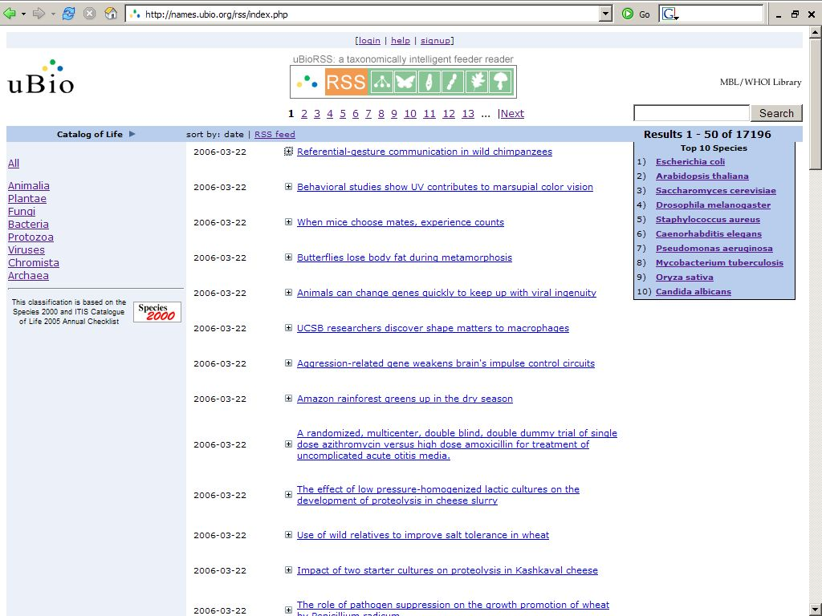

Slide 21
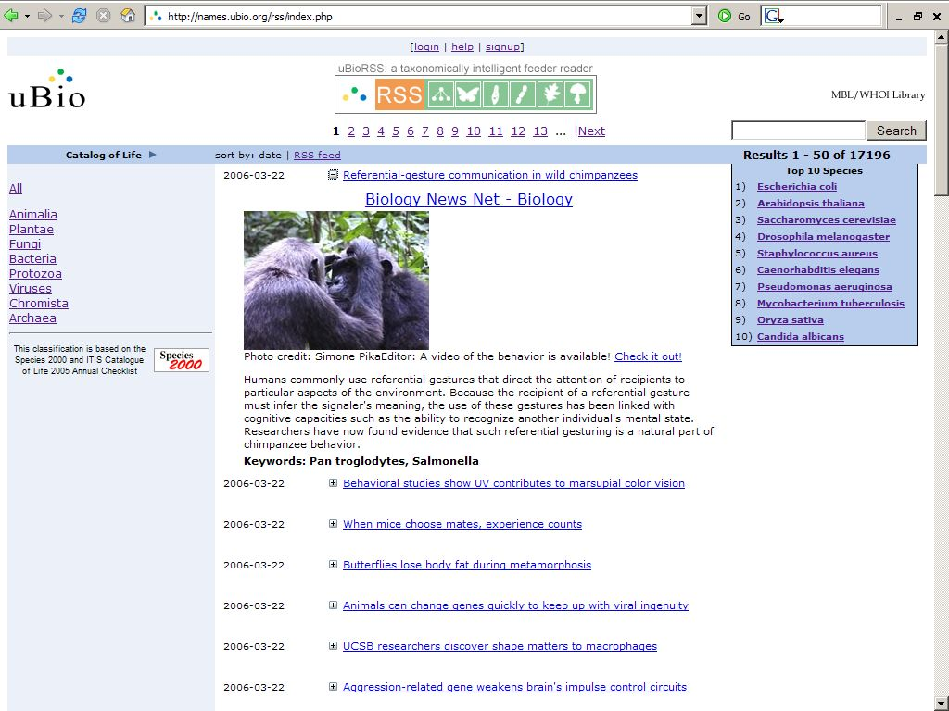

Slide 22
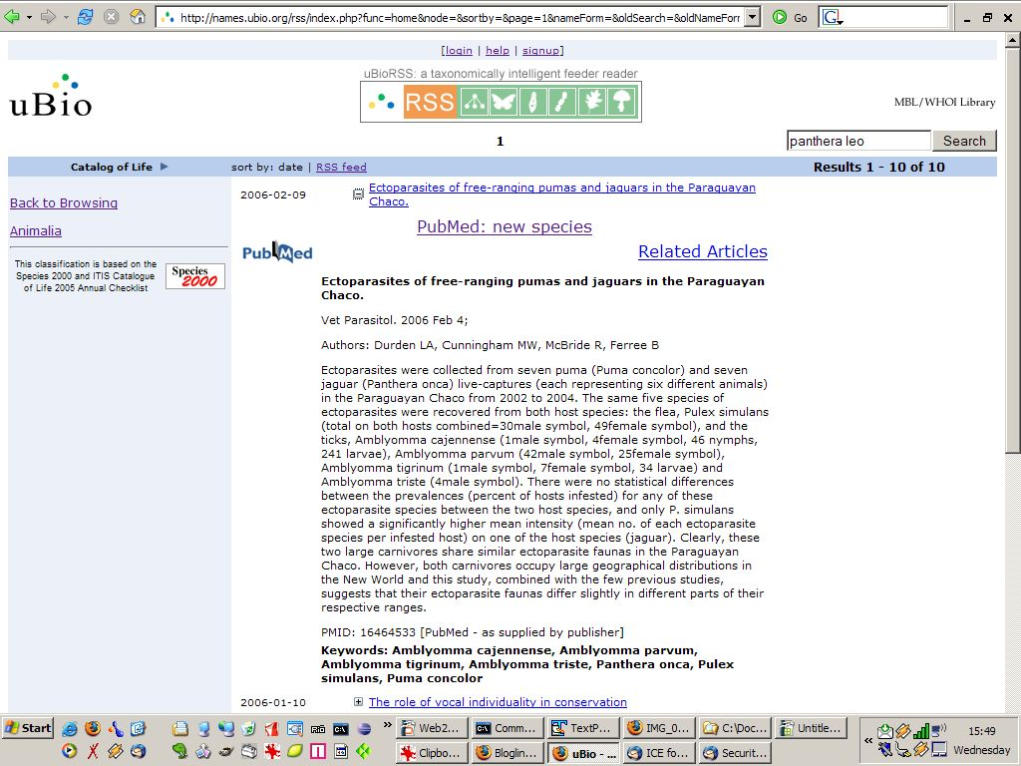

Slide 23
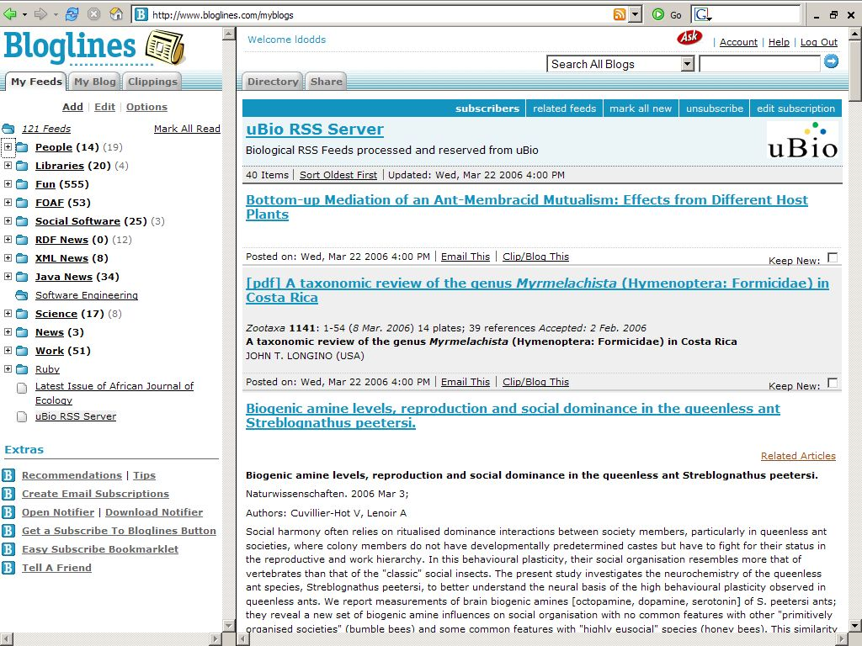

Slide 24
Web Services: Open Data

Slide 25
Web Services
Publish Data Not Pages
  Remember: its your data that they want, not your user interface
  RSS feeds are web services, too
“Mashups”
  Remix Data to Create New Applications
184 Web services listed on ProgrammableWeb.com
  Photo sharing; calendars; messaging; blogging
  File storage; ecommerce; advertising; search

Slide 26
AJAX
(Asynchronous Javascript and XML)

Slide 27
AJAX
Dynamic User Interfaces
Allows web pages to be redrawn or re-presented
without complete recreation of the page and round-
trip of data to the server.

Slide 28
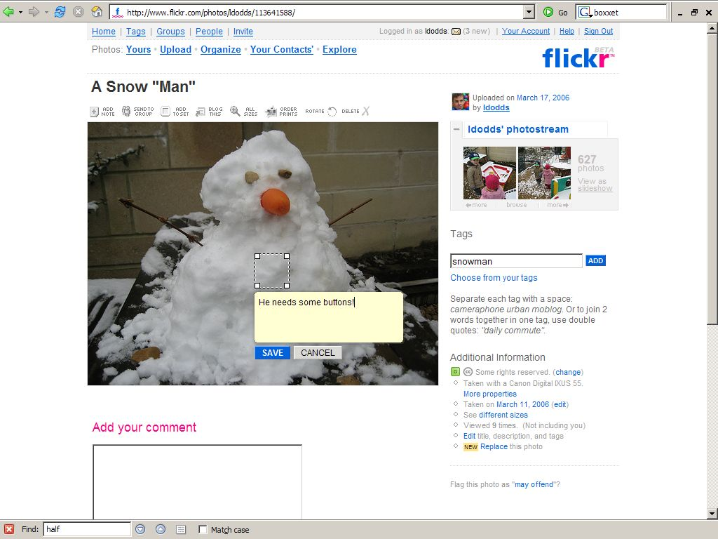

Slide 29
Mashup
is a website or web application that seamlessly combines content from more than one source into an integrated experience.
Content used in mashups is typically sourced from a third party via a public interface or API.
-Wikiepdia(2006)

Slide 30
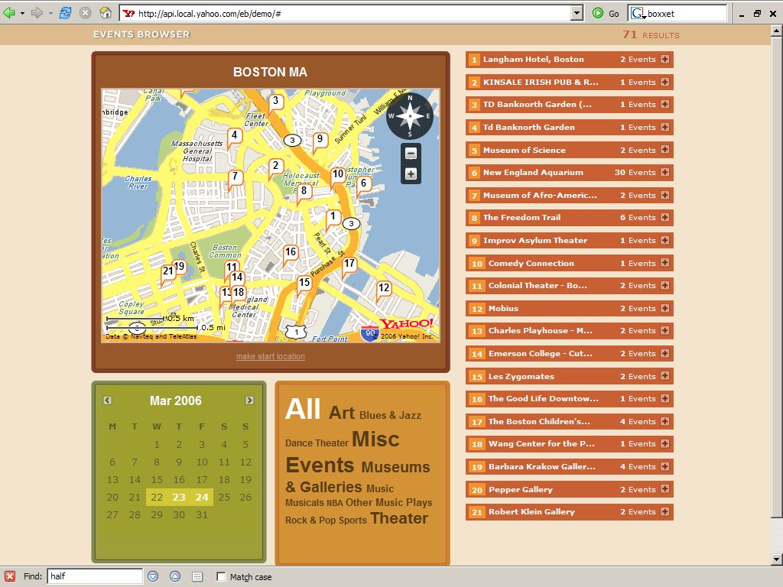

Slide 31
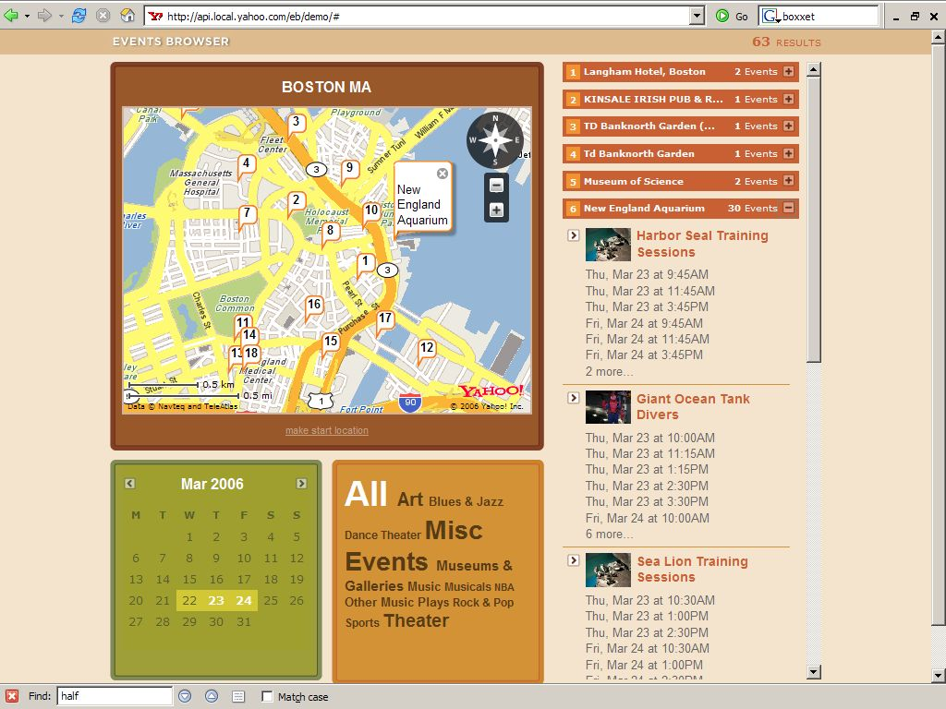

Slide 32
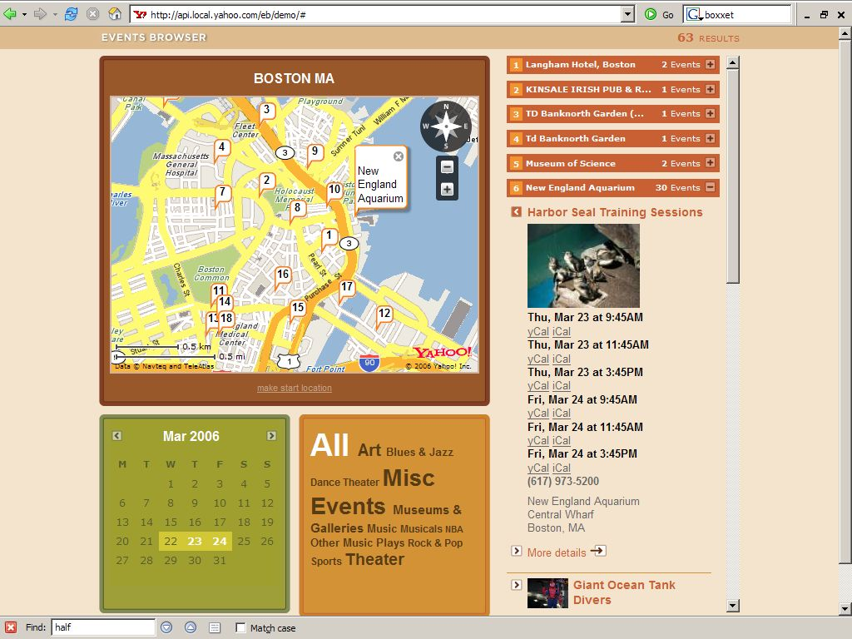

Slide 33
MAP API
EVENTS API
IMAGE
API

Slide 34
Folksonomies
a collaboratively generated, open-ended labeling system that enables Internet users to categorize content such as Web pages, online photographs, and Web links.
-Wikipedia (2006)

Slide 35
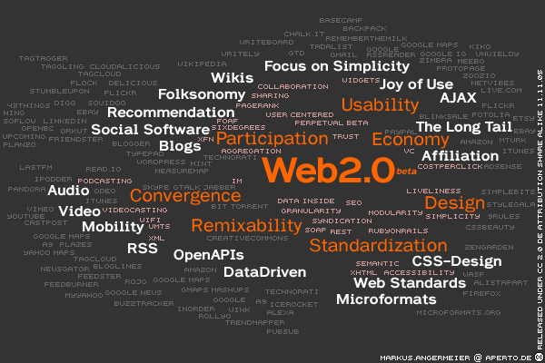

Slide 36
Summing Up

Slide 37
Summing Up
Web 2.0 hard to define, but very far from just hype
  Culmination of a number of web trends
Importance of Open Data
  Allows communities to assemble unique tailored applications
Importance of Users
  Seek and create network effects
Browser as Application Platform
  Huge potential for new kinds of web applications

Slide 38
Summing Up
RSS – really simple syndication
Wikis
New Programming Tools: AJAX, API
Blogs and blogging
Commentary and comments
Personalization and My Profiles
Podcasting and MP3 files
Streaming Media – audio and video
Reviews and User-driven Ratings
Recommender Functionality
Personalized Alerts
Web Services
Instant Messaging and Virtual Reference
Folksonomies, Tagging and Tag Clouds
Photos (e.g. Flickr, Picasa)
Social Networking
Socially Driven Content
Open access, Open Source, Open Content
Social Bookmarking

Slide 39
References
Tim O'Reilly (2005). What Is Web 2.0 Design Patterns and Business Models for the Next Generation of Software . [online] http://www.oreillynet.com/lpt/a/6228
Rebecca Hedreen (2006). Online Research Toolkit Presentation. [Online] http://ortpresentation.blogspot.com/2006/03/introduction.html
Leigh Dodds (2006). [online] http://allmyeye.blogspot.com
Stephen Abram (2006). http://www.sirsidynix.com

