Slide 1
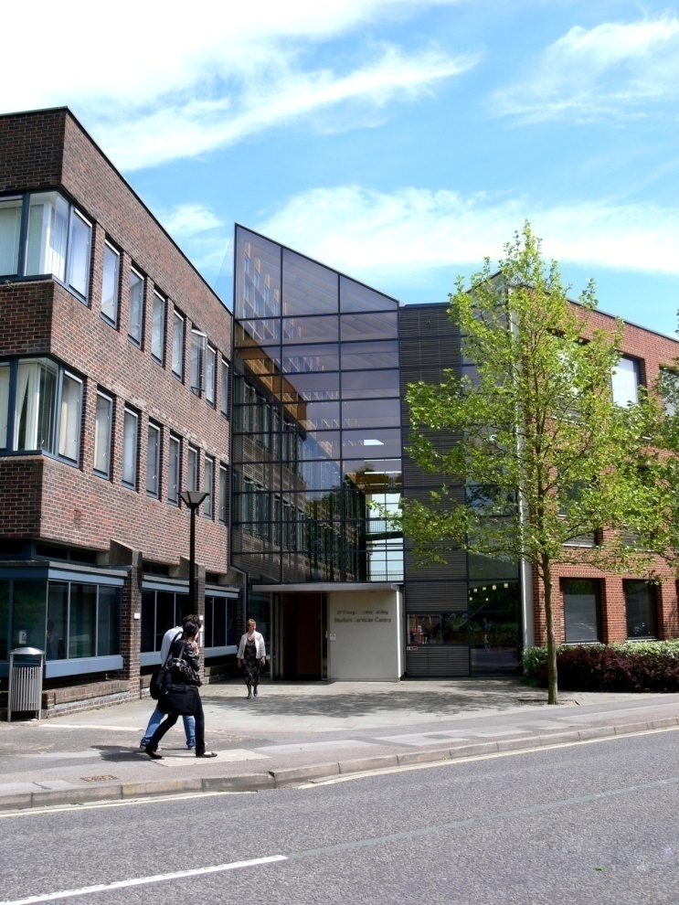
Projecting a professional image
ECS level 1 CV workshop
Diana Fitch djf4@soton.ac.uk
What is a CV?
Styles of CV?
Good and bad practice
CV basics
How to use self-audit
Employability recap
www.southampton.ac.uk/careers

Slide 2
Purpose of these slides
To help you think about CVs
To provide a complement to the workshop activities
To give you guidance
To provide an alternative perspective on your assignment

Slide 3
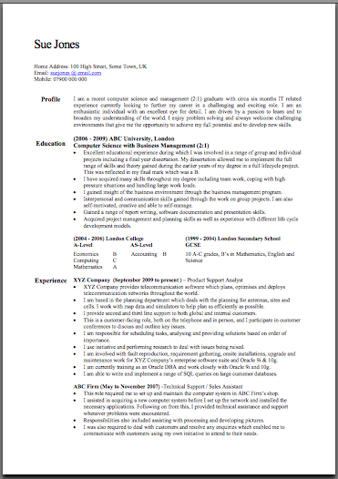
What do you know about CVs?
What is a CV?
Who is it for?
When is it needed?
What should it do?

Slide 4
CV?
A curriculum vitae is a “life list” BUT
CVs:
Inform about your background
Persuade the opportunity provider to see you
What you have done in the past gives EVIDENCE of what you can do in the future
NOT just a list, but a professional and targeted marketing tool which is about your achievements and skills,
        And results in an interview
Notes:
Talk about Shell Step applications and CVs – comment about CV just being a list and cover letter much better to show why you can do the job. In reality its not like that, you’ve got to try and make your CV as interesting and as personal as a covering letter
No one right way to do a CV
Its about your market, what they need to know, what’s going to tempt them
YOU want an interview – START WITH YOURSELF

Slide 5
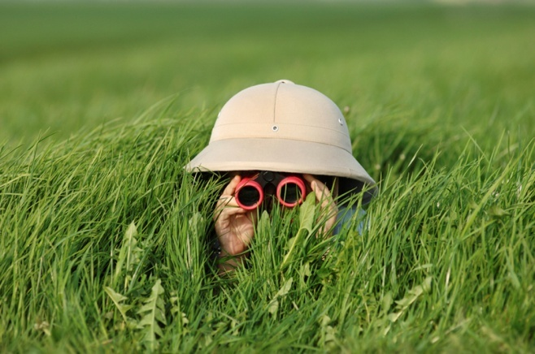
Start with yourself
Self audit: experiences > activities > skills
Computerised guidance programs
Prospects Planner and Adult Directions
Feedback from tutors, colleagues, friends, relations
ALSO
Explore what’s out there
ECS Employability Tutorials
http://www.prospects.ac.uk/ Interest guides
Will take you to the tutorials and Career Destinations website
http://www.ecs.soton.ac.uk/careers> > > >

Slide 6
Employability Skills
Important
1. Motivation & enthusiasm
2. Team working
3. Oral communication
4. Written communication
5. Flexibility
6. Customer focus
7. Problem solving
8. Managing own learning
9. Commercial awareness
10. Planning and organisation
Anxiety about
writing and literacy skills, leadership skills
soft skills particularly communication, problem solving,
managing own learning and being self-motivated
AGR 2006 Survey
AGR 2008 Survey

Slide 7
What needs to go on a CV?
Personal details
Objective or profile – if it adds something
Education/qualifications
Work experience/employment history, including voluntary. Focus on the skills developed, your achievements
Skills/interests/activities/achievements/responsibilities
Referees? - or “Referees available on request”
Edited and organised to fit one or two pages

Slide 8


Danger points
NO target audience
Poor layout, lack of headings, bullet points
Tables and lines which don’t format correctly
Open access software which doesn’t download correctly
Boring, too many unnecessary details, long chunks of text, too many tasks
Too much sailing, football, or too little?
Inappropriate personal information
Poor spelling, grammar, too small, fancy fonts, BOLD
http://www.kent.ac.uk/careers/cv/goodbadCV.htm

Slide 9
Winning points
Clear, attractive layout with space
Good sized font
Easy to navigate (dates and headings are clear)
Demonstrates attention to detail
Gives evidence and is interesting (USPs)
Relevant (shows focus) and to the point
Appropriate style (chronological, skill based, academic)
“I want to meet this person”

Slide 10
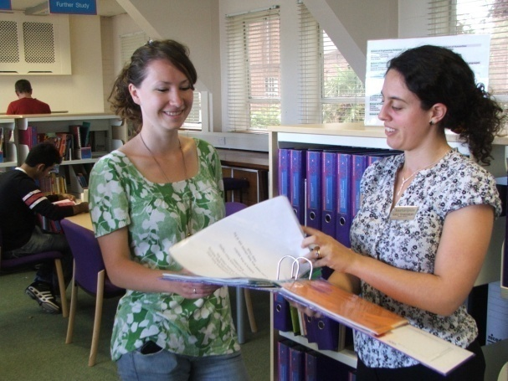

Help
- presenting or developing your skills
Career Destinations, Student Services Centre
  Skills section , workshops
Daily appointments
  15 minute CV/application checks
Use the template, the Guide and the website
  > Make successful applications
Get involved
  > Graduate Passport

Slide 11
What to do next?
Reflect on the class activities
Conduct your own investigations/research
Find example CVs
Take a look at the examples – good and bad
Draft, refine and review your CV
Use the target of a summer job relevant to your degree as a focus for your CV

