Slide 1



Ethical and economical perspectives of open source software
Team Quintinlessness:
Antony Johnston
Steven Pike
Mark Coleman
Alex Burch
Alex Scleparis
Nurbol Baimaganbetov

Slide 2
Learning outcomes
The licensing issues surrounding open source
The ethical consequences of open source
Common misconceptions about open source
Recent news and estimations of the model’s future

Slide 3
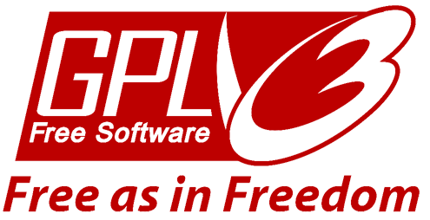
“Copyleft” VS Copyright
Open source software is that which publishes its source code, allowing developers worldwide to modify it
“Copyleft”, enforced by the GPL (general public license)
Allows software to be freely
distributed and changed...
...but requires that all subsequent versions carry the same freedoms
E.g. Linux kernel is available free under the GPL. Distributions of it (Ubuntu, Fedora, OpenSUSE) must be available for free too
Notes:
The key point of open source software is that the original developer(s) publish the source code: this allows any developer who is interested in the project and capable of programming at that level to contribute to the efficiency and functionality of the software.
The goal of the form of licensing which protects open source software, “Copyleft” (obviously, a play on “Copyright”) is to give more freedom to the end user, rather than more freedom to the creator as with Copyright law.
Licensing software with the General Public License (GPL, originally written for the GNU project) ensures that the software can be freely distributed, and the code modified, but also requires that any subsequent software based on the original must also be freely distributed, and allow the code to be modified.
For example, the famous Linux kernel is available under a GPL. All software distributions of the Linux kernel (Ubuntu, Fedora and OpenSUSE being 3 of the most popular) must make themselves free under the same licensing terms.

Slide 4
Ethics
The emerging trend of ethical balance
© Burch & Scleparis, 2010
Ethical Pros of Buying Open Source | Ethical Cons of Buying Open Source
People become empowered, as they get good quality software for free. | Companies will lose money and possibly go out of business.
Industry has to make better software if they wish to stay in the market, meaning those that buy it get better products. | Companies may have to charge users more to compensate lack of business.
Software development and quality will become exponentially better, as more developers move from traditional company employment, to that of open source companies. | Open source has a lack of structured and high quality support for users of their software.
Notes:
It can be said that as time increases, the quality of open source software will increase. This is because experience on how to create good quality open source software becomes better each time a new project is completed.
This presents a choice for a user: to pay for industry created software or choose the free option. Obviously, unless you have a need for advanced options in software, many open source programs can easily replicate the functions needed by the everyday person for no cost.
If the trend follows the increase in open source, and the decrease in traditional corporate software, then the table shown highlights some of the issues that we may be causing, in our ethical decision to choose the open source route.

Slide 5
Ethics (contd’)
There has been a definite increase in the amount of software becoming open source. This could be said to create a security vulnerability
EXAMPLE:
Old GSM 2G Standard phones will become vulnerable as their source code becomes publicly available. Malicious developers therefore are able to create harmful modified code that could for example steal sensitive and personal information.*
*Reference: http://www.silicon.com/technology/security/2009/08/26/open-source-hack-could-make-mobiles-vulnerable-to-prying-ears-39500001/
Notes:
Security of open source software has become a prominent issue of late; Security Researcher Karsten Nohl has initiated the release of the GSM 2G source code as, after much investigation, the technology has been said to be vulnerable.
The code is to be publicised for the sake of highlighting the emerging vulnerabilities of the standard. As the researcher who initiated the publication states:
“We're not creating a vulnerability but publicising a flaw that's already being exploited very widely,"
Information that would previously have taken several months of raw computing power to decrypt could now take seconds. This is due to the fact that the encryption algorithm would now be publicly available to all those who wish to view it.
This example shows that open source code can potentially cause considerable security risks, more so than off the shelf competition.

Slide 6
Common misconceptions
There is no guarantee that development will happen.
There may be significant problems connected to intellectual property
It is sometimes difficult to know that a project exists, and know its current status
Reference: http://eu.conecta.it/paper/Perceived_disadvantages_ope.html
Notes:
In depth explanation of Misconception : No elected leadership and a lack of coordination can potentially result in substantial gaps in software development progression. In this way, the rate at which extra features are developed for open source software can vary. At times, programmers can either be coordinated and therefore make fast progress, or they can be working individually and thus at a slower pace.
In depth explanation of Misconception : It is often unclear as to whether software that achieves a similar result or function is copyrighted, and therefore open source software also performing a similar function could be seen to infringe on a patented software solution.
In depth explanation of Misconception : There is a definite lack of advertising for open source software. This massive difference and gap in marketing provides corporate solutions with large investments in marketing schemes with a competitive advantage over open source software. In a similar way, open source software solutions for particular functions may be less accessible to the common market and may appear to be only available to a select wing of professionals.

Slide 7
Costs and benefits: Individual perspective
Improved skills
Ability to adapt software for own needs
Recognition in community
Employment perspectives
Notes:
The word economics has a wide range of meanings. In this context, we are specifically concentrating on the costs and benefits of participating in open source from individual and social perspectives.
Improved skills – Participating in and solving software development problems enhances a programmer’s skill. 63% of information providers state that their main motive in the open source industry was to enhance their skills.
Direct need to adapt – most people who participate in open source software require the software for their occupation. By solving other people’s software problems in the community, programmers automatically secure themselves against future difficulties, as 32% of information providers stated that they faced the same problem, and already solved it. 68% of people stated that they find it quick to post the answer for others because they faced the same problem, and it would enable other people to implement the solution quickly.
Improved recognition in community – Information providers and information seekers mostly believe to be a part of the community. They state that one of the key reasons to help others is reciprocity, “if I help you, you will help me next time”. According to Lakahani and Hippel’s empirical research, information providers (individuals which provide the most answers) are likely to get answers on average 50% more quickly than other individuals due to their reputation.
Better employment opportunities – All three factors above lead to better employment opportunities and higher salaries. Those who participate in the open source software development process are likely to have better job prospects due to their refined skill of seeking solutions and solving their problems. This is very true with individuals such as William Joy, who is now employed by high profile company Sun Microsystems. It can therefore be assumed that these innovators earn a substantial amount, as they made the idea of open source become true.

Slide 8
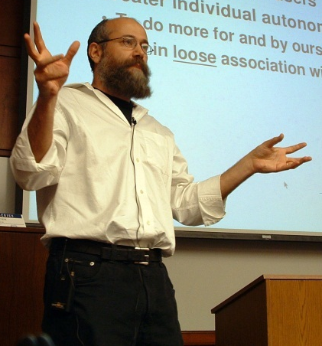
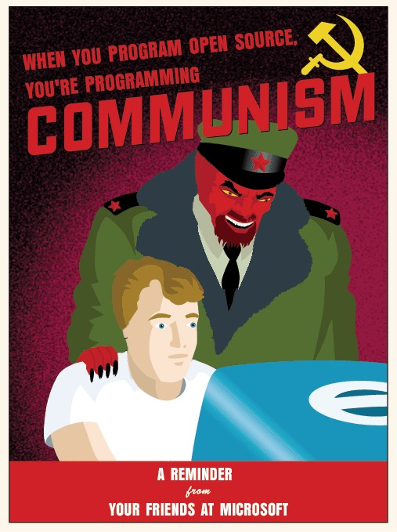
Costs and benefits: Social perspective
Software becomes affordable for smaller companies and poorer individuals
Public influence: “The critical innovation of
Google is outsourcing the decision about
what’s relevant” (Yochai Benkler)¹
Organisational Structure: “Another area in
which software companies might try to
emulate open source development is the
promotion of widespread code sharing
within the company”²
Influence on other industries
1: http://www.youtube.com/watch?v=NgYE75gkzkM
2: http://www.jstor.org/stable/pdfplus/3569837.pdf
Yochai Benkler
Notes:
Software may become more available – Open source software is not necessarily always free, however, generally most open source options available are free. Some examples of this include Ubuntu and open office. As the number of people developing the software has significantly increased all over the world, it is arguable that the quality of open source software has caught up with commercial software. An excellent example of this is Apache web servers. Approximately 70% of all web applications are stored in Apache web servers in direct competition with Microsoft.
Outsourcing – From the Industrial Revolution period onwards, the general rule was that manufacturers dictated to society what was good by producing their products. On the other hand, in open source development, it is the community which tells the manufacturers what is good and what is required. An alternative example of this is Google which allows the public to rank pages for any reason; Yochai Benkler states that the “Critical Innovation of Google is outsourcing the decision about what’s relevant [...] instead of our engineers telling what is the most relevant, it’s says what is relevant”.
Organisational Structure – Commercial software companies such as Microsoft have recently started reacting to open source development by attempting to replicate its structure: e.g. by enabling its development groups to share the code between each other.
Influence on other industries – Much research has been undertaken to determine whether the open source concept can be transmitted to other industries. The general consensus is that some parts can be implemented: For instance, companies have started seeking out their customers’ specific requirements, which enabled them to make their products more popular. However, transmitting major issues of open source to other areas seems to be difficult, and the future is not totally predictable.

Slide 9


Recent news
Open Source software is yet to be fully adopted: many people believe if they show their source code, other people will steal their idea
Google widely utilizes open source software for their own benefit in several
different markets, for example with their new Android OS.
However, Google has been facing
stiff competition from Apple who offer
open source software through their
iPhone app store.
Notes:
Open Source software is yet to be fully discovered today, large business’ such as Microsoft refuse to show their source code in case a competitor will steal their software and modify it for their own. But other companies want to exploit the new opportunity in the market unlike Microsoft which has been slow to react to new trends in the past.
Google is a good example of a business which uses a range of open source software, for instance their new mobile phone Google Android uses a new open source Operating System.
As mobile phone technology expands with thousands of open source apps on Apple’s iPhone, open source software could be a decisive factor to gain a competitive advantage in the market. Apple opened the door to open source software when they stopped using their non-disclosure agreement, allowing developers to understand the software used in their formerly proprietary operating system.

Slide 10
The future of open source
The future is bright for Open Source Software; businesses such as Apple and Microsoft will need to further adapt to open source to stay competitive.
But does it have the power to defy odds and overthrow Microsoft’s Monopoly of the market? How can the new technology be funded for further growth?
The founder of Ubuntu, Mark Shuttleworth believes open source software has both the potential and innovation to grow far into the future.
Notes:
Many researchers believe that in the future either the majority of computer users will switch to a new operating system which utilizes open source software or Microsoft will release a new Windows under an Open Source license. Thus showing how businesses such as Microsoft and Apple will need to orientate themselves around Open Source software if they are to stay competitive in a growing market.
If the government is able to re-direct the millions of pounds they pay in their expenditure on software research to open source software, it can have the potential to finally end Microsoft’s monopoly of the market.
Mark Shuttleworth, the founder of Ubuntu said “Cooperation, consensus and community are the primary drivers of open source.” Before adding that open source’s visibility and importance continues to grow, and “we continue to see innovation in the business models, licensing and governance structures that drive the free software platform.”

Slide 11
Learning outcomes
The licensing issues surrounding open source
The ethical consequences of open source
Common misconceptions about open source
Recent news and estimations of the model’s future

Slide 12
Further reading
Gonzalez-Barahona, J.M., 2000, Perceived disadvantages of open source models, Available at: http://eu.conecta.it/paper/Perceived_disadvantages_ope.html
Mustonen, M., 2003, Copyleft – the economics of Linux and other open source software, Information Economics and Policy, vol. 15, pp. 99–121
Fuggetta, A., 2003, Open source software––an evaluation, Journal of Systems and Software, vol. 66, no. 1, pp. 77-90

