Slide 1

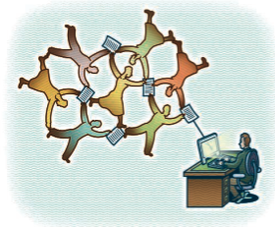
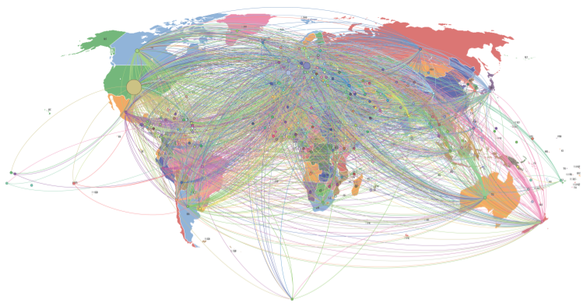
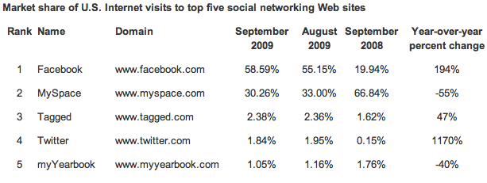
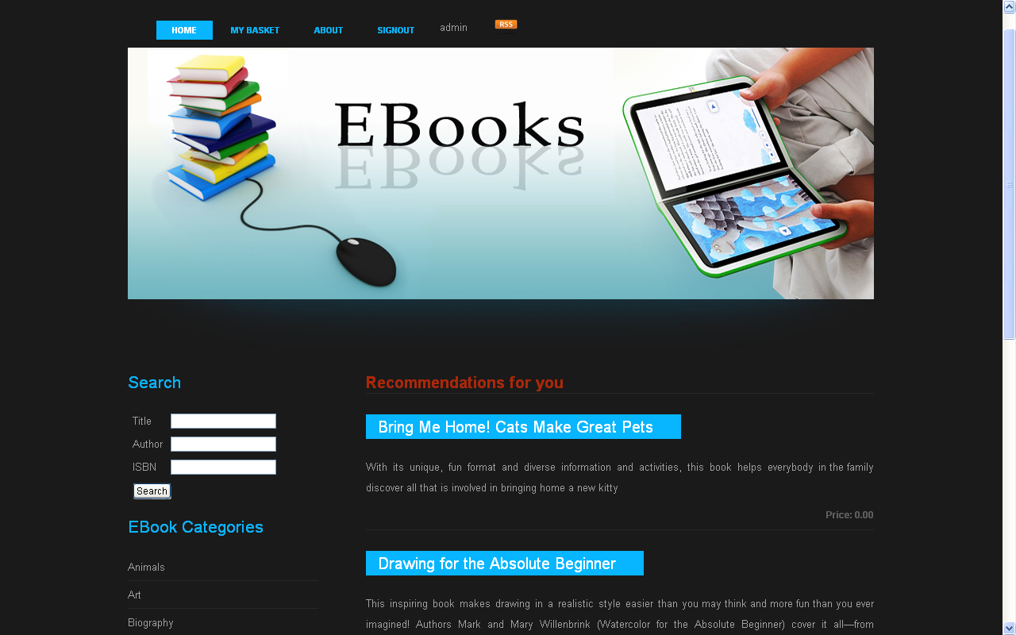
MSc in Web Science
Web Science: How the Web reshapes our lives
Aristea - Maria Zafeiropoulou– az4g09@ecs.soton.ac.uk
School of Electronics and Computer Science
MSc Student in Web Science
Trust on the Social Web
The Evolution of Social Networking Sites
“Without trust the Web wouldn’t function” Hall, W., O’Hara K.
The bootstrapping problem: How does person A know that person B is trustworthy and vice versa?
Properties of trust: Transitivity – Composability – Personalisation and Asymmetry
Have our lives changed for the better or for worse?
  SNSs offer a unique way of communicating
  but are often being misused
How are relationships formed online?
  Homophily – contact among similar people
  Weak Ties – indirect environment
What is private? What is public?
  The boundaries between public and private online
  Privacy Paradox – Privacy not anymore a social norm?
What is the future of Social Networking Sites from a social perspective?
  Social Networking is at its infancy
  SNS future can be beneficial to the society
CouchSurfing.com - A Social Networking Site based on trust
Reputation System based on 3 components:
  Physical Verification
  Personal References
  Vouching System
The CouchSurfing activity on a global scale. Some continents support this activity more than others (Lauterbach et al.)
EBooks Site
Top 5 SNSs in USA from September 2008 to September 2009
Source: Experian Hitwise
Brief CV
Undergraduate Studies in Computer Science at the Athens University of Economics and Business
Erasmus fellow at Humboldt Universitaet zu Berlin (summer semester 2006)
Working Experience:
  4 month Internship as Software Engineer at Velti SA
  Software Engineer at Velti SA (2007-2009)
Spoken Languages: Greek, English, German, French (still learning)
Web Science Interests: Semantic Web, Ontologies in the Semantic Web, Privacy and Trust on the Web, Social Networking
Ebooks Search Engine by Attributes
Personalised and Non-Personalised, Item-to-Item Recommendation System
Star Rating System and User Review System
Current Bestsellers through RSS feeds
Technologies used: Enterprise Java, SQL Server 2008

