Slide 1


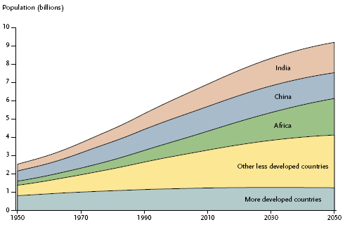
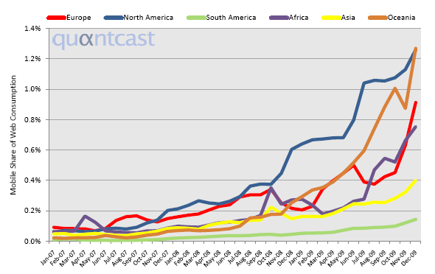
The Impact of Mobile Web in Developing Countries
Betty Purwandari, Wendy Hall and David De Roure
School of Electronics and Computer Science (http://www.ecs.soton.ac.uk/)
{bp08r, wh, dder}@ecs.soton.ac.uk
Introduction
Since 2007 mobile cellular subscriptions have been dominated by the developing world (International Telecommunication Union 2009). It turns out that mobile telecommunication markets in the developed world have become saturated (Bhavnani et al. 2008). As a consequence, mobile operators and service providers increasingly compete in the developing world. This has made mobile communications more affordable for people in developing countries. At the beginning people use mobile phones only for audio or text communications. But as the market matures, browser enabled handsets become cheaper. Besides, the mobile operators offer more reasonable tariffs for data communications, which in turn can make Internet browsing 1,000 times cheaper than sending texts (Boyera 2009). As a result, people in developing countries start using their mobiles to access the Web.
Goal
This research aims to develop a methodology to measure the impact of mobile Web on people in developing countries, as well as the effect on the Web and mobile technologies. In the context of Web Science research, the methodology is needed by various mobile Web stakeholders to enable the advancement of mobile Web technology and anticipate the potential impact on society.
1
There were 4 billion mobile cellular subscriptions globally by the end of 2008 (International Telecommunication Union 2009), whilst the world population was 6.7 billion in 2008 and 80% of them lived in developing countries (Population Reference Bureau 2008). Besides, by the end of 2007 the developing world presented 64% of the global mobile subscriptions (International Telecommunication Union 2009).
3
A framework is proposed to measure the impact of mobile Web in developing countries. It is adopted from the three –stage framework in the evolution towards an information society as discussed in International Telecommunication Union 2009.
1
2
3
Mobile Web Readiness
(Infrastructure,
Access)
Mobile Web Use
(Intensity)
Mobile Web Impact
(Outcomes)
Mobile Web Supporting Enablers
(Standards, Policy, Funding, Collaboration)
Mobile Web Capacity
(Skills)
Mobile Cellular Subscriptions
(International Telecommunication Union, 2009)
The framework will guide case studies, which will be conducted in Nairobi (Kenya) and Riau Archipelago (Indonesia). The data will be collected using document analysis, focus group, semi structured interview, observation, questionnaire, user’s activity log, and tracked mobile Web applications. It will measure indicators as listed in the following table.
(UN Population Division, 2006)
4
2
Although mobile Web usage was still less than 1.5% of all Web traffic, since 2008 there has been tremendous global growth in Web page views from mobile devices. Most of them came from developed countries. But Africa, which is mainly considered as the developing world, has shown impressive increase (Quαntcast 2010).
Mobile Web Impact
Sub Components | Proposed Indicators | Mobile Web Stakeholders
Indirect (social of micro level case) and intangible benefits | Job offer or customer increase | Users, NGO/Grassroots Organisations, Donors, Governments
 | Productivity rise
 | Income growth
 | Time saving
 | Better price of commodity
 | Reduction of travelling
 | Changes in business process
Web technologies | Protocol improvement | Academic/Standard Organisations
 | Browser advancement
 | Standard development
Mobile technologies | Wider, better, cheaper mobile networks | Mobile operators, Academic/Standard Organisations
 | Handset advancement | Handset manufacturers, Academic/Standard Organisations

