Slide 1
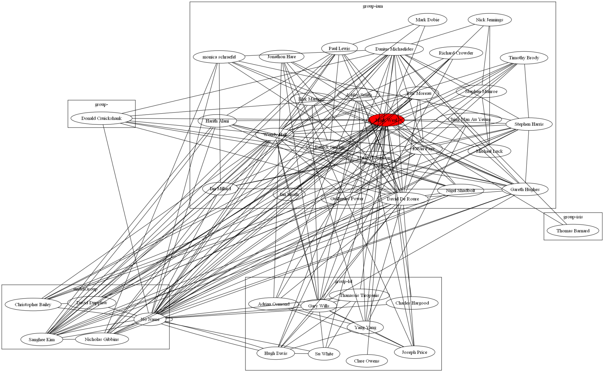
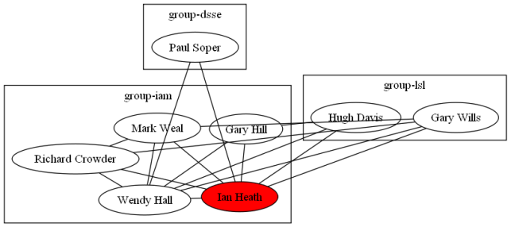
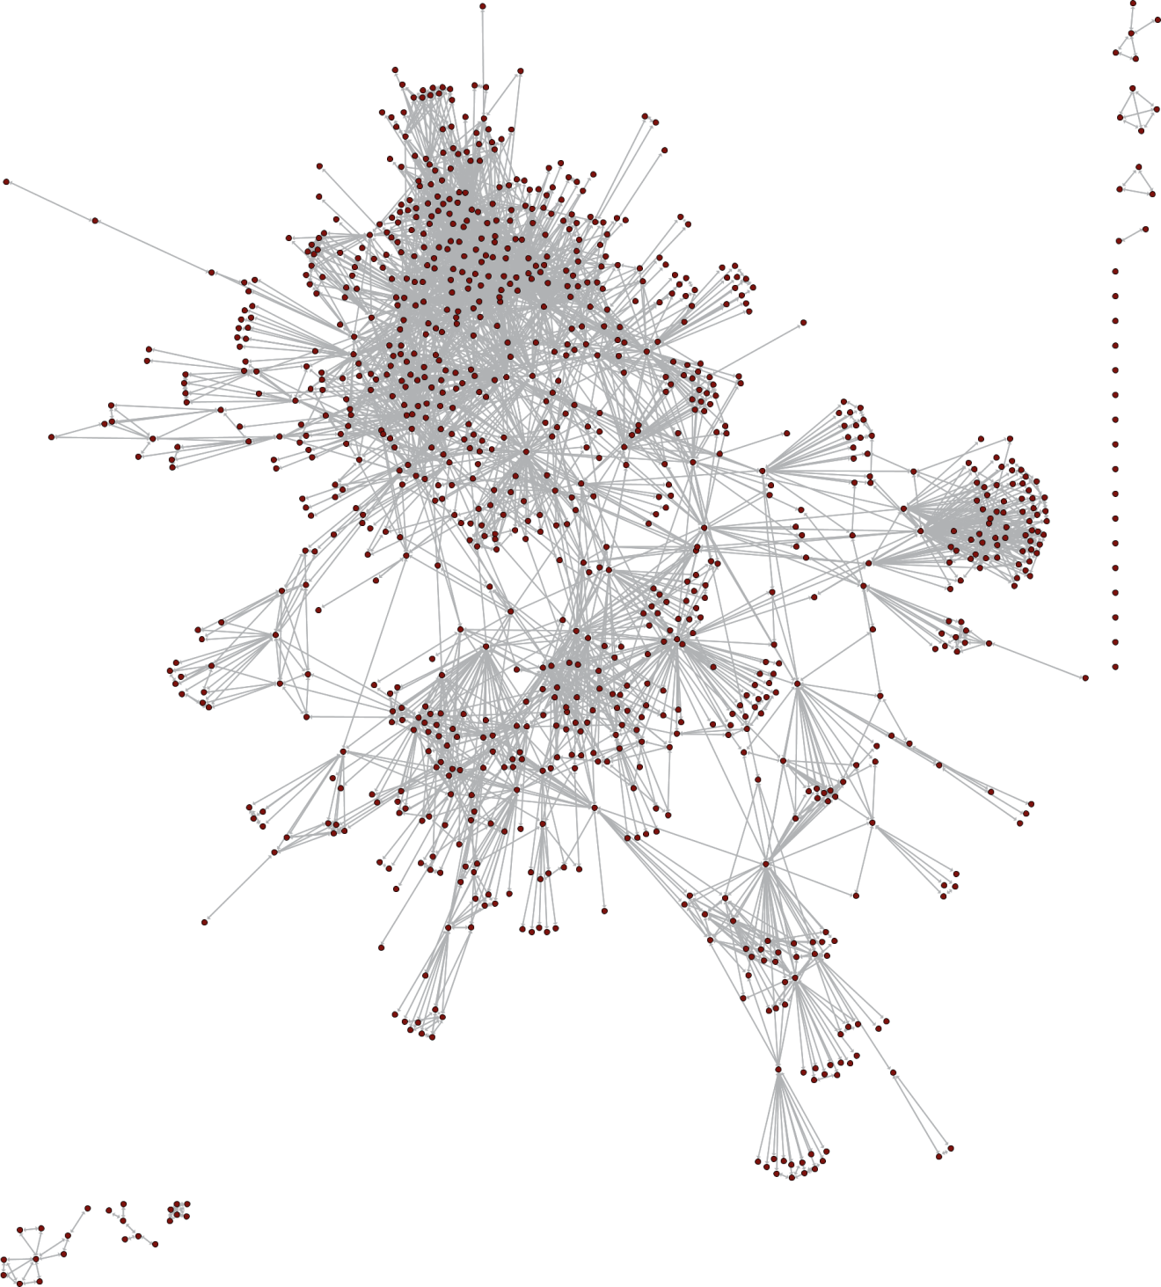
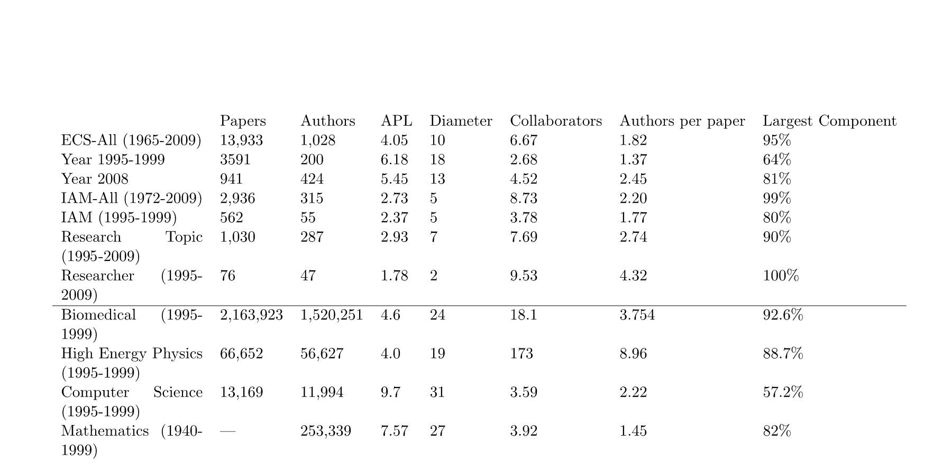


Analysis of University Researcher Collaboration Network
Using Co-authorship
Jiadi Yao (jy2e08@ecs.soton.ac.uk)
School of Electronic and Computer Science, University of Southampton, Southampton, SO17 1BJ
1 Introduction
Social network analysis gives evidence for the connections between groups of individuals. It is these connections that channel flow of information and the sharing of knowledge.
As universities move towards more interdisciplinary modes of research and funding, an effective network that links its entire cohort of active researchers is vital.
3 Author Analysis & Path Length Analysis
Researcher Oriented Analysis
2 Co-authorship Graph Analysis
Figure 2 Visualisation of the collaboration network of chosen authors (Red nodes) in the ECS. Authors are grouped in their own research group, and only the authors that have direct collaboration with the red author is shown.
This gives a direct sense of how collaborative is the author in analysis and the research groups he has worked with.
Using the size of an author’s collaboration, we can find out the set of people that were most collaborative. We call them the ‘core’ of the network.
5
4 Disconnected groups and individuals
4
2
5 Dense group
3
1
1 Sparse fan shaped group. Information has to flow through the root node to reach the leaf nodes. In ECS, these generally represents a supervisor with a group of students
3 Node bridging multiple groups
2 Dense fan shaped group. Multiple root nodes and leaf nodes tend to interconnected. In ECS, these generally represents head of group with researchers
Figure 3 Comparison of the path length distribution when removing the core and dangling authors.
For a network that has a smaller core (Left), the result of removing the core authors from the network is devastating – the longest path length extended from 4 to 17; while removing the dangling authors from the network(PhD students) did not shorten the path length.
For a network that has a larger core (Right), removing the core nodes did not extended the path length as much – from 13 extended to 16; while removing the dangling authors did not shorten the path length
Figure 1 Overview of co-authorship structure between researchers in the School of Electronic and Computer Science in the University of Southampton.
Network Properties Comparison
4 Conclusion
The ECS community is a small-world network with similar knowledge sharing to those communities formed by an entire discipline.
The collaboration between ECS is a small network with average distance 4 – four degrees of separation
The flow of information is closely related to:
  The collaboration circle of the ‘Core’ authors
  Not so with dangling authors (PhD students)
Table 1 Comparisons between different dataset in ECS and large databases. APL: Average path length, the average of the shortest path between any pair in the network. This measures the effectiveness of the information flow in a network, the smaller the better.

