Slide 1


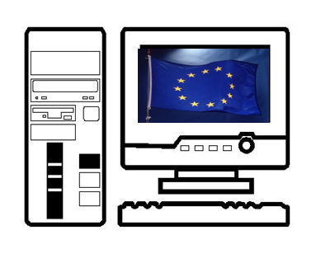
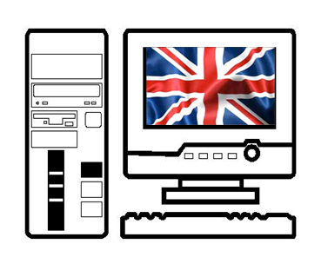
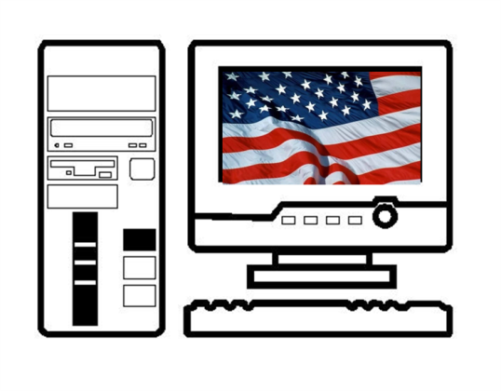

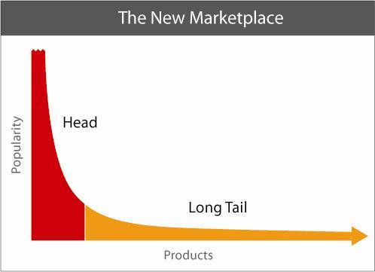

RESEARCH AREAS
WEB SCIENCE MSc - SEMESTER ONE
Laura German LLB (Hons)
Member of the Web Science Doctoral Training Centre (DTC)
School of Electronics and Computer Science,
University of Southampton, UK
leg406@soton.ac.uk
Net Neutrality
Privacy and Social Networking
What is Net Neutrality?
Net Neutrality is a widely debated topic that transcends many disciplines, including: Law, Politics, Sociology, Computer Science and Economics. The term Net Neutrality was coined in around 2005 by Professor Tim Wu, a member of the Law Faculty at Columbia University. [17] The concept of Net Neutrality seems to be centred around the fundamental internet principle that all users should have equal access to content on the Web. [17] Therefore, content service providers (CSPs) should not be able to make their content a priority; for example, when using a search engine a CSP should be prohibited from paying for the top search. [10] Following the principles of Net Neutrality the top search should be based on the usefulness of that web site in regards to the terms searched for. Arguably, if this was removed, search engines would fail to find users the best content, and it would hinder the development of new businesses, which at the moment can develop without extra economic pressure of paying for top searches. [17]
Furthermore, it is disputed whether internet services providers (ISPs) should be allowed to offer tiered packages to consumers, thus, the best packages offering the fastest connections and unlimited downloads are only obtained if an individual can offer to pay for the best services.
The Global Debate
Net Neutrality has sparked a global debate; however, arguably the greatest response to this concept has been the political movement in the USA that seeks to incorporate the principle of Net Neutrality into legislation. [15] Many large Web-based companies such as: Google, Yahoo and Microsoft have shown support to Net Neutrality. [6] However, at present the UK Government does not deem it appropriate to place the concept on a statutory footing. [7]
Although, the term Net Neutrality was only coined in 2005, the role of ISPs in regards to their impact on the development of the Web has been considered at least as early as the mid 1990’s. [9] Furthermore, Schahczenski [16] has argued that “non-discrimination provisions like Net Neutrality have governed the nation’s communications networks since 1930” [16] in the USA. Perhaps, illustrating how this is an old concept in regards to the communications industry, but has recently been applied to the Web.
Overview
Social networking sites (SNSs) such as, Facebook [8] and Bebo,[3] have become very popular; in the UK alone, it has been suggested that around 15 million people in 2009 made use of SNS. [11] Furthermore, Facebook had approximately 34 million members worldwide in 2009 and around 100,000 people joining per week. [11] Therefore, the impact of this new method of social interaction on society is one of significance. Consequently, it has been a thriving research area for many academics from different disciplines including: sociologists, computer scientists, economists and lawyers. [14]
Social networking arguably benefits society by increasing ‘social capital,’ [14] which enables individuals to sustain and advance ‘social relationships’ that are not subject to physical restraints. [5] However, it may also have some harmful effects, mainly in regards to the privacy of users. Bekker et al [4]refer to “the ambiguous and invasive nature of social networking sites” [4] which may be too harsh a description, as it must not be forgotten that individuals can choose to what extent they disclose their personal information online.
The Dangers of Social Networking
There are many dangers associated with individuals using SNSs, Mannan et al [12] argue that the main risks to privacy are from:
Perspective employers rejecting applicants - based on the information found on searching for applicants on SNSs;
Suspension/ Loss of job – if inappropriate information is found on a user’s SNS profile;
Stalking – both online and offline;
Phishing – the spreading of spyware, malware and the creation of botnets;
Identity theft;
Tracking - possibly by governmental agencies;
and the use of SNSs by sex offenders to access personal information – This use is in the minority, as the majority of offenders are known to the victim. However, in 2007 MySpace [13] terminated 29,000 accounts belonging to convicted sex offenders. [1]
References
[1] ABC News, ‘MySpace finds 29,000 sex offenders. News article (July 25, 2007). http://www.abcnews.go.com/Technology/wireStory?id=3409947. Sourced in: Mannan, M. and van Oorschot, P.C, ‘Privacy-Enhanced Sharing of Personal Content on the Web,’ (2008) 17th International World Wide Web Conference, WWW 2008 / Refereed Track: Security and Privacy – Misc, April 21-25, 2008 · Beijing, China, April 21–25, 2008
ACM 978-1-60558-085-2/08/04 http://delivery.acm.org/10.1145/1370000/1367564/p487-mannan.pdf?key1=1367564&key2=1785833621&coll=portal&dl=ACM&CFID=28656067&CFTOKEN=35770880 – Accessed 13th January 2010
[2] Anderson, C, ‘The Long Tail: How Endless Choice is Creating Unlimited Demand,’ (Random House Business Books, London, 2006)
[3] Bebo’s Website: http://www.bebo.com/ – Accessed 13th January 2010
[4] Bekker, A, Burns, J, Ee, D. and Hardjono, A, ‘Our House,’ (2009) C&C’09, Proceeding of the seventh ACM conference on Creativity and cognition, October 26–30, 2009, Berkeley, California, USA, ACM 978-1-60558-403-4/09/10, p421-422. http://portal.acm.org/toc.cfm?id=1640233&type=proceeding- Accessed 13th January 2010
[5] Brey, P, ‘Evaluating the Social and Cultural Implications of the Internet,’ (2006) 36(3) Special print issue of ACM SIGCAS Computers and Society: selection of best papers 2004-2006 41-48, ISSN:0095-2737. http://portal.acm.org/citation.cfm?id=1195721 - Accessed 13th January 2010
[6] Crowcroft, J, ‘Net Neutrality: The Technical Side of the Debate: A White Paper,’ (2007) 37(1) CM SIGCOMM Computer Communication Review 49-55. http://delivery.acm.org/10.1145/1200000/1198263/p49-crowcroft.pdf?key1=1198263&key2=8480262621&coll=portal&dl=ACM&CFID=28656067&CFTOKEN=35770880 – Accessed 4th January 2010
[7] Durie, R, ‘United Kingdom: telecommunications – regulation,’ (2009) 15(4) C.T.L.R. N106-110
[8] Facebook’s Website: http://www.facebook.com/ – Accessed 13th January 2010
[9] Haftke, M, ‘Net liability: is an exemption from liability for on-line service providers required?’ (1996) 7(2) Ent. L.R. 47-49
[10] Hahn, R.W, Litan, R.E. and Singer, H.J, ‘The economics of "wireless net neutrality"’ (2007) 3(3) J.C.L. & E. 399-451
[11] James, S, ‘Social networking sites: regulating the online "Wild West" of Web 2.0,’ (2008) 19(2) Ent. L.R. 47-50 (Available via Westlaw)
[12] Mannan, M. and van Oorschot, P.C, ‘Privacy-Enhanced Sharing of Personal Content on the Web,’ 17th International World Wide Web Conference , WWW 2008 / Refereed Track: Security and Privacy – Misc, Beijing, China, WWW 2008, April 21–25, 2008, ACM 978-1-60558-085-2/08/04 http://delivery.acm.org/10.1145/1370000/1367564/p487-mannan.pdf?key1=1367564&key2=1785833621&coll=portal&dl=ACM&CFID=28656067&CFTOKEN=35770880 – Accessed 13th January 2010
[13] Myspace’s Website: http://www.myspace.com/ – Accessed 13th January 2010
[14] Paci, F, Shehab, M. and Squicciarini, A.C, ‘Collective Privacy Management in Social Networks’ (2009) 18th International World Wide Web Conference 2009 Track: Security and Privacy / Session: Web Privacy April 20–24, 2009, Madrid, Spain, ACM 978-1-60558-487-4/09/04, 521-530. http://delivery.acm.org/10.1145/1530000/1526780/p521-squicciarini.pdf?key1=1526780&key2=8435833621&coll=portal&dl=ACM&CFID=28656067&CFTOKEN=35770880 – Accessed 13th January 2010
[ 15] Powell, A, ‘Lessons from the Net Neutrality lobby: Balancing openness and control in a networked society’ (2009). In: Proceedings of the WebSci'09: Society On-Line, 18-20 March 2009, Athens, Greece. http://journal.webscience.org/130/1/websci09_submission_32.pdf – Accessed 4th January 2010
[16] Schahczenski, S, ‘Net Neutrality, Computing and Social Change,’ (2008) 38(2) SIGCAS Computers and Society 27. http://delivery.acm.org/10.1145/1390000/1386591/p27-schahczenski.pdf?key1=1386591&key2=4701262621&coll=portal&dl=ACM&CFID=28656067&CFTOKEN=35770880 – Accessed 4th January 2010
[17] Stromdale, C, ‘Regulating online content: a global view’ (2007) 13(6) C.T.L.R. 173-178
The Long Tail
Online Copyright Infringement
Overview:
During the Multimedia Systems module I wrote an academic paper entitled: ‘Copyright Law and the Emergence of Multimedia: the Creative Industries’ Demise?’ I presented my paper at the Multimedia Systems Conference 2010 at the University of Southampton, which I also helped to organise as a member of the Conference Committee.
The Abstract:
This paper seeks to examine the contention that: the emergence of multimedia has altered copyright law’s relationship with technology and transformed the creative industries. Copyright infringement pre-dates multimedia and the Web, however, online copyright infringement poses new challenges for the law. Online multimedia technologies have arguably revolutionised the creative industries, by enabling perfect, digital, infringing copies of creative works to be produced and their instantaneous dissemination over the Web. Recognising some may argue that copyright law should be abolished; this paper seeks to demonstrate how reform of copyright law is a more viable prospect and offer recommendations for change. This will be based on examining: the UK Government’s stance, the use of preventative technologies in combating online copyright infringement and examples from other jurisdictions.
Producing a book review and presentation on Chris Anderson’s book – ‘the Long Tail’ [2] was extremely useful in considering the economic impact of the Web.
Is there a move away from the hits-driven economy to one of niches?

