Slide 1
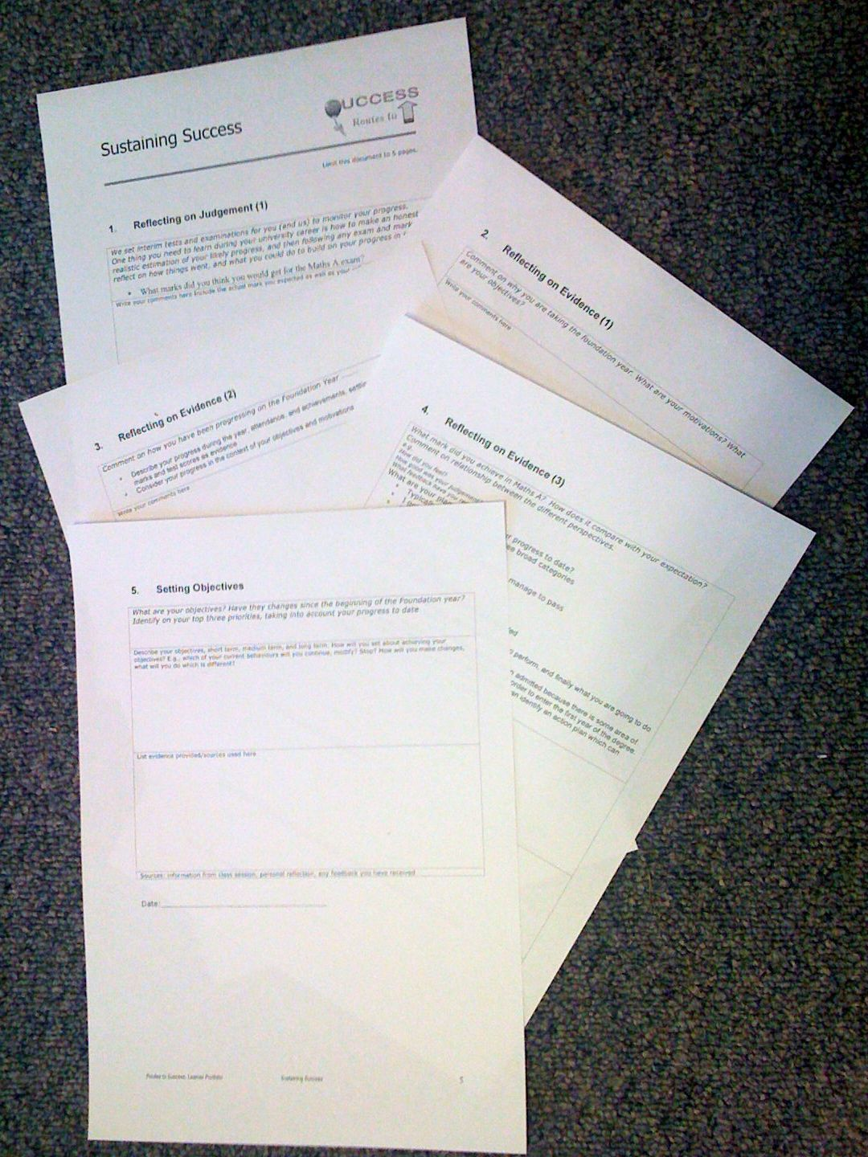
Foundation Year
Routes to Success
Part III - Sustaining Success
Su White
Semester 2
Week4 –Self Knowledge
Notes:
Objective to get to know the each other and establish framework for future sessions
Introduce think pair share
Establish expectations for portfolio contribution for this part of the course
Much of the session will be run via discussion and question and answer
The slides will be used according to need, but can form a useful note for review and revision.
They can also be used as reference by students who do not attend the session.

Slide 2
Self Knowledge? In your portfolio!
Notes:
What you have to think about
Exam (performance and progression)
Motivations
Progress
Self Knowledge
Future Plans

Slide 3

The Plan today
Tasks
Self Knowledge
Exercise
Sharing
Perspectives
Notes:
Intros
Your Objectives
Thinking about personal objectives
Scoping out the area
About Feedback
How can we get feedback
Where can we get feedback
What can we do with feedback
Initial understanding
Task
Framing expectations for the portfolio
Tasks will include
Reflecting on examination result
Making an action plan
Developing frameworks for future reflections
Making explicit understandings of learning by creating advice and guidance for future students

Slide 4

Self Knowledge
Looking in the mirror
Notes:
Need to establish how the classes will be run
Eg Q&A
Think share pair
zappers

Slide 5
Self knowledge what have you done?
✔
✔
✔
Notes:
1) Exam
2) Your motivations
3) Your progress
4) Self knowledge
5) Future Objectives

Slide 6
Self Knowledge
Objectivity – are you honest with yourself?
How much do you attend really?
  Count the hours
  Are you doing enough work?

Slide 7
Sharing perspectives
Use comparison to achieve objectivity

Slide 8

Take a look at each others’ portfolios
Can you spot the difference?

Slide 9
Your Portfolios so far
Think
Take an objective look at your portfolio
What is good about it?
Pair
Swap your portfolio entry with a partner
What do you notice which is different?
Can you offer any advice on how to improve it?
You could use this before you hand in your portfolio

Slide 10
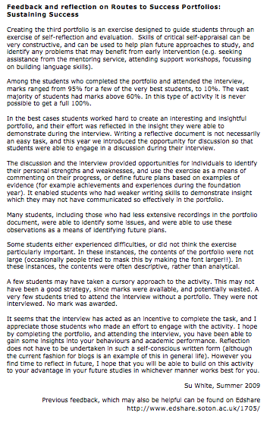
Look at the feedback …
Available
on
EdShare
Notes:
This document is available from EdShare
Read through to identify feedback relevant to you

Slide 11
Exercise
Finding out what the feedback means

Slide 12
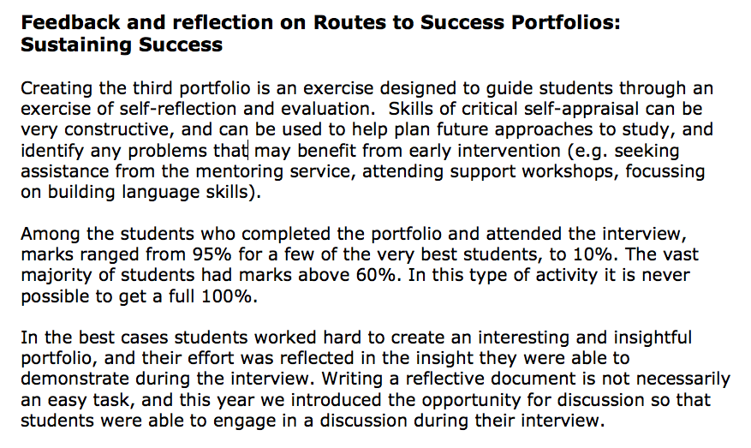
Exercise – understanding feedback
Working in your groups
Rewrite your allocated section in your own words
Read back your version to the class
Email your version to me

Slide 13
Tasks
Before next week…

Slide 14
This week’s task
Fill out the next section in the portfolio
  Your future plans
Remember
  Its OK to work with others in the class
  You may find it enjoyable
  You may find it helpful

Slide 15
Thank You :-)

Slide 16
Week 4 resources
These slides
Class exercise
The portfolio template
Portfolio summary
Feedback from previous years (two versions)
Can be found in Edshare http://www.edshare.soton.ac.uk/
These slides
http://www.edshare.soton.ac.uk/4842/
Collection (all of the above)
http://www.edshare.soton.ac.uk/4845/
Notes:
Portfolio template handout on page with five boxes

